Slide 1
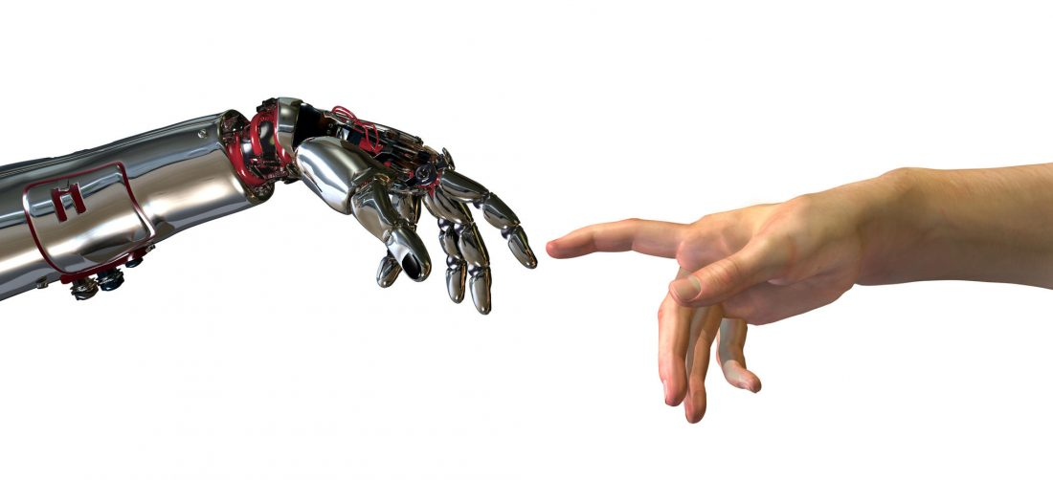
Can a Digital Rater Works Better Than a Human?
Natural Language Processing
Xiaoyu Zhan, Hao Zhan, Chuhan Bin, Lan Zou, Yujie Qiu

Slide 2
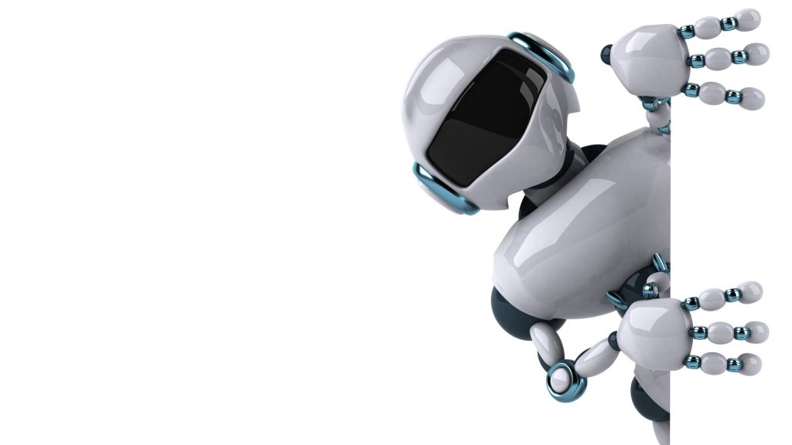
Agenda
Project Purpose
Actionable Information & Insights
Results
1
3
5
2
4
6
Analytic Approach
Error Analysis
Future Work

Slide 3
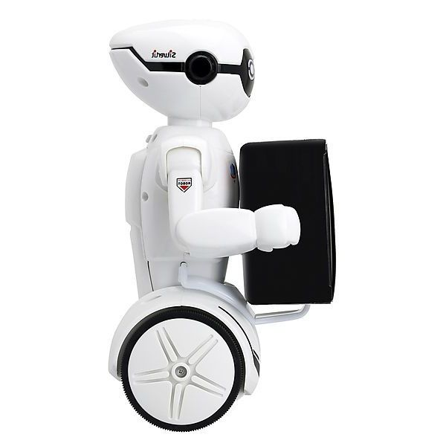

Project Purpose
1
Initial Problem
2
3
Value Proposition
Achievement
To increase the speed & accuracy of product distribution in Home Depot
Proactive Solution
Lower Employee Cost
Error: 0.474
in RMSE
Notes:
AI as project manager
Technology service providers like Accenture work on multiple software projects. A common challenge they often face is that problematic issues are discovered after the fact, which then call for post-mortem investigations to determine the root cause. This is a tedious task, and can become overwhelming when hundreds of projects are occurring at once. A proactive solution would save time and reduce the risk of the problems occurring in the first place. Our team decided to address this problem by finding patterns in a complex volume of data, building machine learning models, and using them to anticipate the occurrence of critical problems. We called our effort “AI project manager.”

Slide 4
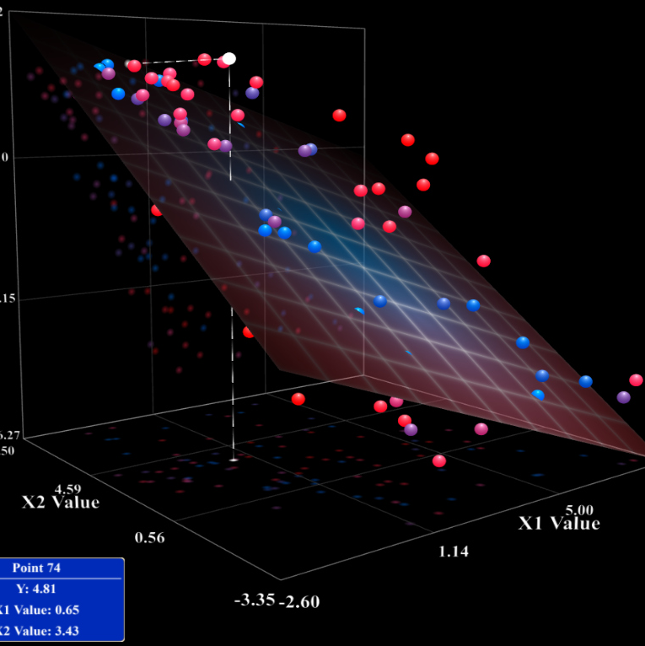

Analytic Approach
Linear Regression
Random Forest
Error 0.478 in RMSE
Truly Linear
Rich in features
Independent input
High error
Non-linear & dependent
Error 0.474 in RMSE
Reduction in overfitting
Accurate & flexible
Missing data friendly
Slow & complex
Notes:
Semantic similarity, similar feature and classification
Slow than FB FastText
Label required: unsupervised learning
Inability to handle unknown or OOV words
Perhaps the biggest problem with word2vec is the inability to handle unknown or out-of-vocabulary (OOV) words.
If your model hasn’t encountered a word before, it will have no idea how to interpret it or how to build a vector for it. You are then forced to use a random vector, which is far from ideal.
No shared representations at sub-word levels
This can particularly be an issue in domains like Twitter where you have a lot of noisy and sparse data, with words that may only have been used once or twice in a very large corpus.
This can also become a challenge in morphologically rich, and polysynthetic languages such as Arabic, German or Turkish.
RF:
Reduction in overfitting: by averaging several trees, there is a significantly lower risk of overfitting.
Less variance: By using multiple trees, you reduce the chance of stumbling across a classifier that doesn’t perform well because of the relationship between the train and test data.
Input friendly: able to handle large proportion of missing data

Slide 5


Analytic Approach
Word2Vec
Base Line
Error 0.49 to 0.48 in RMSE
Logical/semantic meaning
Widely acceptable in AI model
Unknown vocab
Label required
Arabic, German or Turkish
Error: 0.494 in RMSE
Common count
Fuzzy score
Search term length
Notes:
Semantic similarity, similar feature and classification
Slow than FB FastText
Label required: unsupervised learning
Inability to handle unknown or OOV words
Perhaps the biggest problem with word2vec is the inability to handle unknown or out-of-vocabulary (OOV) words.
If your model hasn’t encountered a word before, it will have no idea how to interpret it or how to build a vector for it. You are then forced to use a random vector, which is far from ideal.
No shared representations at sub-word levels
This can particularly be an issue in domains like Twitter where you have a lot of noisy and sparse data, with words that may only have been used once or twice in a very large corpus.
This can also become a challenge in morphologically rich, and polysynthetic languages such as Arabic, German or Turkish.
RF:
Reduction in overfitting: by averaging several trees, there is a significantly lower risk of overfitting.
Less variance: By using multiple trees, you reduce the chance of stumbling across a classifier that doesn’t perform well because of the relationship between the train and test data.
Input friendly: able to handle large proportion of missing data

Slide 6

Results
Optimization | common count + fuzzy + len of search term |  | common count + fuzzy + len of search term + Word2vect
Algorithm | Linear Regression | Random Forest | Linear Regression | Random Forest
Accuracy | 0.494 | 0.490 | 0.478 | 0.474
Write Compact Website
Increase Keyword Frequency

Slide 7
Error Analysis
Phrase
Semantic Error
“Plastic Case”
Found: “Plastic”; “Case” as unit
Diff: 1.402
Real: 1
“Fuel Oil”
Found: “Oil”
Diff: 1.404
Real: 1

Slide 8

Actionable Information & Insights
Optimal Algorithm:
Word2vec
Random Forest
Rater:
Product title & product description
Match Degree 1) between search keyword & product title, 2) between search keyword & product description
Length of search keyword

Slide 9

Future Work
Spelling Check
Grid Research
Deep Learning Neural Network – RNN & Snorkel

Slide 10

Thank You

