Slide 1
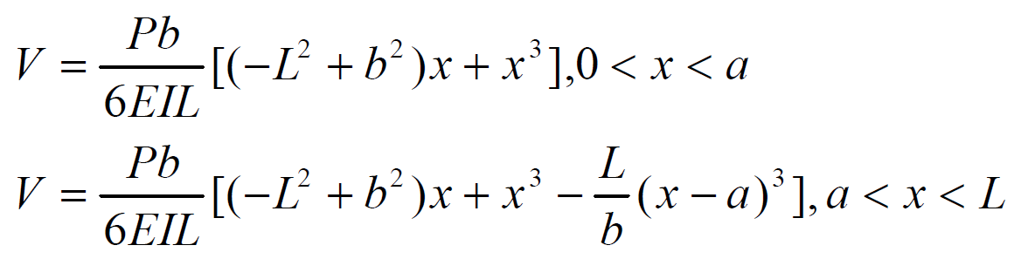
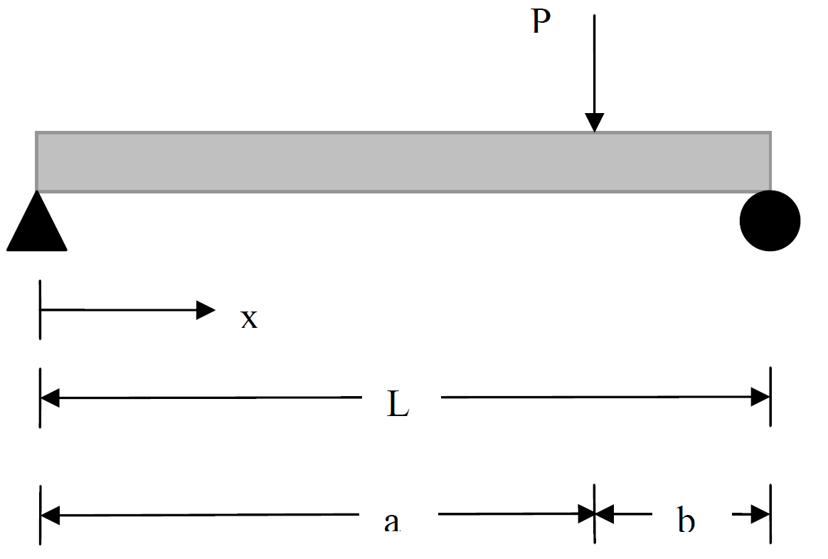
Title: Beam deflection.
Problem: A beam is simply supported at both ends is loaded as shown in the figure below. Under the load, the beam will deflect vertically. This vertical deflection of the beam, V will vary along the length of the beam from x=0 to L and is given by
x :the distance from the left end,
P : the load,
L :length of the beam,
a : the location where the load P is applied,
E : the Young’s modulus of the beam material
I : the second moment of inertia
Specification:
Input the following:
x L P a E I
And output:
V

Slide 2
Assignment
Write a MATLAB function that takes the force(P), L, and a, and outputs the distribution of the deflection over the beam length.
Add a command to your MATLAB code (function) that plots the data (V versus x), as well.

