Slide 1

PAMCA698 · DISSERTATION I · REVIEW 2 · 07.10.2026
Calibrated Uncertainty in Food Import Demand Forecasting
Deep evidential regression with a SHA-256 provenance ledger — FoodTrace
<Student Name> · <Reg. No.>
Guide: Dr Karthikeyan P, Professor
Department of Computer Applications, School of Computer Science Engineering and Information Systems

Slide 2


Problem: a point forecast hides when it is wrong
Silent unreliability
Traceability has no measured value
Point forecasts look identical whether the data support them or not
Recalls and outbreaks shift import demand abruptly
Planners, insurers and lenders get no signal to discount the number
Provenance systems are justified on qualitative grounds
No evidence links record completeness to forecast reliability
So traceability cannot be priced as a risk reducer
Goal: a demand forecast that also states how far it can be trusted

Slide 3
Objectives and scope
1
Forecast monthly US food imports per supply node with aleatoric and epistemic uncertainty in one pass
In scope
23 commodities, 30 origin countries
Jan 2016 – Jul 2026, monthly
Public data only
API + web dashboard
2
Store every input record in a tamper-evident proof-of-work ledger
3
Test whether traceability completeness lowers epistemic uncertainty
Out of scope
Test whether uncertainty rises in the months before an FDA recall
Retail sales demand
Real blockchain shipment logs (none public)
Credit-risk pricing (future work)
4

Slide 4
Research questions and hypotheses
H1
H2
H3
Traceability
Lead signal
Perishability
Nodes with more complete traceability records have lower epistemic uncertainty
Epistemic uncertainty rises in the 3 months before an FDA recall is initiated
The H1 gap is concentrated in perishable commodities
Plus two checks: is the evidential model as accurate as the baselines, and are its intervals calibrated?

Slide 5
Literature foundations
Work | Used in this project for
Amini et al., 2020 — Deep Evidential Regression (NeurIPS) | NIG output head and loss
Kuleshov et al., 2018 — Calibrated regression (ICML) | Interval calibration, PICP
Gal & Ghahramani, 2016 — Dropout as Bayesian approximation (ICML) | MC-dropout baseline
Cho et al., 2014 — GRU encoder–decoder (EMNLP) | Sequence encoder
Box & Jenkins — Time Series Analysis (SARIMA) | Classical baseline
Hyndman & Koehler, 2006 — Measures of forecast accuracy (IJF) | MASE metric
Nakamoto, 2008 — Bitcoin: peer-to-peer electronic cash | Proof of work, Merkle roots
US FDA, 2022 — FSMA §204 Food Traceability Rule | Key Data Elements → “verified”
Full survey (15+ papers with merits and demerits) is in the Review 2 report.

Slide 6



Three real, public data sources
UN Comtrade
openFDA enforcement
CDC NORS
127
2,661
1,923
months of imports
FDA recalls matched
outbreaks matched
US imports by HS6 code × origin country, net weight in kg, Jan 2016 – Jul 2026
From 29,471 food recall records; 13.5% pass all five traceability checks
Foodborne outbreaks with the implicated food; stored on the ledger, kept out of model inputs
No synthetic records anywhere in the pipeline.

Slide 7
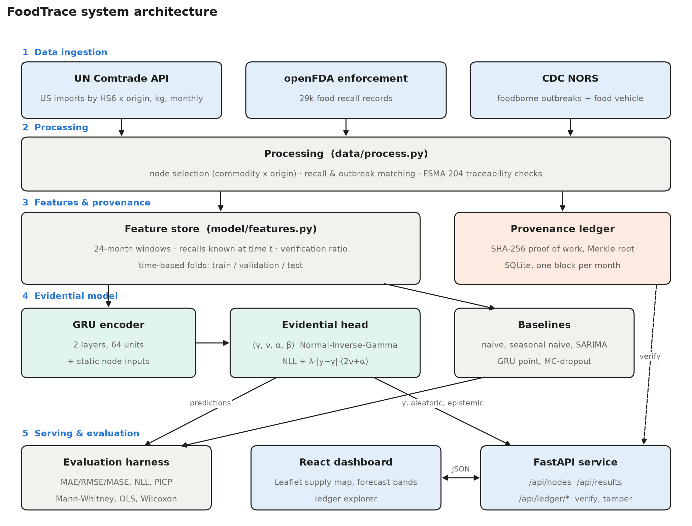
Proposed system architecture

Slide 8
73 supply nodes: one commodity from one origin
73
nodes · 23 commodities · 30 countries
A country becomes a node when it:
supplies ≥ 2% of the commodity's US imports
ships in ≥ 85% of months
is in the top 6 origins for that commodity

Slide 9
What “verified” means: FSMA §204 record checks
13.5%
pass all five checks = verified
Node verification ratio = verified share of its recall records
Shrunk toward the commodity rate when records are few
Uses only recalls published before the training cut-off

Slide 10
Evidential model: one pass, two uncertainties
Input window
GRU encoder
Evidential head
Read-out
24 months: log imports, calendar month, recalls already published
2 layers, 64 units, + verification ratio, perishability, volume
γ, ν, α, β of a Normal-Inverse-Gamma distribution
Forecast γ · aleatoric β/(α−1) · epistemic β/(ν(α−1))
Loss NIG negative log-likelihood + λ·|y−γ|·(2ν+α)
λ = 0.1 chosen on the 2022 validation year by interval calibration
No node ID no node embedding, so the model cannot memorise nodes
Status unreliable if epistemic ≥ 80th pct of validation; volatile if aleatoric is

Slide 11
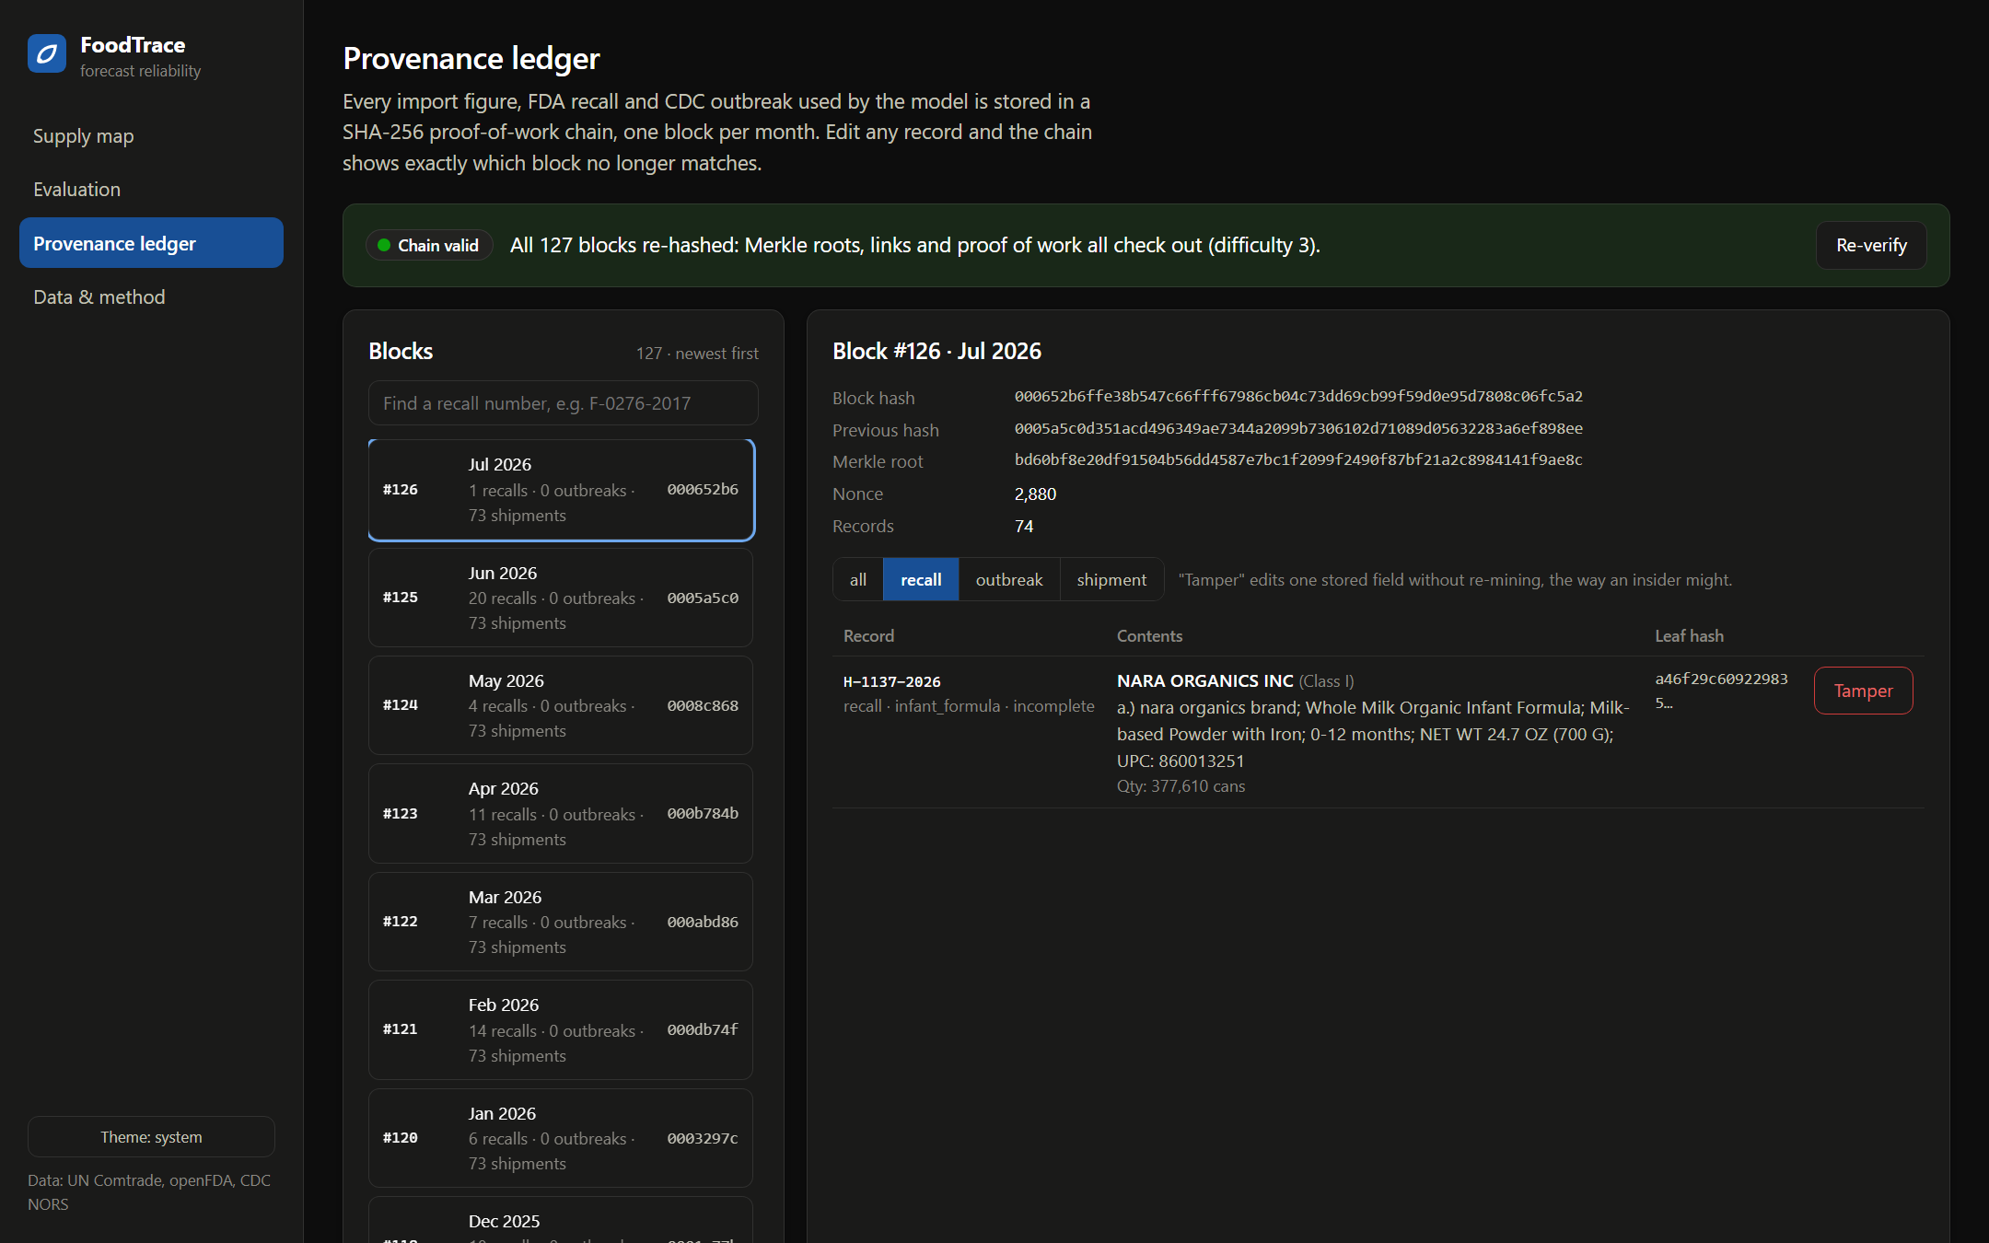
Provenance ledger: every input is tamper-evident
127
blocks, one per month
11,484
records hashed
000…
proof of work, difficulty 3
9,271 shipments · 1,676 recalls · 537 outbreaks
Record → SHA-256 leaf → Merkle root → block hash → next block's link
Tamper demo edits one field; verify names the exact block

Slide 12



Evaluation design: rolling origin, split by time
Fold | Train targets | Validation | Test
2021-22 | 2018-01 → 2019-12 | 2020 | 2021-01 → 2022-12
2023-26 (main) | 2018-01 → 2021-12 | 2022 | 2023-01 → 2026-07
Baselines
Metrics
Tests
Naive, seasonal naive
SARIMA(1,0,1)(1,0,0)₁₂
Same GRU, point head
MC-dropout GRU, 50 passes
MAE, RMSE, MAPE, WAPE, MASE
NLL
Interval coverage (PICP) and width at 50 / 80 / 90 / 95%
H1: Mann-Whitney U, OLS (HC3)
H2: Wilcoxon signed-rank
H3: Mann-Whitney by group
3 seeds for stability

Slide 13
Accuracy: evidential GRU has the lowest MASE
Model | WAPE | NLL
Evidential | 15.9% | 1.129
SARIMA | 15.8% | 1.813
MC-dropout | 16.9% | 1.630
Naive | 21.3% | —
3,139 test forecasts
SARIMA is close on point accuracy
Seed stability: MAE (log) 0.651 ± 0.007 over 3 seeds

Slide 14
Calibration: intervals keep their stated coverage
91.8%
evidential coverage of the 90% interval
1.129
evidential NLL (MC-dropout 1.630, SARIMA 1.813)
1.4 pts
mean coverage gap (MC-dropout 3.3, SARIMA 4.6)

Slide 15
H1: traceability does not lower epistemic uncertainty
NOT SUPPORTED
Median epistemic
2.41 verified vs 2.57 unverified
Mann-Whitney U
p = 0.48 (one-sided)
Spearman ρ
−0.09, p = 0.47
OLS + controls (HC3)
coef −0.18, p = 0.55
With commodity effects
coef 0.62, p = 0.59

Slide 16
H2 partly supported; H3 not supported
H2 · uncertainty before recalls
PARTLY
H3 · perishability
57%
1.14×
NOT SUPPORTED
of events: higher before the recall
median pre / quiet ratio
Perishable
28 vs 29 nodes
medians 2.34 vs 2.45, p = 0.63
Shelf-stable
8 vs 8 nodes
medians 2.75 vs 3.01, p = 0.29
p = 0.010
p = 0.18
Wilcoxon, evidential
Wilcoxon, MC-dropout
245 commodity-level events across 30 nodes
Result moved when matching rules were tightened
Only 5 recalls name an origin: node level untestable

Slide 17
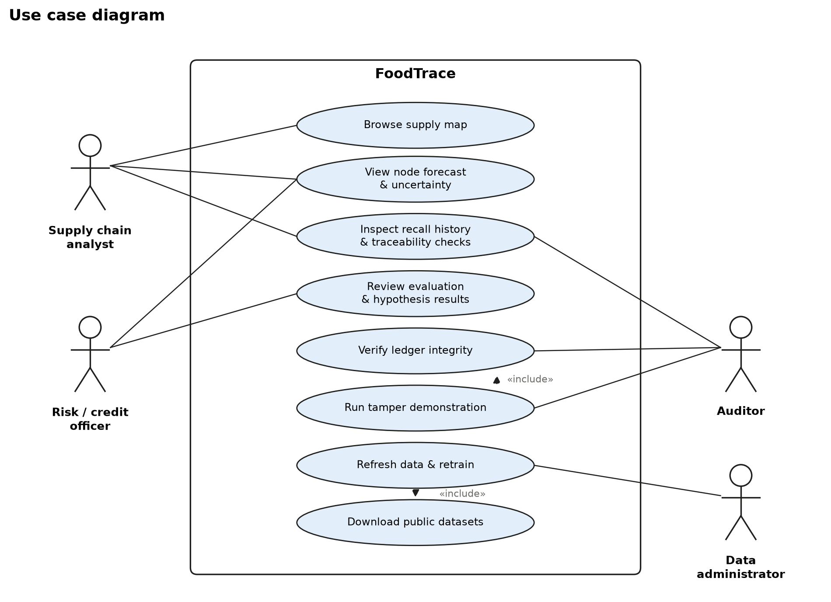
Use case diagram

Slide 18
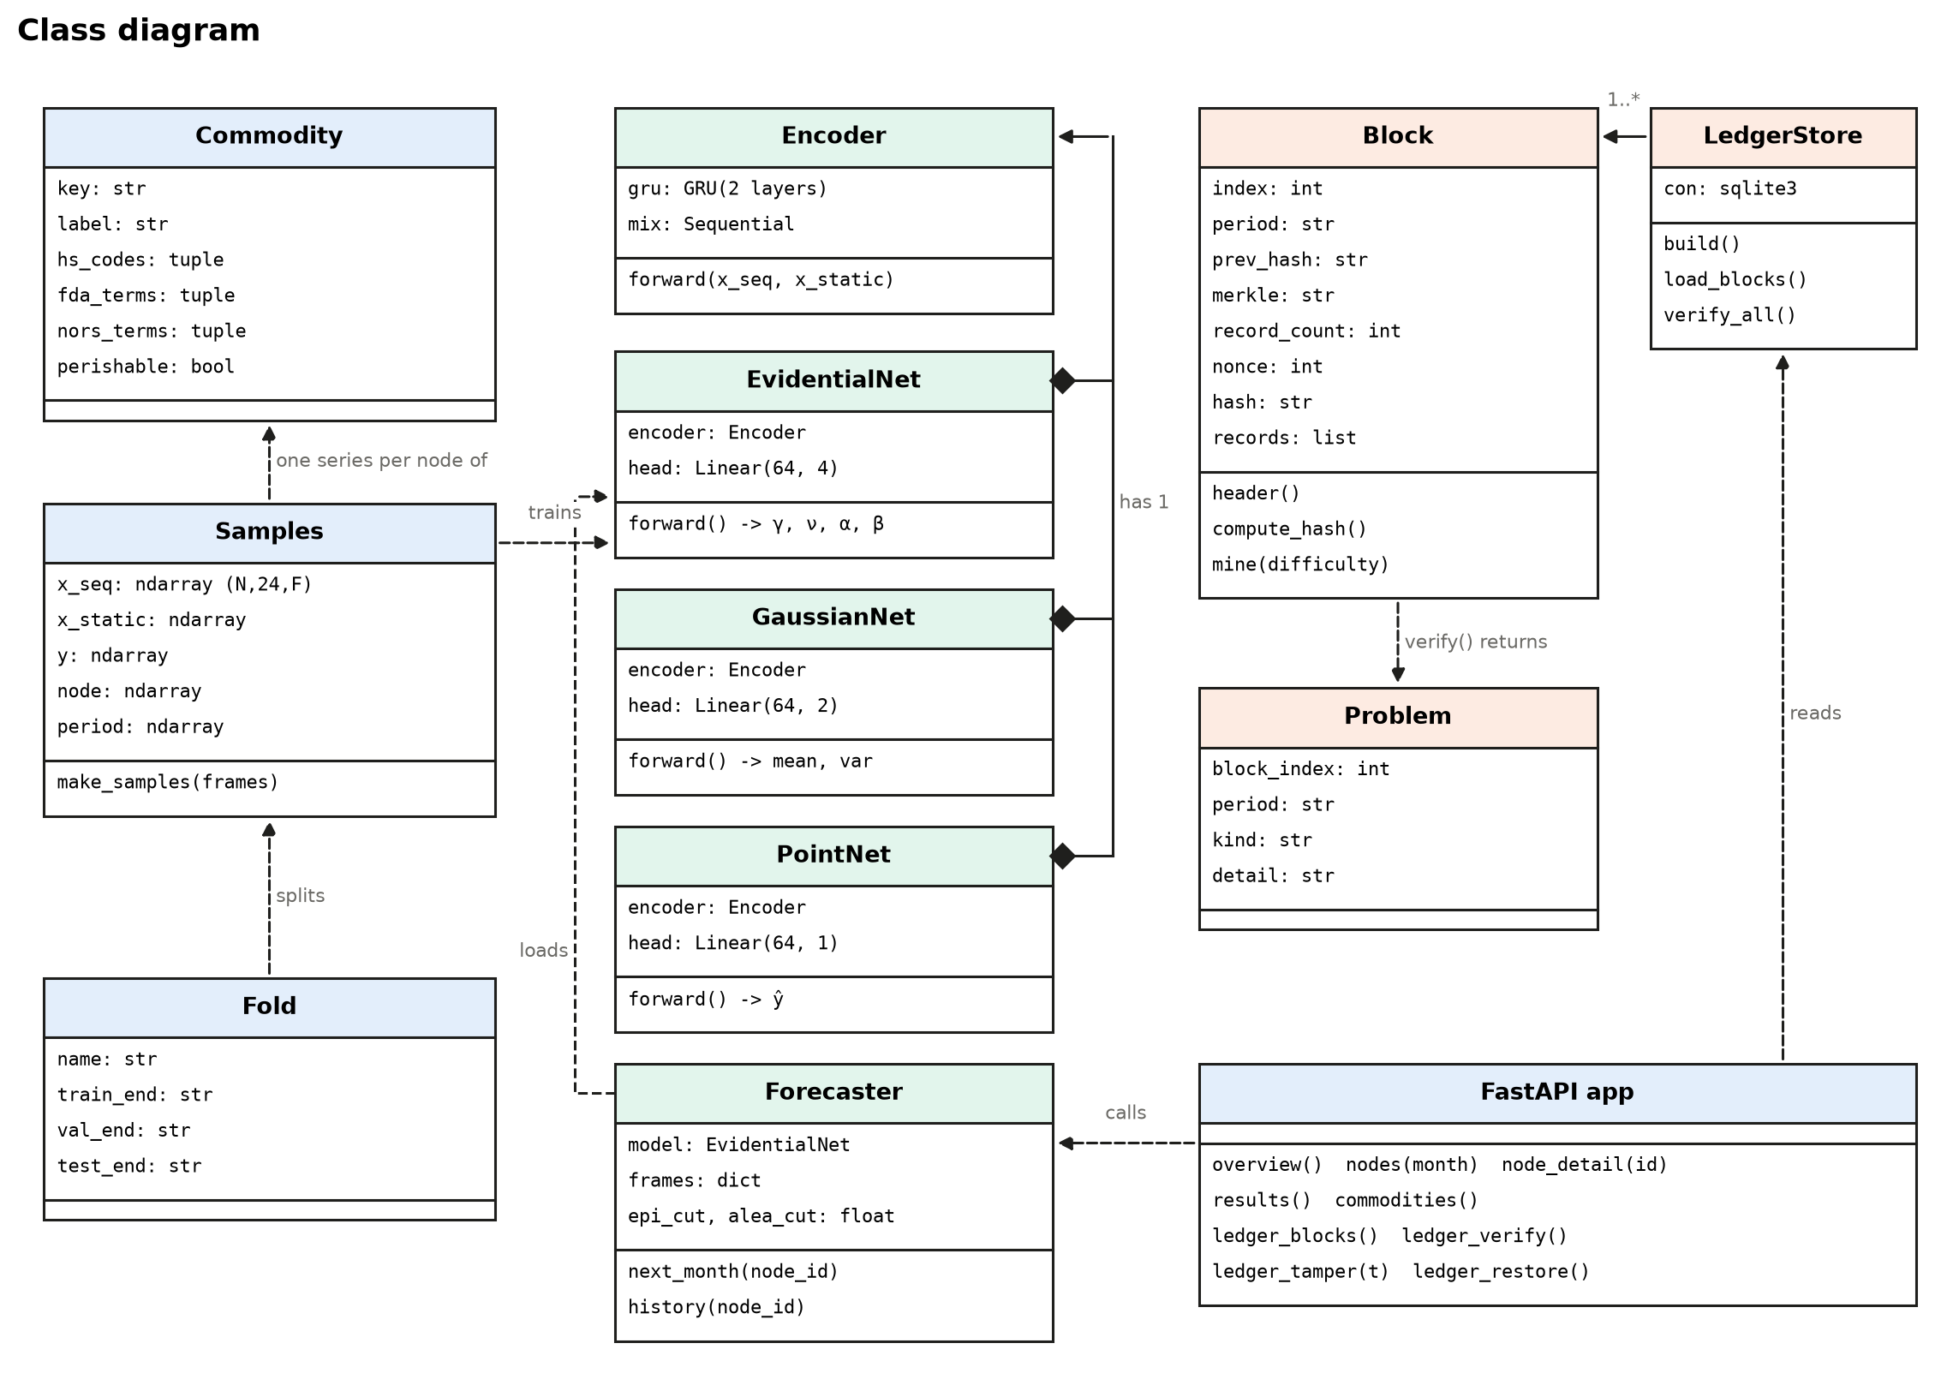
Class diagram

Slide 19
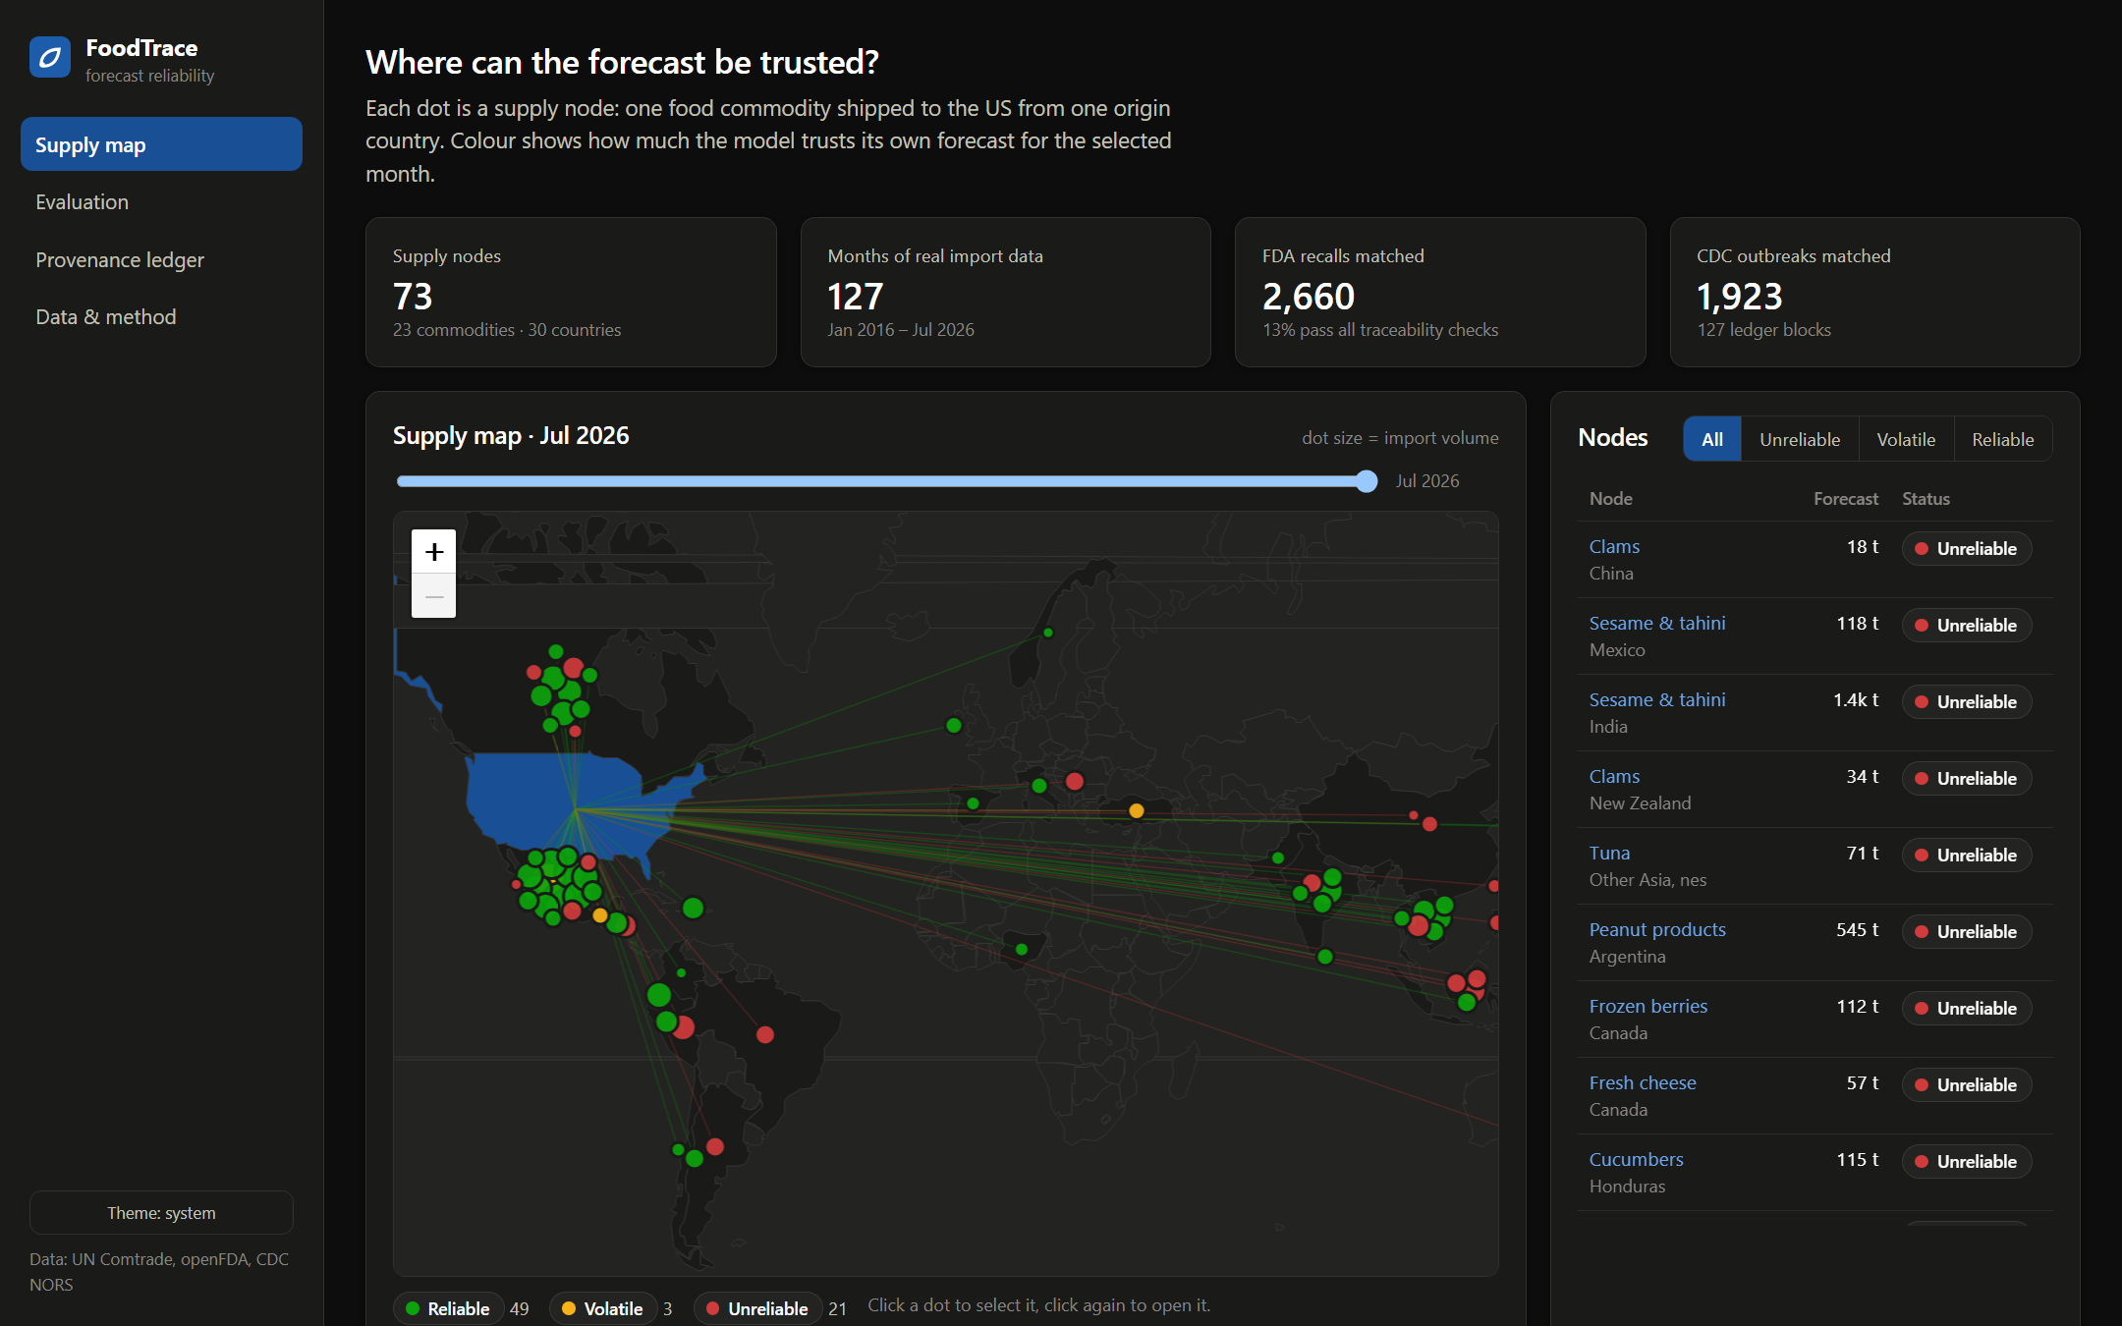
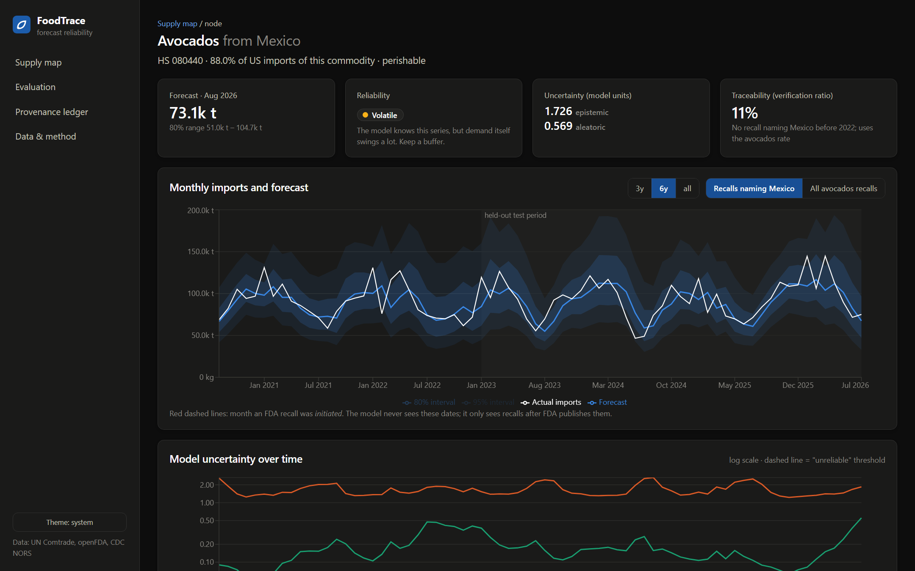
Dashboard: where can the forecast be trusted?
Supply map: 49 reliable · 3 volatile · 21 unreliable (Jul 2026)
Node page: forecast, 80/95% band, both uncertainties, recalls

Slide 20
Implementation and testing
Stack
Tests: 20 pytest cases, all passing
Python 3.12 pandas · statsmodels · scipy
PyTorch 2.14 CUDA on RTX 3050
FastAPI REST API, serves the dashboard
SQLite ledger store
One-command setup, run and full rebuild scripts (setup.ps1, run.ps1, pipeline.ps1)
Installs entirely inside the project folder; tested on a second laptop
React 19 + Vite Leaflet map · Recharts

Slide 21


Limitations and future work
Limitations
Future work
Imports are a proxy for demand
Recall matching is keyword-based
Most recalls do not name an origin country
Record completeness ≠ blockchain use
73 nodes limit statistical power
Manual precision audit of recall matches
Node-level recall links via importer records
Map epistemic uncertainty to a credit-risk premium
More commodities and origin countries

Slide 22
Summary
0.773
91.8%
p = 0.48
p = 0.010
best MASE of six models
coverage of the 90% interval
H1: no traceability effect
H2: suggestive lead signal
Calibrated uncertainty is the main contribution, not point accuracy
Null and fragile results are reported as they came out
Next: Review 2 report, recall-match audit, code on GitHub

Slide 23
References
A. Amini, W. Schwarting, A. Soleimany, D. Rus, “Deep Evidential Regression,” NeurIPS, 2020.
V. Kuleshov, N. Fenner, S. Ermon, “Accurate Uncertainties for Deep Learning Using Calibrated Regression,” ICML, 2018.
Y. Gal, Z. Ghahramani, “Dropout as a Bayesian Approximation,” ICML, 2016.
K. Cho et al., “Learning Phrase Representations using RNN Encoder–Decoder,” EMNLP, 2014.
G. Box, G. Jenkins, Time Series Analysis: Forecasting and Control, Holden-Day.
R. Hyndman, A. Koehler, “Another Look at Measures of Forecast Accuracy,” Int. J. Forecasting, 2006.
S. Nakamoto, “Bitcoin: A Peer-to-Peer Electronic Cash System,” 2008.
US FDA, Requirements for Additional Traceability Records for Certain Foods (FSMA §204), 21 CFR Part 1 Subpart S, 2022.
Data: UN Comtrade API; openFDA Food Enforcement; CDC NORS (data.cdc.gov).

