Slide 1
DELIVERY DASHBOARD - DEMO

Slide 2
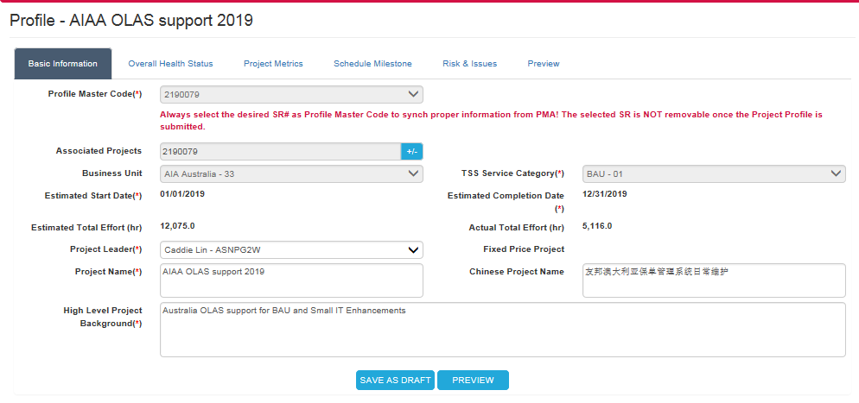
BASIC INFORMATION – for all categories
INTENTIONALLY MASKED
PMs are able to add/remove SRs into an individual profile
INTENTIONALLY MASKED
Estimated Total Effort:
Automatically calculated & populated from selected service request(s)
INTENTIONALLY MASKED
WHEN TO REFRESH?
Actual Total Effort:
Labor effort and effort charged using PMA 51 / 53 form.
INTENTIONALLY MASKED
INTENTIONALLY MASKED
INTENTIONALLY MASKED
INTENTIONALLY MASKED
While updating project profile,
Identified PROFILE MASTER CODE can’t be removed
Only those service requests have same attributes with that of PROFILE MASTER CODE are available for adding
Once adding / Removing service request(s), below information will be recalculated & populated accordingly: profile estimated start date & estimated completion date, profile estimated effort and actual effort.
RULES /
CALCULATIONS

Slide 3
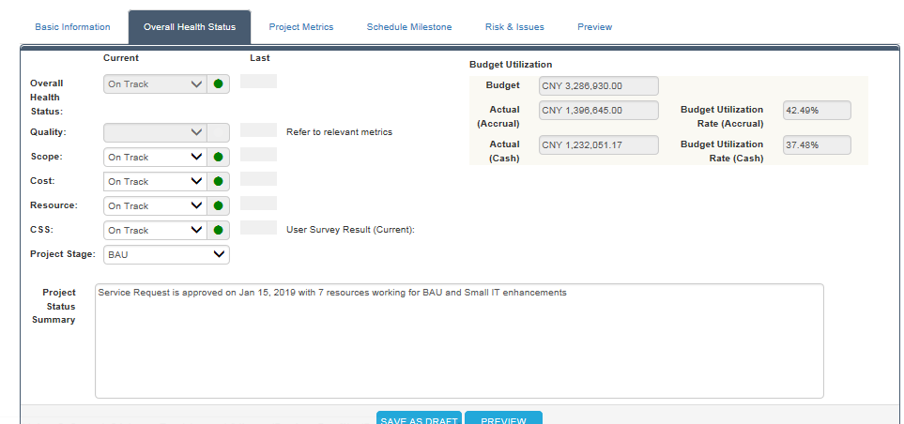
OVERALL HEALTH STATUS - BAU
Quality metrics of BAU (as defined by QAG team.
Actual (Accrual):
Including cost of not approved service request
Actual (Cash base):
Actual Billed out cost, including cost charged by 51 / 53 form
Such User Survey Result (current) is filled by QAG members (not real-time); however, CSS is reflecting the real-time status, manually updated by PM
INTENTIONALLY MASKED
This text box is for PM to update the project health status, which can be exported for generating management report.
Manually selected by PM

Slide 4
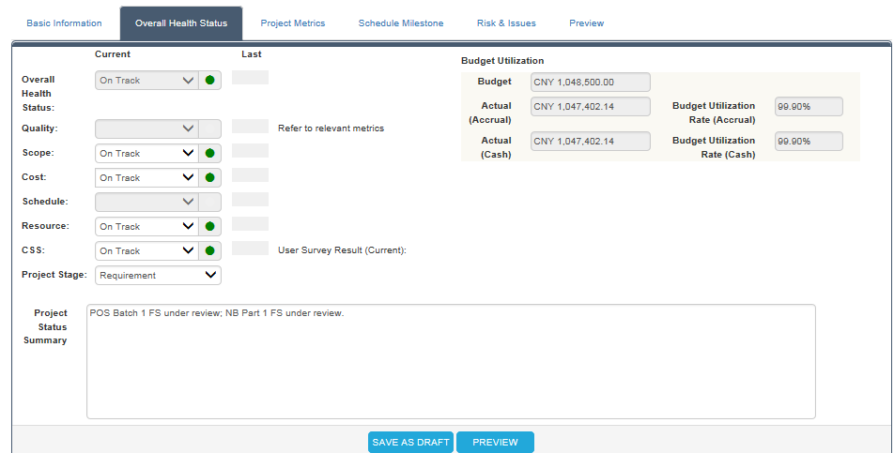
OVERALL HEALTH STATUS – BAU ENHANCEMENT
Schedule:
Referring to ‘task on schedule’ on “Project Metrics” page
INTENTIONALLY MASKED
Manually selected by PM

Slide 5
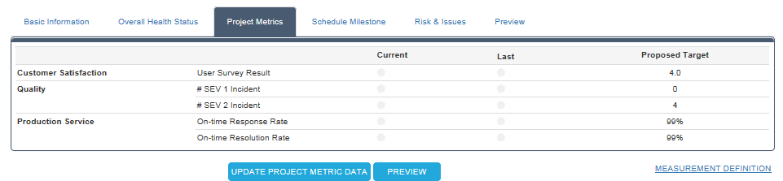
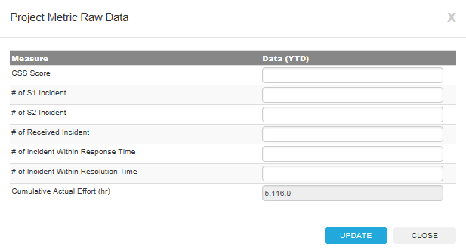
PROJECT METRICS – BAU
‘USER SURVEY RESULT’ next to CSS Indicator
‘QUALITY’ Indicator
All entered raw data is accumulated per project profile level (sum up all relevant service request(s)).
RULES /
CALCULATIONS
Below measures are calculated & populated automatically by system. It will recalculate each time UPON opening the Metric Raw Data update page.
Cumulative Actual Effort
PV
EV
Actual Labor Cost
Please Note:
Effort / Cost charged via PMA 51 / 53 forms is excluded here.

Slide 6
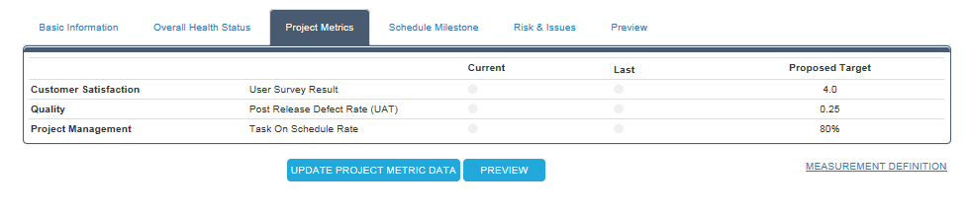
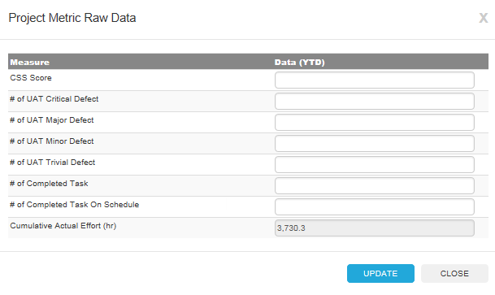
PROJECT METRICS – BAU ENHANCEMENT
‘USER SURVEY RESULT’ next to CSS Indicator
‘QUALITY’ Indicator
‘SCHEDULE’ Indicator
All entered raw data is accumulated per project profile level (sum up all relevant service request(s)).
RULES /
CALCULATIONS
Below measures are calculated & populated automatically by system. It will recalculate each time UPON opening the Metric Raw Data update page.
Cumulative Actual Effort
PV
EV
Actual Labor Cost
Please Note:
Effort / Cost charged via PMA 51 / 53 forms is excluded here.

Slide 7
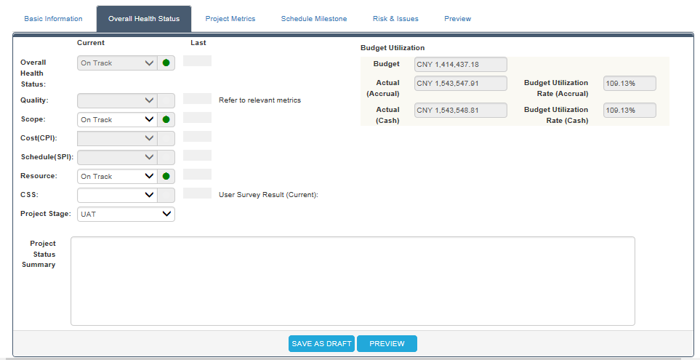
OVERALL HEALTH STATUS – PROJECT DEPLOYMENT
Quality metrics of BAU (as defined by QAG team.
Actual (Accrual):
Including cost of not approved service request
Actual (Cash base):
Actual Billed out cost, including cost charged by 51 / 53 form
Such User Survey Result (current) is filled by QAG members (not real-time); however, CSS is reflecting the real-time status, manually updated by PM
This text box is for PM to update the project health status, which can be exported for generating management report.
Manually selected by PM

Slide 8
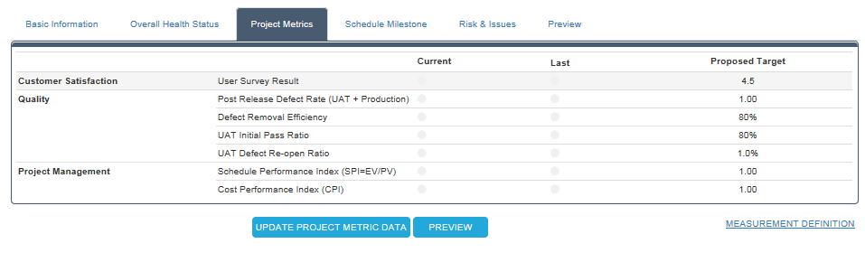
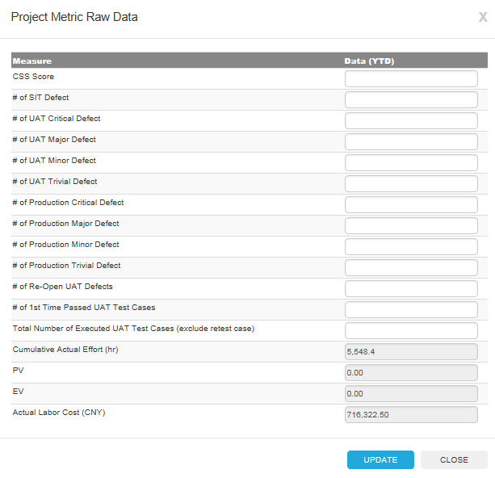
PRJECT METRICS – PROJECT DEPLOYMENT / DEVELOPMENT
All entered raw data is accumulated per project profile level (sum up all relevant service request(s)).
RULES /
CALCULATIONS
Below measures are calculated & populated automatically by system. It will recalculate each time UPON opening the Metric Raw Data update page.
Cumulative Actual Effort
PV
EV
Actual Labor Cost
Please Note:
Effort / Cost charged via PMA 51 / 53 forms is excluded here.

Slide 9
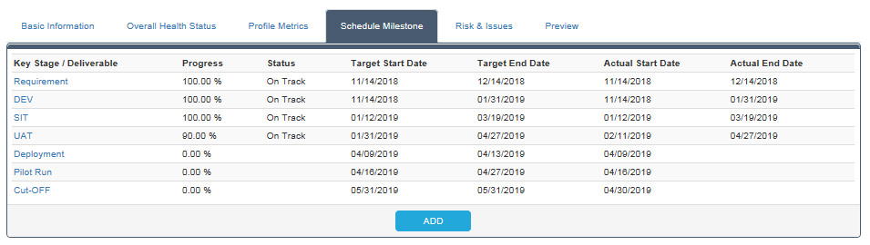
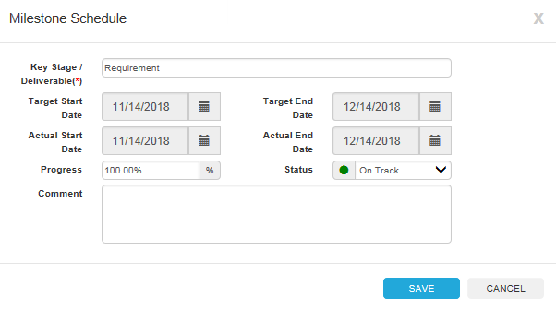
SCHEDULE MILESTONES

Slide 10
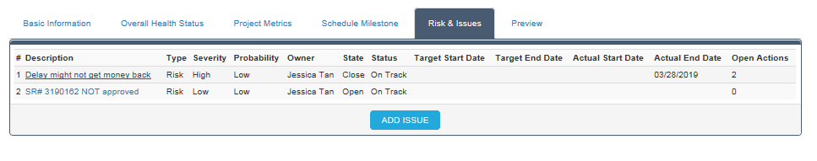
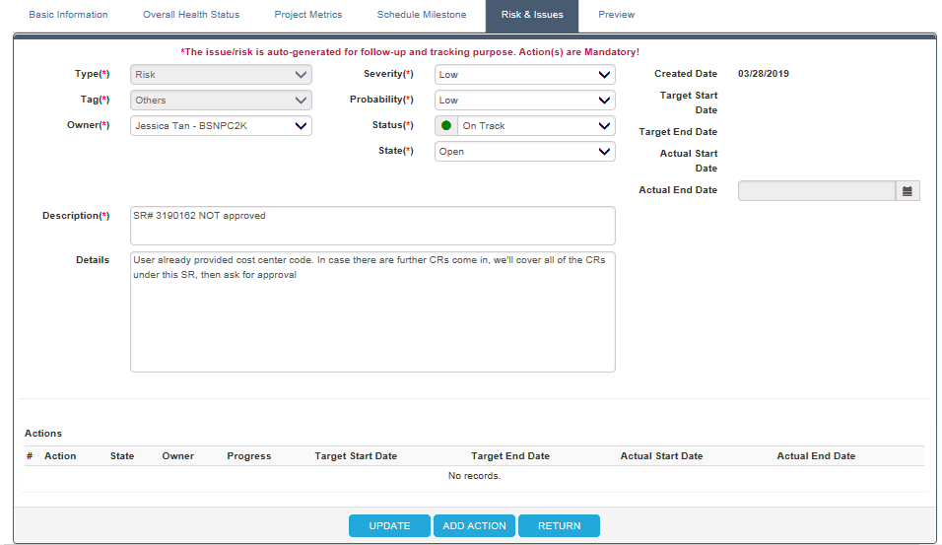
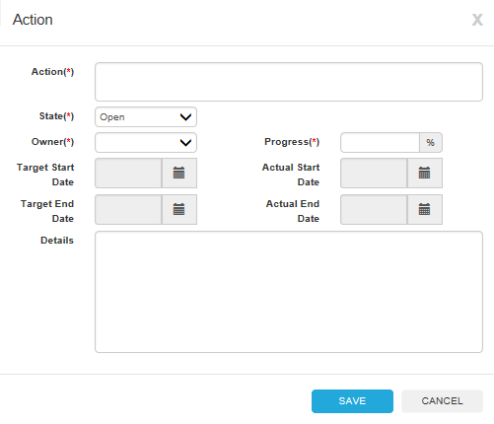
RISK & ISSUES

