Slide 1
Bridge
Architecture Patterns
End of Part I
AI-Driven SDLC — A Federated Framework

Slide 2
Learning Objectives
Bridge — Architecture Patterns
Identify six architecture patterns: monolith, layered, microservices, event-driven, hexagonal, CQRS
Apply the architecture pattern matrix to choose between them
Distinguish hexagonal architecture from CQRS (both involve separation, of different things)
Use the five C.8 questions to defend an architectural choice

Slide 3
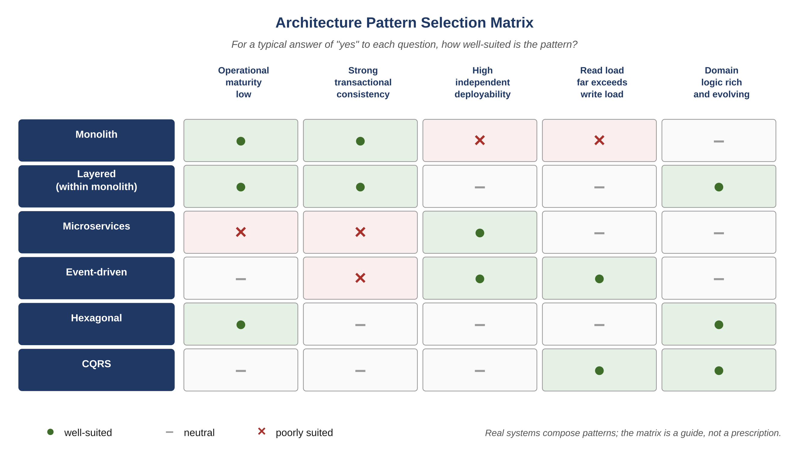
Figure C.1 — Architecture pattern selection matrix
AI-Driven SDLC — A Federated Framework

Slide 4
Six Patterns in One View
Bridge
Monolith: all code in one deployable
Layered: code organized in layers, deployed together
Microservices: independently deployable services
Event-driven: services communicate by events, loose coupling
Hexagonal: domain core separated from infrastructure
CQRS: write path separated from read path

Slide 5
Hexagonal vs. CQRS
Bridge
Both involve separation; they separate different things
Hexagonal separates domain logic from infrastructure (databases, queues, network)
CQRS separates the write path (commands, mutations) from the read path (queries, projections)
A system can use both: write side and read side can each be hexagonal internally

Slide 6
The Five C.8 Questions
Bridge
Operational maturity: do we have the distributed-systems plumbing?
Concurrency profile: read-heavy, write-heavy, fan-out, transactional?
Deployment cadence: do we benefit from independent deployability?
Domain shape: is the business logic rich enough to repay separation?
Team familiarity: do we have experience with this pattern?

Slide 7
Defensible Choice
Bridge
Answer all five questions explicitly
A choice that answers only one (often "what is fashionable") is a bet placed without seeing the other side
The matrix surfaces patterns poorly suited to specific conditions
Microservices with low operational maturity + transactional consistency: poorly suited

Slide 8
Common Mistakes
Bridge — patterns that look reasonable and aren't
Choosing the pattern by what is currently fashionable
Conflating hexagonal and CQRS as the same kind of separation
Skipping the operational-maturity question

Slide 9
Takeaway
Bridge — Architecture Patterns
Architecture pattern choices are bets. A defensible choice answers all five questions: operational maturity, concurrency profile, deployment cadence, domain shape, team familiarity. A team that picks by familiarity alone has placed a bet without seeing the other side.

