Slide 1
Bridge
Data Engineering
End of Part II
AI-Driven SDLC — A Federated Framework

Slide 2
Learning Objectives
Bridge — Data Engineering
Treat data as a first-class engineering concern, not auxiliary
Apply lineage discipline: every consumer's view traces back through named transformations to source
Recognize the operational value of lineage even when nothing is broken
Apply the same disciplines (versioning, testing, observability) to data that you apply to code

Slide 3
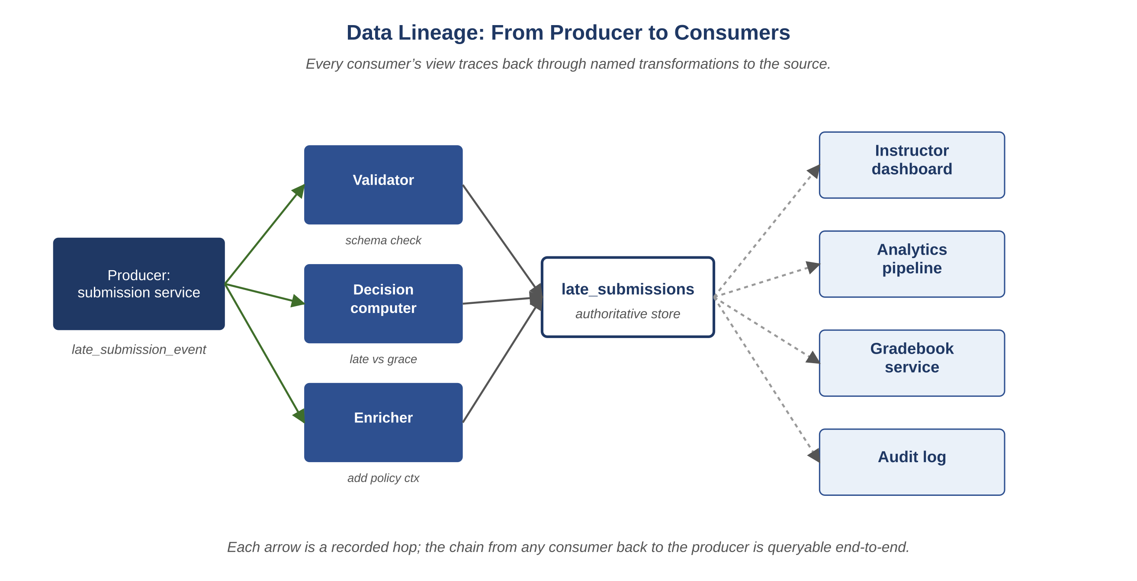
Figure D.1 — Data lineage from producer to consumers
AI-Driven SDLC — A Federated Framework

Slide 4
Data Is First-Class
Bridge
Code engineering and data engineering deserve the same disciplines
Versioning, lineage, testing, observability — all of these
A team that treats data as auxiliary will discover its primacy during an audit or outage
Data is not what code happens to operate on; data and code are co-equal

Slide 5
Lineage as Operational Substrate
Bridge
Lineage: every consumer's view traces back through named transformations to a source
Producers, transformation hops, authoritative store, consumers
When something breaks, lineage makes diagnosis fast
When something hasn't broken yet, lineage enables structural change without breaking consumers

Slide 6
Why Lineage Pays Off in Quiet Times
Bridge
Schema changes: lineage tells which consumers need updating, in what order
Deprecation: lineage shows which consumers depend on what is being removed
Compliance: regulators ask "where did this data come from?"; lineage is the answer
Migrations: lineage tells what must be backfilled

Slide 7
Same Disciplines as Code
Bridge
Schema versioning: every change recorded, rollback possible
Tests: data quality, integrity, freshness
Observability: lineage events, schema events, freshness metrics
CI: schema-change PRs go through review like code-change PRs

Slide 8
Common Mistakes
Bridge — patterns that look reasonable and aren't
Treating data as auxiliary to code
Skipping lineage because "nothing is broken"
Versioning code but not schemas

Slide 9
Takeaway
Bridge — Data Engineering
Data is a first-class engineering concern. Lineage gives every consumer's view a traceable path back through named transformations to the authoritative source. A team that has lineage in place can diagnose, deprecate, and migrate confidently; a team without it discovers what depends on what during an outage.

