Slide 1
Bridge
Ethics and Responsible AI
Between Ch 22 and Ch 23
AI-Driven SDLC — A Federated Framework

Slide 2
Learning Objectives
Bridge — Ethics and Responsible AI
Recognize the four patterns of harm: bias amplification, accountability dilution, surveillance creep, autonomy erosion
Apply ethical review as extension of the framework, not competition with it
Apply mitigation disciplines specific to each harm pattern
Refuse "the AI did it" as a defense in incident response

Slide 3
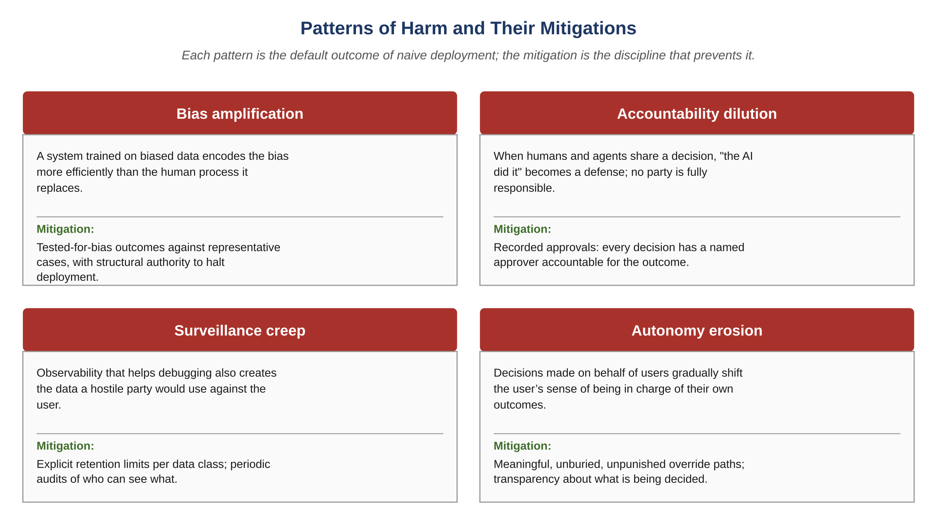
Figure E.1 — Patterns of harm and their mitigations
AI-Driven SDLC — A Federated Framework

Slide 4
Four Harm Patterns
Bridge
Bias amplification: training data biases compound through deployment
Accountability dilution: nobody is responsible when humans and agents share decisions
Surveillance creep: data collected for one purpose enables another
Autonomy erosion: defaults shift behavior in ways users can't easily resist

Slide 5
Ethical Review Extends the Framework
Bridge
A system that meets every functional and non-functional requirement can still be ethically problematic
Ethical review extends rather than competes with the framework
Mitigations are explicit disciplines, not absence of malice
"Outside the scope" is itself the failure mode

Slide 6
Mitigation Disciplines
Bridge
Bias amplification: tested-against-representative-cases with halt authority
Accountability dilution: named human approver for every adverse decision
Surveillance creep: explicit retention limits, named data flows
Autonomy erosion: unburied override paths, opt-outs that work

Slide 7
Refuse the AI-Did-It Defense
Bridge
When humans and agents share a decision, "the AI did it" lets every party off the hook
No party is fully responsible; the harm has no owner
Recorded approvals push accountability back into the human review path
Every adverse decision has a named approver accountable for the outcome

Slide 8
Common Mistakes
Bridge — patterns that look reasonable and aren't
Treating ethics as outside the framework's scope
Generic ethics statements without concrete mitigations
Allowing "the AI did it" as a defense

Slide 9
Takeaway
Bridge — Ethics and Responsible AI
Ethical review extends the framework rather than competing with it. The four harm patterns — bias amplification, accountability dilution, surveillance creep, autonomy erosion — are the default outcome of naive deployment. Mitigations are explicit disciplines, not absence of malice.

