Slide 1
Bridge
Requirements Engineering
Between Ch 2 and Ch 3
AI-Driven SDLC — A Federated Framework

Slide 2
Learning Objectives
Bridge — Requirements Engineering
Treat requirements as evolving artifacts, not one-time documents
Distinguish functional requirements from quality attribute requirements
Identify stakeholders beyond direct users
Maintain a requirements register with explicit staleness tracking

Slide 3
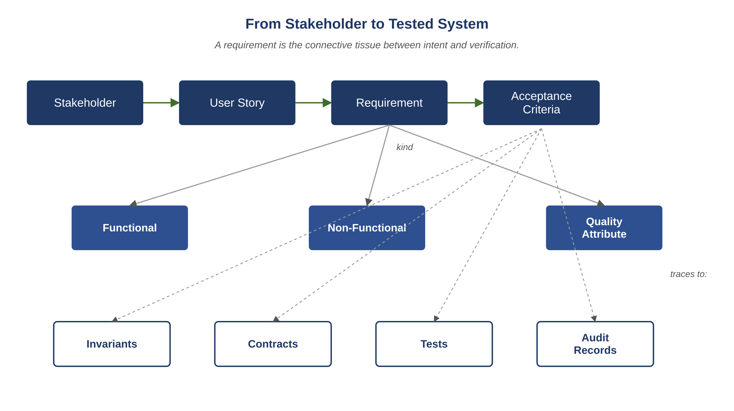
Figure B.1 — From stakeholder to tested system: the requirements pipeline
AI-Driven SDLC — A Federated Framework

Slide 4
Why Requirements Drift Constantly
Bridge
The system, the users, and the business context all drift
A register that hasn't been updated is almost certainly stale
Staleness is the default state; freshness is the discipline
Without explicit tracking, drift is invisible until something breaks

Slide 5
Functional vs. Quality Attribute
Bridge
Functional: what the system does (behaviors, transactions, outputs)
Quality attribute: properties the system must have (latency, availability, security, accessibility)
Both matter; they describe different things
A requirements register that only captures functional misses where most expensive failures live

Slide 6
Stakeholders Beyond Users
Bridge
A user interacts with the system directly
A stakeholder has interest in the system's outcomes (regulators, sponsors, downstream consumers, affected non-users)
A users-only view misses constraints (regulatory, contractual, organizational)
Some of the most expensive requirements come from non-user stakeholders

Slide 7
The Requirements Register
Bridge
Schema: id, type, statement, source, last_reviewed, status, related_artifacts
Review cadence: every requirement reviewed annually; functional requirements touched by feature change reviewed at design time
Staleness detection: a Validator agent flagging requirements with last_reviewed past policy threshold
Trace from defect to requirement; trace from requirement to test

Slide 8
Common Mistakes
Bridge — patterns that look reasonable and aren't
Treating requirements as a one-time document, not a living register
Capturing functional requirements without quality attributes
Defining stakeholders as direct users only

Slide 9
Takeaway
Bridge — Requirements Engineering
Requirements drift constantly because the system, users, and context all drift. A register that hasn't been updated is almost certainly stale. The discipline is explicit staleness tracking, structured stakeholder mapping, and traceability between requirements and the artifacts that satisfy them.

