Slide 1
Chapter 11
The Execution Loop
Part III — The Agents
AI-Driven SDLC — A Federated Framework

Slide 2
Learning Objectives
Chapter 11 — The Execution Loop
Identify the seven stages of the execution loop
Distinguish local fixes from non-local fixes (contract, schema, invariant)
Recognize the cost of fast-laning trivial changes
Apply the loop's discipline uniformly without skipping

Slide 3
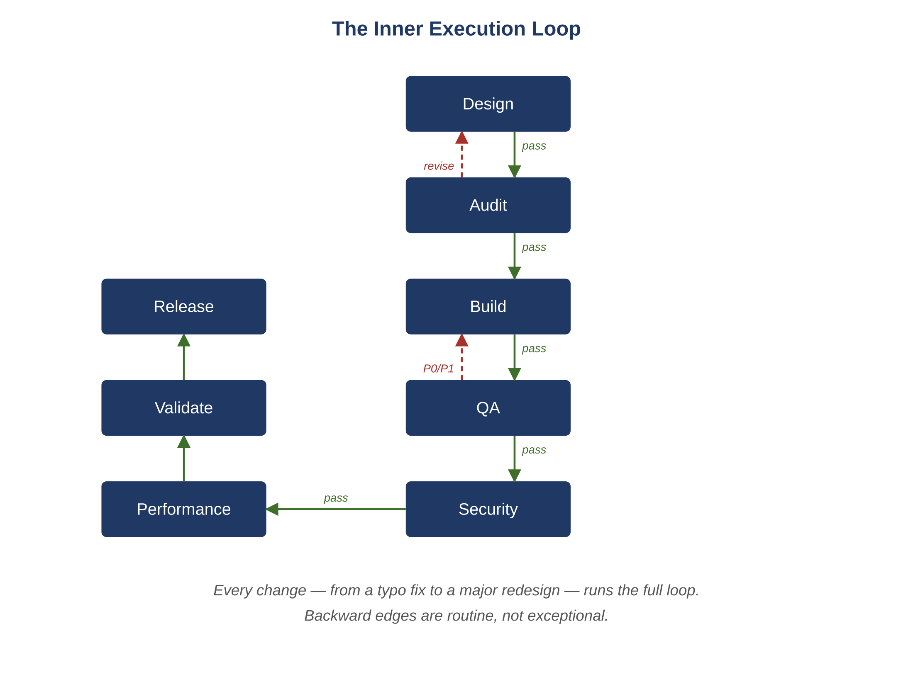
Figure 11.1 — The inner execution loop
AI-Driven SDLC — A Federated Framework

Slide 4
The Loop's Stages
Chapter 11
Design → Develop → QA → Security → Performance → Validate → Release
Each stage produces a structured output
The Validator catches cross-artifact problems no single agent would notice
The Release Governor decides on canary, observation windows, rollback

Slide 5
Local vs. Non-Local Fixes
Chapter 11
Local: a logic fix that doesn't change return types, contracts, schemas, or invariants
Non-local: anything that does
Local fixes stay inside the current iteration
Non-local fixes bounce back to Design — the loop runs from the affected upstream stage

Slide 6
Why Skip-the-Loop Fails
Chapter 11
"This change is too small for the full loop" — until the day a label change collapses two enums
"This bug fix is urgent, skip Security" — the loop catches what urgency hides
The loop earns most of its value on changes the team is most tempted to skip it for

Slide 7
Common Mistakes
Chapter 11 — patterns that look reasonable and aren't
Fast-laning trivial changes
Treating contract-touching bug fixes as local
Skipping a stage because the team trusts it

Slide 8
Takeaway
Chapter 11 — The Execution Loop
Every change runs the full loop, including the changes that feel too small to bother with. Local fixes stay inside the iteration; non-local fixes bounce back to Design. The loop earns most of its value on the changes that look trivial.

