Slide 1
Chapter 12
Anti-Patterns
Part III — The Agents
AI-Driven SDLC — A Federated Framework

Slide 2
Learning Objectives
Chapter 12 — Anti-Patterns
Recognize the twelve recurring anti-patterns from Chapter 12
Apply diagnostic questions that surface anti-patterns the team has not named
Distinguish symptomatic responses (adding agents, fast-lanes) from root-cause repair
Treat recurring escapes as patterns, not coincidences

Slide 3
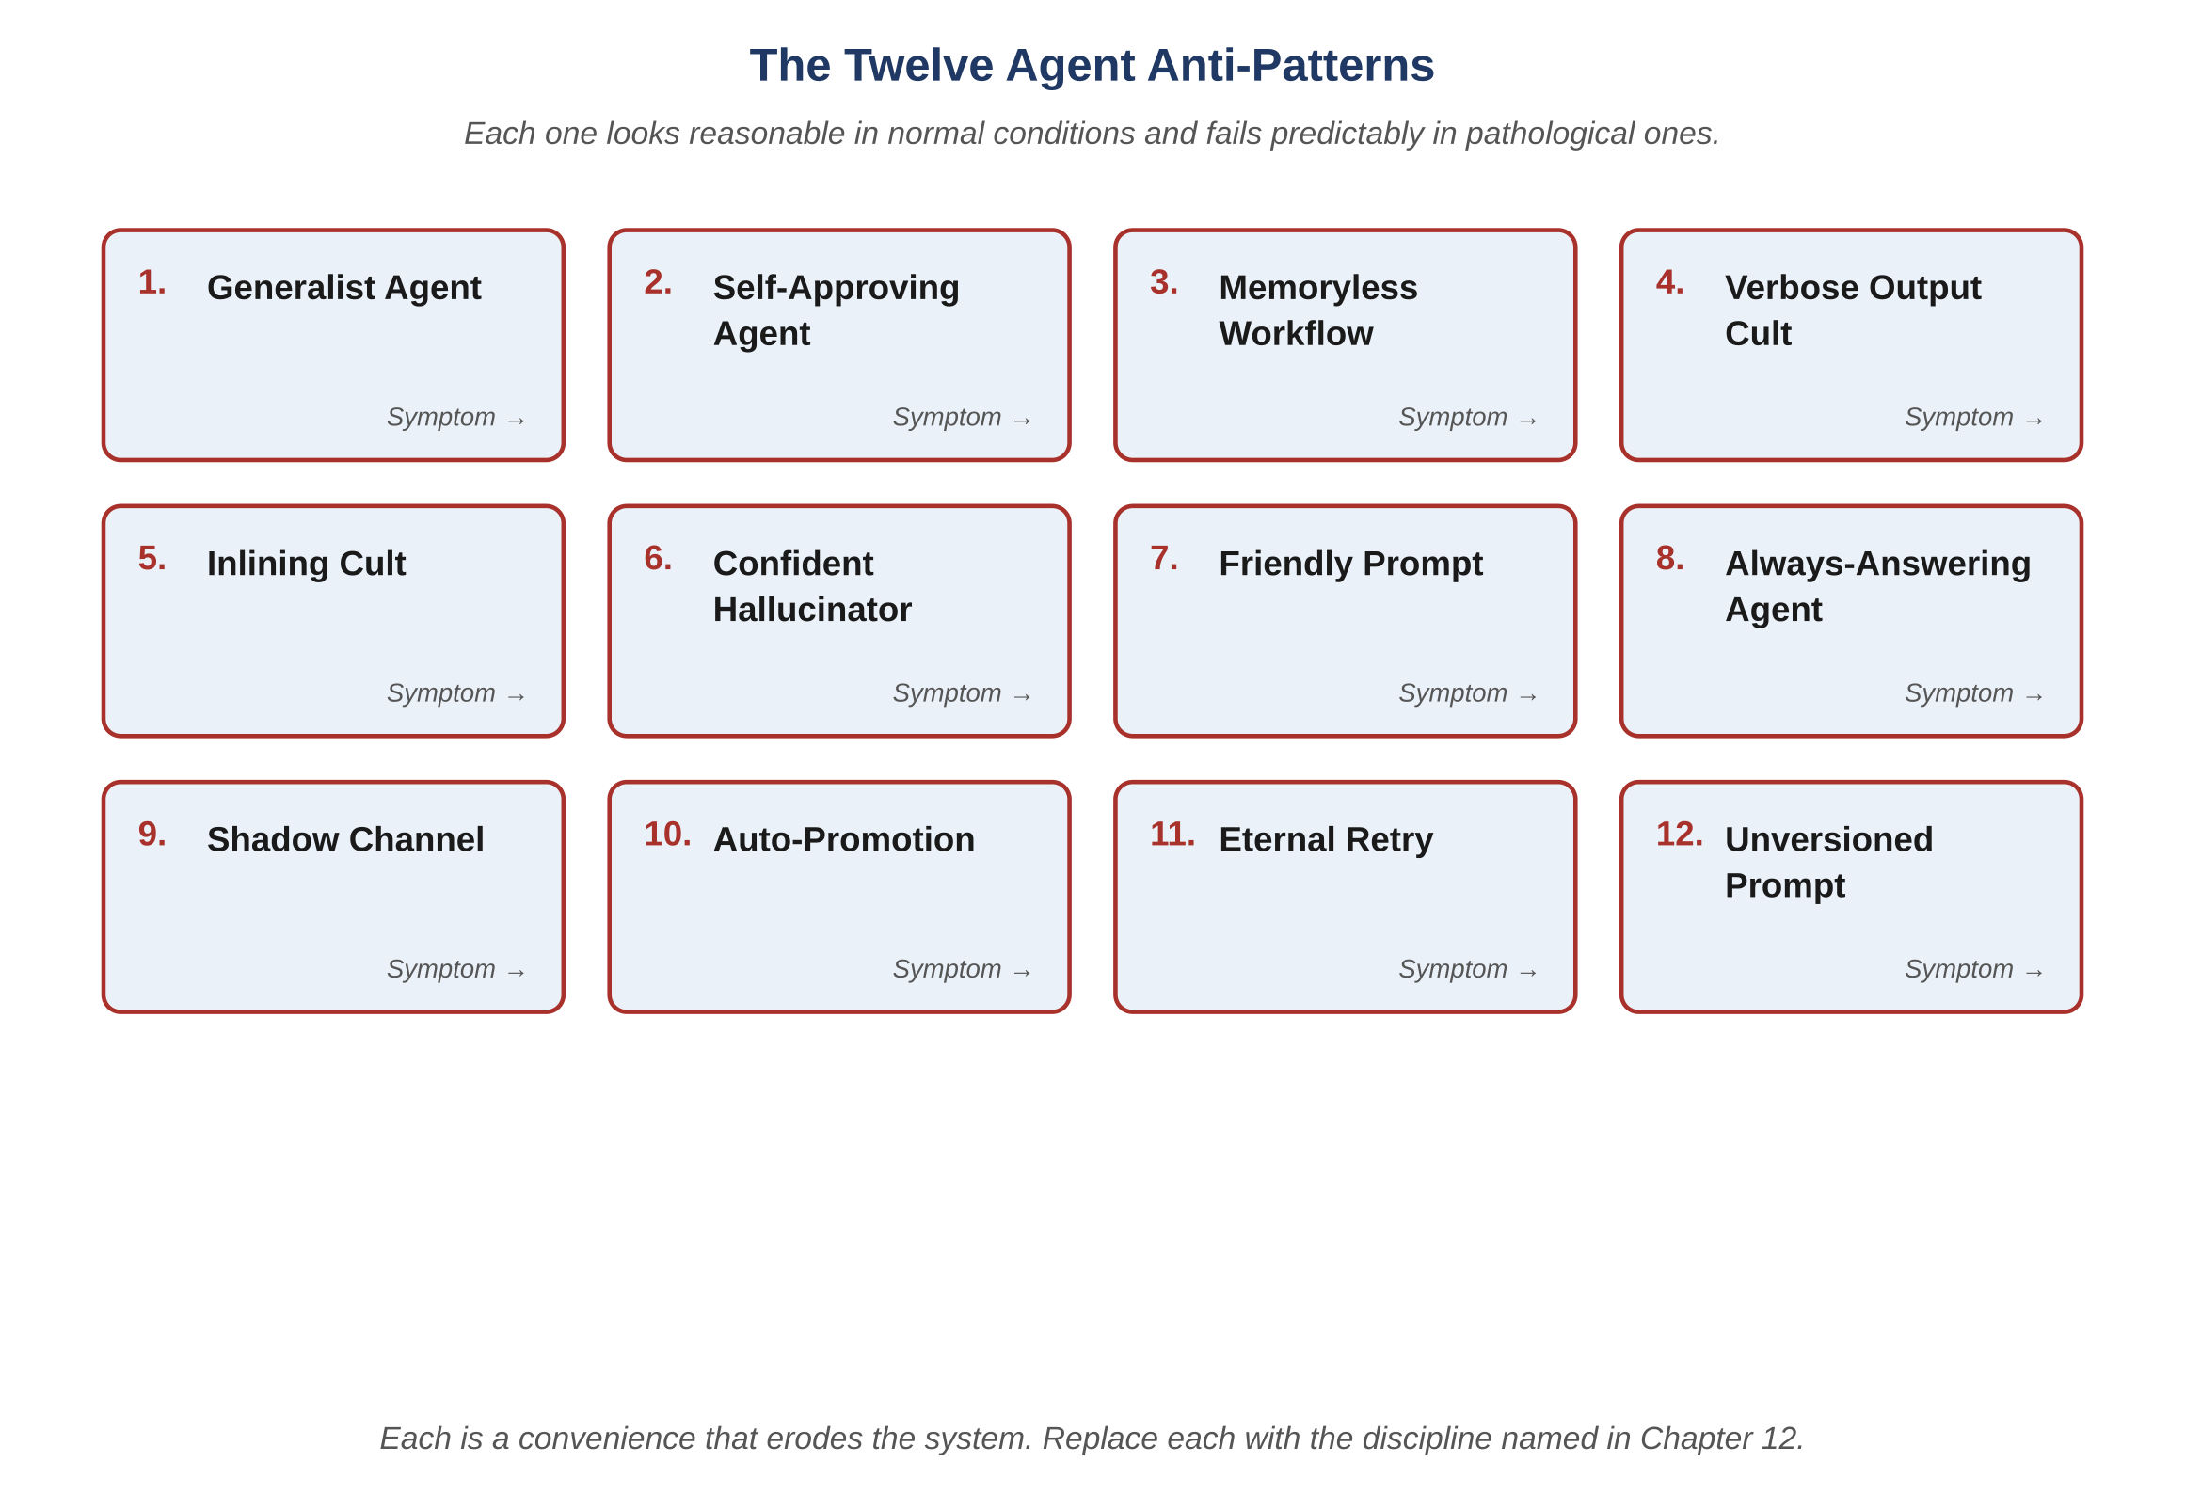
Figure 12.1 — The twelve agent anti-patterns
AI-Driven SDLC — A Federated Framework

Slide 4
Why Self-Assessment Fails
Chapter 12
Teams see outcomes (we ship) and not the discipline that should have produced them
"We don't do any of these" is itself an anti-pattern
Three diagnostic questions almost always reveal at least one anti-pattern present
External review or rotating audit roles surface what the team can't see in itself

Slide 5
Patterns of Avoidance
Chapter 12
Adding a new agent role to handle the symptoms of a broken workflow
Reviewer-of-reviewers patterns paper over the gap rather than closing it
Closing tickets without a postmortem when retries fix them — the seat-overrun signature
Three similar incidents in a quarter is a pattern, not a coincidence

Slide 6
The Discipline Underneath
Chapter 12
Most anti-patterns get adopted as conveniences during normal operation
They reveal their cost only during pathological cases
The instinct to "simplify" is often the instinct to remove what was keeping a failure mode under control
Honest naming of the pattern is the first repair

Slide 7
Common Mistakes
Chapter 12 — patterns that look reasonable and aren't
Believing "we don't do any of these"
Adding a new agent role rather than fixing the workflow
Treating recurring escapes as one-off bugs

Slide 8
Takeaway
Chapter 12 — Anti-Patterns
Twelve common failure modes, each with the discipline that prevents it. Most get adopted as conveniences and reveal their cost during pathological cases. The instinct to "simplify" is often the instinct to remove what was keeping a specific failure mode under control.

