Slide 1
Chapter 13
Failure-First QA
Part IV — Quality Concerns
AI-Driven SDLC — A Federated Framework

Slide 2
Learning Objectives
Chapter 13 — Failure-First QA
Apply the failure-first inversion: enumerate failure modes before specifying success
Identify the recurring categories: concurrency, idempotency, boundaries, failure injection, time-related
Distinguish "all tests pass" from "the system is correct"
Build test plans that surface failure modes the team would miss otherwise

Slide 3
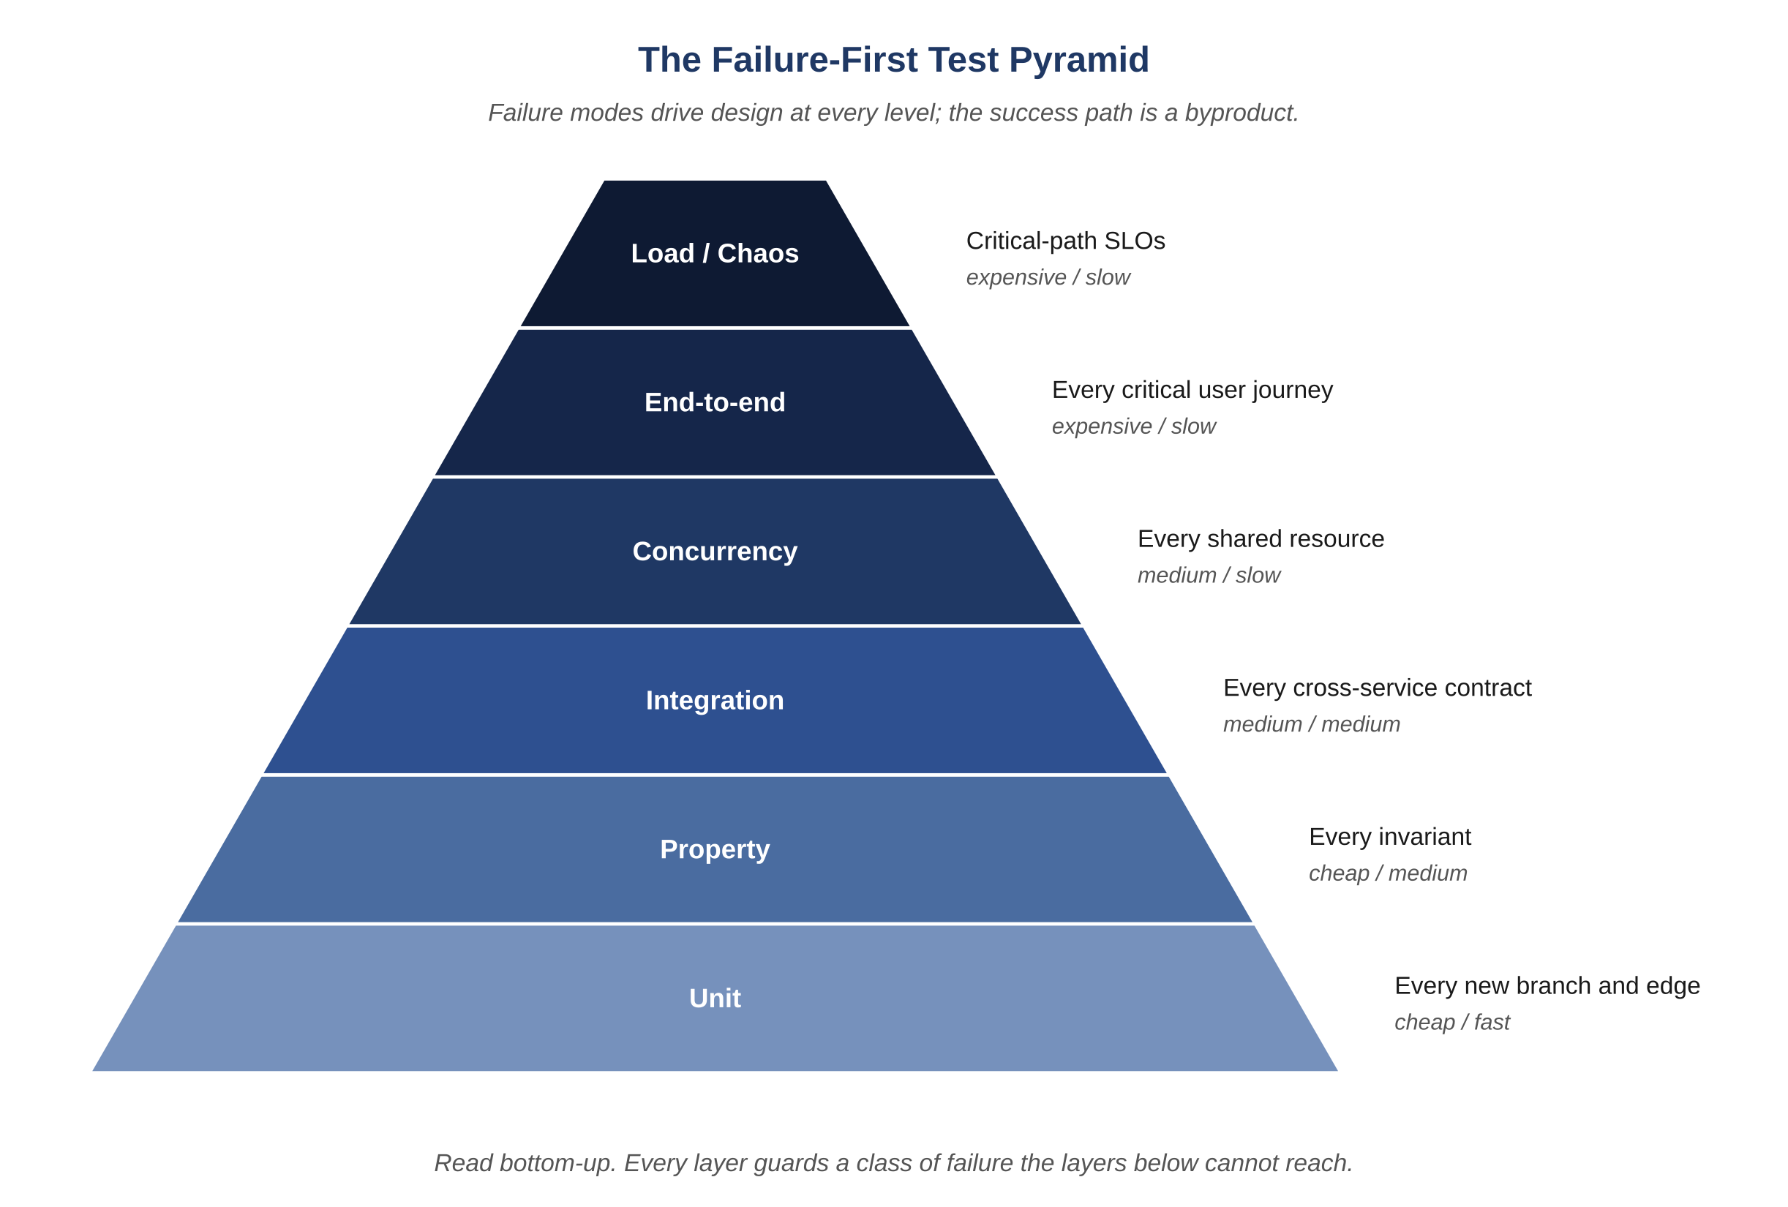
Figure 13.1 — The failure-first test pyramid
AI-Driven SDLC — A Federated Framework

Slide 4
The Inversion
Chapter 13
Traditional: write tests for the happy path, then add edge cases
Failure-first: enumerate the ways the system can fail, write a test for each
Then confirm the success path still works
The reordering changes what gets covered

Slide 5
Recurring Categories
Chapter 13
Concurrency: contention, races, ordering
Idempotency: retries produce the same observable result
Boundaries: empty, max, off-by-one, type limits
Failure injection: dependencies fail, timeouts trigger, partial state
Time-related: clock skew, daylight saving, timezone, timestamp parsing

Slide 6
Test Count Is Not Coverage
Chapter 13
"We have 4,000 tests" measures effort, not protection
"Every invariant has a guarding test" is the framework's standard
Most large suites cover happy path well, failure modes thinly
Coverage by count hides the imbalance

Slide 7
Common Mistakes
Chapter 13 — patterns that look reasonable and aren't
Counting tests instead of measuring invariant coverage
Skipping concurrency tests on low-traffic endpoints
Treating "all tests pass" as proof of correctness

Slide 8
Takeaway
Chapter 13 — Failure-First QA
Failure-first QA starts with the ways the system can fail and only afterward confirms that the success path still works. Every invariant has at least one negative test that fails when the invariant is violated.

