Slide 1
Chapter 14
Security
Part IV — Quality Concerns
AI-Driven SDLC — A Federated Framework

Slide 2
Learning Objectives
Chapter 14 — Security
Apply STRIDE (Spoofing, Tampering, Repudiation, Information disclosure, Denial of service, Elevation of privilege)
Distinguish test-mitigated security from construction-mitigated security
Treat the meta-surface (agents, controller, memory) as itself attack surface
Run security as a thread across stages, not a single late gate

Slide 3
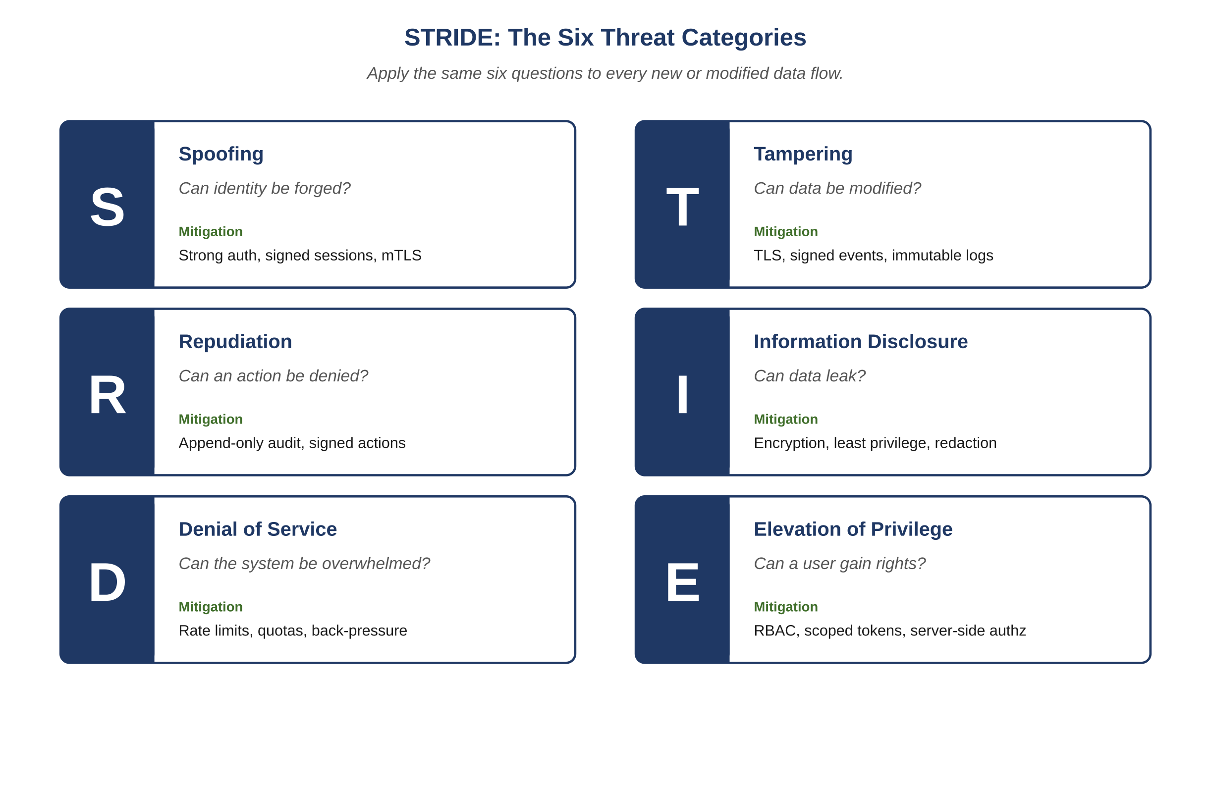
Figure 14.1 — STRIDE: the six threat categories
AI-Driven SDLC — A Federated Framework

Slide 4
STRIDE
Chapter 14
Spoofing: pretending to be someone you are not
Tampering: modifying data or code in flight
Repudiation: denying actions you took
Information disclosure: leaking data to unauthorized parties
Denial of service: making the system unavailable
Elevation of privilege: gaining capabilities you should not have

Slide 5
Construction Beats Tests
Chapter 14
A test that confirms cross-tenant data is rejected: useful
A database constraint that prevents cross-tenant queries: better
Test-mitigated security depends on the test's correctness, coverage, and execution
Construction-mitigated security depends on none of those

Slide 6
The Meta-Surface
Chapter 14
Agents can be prompt-injected
Controllers can be bypassed
Memory can be poisoned with adversarial inputs
A security review covering only the application is a review of part of the system

Slide 7
Common Mistakes
Chapter 14 — patterns that look reasonable and aren't
Mitigating with tests rather than with construction
Skipping STRIDE because the system is internal
Treating the meta-surface as outside scope

Slide 8
Takeaway
Chapter 14 — Security
Security runs as a thread across stages rather than as a single late stage. STRIDE gives a domain-independent vocabulary. The meta-surface (agents, controller, memory) is itself attack surface and deserves the same discipline.

