Slide 1
Chapter 15
Performance
Part IV — Quality Concerns
AI-Driven SDLC — A Federated Framework

Slide 2
Learning Objectives
Chapter 15 — Performance
Apply tail latency (p99) rather than averages as the user-perceived metric
Enumerate the critical path explicitly and defend it
Use four levers: latency, persistence, caching, concurrency
Recognize when waivers indicate a budget is wrong, not just convenient

Slide 3
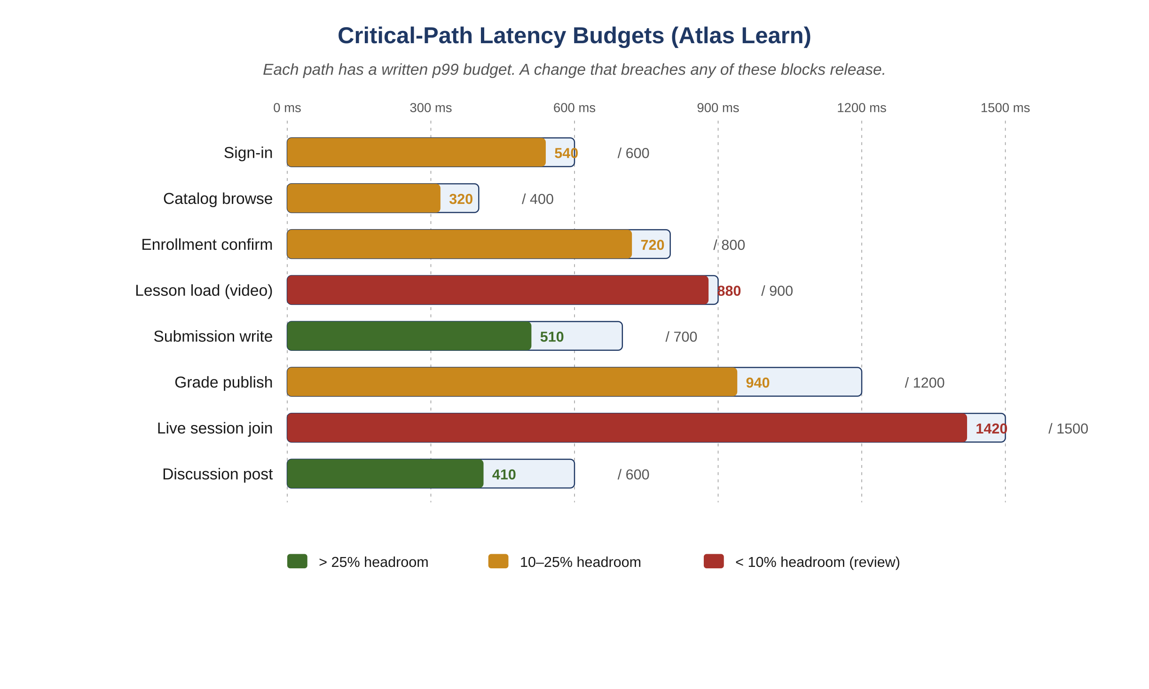
Figure 15.1 — Critical-path latency budgets (Atlas Learn)
AI-Driven SDLC — A Federated Framework

Slide 4
Tail Beats Median
Chapter 15
A 200ms median with a 5-second p99: 1% of users hit something close to broken
User-perceived performance lives in the tail
A team that schedules to median estimates will be slow most of the time
p99 is the default budget metric

Slide 5
Enumerate the Critical Path
Chapter 15
If every endpoint is critical, none of them are
List the operations user perception depends on (login, checkout, content load)
Set p50/p95/p99 budgets for each
Operations not on the critical path can degrade gracefully

Slide 6
Four Levers
Chapter 15
Latency: round-trip time, serialization, work per request
Persistence: write throughput, read latency, durability cost
Caching: hit rate, invalidation, staleness
Concurrency: parallelism, contention, queue depth

Slide 7
Waivers
Chapter 15
A documented waiver for a single regression is a tool
Five waivers on the same path within a quarter is a signal: budget is wrong, path is broken, or both
Continuing to issue waivers makes the situation worse
The recurring pattern is the diagnostic

Slide 8
Common Mistakes
Chapter 15 — patterns that look reasonable and aren't
Optimizing average latency rather than tail
Treating the critical path as everything
Letting waivers accumulate

Slide 9
Takeaway
Chapter 15 — Performance
The critical path needs to be enumerated and defended explicitly. A regression on the critical path should never ship without a written, time-bounded waiver. Latency, persistence, caching, and concurrency are the four main levers.

