Slide 1
Chapter 16
Observability
Part IV — Quality Concerns
AI-Driven SDLC — A Federated Framework

Slide 2
Learning Objectives
Chapter 16 — Observability
Identify the four observability axes: logs, traces, metrics, agent decision logs
Treat decision logs as a typed first-class artifact, not ordinary application logs
Recognize when observability has been instrumented as ceremony rather than as signal
Instrument observability at design time, not in postmortem

Slide 3
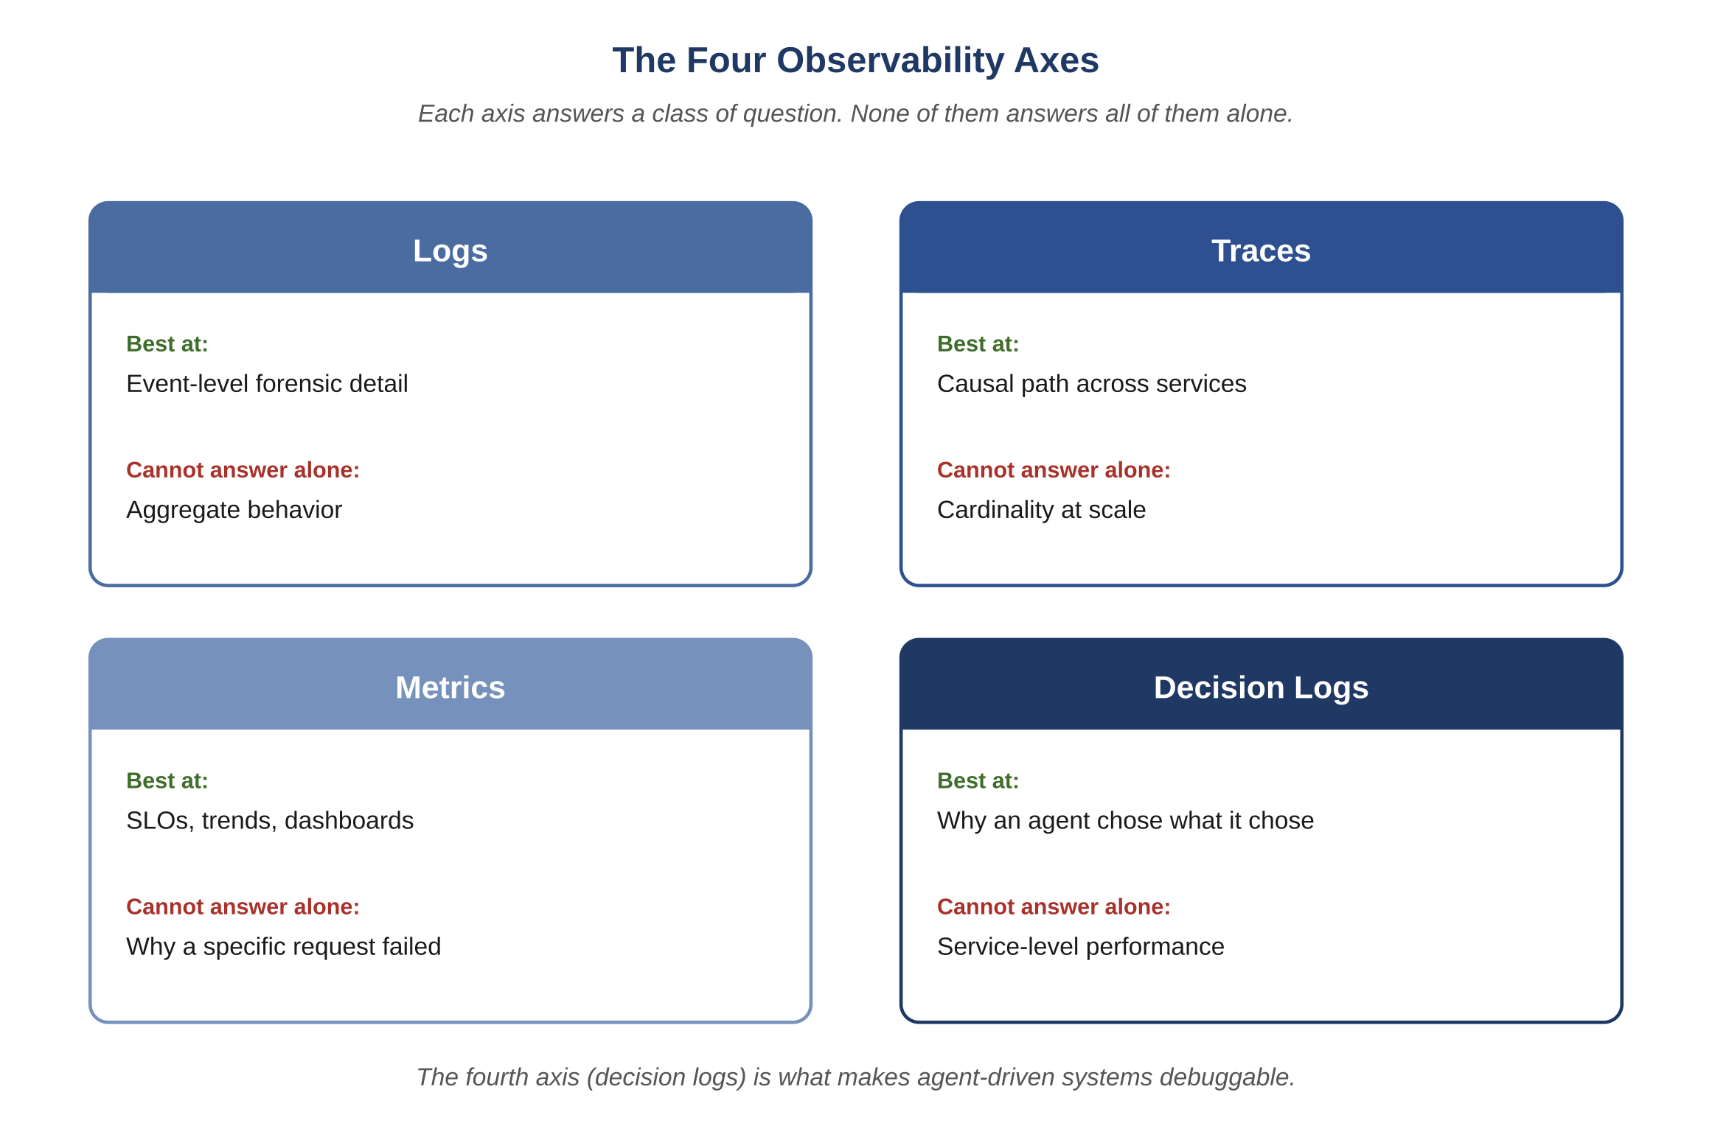
Figure 16.1 — The four observability axes
AI-Driven SDLC — A Federated Framework

Slide 4
Four Axes
Chapter 16
Logs: discrete events with structured fields
Traces: spans connecting events across services
Metrics: aggregated time-series numbers
Agent decision logs: structured records of why an agent decided what it did

Slide 5
Decision Logs as a Typed Artifact
Chapter 16
Decision logs need their own schema, retention, query path
Mixing them into application log streams produces data that exists but is operationally unreachable
The question "why did the agent decide X?" must be queryable in seconds
The fourth axis is what separates a debuggable agentic system from one reconstructed by guesswork

Slide 6
High Signal, Not High Volume
Chapter 16
High-cardinality metric labels explode dashboard cost
Verbose logs drown signal in noise
Full traces sampled at 100% are unaffordable at scale
The discipline is selectivity, not completeness

Slide 7
Design Time, Not Postmortem
Chapter 16
Each new endpoint, agent, memory artifact gets observability instrumented at design time
Post-incident instrumentation captures the lesson but doesn't prevent the next incident
Pre-incident instrumentation reduces incident frequency

Slide 8
Common Mistakes
Chapter 16 — patterns that look reasonable and aren't
Treating decision logs as ordinary application logs
Logging everything for safety
Adding observability after the incident

Slide 9
Takeaway
Chapter 16 — Observability
The four axes are logs, traces, metrics, and agent decision logs. Each release should preserve or improve them. The fourth axis separates a debuggable agentic system from one where production behavior is reconstructed by guesswork.

