Slide 1
Chapter 17
Failure and Recovery
Part V — Operating the System
AI-Driven SDLC — A Federated Framework

Slide 2
Learning Objectives
Chapter 17 — Failure and Recovery
Identify the five recurring classes of failure: agent, output, context, dependency, operational
Design recovery in advance, not during the incident
Apply bounded retries as discipline that surfaces failures rather than masking them
Treat patterns of "retries fix it" as structural signals, not isolated incidents

Slide 3
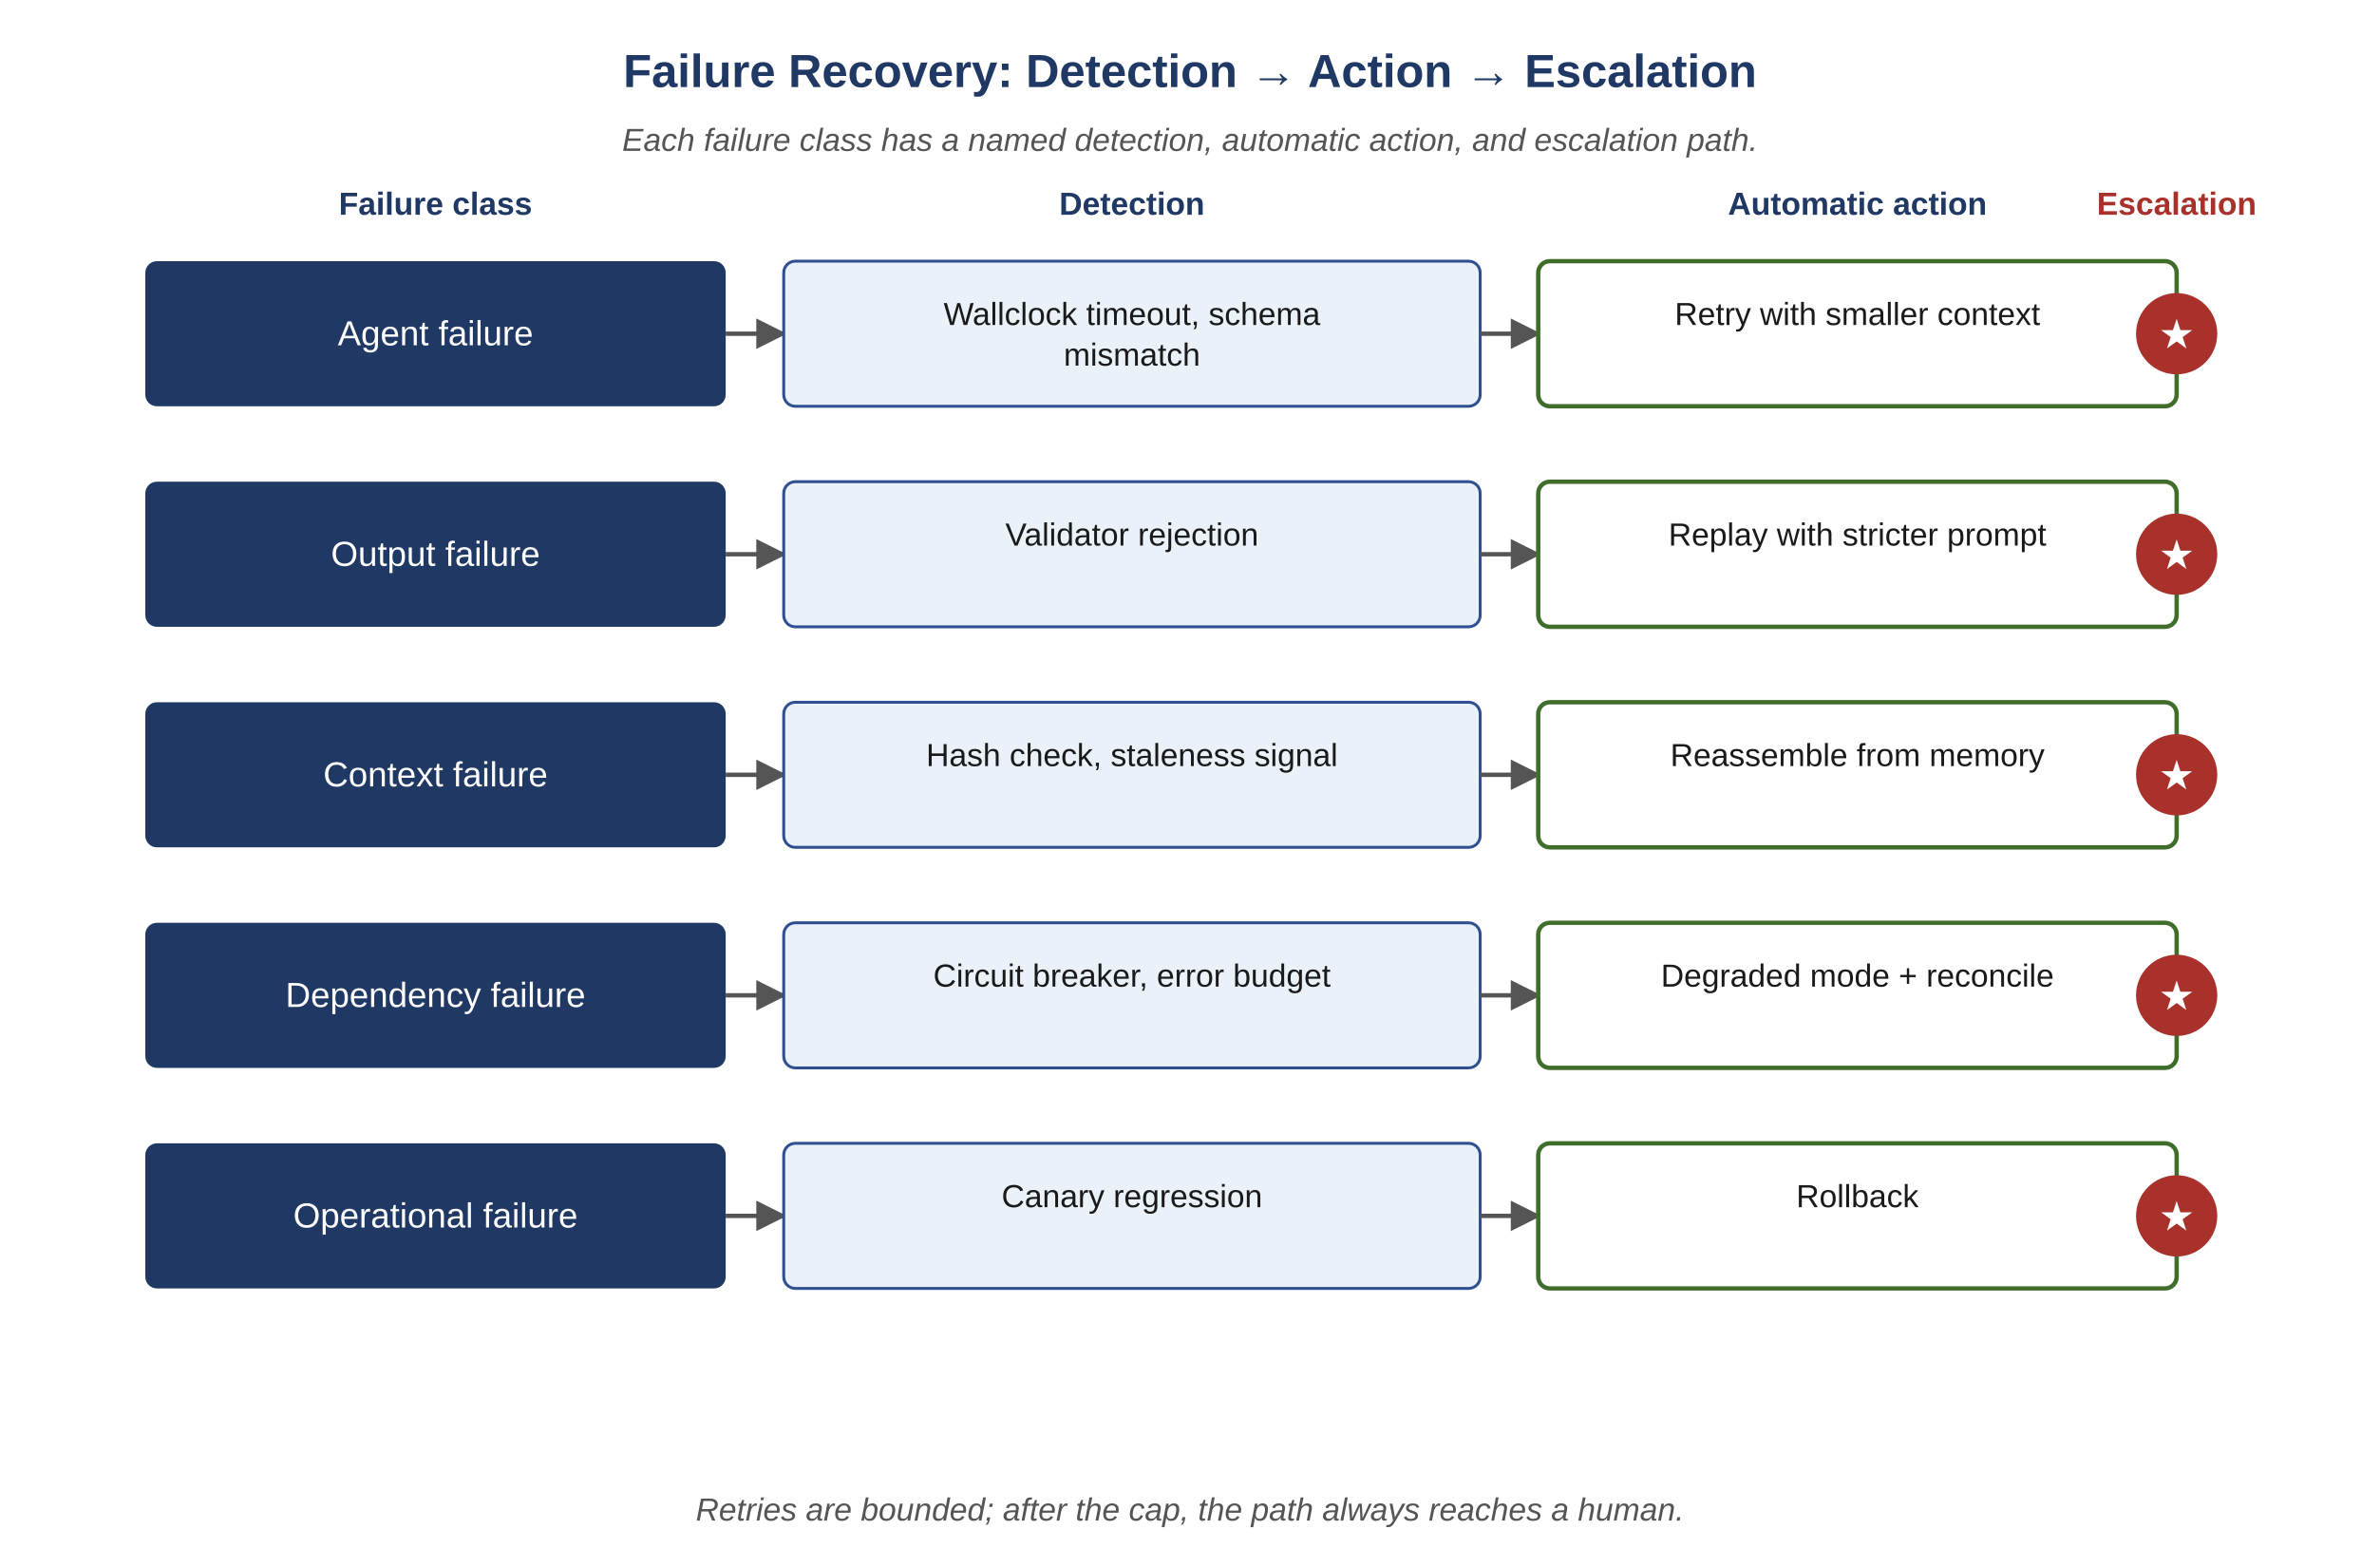
Figure 17.1 — Failure recovery: detection, action, escalation
AI-Driven SDLC — A Federated Framework

Slide 4
Five Failure Classes
Chapter 17
Agent failure: the agent itself produces no output or an error
Output failure: the agent produces output that is wrong
Context failure: the input data was wrong or stale
Dependency failure: an external service is unavailable
Operational failure: deploy went wrong, infrastructure outage

Slide 5
Recovery Designed in Advance
Chapter 17
Incidents are the worst time to design recovery
Incomplete information, time pressure, partial state, ad hoc decisions
Improvised recovery typically produces secondary incidents
Recovery designed in advance, even imperfectly, holds up better

Slide 6
Bounded Retries Are Discipline
Chapter 17
Removing the bound feels like reliability; it is the opposite
The bound surfaces real failures rather than absorbing them as cost runaways
A team that "fixes" the bound has chosen to make every transient failure invisible
The seat-overrun bug had this exact early signature

Slide 7
Common Mistakes
Chapter 17 — patterns that look reasonable and aren't
Improvising recovery during an incident
Treating bounded retries as a bug to be removed
Closing tickets without postmortem when retries fix them

Slide 8
Takeaway
Chapter 17 — Failure and Recovery
Five recurring failure classes, each with detection, automatic action, and escalation rule. Recovery works best when designed in advance. The tracker enables resumption; the controller bounds retries; the Validator catches what no single agent notices.

