Slide 1
Chapter 18
Cost Economics
Part V — Operating the System
AI-Driven SDLC — A Federated Framework

Slide 2
Learning Objectives
Chapter 18 — Cost Economics
Identify the four cost components: model, infrastructure, human oversight, failure
Measure end-to-end cost per task, not unit cost per token
Recognize that optimizing one component pushes others up
Plan for front-loaded investment paying back over a long tail

Slide 3
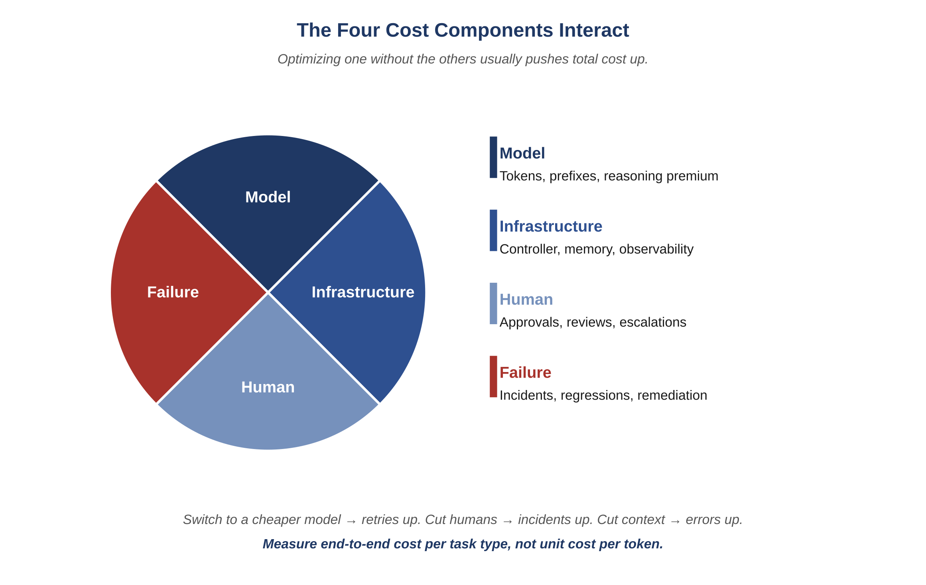
Figure 18.1 — The four cost components
AI-Driven SDLC — A Federated Framework

Slide 4
Four Components
Chapter 18
Model: vendor invoice, the visible line
Infrastructure: compute, storage, network
Human oversight: engineer time on review, escalation, postmortem
Failure: incidents, customer impact, secondary effects

Slide 5
Don't Optimize One in Isolation
Chapter 18
A 30% drop in unit cost from a cheaper model can be wiped out by retry rate
Switching models without measuring end-to-end cost is gambling
The model line is the most visible because it has an invoice
The other three are usually larger combined and almost always more strategic

Slide 6
Failure Cost Belongs in the Dashboard
Chapter 18
On-call rotation budget rising as the team grows: that's failure cost
Hiding it in HR or operations budgets produces decisions that look right and aren't
Customer impact and secondary incidents are part of the failure cost too
A cost dashboard with only model and infrastructure is missing half the picture

Slide 7
Front-Loaded Investment
Chapter 18
The framework's disciplines cost engineering time before they pay back
Payback comes in reduced incidents, faster postmortems, smoother audits
Teams that skip the disciplines: cheap first quarter, expensive fourth
Teams that invest: more upfront, recoup over the long tail

Slide 8
Common Mistakes
Chapter 18 — patterns that look reasonable and aren't
Switching to a cheaper model based on unit cost alone
Hiding failure cost in the on-call rotation budget
Treating model cost as the whole cost story

Slide 9
Takeaway
Chapter 18 — Cost Economics
Four cost components together set the actual operating cost. Optimizing one in isolation tends to push the others up. The right unit of measurement is end-to-end cost per task. Disciplines front-load investment and pay back across the long tail.

