Slide 1
Chapter 19
Maturity Model
Part V — Operating the System
AI-Driven SDLC — A Federated Framework

Slide 2
Learning Objectives
Chapter 19 — Maturity Model
Identify the five maturity levels: Ad Hoc, Shared Practice, Codified, Federated, Adaptive
Honestly assess a team's current level
Sequence adoption rather than attempting all levels at once
Recognize what the team has stopped being willing to skip as the indicator of progress

Slide 3
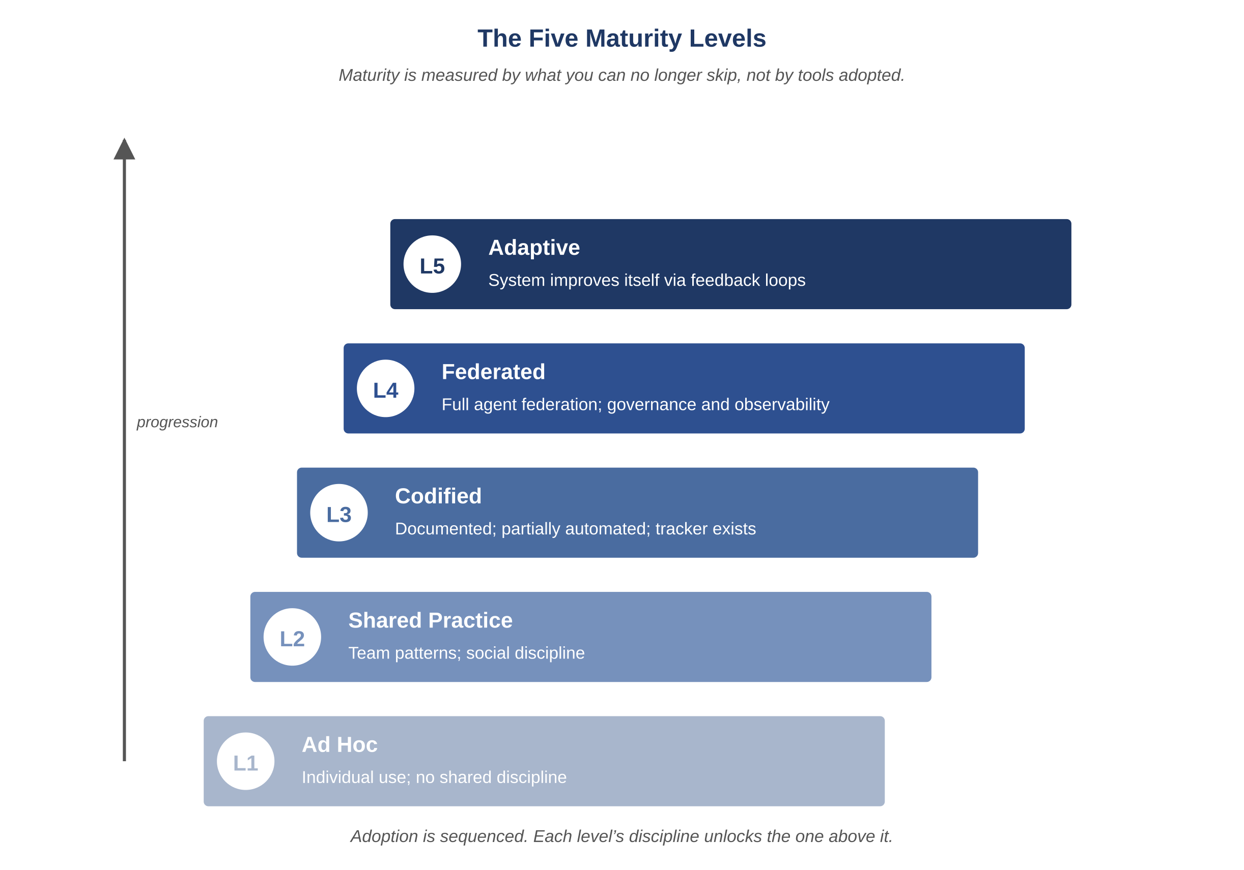
Figure 19.1 — The five maturity levels
AI-Driven SDLC — A Federated Framework

Slide 4
Five Levels
Chapter 19
Level 1 (Ad Hoc): each engineer does it differently
Level 2 (Shared Practice): team conventions, undocumented
Level 3 (Codified): conventions documented, mostly followed
Level 4 (Federated): disciplines practiced reflexively, no exceptions tolerated
Level 5 (Adaptive): the team improves the framework itself

Slide 5
Honest Assessment
Chapter 19
Most teams overestimate their level by one
Having artifacts in place is necessary but not sufficient for Level 4
The honest test: are disciplines practiced reflexively, or only when convenient?
Mixed-level teams are common: Level 4 on tracker, Level 2 on cost telemetry

Slide 6
Sequenced Adoption
Chapter 19
Big-bang adoption produces partial completion of every discipline, none fully landed
Phases exist because each output is the next phase's input
Memory artifacts before the tracker; tracker before Auditor; Auditor before approval gates
Trying to do them in parallel produces a process nobody owns

Slide 7
The Progress Indicator
Chapter 19
Not what new tools have been added
What the team has stopped being willing to skip
The stop-skipping indicator captures whether discipline is reflexive
Tools without stopped-skipping is theater

Slide 8
Common Mistakes
Chapter 19 — patterns that look reasonable and aren't
Adopting all five levels in one quarter
Buying the tooling before doing the discipline
Calling yourself Level 4 because the artifacts exist

Slide 9
Takeaway
Chapter 19 — Maturity Model
Five levels: ad hoc, shared practice, codified, federated, adaptive. Most teams travel them in roughly that order. Adoption needs to be sequenced. The most reliable indicator of progress is what the team has stopped being willing to skip.

