Slide 1
Chapter 20
Domain Application Patterns
Part V — Operating the System
AI-Driven SDLC — A Federated Framework

Slide 2
Learning Objectives
Chapter 20 — Domain Application Patterns
Apply the framework's skeleton to a domain not covered in the textbook
Distinguish domain-independent structure from domain-specific specifics
Re-derive invariants for a new domain rather than copying
Recognize that judgment is domain-specific even when tooling is portable

Slide 3
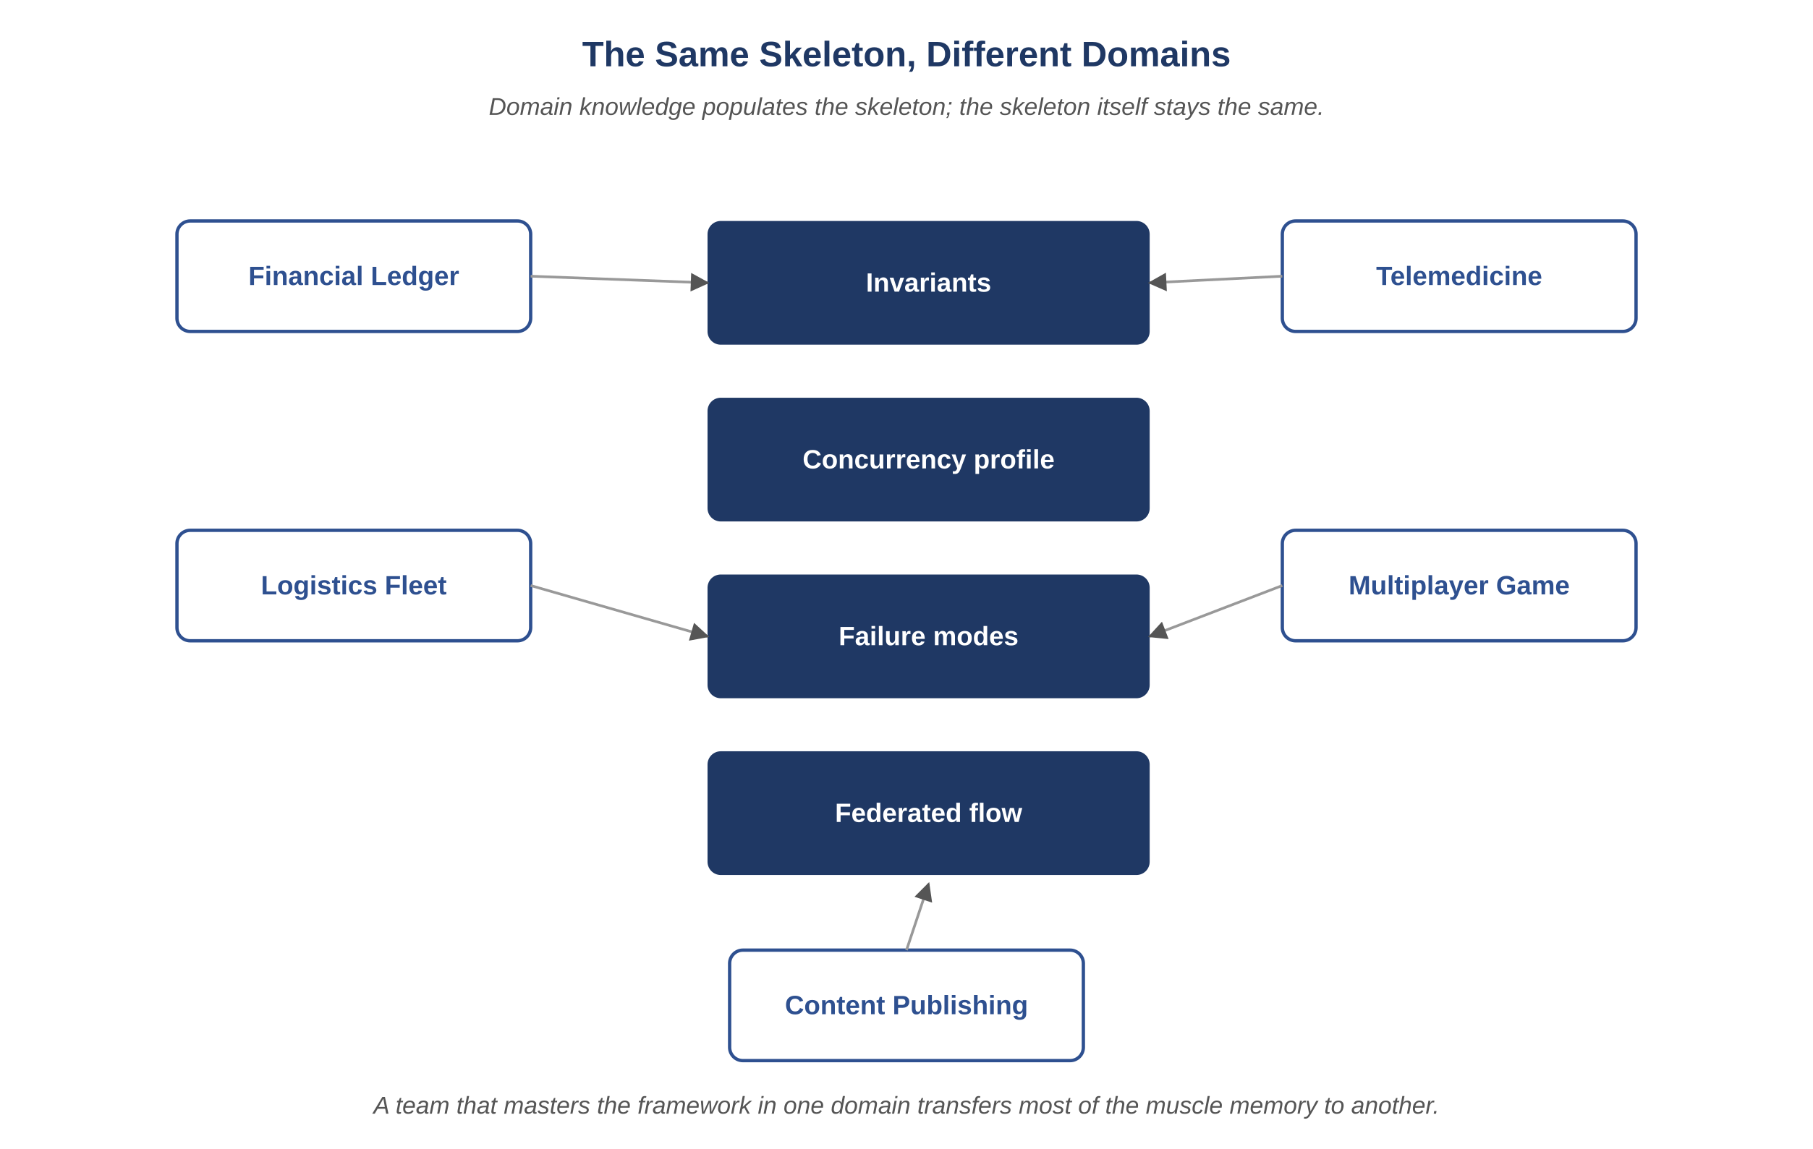
Figure 20.1 — The same skeleton, different domains
AI-Driven SDLC — A Federated Framework

Slide 4
The Skeleton Is Portable
Chapter 20
Four layers, eight agents, the loop, the tracker, the four observability axes
These recur across banking, healthcare, logistics, gaming, content publishing
Domain-independent because they're about how engineering work is structured
Not portable: the specific contracts, the specific invariants, the specific failure modes

Slide 5
Re-Derive, Don't Copy
Chapter 20
Atlas Learn has ten invariants — not because ten is right, but because the system has ten
A new domain has its own count, derived from what the system must preserve
Copying invariants from another domain produces a list that looks like rigor and isn't
Each invariant must come from the actual domain properties

Slide 6
Tooling vs. Judgment
Chapter 20
Tooling (tracker schema, prompt library structure, controller patterns) ports across domains
Judgment (what to record, what to prompt for, what to validate) is domain-specific
A team that ports tooling without re-developing judgment: working tools, broken outputs
The framework's value is in the judgment, not just the artifacts

Slide 7
Common Mistakes
Chapter 20 — patterns that look reasonable and aren't
Skipping the skeleton because "our domain is special"
Copying another domain's invariants without re-deriving
Treating tooling as the transferable part

Slide 8
Takeaway
Chapter 20 — Domain Application Patterns
The framework recurs with similar shape across domains. What changes is the specifics: invariants, concurrency profiles, failure modes. A team that has worked through it in one domain typically gets to working competence in the next much faster than a team starting from scratch.

