Slide 1
Chapter 23
Final Principles
Part VI — Reflection
AI-Driven SDLC — A Federated Framework

Slide 2
Learning Objectives
Chapter 23 — Final Principles
Recall the ten final principles as a minimum set, not a menu
Apply principles in actual decisions, not on a poster
Revisit principles annually as the team grows
Identify the weakest stage and address it iteratively

Slide 3
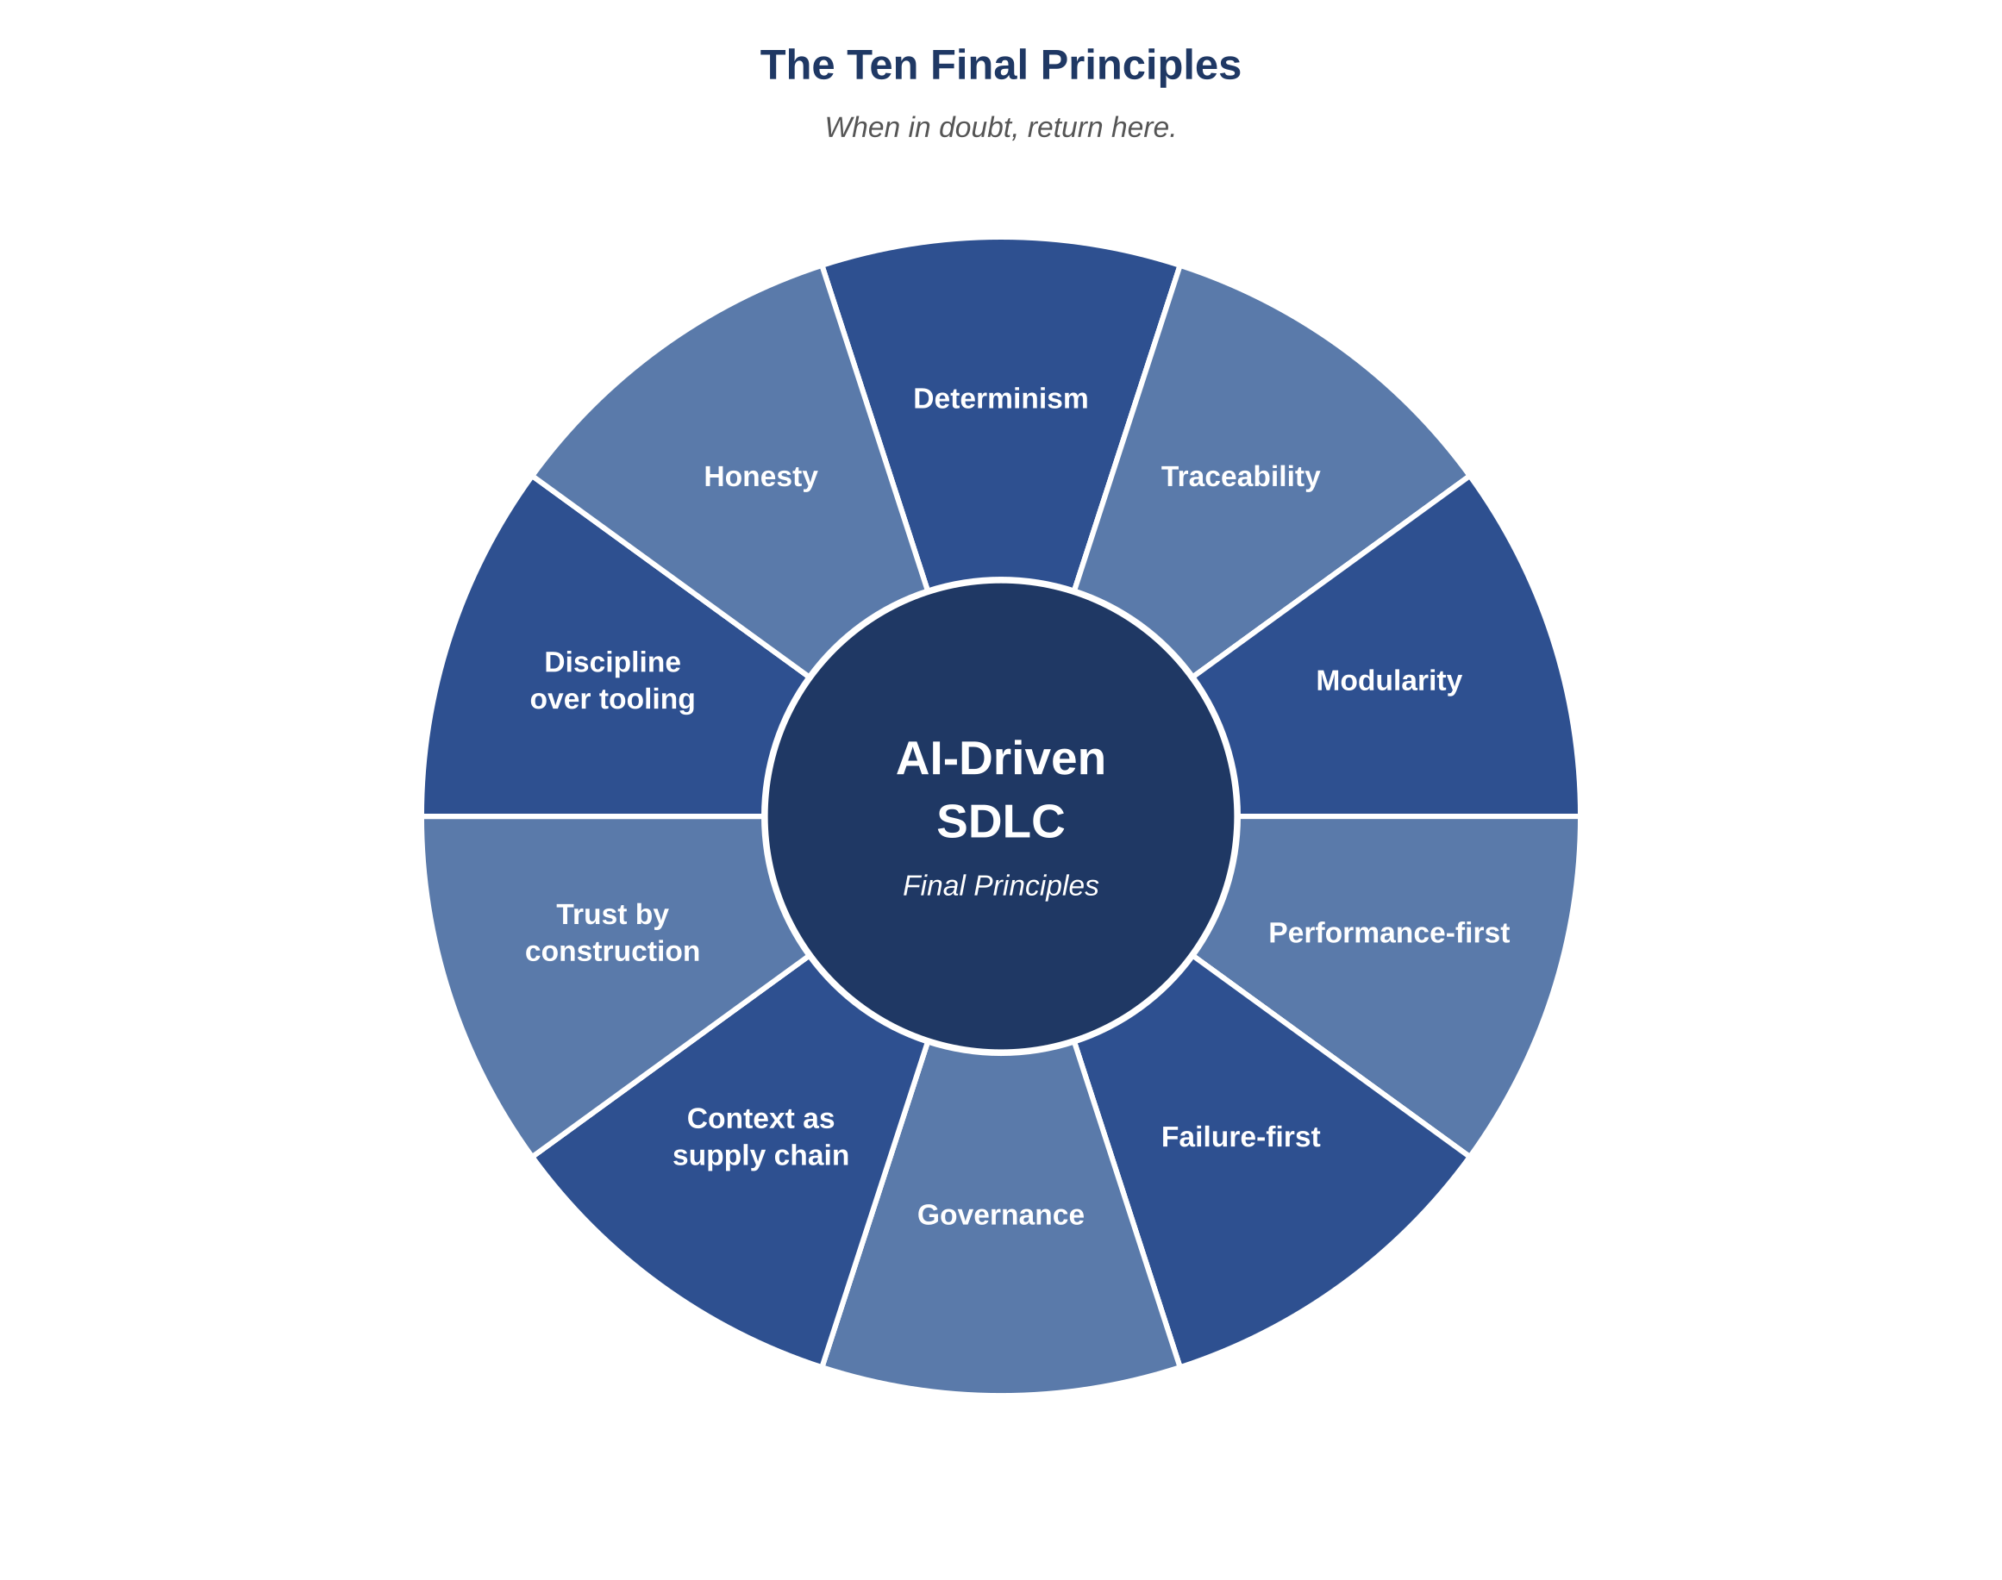
Figure 23.1 — The ten final principles
AI-Driven SDLC — A Federated Framework

Slide 4
Principles as Minimum Set
Chapter 23
The ten principles are not a menu to pick from
A team that excels at determinism and traceability while neglecting failure-first thinking has a debuggable system that does not survive its own incidents
Picking favorites is itself a failure mode

Slide 5
In Operation, Not on a Poster
Chapter 23
A poster of "We Believe In These Ten Principles" is a poster
Principles in operation: which design is approved, which trade-off is accepted, which release is blocked
The discipline is whether principles surface in actual decisions
A poster without operation is decoration

Slide 6
Revisit Annually
Chapter 23
Principles that worked at fifteen engineers may not work at fifty
Growth changes communication patterns, decision speed, audit needs
Annual re-read with the question: does the team's actual operation reflect the principles?
Without that audit, principles drift silently

Slide 7
The Long-Run Value
Chapter 23
A system fails at its weakest stage
Identify which stage that is. Address it.
Identify the new weakest stage. Address that.
The framework is more elaborate than this in detail, but most of its long-run value comes from doing this one thing repeatedly.

Slide 8
Common Mistakes
Chapter 23 — patterns that look reasonable and aren't
Picking a favorite principle and ignoring the rest
Treating principles as a quality stamp
Not revisiting principles when the team grows

Slide 9
Takeaway
Chapter 23 — Final Principles
A system fails at its weakest stage. The most reliable way to improve it is to identify which stage that currently is and address it. Then identify the new weakest stage and address that. Most of the framework's long-run value comes from doing this one thing repeatedly.

