Slide 1
Chapter 3
Federation of Lifecycles
Part I — Foundations
AI-Driven SDLC — A Federated Framework

Slide 2
Learning Objectives
Chapter 3 — Federation of Lifecycles
Name the seven lifecycles and the work each one owns
Explain why federation differs structurally from a pipeline
Identify backward edges in real engineering workflows
Recognize the cost of skipping a lifecycle

Slide 3
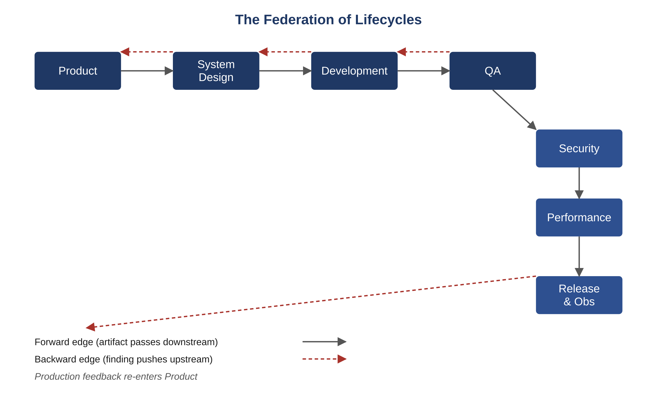
Figure 3.1 — The federation of lifecycles
AI-Driven SDLC — A Federated Framework

Slide 4
Seven Lifecycles
Chapter 3
Product (what to build)
System Design (architecture and contracts)
Development (the implementation)
QA (failure-first testing)
Security (threat modeling and defense)
Performance (latency and resource budgets)
Release & Observability (rollout and operational signals)

Slide 5
Federation, Not Pipeline
Chapter 3
Pipeline framing implies one direction: Product → Design → Dev → QA → ...
Reality: work bounces among lifecycles repeatedly
A QA finding that requires changing a contract bounces back to Design
A performance regression bounces back to Development
These are normal operation, not exceptions

Slide 6
Backward Edges
Chapter 3
A backward edge is work flowing from downstream to upstream
Healthy: QA bounces a finding back to Design with the invariant cited
Unhealthy: QA patches locally without notifying Design — contracts now inconsistent
The discipline is to record backward edges as artifacts, not just as conversations

Slide 7
Skipped Lifecycles
Chapter 3
Every skipped lifecycle's work still has to happen
Skipping is deferral, often to an incident
A team that skips Performance until something is slow has chosen to discover the budget by exceeding it
A team that skips Security until something is breached has the same pattern

Slide 8
Common Mistakes
Chapter 3 — patterns that look reasonable and aren't
Treating the seven lifecycles as one pipeline
Skipping a lifecycle because "we don't need it yet"
Not recording the backward edges

Slide 9
Takeaway
Chapter 3 — Federation of Lifecycles
There are seven lifecycles, each with its own inputs, outputs, and exit criteria. Feedback edges are part of normal operation. Development is the engine; the other six are what keep the engine pointed at the road.

