Slide 1
Chapter 4
Four-Layer System Architecture
Part I — Foundations
AI-Driven SDLC — A Federated Framework

Slide 2
Learning Objectives
Chapter 4 — Four-Layer System Architecture
Identify the four layers (Memory, Controller, Agents, Artifacts) and what each owns
Explain why all cross-layer interactions go through the controller
Recognize when a proposed change would require a "fifth layer" and what to do instead
Apply the architecture to a small system end-to-end

Slide 3
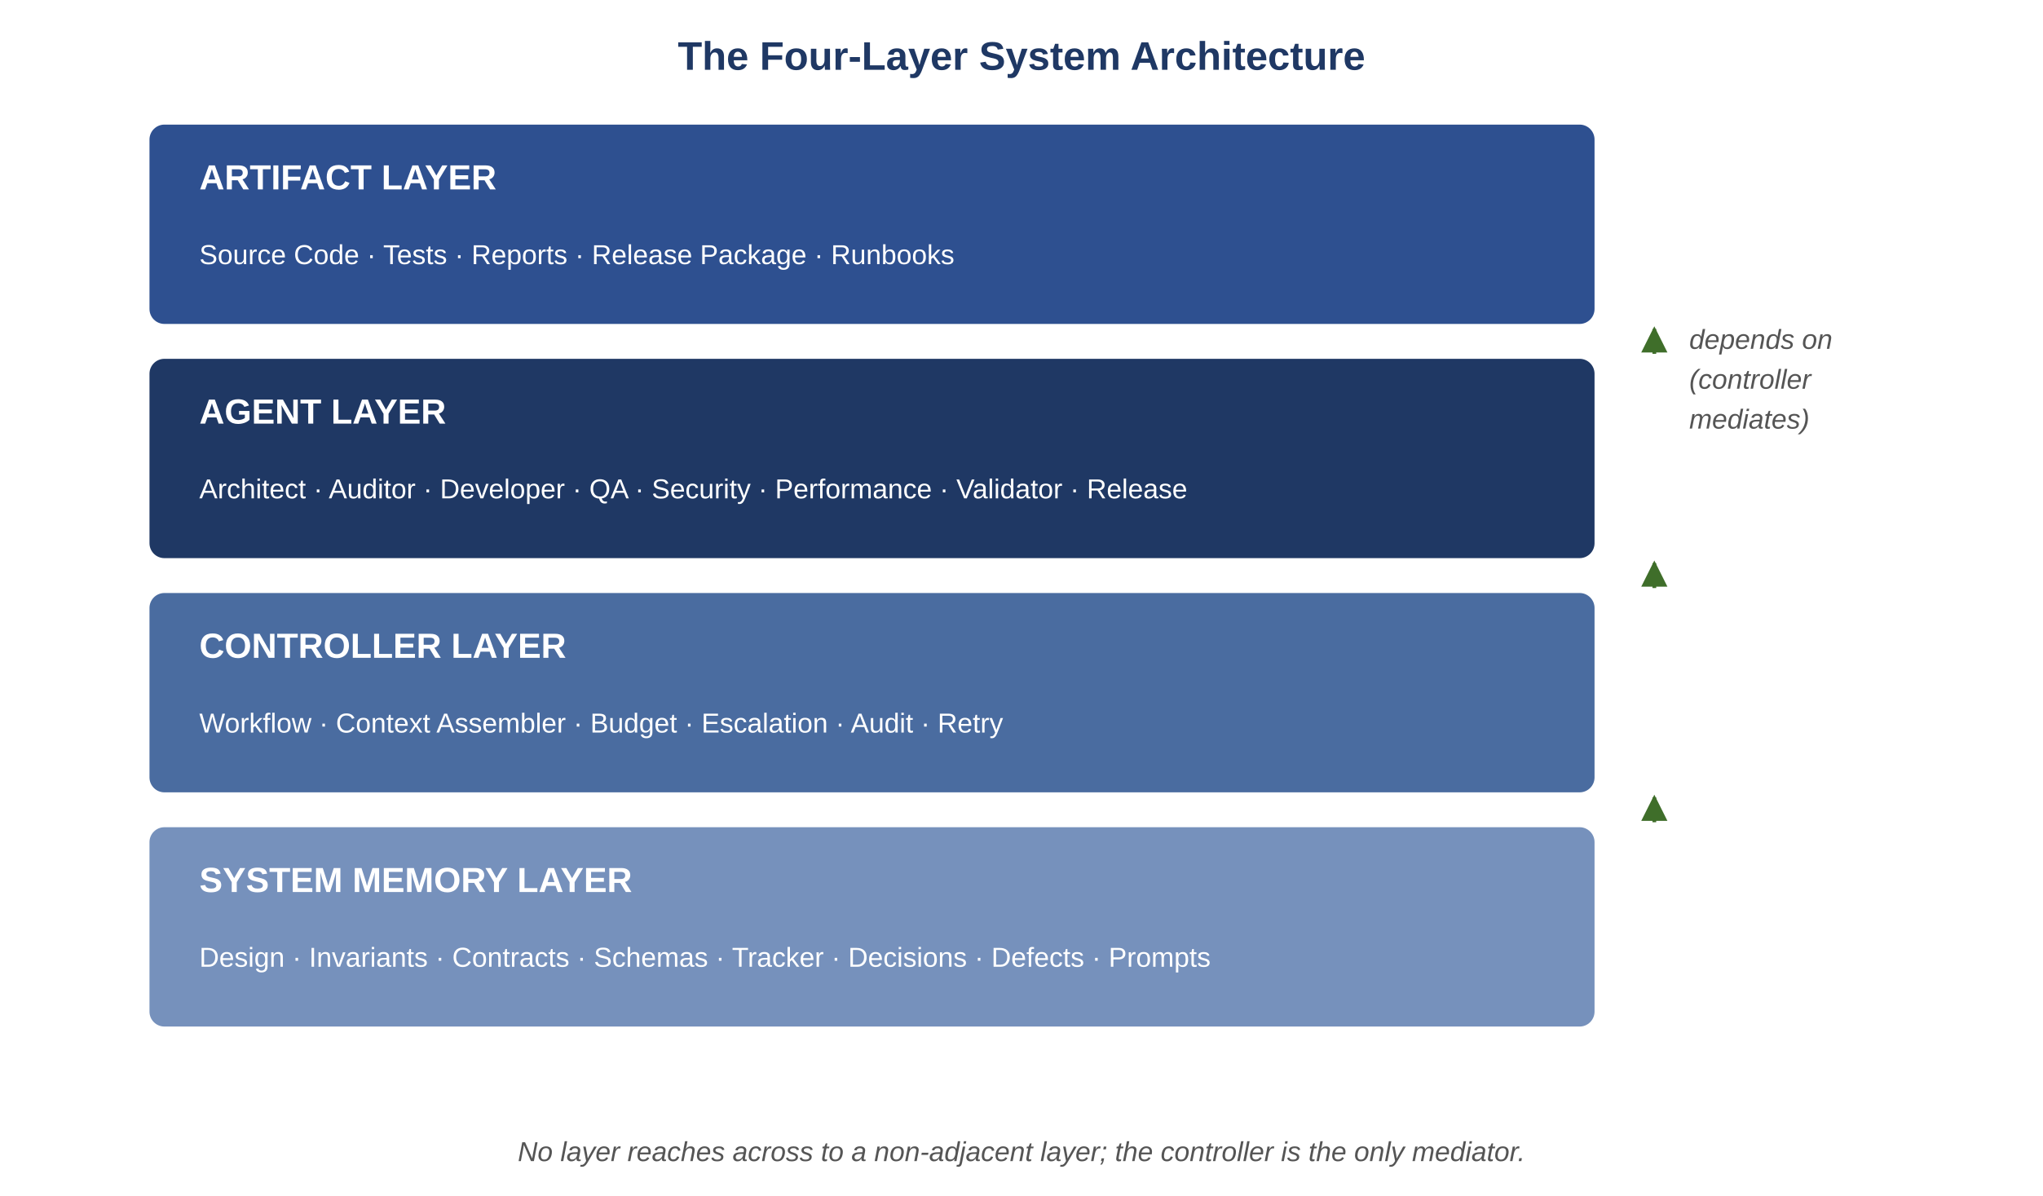
Figure 4.1 — The four-layer system architecture
AI-Driven SDLC — A Federated Framework

Slide 4
The Four Layers
Chapter 4
Memory: tracker, prompt context, agent decision logs, the system's working state
Controller: the chokepoint where retries are bounded, transitions are decided, audit is written
Agents: the eight named roles that produce structured outputs
Artifacts: the products of the engineering work — code, designs, tests, contracts

Slide 5
Controller as Chokepoint
Chapter 4
The controller mediates every cross-layer interaction
Agents do not reach into memory directly
Agents do not call other agents directly
The controller bounds retries, decides transitions, writes audit
A controller that "just forwards" has lost what justified having it

Slide 6
Why the Constraint Pays Off
Chapter 4
Audit trail completeness: every cross-layer operation recorded
Bounded retries: the controller decides when to give up
Replaceability: any single layer can change without rewriting others
Resumability: sessions resume from the tracker because the controller's decisions are recorded

Slide 7
When Something Doesn't Fit
Chapter 4
Temptation: invent a fifth layer to handle the special case
Honest answer: the special case usually belongs inside one of the four
A fifth layer is typically a workaround, not a refinement
Identify which existing layer the case belongs in and extend that layer's capability

Slide 8
Common Mistakes
Chapter 4 — patterns that look reasonable and aren't
"Just this once" cross-layer reads bypassing the controller
Treating the controller as a passing-through router
Adding a fifth layer for a special case

Slide 9
Takeaway
Chapter 4 — Four-Layer System Architecture
The four layers are Memory, Controller, Agents, Artifacts. The controller mediates every cross-layer interaction. The value of this constraint shows up in audit, debugging, and replaceability — and is most visible when one layer's technology changes without disturbing the others.

