Slide 1
Chapter 5
Context as Supply Chain
Part II — Operating Disciplines
AI-Driven SDLC — A Federated Framework

Slide 2
Learning Objectives
Chapter 5 — Context as Supply Chain
Apply the supply-chain lens to context flow in an AI system
Identify provenance, layering, minimization, and invalidation as discipline requirements
Recognize when a context is too large rather than too small
Diagnose stale-context bugs in deployed systems

Slide 3
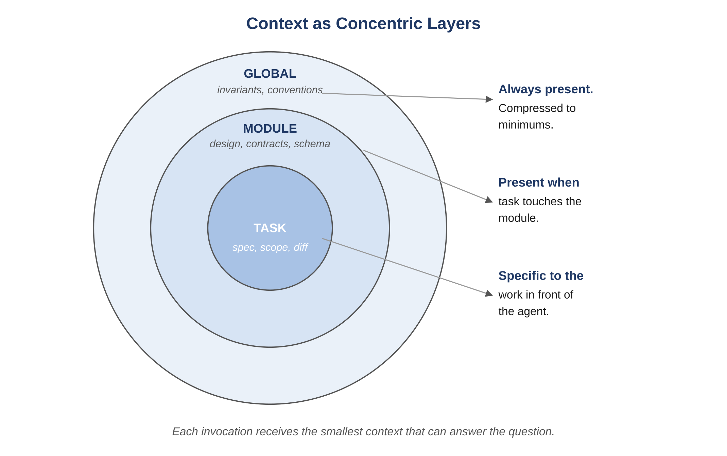
Figure 5.1 — Context as concentric layers
AI-Driven SDLC — A Federated Framework

Slide 4
Context Has Provenance
Chapter 5
Every piece of context comes from somewhere: an artifact, a prior turn, a human input
Provenance lets you trace why an agent decided what it did
Without provenance, debugging requires guesswork

Slide 5
More Context Is Often Worse
Chapter 5
Models reason worse over noise
Most "more context" ends up being noise
The discipline is minimization, not accumulation
Inlining a 2,800-line file when an ID would suffice is a token-cost incident waiting to happen

Slide 6
Layering and Minimization
Chapter 5
Different sources stack: system prompt, role spec, task input, prior turns, retrieved context
Each layer should justify its presence
If a layer doesn't change the output, drop it

Slide 7
Invalidation: The Hardest Discipline
Chapter 5
When upstream artifacts change, downstream context must be invalidated
A schema change ships, the contract is updated, the cached context is now stale
Without invalidation: subsequent agent invocations operate on stale context for hours or days
The invalidation discipline is part of the supply chain, not optional polish

Slide 8
Common Mistakes
Chapter 5 — patterns that look reasonable and aren't
"More context = better outputs" (the inverse is usually true)
Inlining whole files when an ID would suffice
Not invalidating context when upstream artifacts change

Slide 9
Takeaway
Chapter 5 — Context as Supply Chain
Context behaves like a supply chain: it has provenance, it gets layered, it needs minimization, and it requires invalidation when upstream changes. The quality of memory artifacts upstream sets a ceiling on agent output downstream.

