Slide 1
Chapter 6
Token Economics
Part II — Operating Disciplines
AI-Driven SDLC — A Federated Framework

Slide 2
Learning Objectives
Chapter 6 — Token Economics
Identify the four cost components and their interactions
Apply the five token disciplines (deltas, IDs, compression, adaptive verbosity, pruning)
Recognize when optimizing one cost component pushes another up
Measure end-to-end cost per task, not unit cost per token

Slide 3
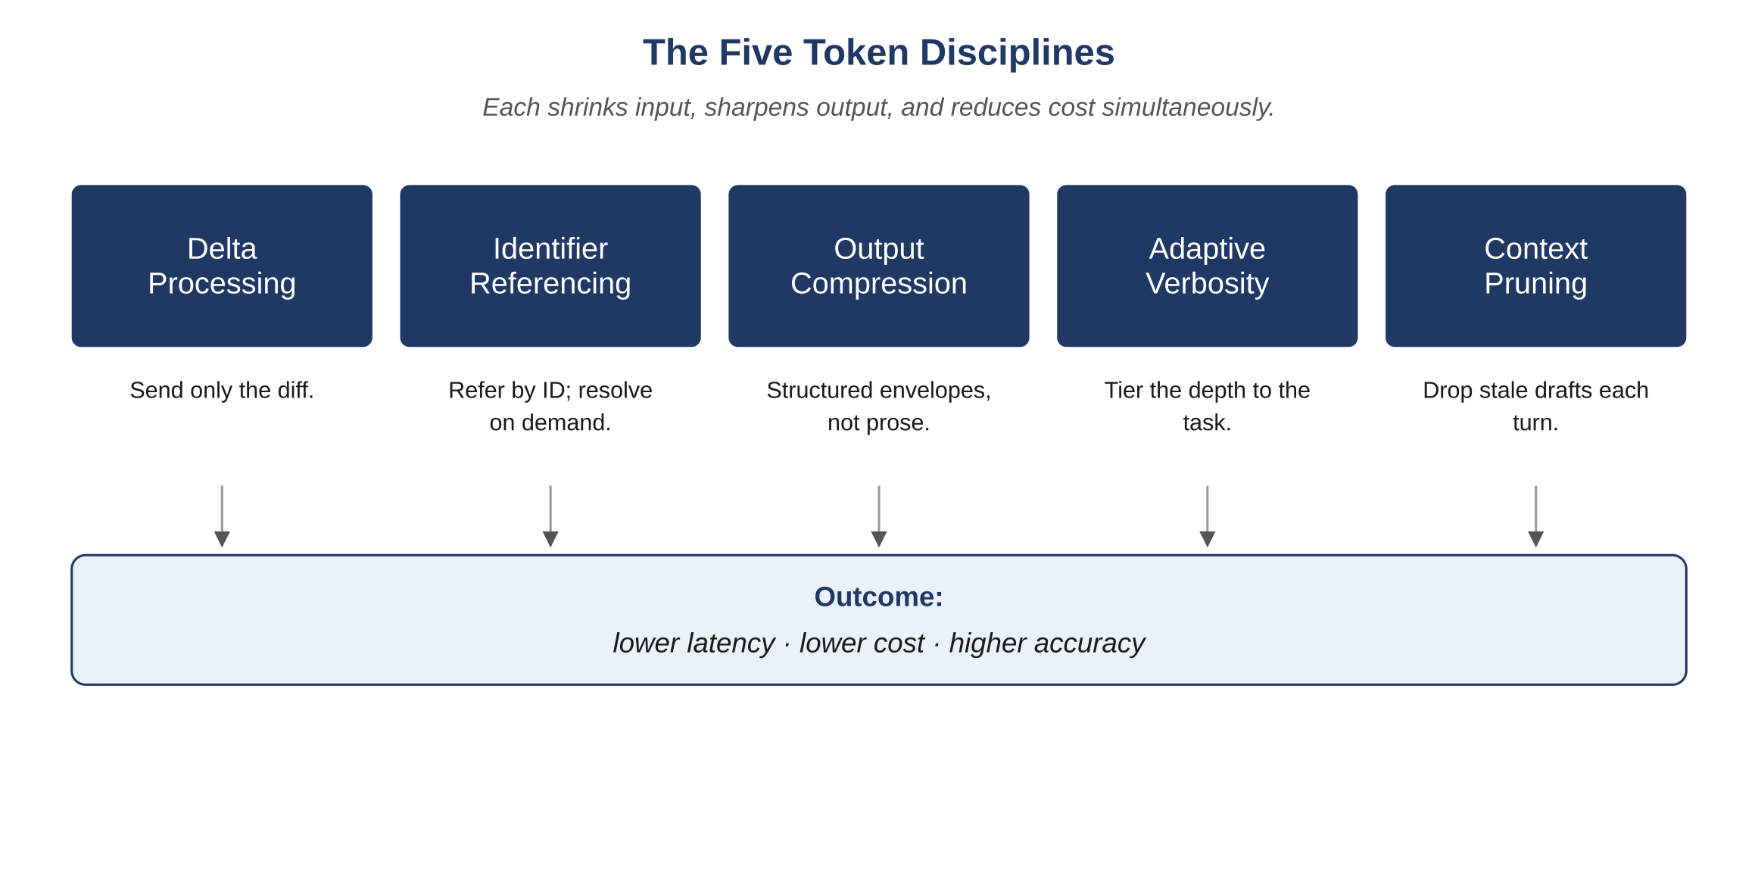
Figure 6.1 — The five token disciplines
AI-Driven SDLC — A Federated Framework

Slide 4
Five Token Disciplines
Chapter 6
Deltas: send what changed, not the whole artifact
IDs: reference artifacts by ID rather than inlining
Compression: structured summaries of long content
Adaptive verbosity: simple tasks at lower tier, complex tasks at higher
Pruning: remove context that isn't justifying its tokens

Slide 5
Token Discipline Correlates with Quality
Chapter 6
Both improve when context shrinks
Smaller, well-targeted context produces lower cost AND sharper outputs
Larger context produces more cost AND more noise
The correlation is structural: discipline in input produces discipline in result

Slide 6
Don't Optimize One Component in Isolation
Chapter 6
Switching to a cheaper model: model cost down, retry cost up, sometimes net higher
Adding caching: infrastructure cost up, model cost down
Default tier 4 verbosity "for safety": every task more expensive without quality gain
Measure end-to-end cost per task, not unit cost per token

Slide 7
Common Mistakes
Chapter 6 — patterns that look reasonable and aren't
Optimizing only model cost, ignoring other components
Setting verbosity tier 4 as default for safety
Sending whole files instead of deltas

Slide 8
Takeaway
Chapter 6 — Token Economics
Five disciplines: deltas, IDs, compression, adaptive verbosity, pruning. Token discipline and quality discipline correlate; both improve when context shrinks. Measure tokens per task type and use the data to target the next discipline to add.

