Slide 1
Chapter 7
Governance, Approvals, and Audit
Part II — Operating Disciplines
AI-Driven SDLC — A Federated Framework

Slide 2
Learning Objectives
Chapter 7 — Governance, Approvals, and Audit
Identify the three pillars of governance: role isolation, approval gates, audit trails
Distinguish P0/P1/P2 issues by their impact on release
Recognize when approval has decayed from gate to ceremony
Apply governance discipline without producing pure friction

Slide 3
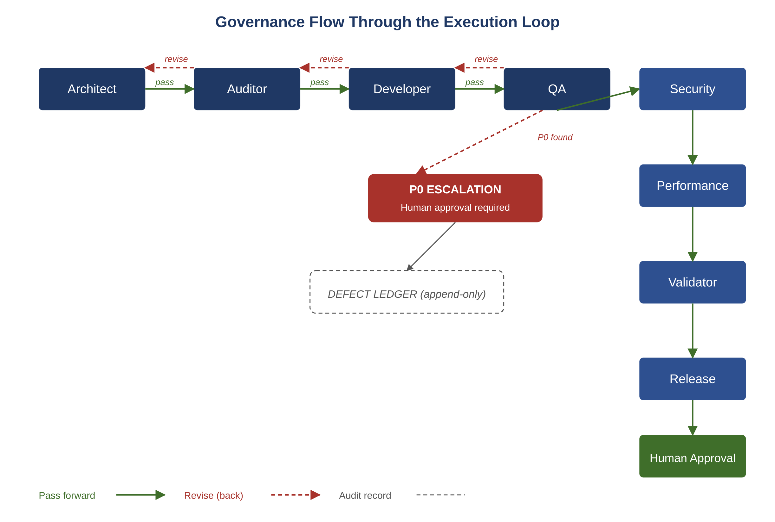
Figure 7.1 — Governance flow through the execution loop
AI-Driven SDLC — A Federated Framework

Slide 4
Three Pillars
Chapter 7
Role isolation: each agent or human has a defined role; no role does the work of another
Approval gates: explicit moments where a named approver must consent
Audit trails: every decision recorded with who, what, when, why

Slide 5
P0 / P1 / P2 Classification
Chapter 7
P0: blocks release; must be fixed before any deployment
P1: significant problem that must be addressed soon but doesn't block
P2: tracked but not urgent
Classification drives action: governance wires into priority

Slide 6
When Approval Decays
Chapter 7
The approver who "rubber-stamps" reviews has converted approval into ceremony
The gate exists in form but not in function
The first incident that should have been blocked at the gate reveals nothing was checked
Discipline: approvers must produce findings or explicitly state none found

Slide 7
Shadow Channels
Chapter 7
Side conversations, out-of-band approvals, "quick fixes" bypassing the recorded path
Each one is convenient in the moment
Cumulatively they make the audit trail fictional
The recorded history doesn't reflect what actually happened

Slide 8
Common Mistakes
Chapter 7 — patterns that look reasonable and aren't
Approving everything to avoid friction
Auto-promoting because the QA agent passed
Letting shadow channels grow because they're convenient

Slide 9
Takeaway
Chapter 7 — Governance, Approvals, and Audit
The three pillars are role isolation, approval gates, and audit trails. Governance is what enables a team to delegate confidently rather than constantly second-guessing. Issue classification (P0/P1/P2) wires governance into action.

