Slide 1
Chapter 8
Prompt Engineering as a Discipline
Part II — Operating Disciplines
AI-Driven SDLC — A Federated Framework

Slide 2
Learning Objectives
Chapter 8 — Prompt Engineering as a Discipline
Apply the canonical six-field prompt template (role, input, objective, constraints, output format, self-review)
Treat prompts as code: versioned, reviewed, evaluated, rollback-able
Recognize the failure mode of edited-in-place prompts
Build a prompt library that compounds over time

Slide 3
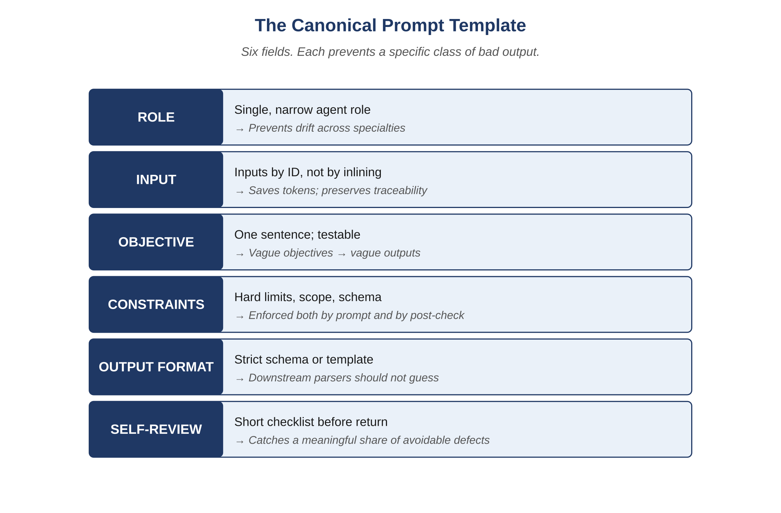
Figure 8.1 — The canonical prompt template
AI-Driven SDLC — A Federated Framework

Slide 4
Prompts Deserve What Code Deserves
Chapter 8
Versioning: every change recorded
Review: a second pair of eyes before merging
Evaluation: regression tests against held-out cases
Rollback: returning to a prior version is routine

Slide 5
The Canonical Six-Field Template
Chapter 8
Role: who the agent is acting as
Input: what data the agent receives
Objective: what the agent must produce
Constraints: what the agent must not do
Output format: the structure of the response
Self-review: the agent checks its own output

Slide 6
Why Each Field Matters
Chapter 8
Role focuses reasoning to the right context
Input separates data from instructions
Objective and Constraints are deliberately separate (the agent reasons about them separately)
Output format reduces post-processing variance
Self-review catches obvious errors before they propagate

Slide 7
Prompt Library Discipline
Chapter 8
Centralized directory, one file per agent role
Versioned in source control
CI checks that prompts conform to the template
Held-out evaluation set runs on every prompt change

Slide 8
Common Mistakes
Chapter 8 — patterns that look reasonable and aren't
Editing prompts in place without versioning
Mixing OBJECTIVE and CONSTRAINTS into one field
Friendly prose instead of structured fields

Slide 9
Takeaway
Chapter 8 — Prompt Engineering as a Discipline
Prompts deserve the same treatment as code: versioned, reviewed, evaluated, rolled back when they regress. The canonical six-field template gives the agent a shape it can satisfy reliably.

