Slide 1
Chapter 9
The Tracker
Part II — Operating Disciplines
AI-Driven SDLC — A Federated Framework

Slide 2
Learning Objectives
Chapter 9 — The Tracker
Identify the canonical tracker fields and explain why each one is included
Distinguish event-sourced (append-only) from mutable trackers
Apply tracker discipline to incident postmortems and audit responses
Recognize when a tracker has decayed from substrate to record-keeping

Slide 3
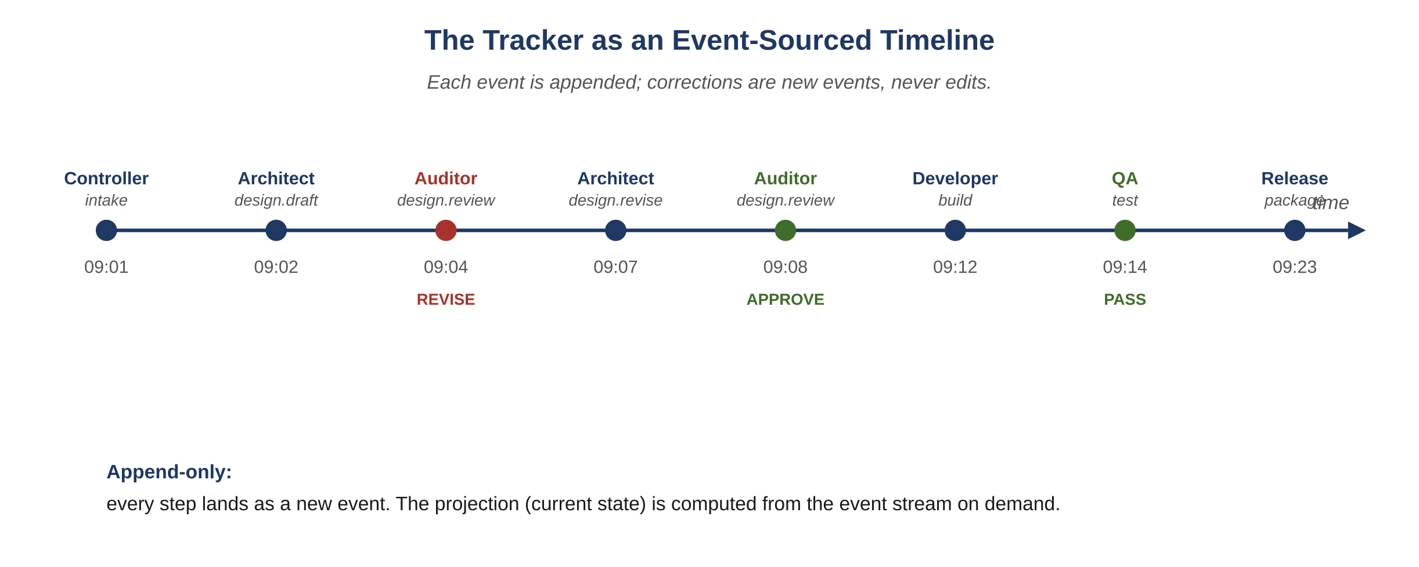
Figure 9.1 — The tracker as an event-sourced timeline
AI-Driven SDLC — A Federated Framework

Slide 4
Event-Sourced and Append-Only
Chapter 9
A tracker event is append-only
Corrections flow as new amendment events, not edits
In-place edits break the audit property
Question "what did the system know at time T?" must be reliably answerable

Slide 5
Canonical Fields
Chapter 9
ts (when), task_id (what work), agent + role (who)
stage, prompt_id (which prompt version), context_hash (state)
input_ids + output_ids (artifacts), decision + reason
tokens_in/out, duration_ms, model, verbosity_tier (cost telemetry)

Slide 6
Projection vs. Stream
Chapter 9
Stream of events is the source of truth
Projection is a fast read, derived from the stream
When they disagree (and over time, in any system, they will): rebuild projection from stream
Never the other way around

Slide 7
What the Tracker Enables
Chapter 9
Postmortems written from data, not memory
Audit responses queryable in seconds
Replay of past sessions deterministically
Resumption after crash, deploy, or pause

Slide 8
Common Mistakes
Chapter 9 — patterns that look reasonable and aren't
Editing tracker events to fix typos
Treating the projection as authoritative
Skipping the tracker for "small" decisions

Slide 9
Takeaway
Chapter 9 — The Tracker
The tracker is event-sourced and append-only. Resumption after crash, deploy, or pause is a property of the tracker. A well-kept tracker reduces postmortem and audit cost more than almost any other single discipline.

