Slide 1
CNN
Classification for cats and dogs with tensorflow implementation
高唯唯 Vivi s1064822

Slide 2
Introduction
1. Organize the data
2. Fetch the images and their labels
3. Data preprocessing
4. Multiple epochs processing
5. Building the Dog_Cat CNN Classifier
6. Create the Estimator
7. Training and Evaluating the Classifier

Slide 3
Organize the data
create a data folder in which we'll have in 2 subfolders
Train
Validation
Each of them will have 2 folders: cats and Dogs
This structure will allow our model to know from which folder to fetch the images as well as their labels for either training or validation.

Slide 4
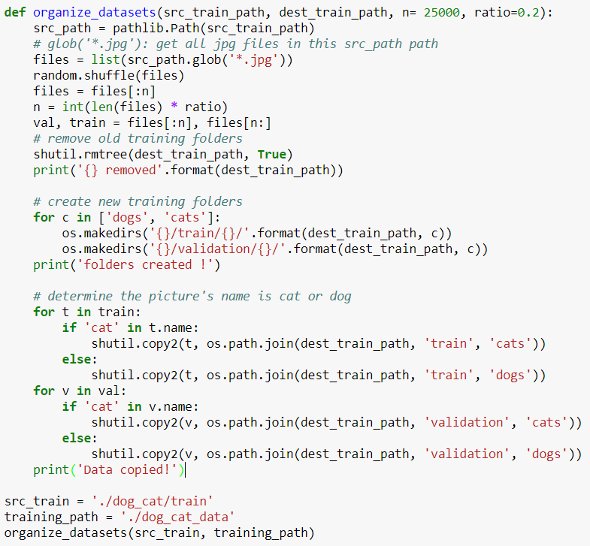

Slide 5
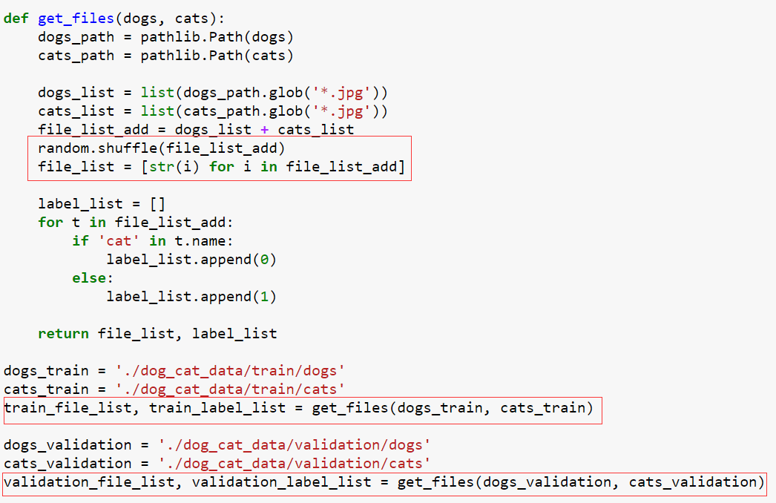
Fetch the images and their labels
-> shuffle and generate the images list
-> generate the labels list

Slide 6
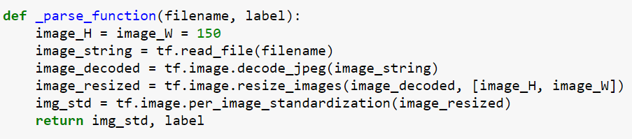
Data preprocessing
When training a neural network on real-world image data, it is often necessary to convert images of different sizes to a common size, so that they may be batched into a fixed size.
Reads an image from a file, decodes it into a dense tensor, and resizes it to a fixed shape.

Slide 7
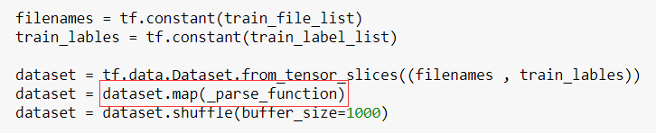
Data preprocessing
Preprocessing data with Dataset.map( )
The Dataset.map(f) transformation produces a new dataset by applying a given function f to each element of the input dataset.

Slide 8
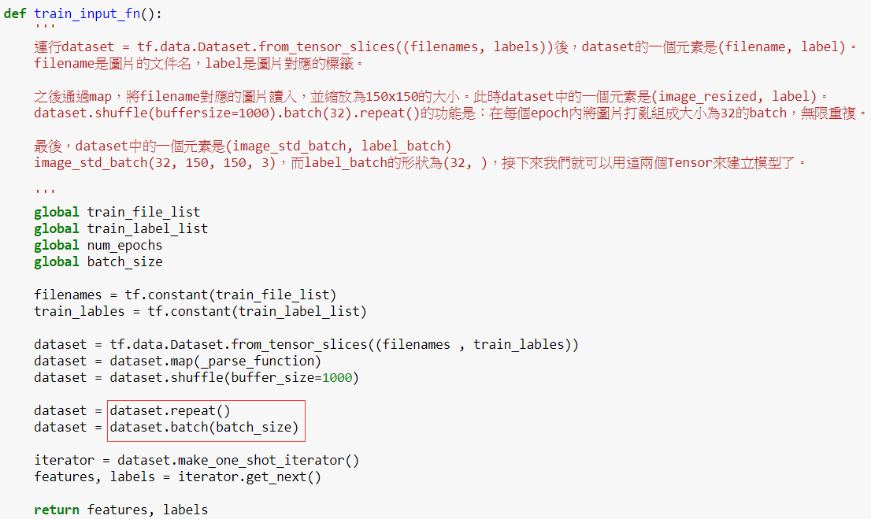
Multiple epochs processing
the simplest way to iterate over a dataset in multiple epochs is to use the Dataset.repeat() transformation.
batch_size = 50

Slide 9
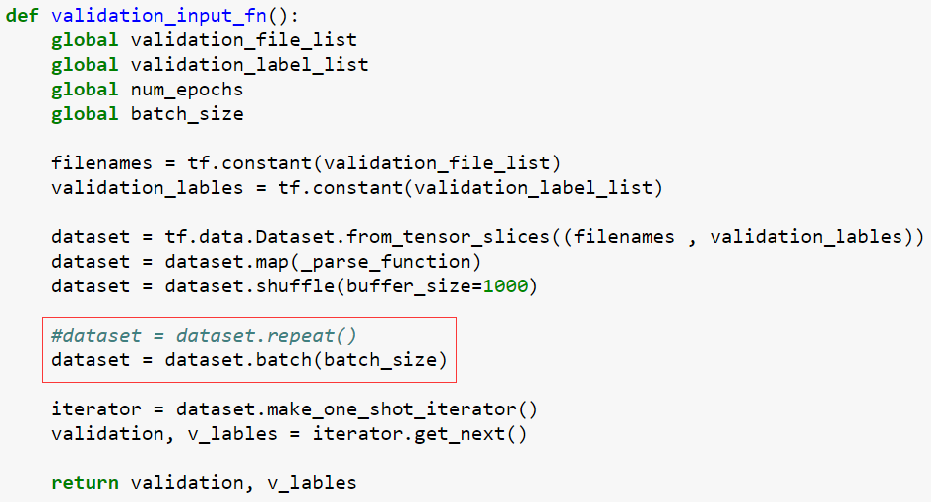
Multiple epochs processing
Validate all the images in the validation folder once In validation_input_fn
batch_size = 50

Slide 10
Building the Dog_Cat CNN Classifier
1. Convolutional Layer #1: Applies 32 5x5 filters (extracting 5x5‐pixel subregions), with ReLU activation function
2. Pooling Layer #1: Performs max pooling with a 2x2 filter and stride of 2 (which specifies that pooled regions do not overlap)
3. Convolutional Layer #2: Applies 64 5x5 filters, with ReLU activation function
4. Pooling Layer #2: Again, performs max pooling with a 2x2 filter and stride of 2
5. Dense Layer #1: 1,024 neurons, with dropout regularization rate of 0.4
6. Dense Layer #2 (Logits Layer): 2 neurons, one for each digit target class (0 or 1).

Slide 11
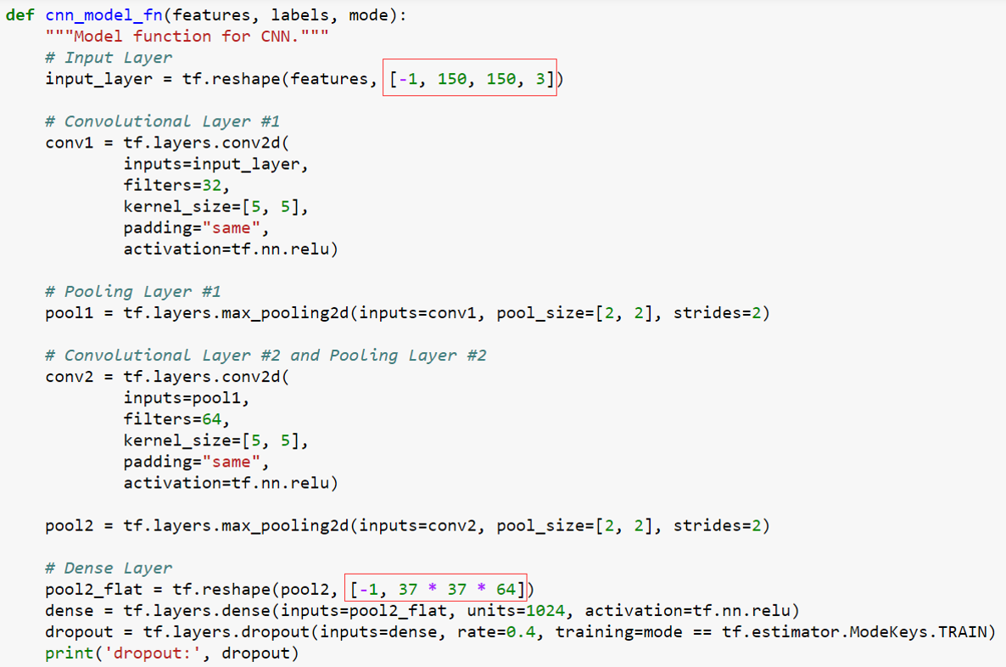
[batch_size, image_width, image_height, channels]
the 2x2 filter reduces
width and height by 50% each
150 is reduced to 37 after 2 filters

Slide 12
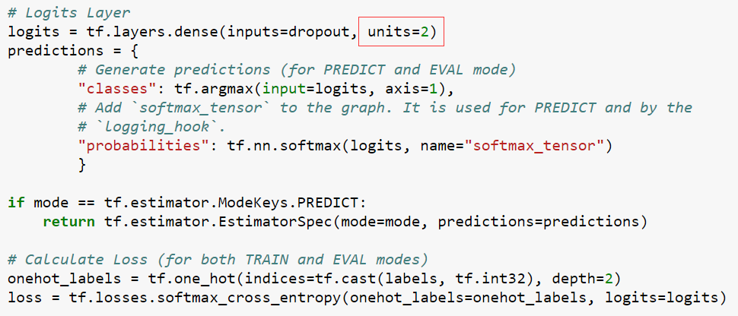

Slide 13
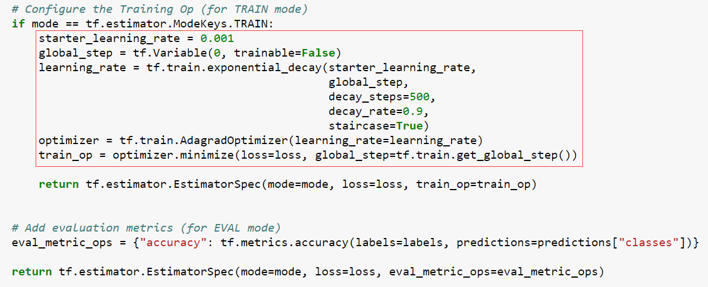

Slide 14
TensorFlow's Estimator API
The above cnn_model_fn function, which conforms to the interface expected by TensorFlow's Estimator API
cnn_model_fn(features, labels, mode)
cnn_model_fn function takes Dog_Cat feature data, labels, and model mode (TRAIN, EVAL, PREDICT) as arguments
configures the CNN and returns predictions, loss, and a training operation.

Slide 15
Create the Estimator
The model_fn argument specifies the model function to use for training, evaluation, and prediction.

Slide 16
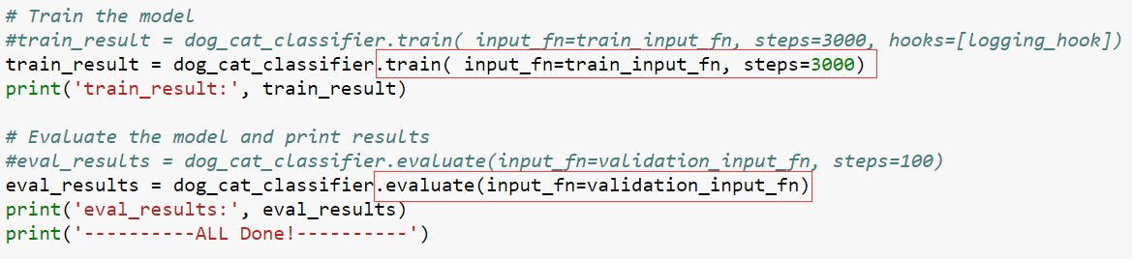
Training and Evaluating the Dog_Cat CNN Classifier
20,000 images in train folder and 5,000 images in validation folder
batch_size = 50
3000 train steps
Validate all the validation images once

Slide 17
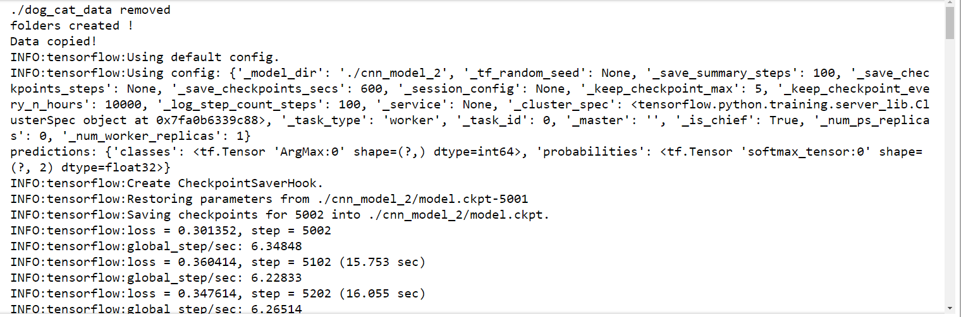
Result
train_results : Loss for final step: 0.192133.

Slide 18
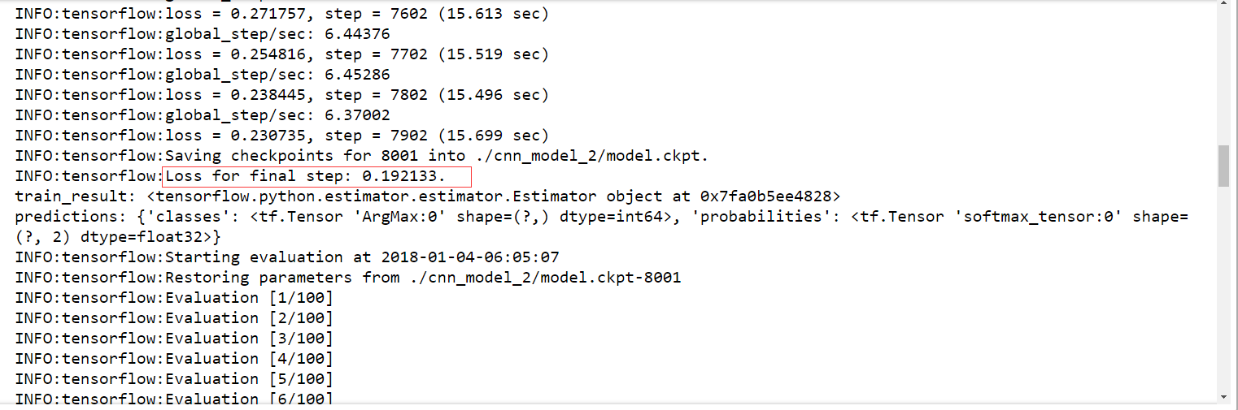
Result
train_results : Loss for final step: 0.192133.

Slide 19
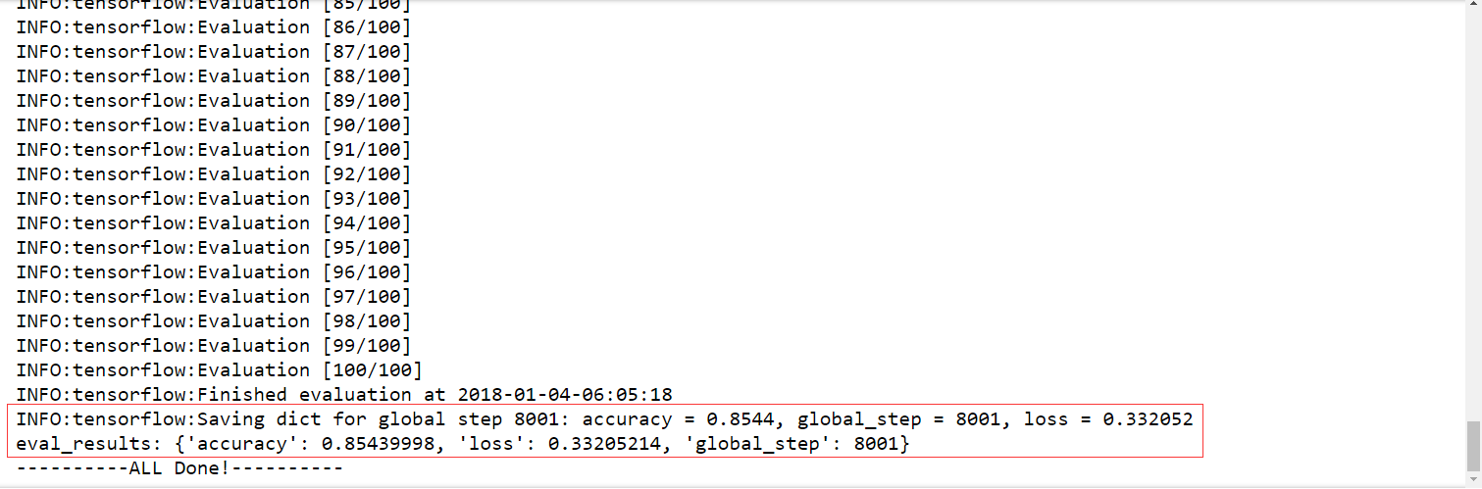
Result
eval_results: {'accuracy': 0.85439998, 'loss': 0.33205214, 'global_step': 8001}

Slide 20
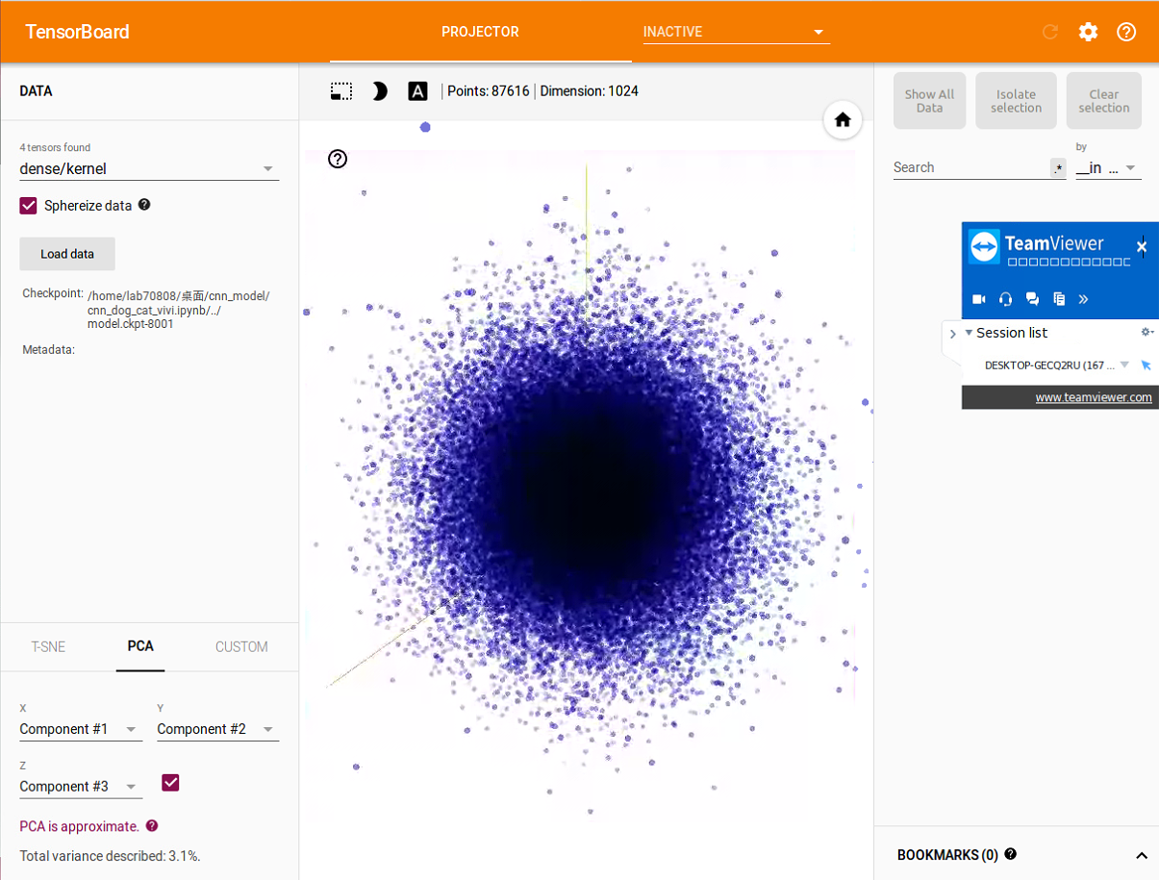
Visualizing Log Data with TensorBoard
tensorboard ‐‐logdir= [./cnn_dog_cat_vivi.ipynb]
TensorBoard 0.4.0rc3 at http://lab70808:6006 (Press CTRL+C to quit)

Slide 21
Thank you!

