Slide 1
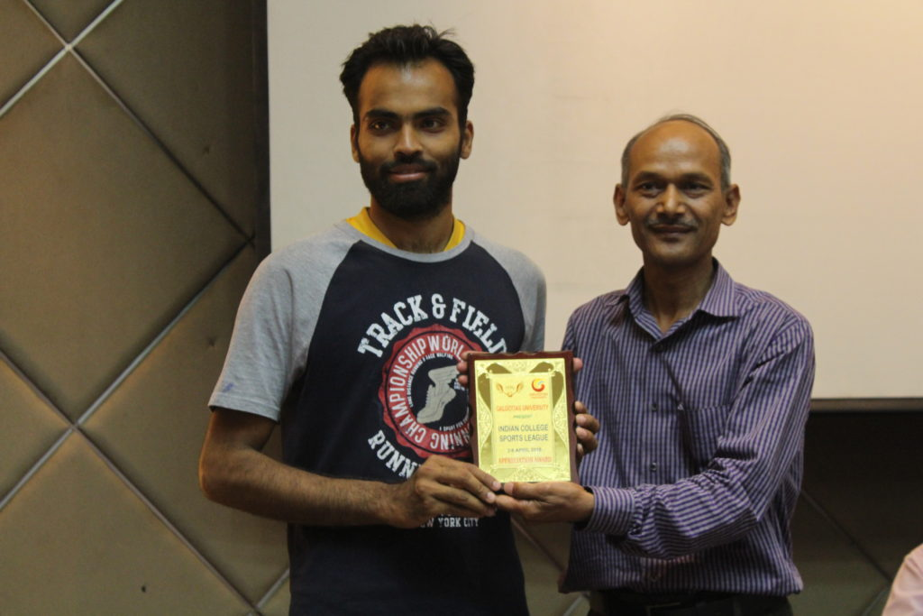
SHINING STARS IN SPORTS
SHIVAM MISHRA
(Ex-Sports Head & Basketball Head)
Grabs a package of
7 LPA
In
PNB Housing Finance Limited

Slide 2
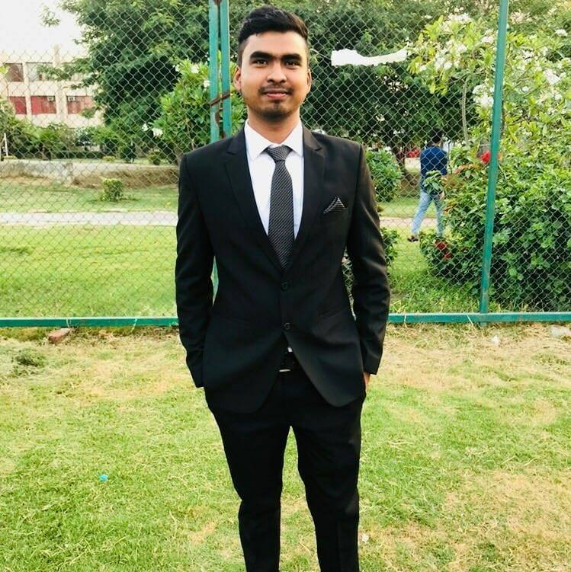
SHINING STARS IN SPORTS
Rahul upadhyay
(EX-BADMINTON HEAD & Deputy secretary)
Grabs a package of
6.7 LPA
In
SAMSUNG

Slide 3

SHINING STARS IN SPORTS
ANAS QURESHI
(Ex- External Affairs Head)
Grabs a package of
3.5 LPA
In
QA Infotech

Slide 4
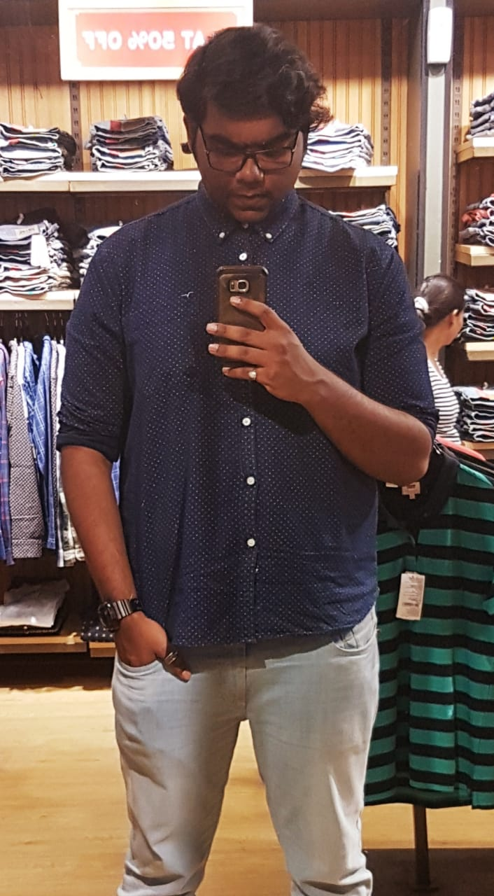
SHINING STARS IN SPORTS
AVINASH KUMAR
Grabs a package of
5.5 LPA
In
Principal Global Services

Slide 5
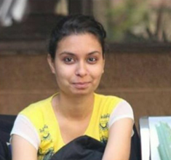
SHINING STARS IN SPORTS
SHIVANGI MISHRA
(Ex-Sports Head)
Grabs a package of
3 LPA
In
Child Learning Pvt. Ltd.

