Slide 1
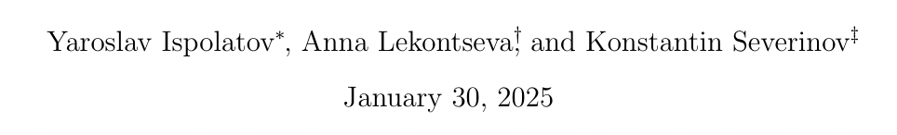
The number of immune defense and counter-defense systems
sustained in the arms race between procaryotes and viruses

Slide 2
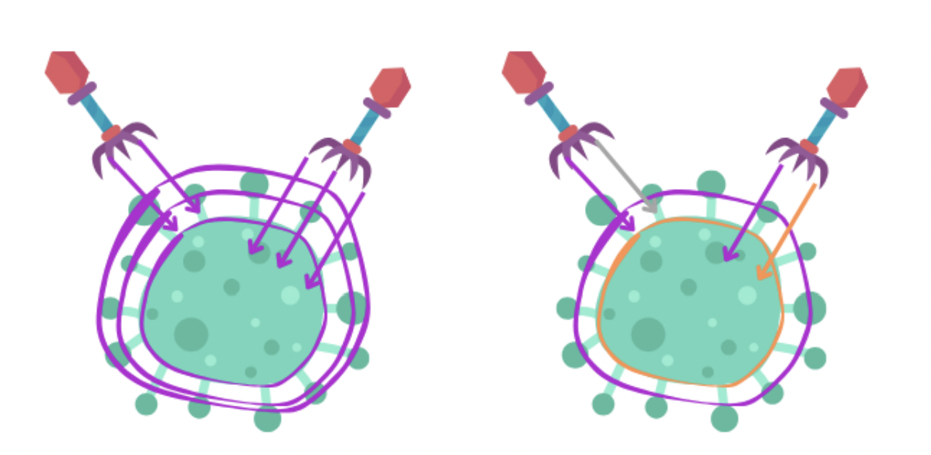
Introduction
Prokaryotes and viruses are locked in an evolutionary arms race, with hosts developing immune defenses and viruses evolving counter-defenses.
The number of such systems maintained by a given virus or host is limited
Idea: to determine the ecological and evolutionary constraints that limit the number of sustainable defense and counter-defense systems
Notes:
Prokaryotes and viruses are engaged in an ongoing evolutionary arms race, with hosts developing immune defenses and viruses evolving counter-defenses. Despite the discovery of numerous defense and counter-defense mechanisms, the number of such systems maintained by a given virus or host is limited. This study explores the ecological and evolutionary constraints that determine the maximal number of sustainable defense and counter-defense systems. Using numerical and theoretical models, we demonstrate that the number of such systems is typically around 10, balancing the metabolic and autoimmune costs against the benefits of additional defenses.

Slide 3
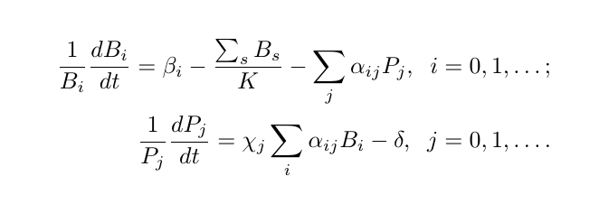
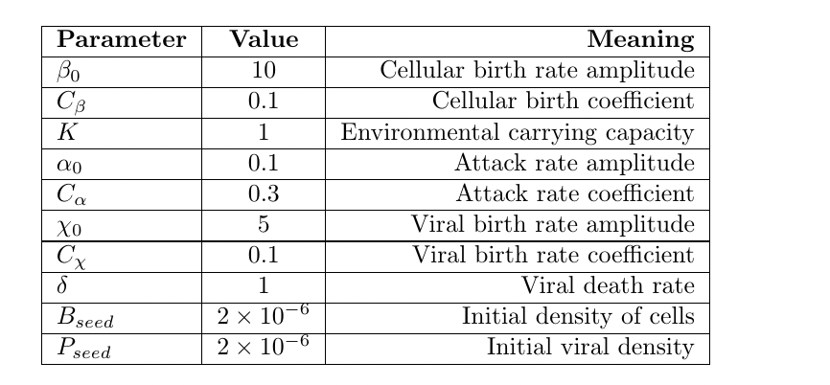
Methods
Lotka-Volter
Ecological and Evolutionary Simmulation
Notes:
Model: Developed a Lotka-Volterra model to describe the population dynamics of prokaryotic cells and viruses.
Parameters: Incorporated metabolic costs of maintaining defense and counter-defense systems and the specificity of interactions between them.
Simulations:
Ecological Simulations: All possible strains are present from the start.
Evolutionary Simulations: New strains emerge through mutations.
Variations: Explored different costs (additive vs. multiplicative) and specificity of defense and counter-defense mechanisms.
Table 1: Values of parameters
Parameter
Value
Meaning
β0
10
Cellular birth rate amplitude
Cβ
0.1
Cellular birth coefficient
K
1
Environmental carrying capacity
α0
0.1
Attack rate amplitude
Cα
0.3
Attack rate coefficient
χ0
5
Viral birth rate amplitude
Cχ
0.1
Viral birth rate coefficient
δ
1
Viral death rate
Bseed
2× 10−6
Initial density of cells
P
−6
seed
2× 10
Initial viral density
We developed a Lotka-Volterra model to describe the population dynamics of prokaryotic cells and viruses, each characterized by their defense and counter-defense systems. The model incorporates the metabolic costs of maintaining these systems and the specificity of interactions between defense and counter-defense mechanisms. We conducted two types of simulations: ecological simulations, where all possible strains are present from the start, and evolutionary simulations, where new strains emerge through mutations. The simulations varied parameters such as the costs of defense and counter-defense systems and their specificity to understand their impact on the sustainable number of layers.

Slide 4
Code walkthrough

Slide 5
Results
Sustainable Layers: The number of sustainable defense and counter-defense layers is typically around 10.
Cost Impact:
Additive Costs: Limited the number of layers to 4.
Multiplicative Costs: Allowed up to 6 layers.
Generalization: The principles may apply to other antagonistic interactions, such as pathogen-host interactions, predator-prey dynamics, and even social conflicts like crime and law enforcement.
Notes:
Our simulations revealed that the number of sustainable defense and counter-defense layers is limited, typically around 10, due to the balance between the benefits of additional defenses and their metabolic costs. Additive costs for cells and viruses limited the number of layers to 4, while multiplicative costs allowed up to 6 layers. Specificity of defense and counter-defense mechanisms further reduced the number of sustainable layers. For example, with specific mechanisms, only 2 layers were sustainable compared to 4 in the non-specific case. Variations in metabolic costs significantly influenced the number of sustainable layers, with lower costs allowing more layers and higher costs restricting them. These findings were supported by a theoretical estimate that accurately predicted the maximal number of sustainable layers based on the model parameters.

