Slide 1
JavaScript Foundations
Important Fundamental
Concepts

Slide 2

All code in Javascript is executed inside an Execution context

Slide 3



The Global
Environment & the Global Object
Global execution context
Variable Environment

Slide 4
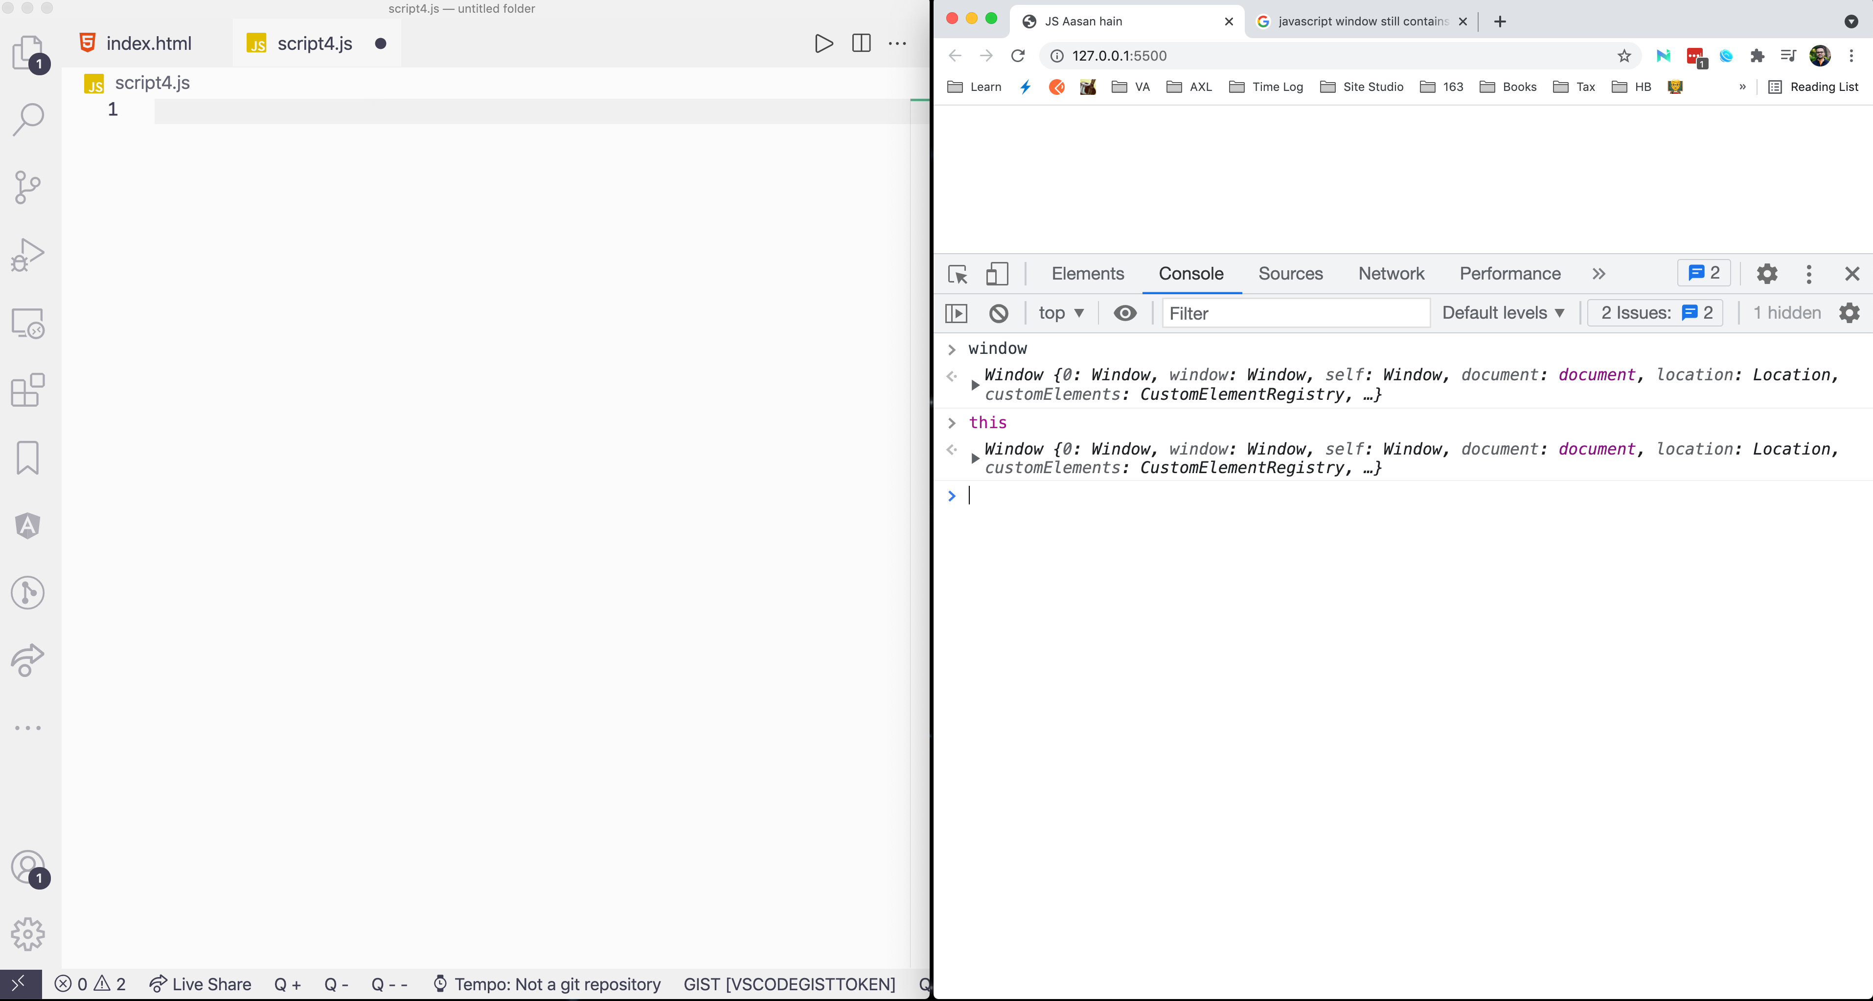

Slide 5
Execution context
1
Whenever a code runs in JavaScript, it runs inside an Execution context.
2
The execution context is a wrapper to help manage the code that is running.
3
An execution context can contain things beyond what you have written in your code like a global object, the this variable, and a reference to the outer ( lexical ) variables environment.

Slide 6
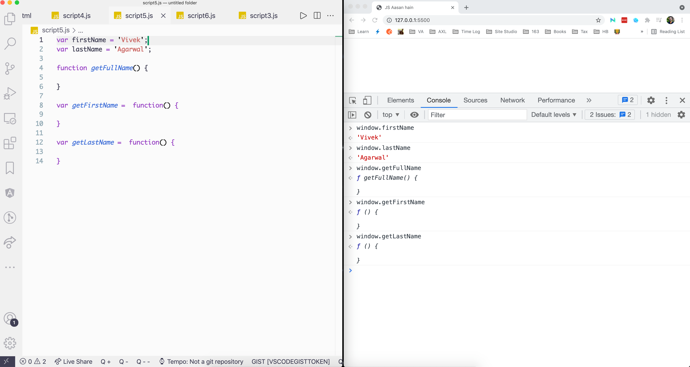

Slide 7
Execution context
1
Any code outside a function is in the Global Scope
2
Variables and Functions written in the Global Scope, sits on the global object.

Slide 8
The Execution context has two phases
1
CREATION PHASE: The code is parsed line by line. Grammar of your code is validated, Scopes are setup & Variables and function declarations are initialized in the memory as a key-value pair
2
EXECUTION PHASE: The real assignment and execution happens at this phase.

Slide 9
A simple example

Slide 10
PHASE - 1
function sayName() {
console.log('Name: ', myVar);
function sayAge() {
myVar = 36;
console.log('Age: ', myVar);
}
sayAge();
}
var myVar = 'Vivek';
sayName();
The creation phase of the Global execution context
Global execution context
Variable Environment
sayName: function(){ … }

Slide 11
PHASE - 1
function sayName() {
console.log('Name: ', myVar);
function sayAge() {
myVar = 36;
console.log('Age: ', myVar);
}
sayAge();
}
var myVar = 'Vivek';
sayName();
The creation phase of the Global execution context
Global execution context
Variable Environment
sayName: function(){ … }
myVar: undefined

Slide 12
PHASE - 2
function sayName() {
console.log('Name: ', myVar);
function sayAge() {
myVar = 36;
console.log('Age: ', myVar);
}
sayAge();
}
var myVar = 'Vivek';
sayName();
The execution phase of the Global execution context
Global execution context
Variable Environment
Line by line code execution
sayName: function(){ … }
myVar: ‘Vivek’

Slide 13
PHASE - 2
function sayName() {
console.log('Name: ', myVar);
function sayAge() {
myVar = 36;
console.log('Age: ', myVar);
}
sayAge();
}
var myVar = 'Vivek';
sayName();
The execution phase of the Global execution context
Global execution context
Variable Environment
sayName: function(){ … }
myVar: ‘Vivek’

Slide 14
PHASE - 1
function sayName() {
console.log('Name: ', myVar);
function sayAge() {
myVar = 36;
console.log('Age: ', myVar);
}
sayAge();
}
var myVar = 'Vivek';
sayName();
The creation phase of the sayName()’s execution context
sayName()’s execution context
Variable Environment
sayAge: function(){ … }
Global execution context
Variable Environment
sayName: function(){ … }
myVar: ‘Vivek’

Slide 15
PHASE - 2
function sayName() {
console.log('Name: ', myVar);
function sayAge() {
myVar = 36;
console.log('Age: ', myVar);
}
sayAge();
}
var myVar = 'Vivek';
sayName();
The execution phase of the sayName()’s execution context
sayName()’s execution context
Variable Environment
sayAge: function(){ … }
Global execution context
Variable Environment
sayName: function(){ … }
myVar: ‘Vivek’

Slide 16
PHASE - 2
function sayName() {
console.log('Name: ', myVar);
function sayAge() {
myVar = 36;
console.log('Age: ', myVar);
}
sayAge();
}
var myVar = 'Vivek';
sayName();
The execution phase of the sayName()’s execution context
sayName()’s execution context
Variable Environment
sayAge: function(){ … }
Global execution context
Variable Environment
sayName: function(){ … }
myVar: ‘Vivek’

Slide 17
function sayName() {
console.log('Name: ', myVar);
function sayAge() {
myVar = 36;
console.log('Age: ', myVar);
}
sayAge();
}
var myVar = 'Vivek';
sayName();
sayAge()’s execution context
Variable Environment
sayName()’s execution context
Variable Environment
sayAge: function(){ … }
Global execution context
Variable Environment
sayName: function(){ … }
myVar: ‘Vivek’

Slide 18
PHASE - 1
function sayName() {
console.log('Name: ', myVar);
function sayAge() {
myVar = 36;
console.log('Age: ', myVar);
}
sayAge();
}
var myVar = 'Vivek';
sayName();
The creation phase of the sayAge()’s execution context
sayAge()’s execution context
Variable Environment
sayName()’s execution context
Variable Environment
sayAge: function(){ … }
Global execution context
Variable Environment
sayName: function(){ … }
myVar: 36

Slide 19
PHASE - 2
function sayName() {
console.log('Name: ', myVar);
function sayAge() {
myVar = 36;
console.log('Age: ', myVar);
}
sayAge();
}
var myVar = 'Vivek';
sayName();
The execution phase of the sayAge()’s execution context
sayAge()’s execution context
Variable Environment
sayName()’s execution context
Variable Environment
sayAge: function(){ … }
Global execution context
Variable Environment
sayName: function(){ … }
myVar: 36

Slide 20
PHASE - 2
function sayName() {
console.log('Name: ', myVar);
function sayAge() {
myVar = 36;
console.log('Age: ', myVar);
}
sayAge();
}
var myVar = 'Vivek';
sayName();
The execution phase of the sayAge()’s execution context
sayAge()’s execution context
Variable Environment
sayName()’s execution context
Variable Environment
sayAge: function(){ … }
Global execution context
Variable Environment
sayName: function(){ … }
myVar: 36

Slide 21
PHASE - 2
function sayName() {
console.log('Name: ', myVar);
function sayAge() {
myVar = 36;
console.log('Age: ', myVar);
}
sayAge();
}
var myVar = 'Vivek';
sayName();
The execution phase of the sayName()’s execution context
sayName()’s execution context
Variable Environment
sayAge: function(){ … }
Global execution context
Variable Environment
sayName: function(){ … }
myVar: 36

Slide 22
PHASE - 2
function sayName() {
console.log('Name: ', myVar);
function sayAge() {
myVar = 36;
console.log('Age: ', myVar);
}
sayAge();
}
var myVar = 'Vivek';
sayName();
The execution phase of the global execution context
Global execution context
Variable Environment
sayName: function(){ … }
myVar: 36

Slide 23
Execution context
1
`return` from a function, returns the control of the program to the place where the function was invoked.
2
The scope chain is formed based on the lexical scope, meaning the place where the variable .

Slide 24
A more evolved Example

Slide 25
var firstName = 'Vivek';
var lastName = 'Agarwal’;
function getFullName() {
var firstName = 'Akash’;
var lastName = 'Sharma’;
var fname = getFirstName();
var lname = getLastName();
var fullName = fname + ' ' + lname;
return fullName;
}
var getFirstName = function() {
return firstName;
}
var getLastName = function() {
return lastName;
}
var fullName = getFullName();
console.log(fullName);
PHASE - 1
The creation phase of the Global execution context
Global execution context
Variable Environment
firstName: undefined

Slide 26
var firstName = 'Vivek';
var lastName = 'Agarwal’;
function getFullName() {
var firstName = 'Akash’;
var lastName = 'Sharma’;
var fname = getFirstName();
var lname = getLastName();
var fullName = fname + ' ' + lname;
return fullName;
}
var getFirstName = function() {
return firstName;
}
var getLastName = function() {
return lastName;
}
var fullName = getFullName();
console.log(fullName);
PHASE - 1
The creation phase of the Global execution context
Global execution context
Variable Environment
firstName: undefined
lastName: undefined

Slide 27
var firstName = 'Vivek';
var lastName = 'Agarwal’;
function getFullName() {
var firstName = 'Akash’;
var lastName = 'Sharma’;
var fname = getFirstName();
var lname = getLastName();
var fullName = fname + ' ' + lname;
return fullName;
}
var getFirstName = function() {
return firstName;
}
var getLastName = function() {
return lastName;
}
var fullName = getFullName();
console.log(fullName);
PHASE - 1
The creation phase of the Global execution context
Global execution context
Variable Environment
firstName: undefined
lastName: undefined
function getFullName() { … }

Slide 28
var firstName = 'Vivek';
var lastName = 'Agarwal’;
function getFullName() {
var firstName = 'Akash’;
var lastName = 'Sharma’;
var fname = getFirstName();
var lname = getLastName();
var fullName = fname + ' ' + lname;
return fullName;
}
var getFirstName = function() {
return firstName;
}
var getLastName = function() {
return lastName;
}
var fullName = getFullName();
console.log(fullName);
PHASE - 1
The creation phase of the Global execution context
Global execution context
Variable Environment
firstName: undefined
lastName: undefined
function getFullName() { … }
getFirstName: undefined

Slide 29
var firstName = 'Vivek';
var lastName = 'Agarwal’;
function getFullName() {
var firstName = 'Akash’;
var lastName = 'Sharma’;
var fname = getFirstName();
var lname = getLastName();
var fullName = fname + ' ' + lname;
return fullName;
}
var getFirstName = function() {
return firstName;
}
var getLastName = function() {
return lastName;
}
var fullName = getFullName();
console.log(fullName);
PHASE - 1
The creation phase of the Global execution context
Global execution context
Variable Environment
firstName: undefined
lastName: undefined
function getFullName() { … }
getFirstName: undefined
getLastName: underfined

Slide 30
var firstName = 'Vivek';
var lastName = 'Agarwal’;
function getFullName() {
var firstName = 'Akash’;
var lastName = 'Sharma’;
var fname = getFirstName();
var lname = getLastName();
var fullName = fname + ' ' + lname;
return fullName;
}
var getFirstName = function() {
return firstName;
}
var getLastName = function() {
return lastName;
}
var fullName = getFullName();
console.log(fullName);
PHASE - 1
The creation phase of the Global execution context
Global execution context
Variable Environment
firstName: undefined
lastName: undefined
function getFullName() { … }
getFirstName: undefined
getLastName: underfined
fullName: undefined

Slide 31
var firstName = 'Vivek';
var lastName = 'Agarwal’;
function getFullName() {
var firstName = 'Akash’;
var lastName = 'Sharma’;
var fname = getFirstName();
var lname = getLastName();
var fullName = fname + ' ' + lname;
return fullName;
}
var getFirstName = function() {
return firstName;
}
var getLastName = function() {
return lastName;
}
var fullName = getFullName();
console.log(fullName);
PHASE - 2
The Execution phase of the Global execution context
Global execution context
Variable Environment
firstName: ‘Vivek’
lastName: undefined
function getFullName() { … }
getFirstName: undefined
getLastName: underfined
fullName: undefined
Executes your code line by line

Slide 32
var firstName = 'Vivek';
var lastName = 'Agarwal’;
function getFullName() {
var firstName = 'Akash’;
var lastName = 'Sharma’;
var fname = getFirstName();
var lname = getLastName();
var fullName = fname + ' ' + lname;
return fullName;
}
var getFirstName = function() {
return firstName;
}
var getLastName = function() {
return lastName;
}
var fullName = getFullName();
console.log(fullName);
PHASE - 2
The Execution phase of the Global execution context
Global execution context
Variable Environment
firstName: ‘Vivek’
lastName: ‘Agarwal’
function getFullName() { … }
getFirstName: undefined
getLastName: underfined
fullName: undefined
Executes your code line by line

Slide 33
var firstName = 'Vivek';
var lastName = 'Agarwal’;
function getFullName() {
var firstName = 'Akash’;
var lastName = 'Sharma’;
var fname = getFirstName();
var lname = getLastName();
var fullName = fname + ' ' + lname;
return fullName;
}
var getFirstName = function() {
return firstName;
}
var getLastName = function() {
return lastName;
}
var fullName = getFullName();
console.log(fullName);
PHASE - 2
The Execution phase of the Global execution context
Global execution context
Variable Environment
firstName: ‘Vivek’
lastName: ‘Agarwal’
function getFullName() { … }
getFirstName: undefined
getLastName: underfined
fullName: undefined
Executes your code line by line

Slide 34
var firstName = 'Vivek';
var lastName = 'Agarwal’;
function getFullName() {
var firstName = 'Akash’;
var lastName = 'Sharma’;
var fname = getFirstName();
var lname = getLastName();
var fullName = fname + ' ' + lname;
return fullName;
}
var getFirstName = function() {
return firstName;
}
var getLastName = function() {
return lastName;
}
var fullName = getFullName();
console.log(fullName);
PHASE - 2
The Execution phase of the Global execution context
Global execution context
Variable Environment
firstName: ‘Vivek’
lastName: ‘Agarwal’
function getFullName() { … }
getFirstName: function() { … }
getLastName: underfined
fullName: undefined
Executes your code line by line

Slide 35
var firstName = 'Vivek';
var lastName = 'Agarwal’;
function getFullName() {
var firstName = 'Akash’;
var lastName = 'Sharma’;
var fname = getFirstName();
var lname = getLastName();
var fullName = fname + ' ' + lname;
return fullName;
}
var getFirstName = function() {
return firstName;
}
var getLastName = function() {
return lastName;
}
var fullName = getFullName();
console.log(fullName);
PHASE - 2
The Execution phase of the Global execution context
Global execution context
Variable Environment
firstName: ‘Vivek’
lastName: ‘Agarwal’
function getFullName() { … }
getFirstName: function() { … }
getLastName: function() { … }
fullName: undefined
Executes your code line by line

Slide 36

var firstName = 'Vivek';
var lastName = 'Agarwal’;
function getFullName() {
var firstName = 'Akash’;
var lastName = 'Sharma’;
var fname = getFirstName();
var lname = getLastName();
var fullName = fname + ' ' + lname;
return fullName;
}
var getFirstName = function() {
return firstName;
}
var getLastName = function() {
return lastName;
}
var fullName = getFullName();
console.log(fullName);
PHASE - 2
The Execution phase of the Global execution context
Global execution context
Variable Environment
firstName: ‘Vivek’
lastName: ‘Agarwal’
function getFullName() { … }
getFirstName: function() { … }
getLastName: function() { … }
fullName: return value of getFullName()
Executes your code line by line

Slide 37
PHASE - 1
var firstName = 'Vivek';
var lastName = 'Agarwal’;
function getFullName() {
var firstName = 'Akash’;
var lastName = 'Sharma’;
var fname = getFirstName();
var lname = getLastName();
var fullName = fname + ' ' + lname;
return fullName;
}
var getFirstName = function() {
return firstName;
}
var getLastName = function() {
return lastName;
}
var fullName = getFullName();
console.log(fullName);
The Creation phase of the getFullName()’s execution context
getFullName()’s execution context
Variable Environment
firstName: undefined
Global execution context
Variable Environment
firstName: ‘Vivek’
lastName: ‘Agarwal’
…
fullName: return value of getFullName()
Executes your code line by line

Slide 38
PHASE - 1
var firstName = 'Vivek';
var lastName = 'Agarwal’;
function getFullName() {
var firstName = 'Akash’;
var lastName = 'Sharma’;
var fname = getFirstName();
var lname = getLastName();
var fullName = fname + ' ' + lname;
return fullName;
}
var getFirstName = function() {
return firstName;
}
var getLastName = function() {
return lastName;
}
var fullName = getFullName();
console.log(fullName);
The Creation phase of the getFullName()’s execution context
getFullName()’s execution context
Variable Environment
firstName: undefined
lastName: undefined
Global execution context
Variable Environment
firstName: ‘Vivek’
lastName: ‘Agarwal’
…
fullName: return value of getFullName()
Executes your code line by line

Slide 39
PHASE - 1
var firstName = 'Vivek';
var lastName = 'Agarwal’;
function getFullName() {
var firstName = 'Akash’;
var lastName = 'Sharma’;
var fname = getFirstName();
var lname = getLastName();
var fullName = fname + ' ' + lname;
return fullName;
}
var getFirstName = function() {
return firstName;
}
var getLastName = function() {
return lastName;
}
var fullName = getFullName();
console.log(fullName);
The Creation phase of the getFullName()’s execution context
getFullName()’s execution context
Variable Environment
firstName: undefined
lastName: undefined
fname: undefined
Global execution context
Variable Environment
firstName: ‘Vivek’
lastName: ‘Agarwal’
…
fullName: return value of getFullName()
Executes your code line by line

Slide 40
PHASE - 1
var firstName = 'Vivek';
var lastName = 'Agarwal’;
function getFullName() {
var firstName = 'Akash’;
var lastName = 'Sharma’;
var fname = getFirstName();
var lname = getLastName();
var fullName = fname + ' ' + lname;
return fullName;
}
var getFirstName = function() {
return firstName;
}
var getLastName = function() {
return lastName;
}
var fullName = getFullName();
console.log(fullName);
The Creation phase of the getFullName()’s execution context
getFullName()’s execution context
Variable Environment
firstName: undefined
lastName: undefined
fname: undefined
lname: undefined
Global execution context
Variable Environment
firstName: ‘Vivek’
lastName: ‘Agarwal’
…
fullName: return value of getFullName()
Executes your code line by line

Slide 41
PHASE - 1
var firstName = 'Vivek';
var lastName = 'Agarwal’;
function getFullName() {
var firstName = 'Akash’;
var lastName = 'Sharma’;
var fname = getFirstName();
var lname = getLastName();
var fullName = fname + ' ' + lname;
return fullName;
}
var getFirstName = function() {
return firstName;
}
var getLastName = function() {
return lastName;
}
var fullName = getFullName();
console.log(fullName);
The Creation phase of the getFullName()’s execution context
getFullName()’s execution context
Variable Environment
firstName: undefined
lastName: undefined
fname: undefined
lname: undefined
fullName: undefined
Global execution context
Variable Environment
firstName: ‘Vivek’
lastName: ‘Agarwal’
…
fullName: return value of getFullName()
Executes your code line by line

Slide 42
PHASE - 1
var firstName = 'Vivek';
var lastName = 'Agarwal’;
function getFullName() {
var firstName = 'Akash’;
var lastName = 'Sharma’;
var fname = getFirstName();
var lname = getLastName();
var fullName = fname + ' ' + lname;
return fullName;
}
var getFirstName = function() {
return firstName;
}
var getLastName = function() {
return lastName;
}
var fullName = getFullName();
console.log(fullName);
The Creation phase of the getFullName()’s execution context
getFullName()’s execution context
Variable Environment
firstName: undefined
lastName: undefined
fname: undefined
lname: undefined
fullName: undefined
Global execution context
Variable Environment
firstName: ‘Vivek’
lastName: ‘Agarwal’
…
fullName: return value of getFullName()
Executes your code line by line

Slide 43
PHASE - 2
var firstName = 'Vivek';
var lastName = 'Agarwal’;
function getFullName() {
var firstName = 'Akash’;
var lastName = 'Sharma’;
var fname = getFirstName();
var lname = getLastName();
var fullName = fname + ' ' + lname;
return fullName;
}
var getFirstName = function() {
return firstName;
}
var getLastName = function() {
return lastName;
}
var fullName = getFullName();
console.log(fullName);
The Execution phase of the getFullName()’s execution context
getFullName()’s execution context
Variable Environment
firstName: undefined
lastName: undefined
fname: undefined
lname: undefined
fullName: undefined
Executes your code line by line
Global execution context
Variable Environment
firstName: ‘Vivek’
lastName: ‘Agarwal’
…
fullName: return value of getFullName()
Executes your code line by line

Slide 44
PHASE - 2
var firstName = 'Vivek';
var lastName = 'Agarwal’;
function getFullName() {
var firstName = 'Akash’;
var lastName = 'Sharma’;
var fname = getFirstName();
var lname = getLastName();
var fullName = fname + ' ' + lname;
return fullName;
}
var getFirstName = function() {
return firstName;
}
var getLastName = function() {
return lastName;
}
var fullName = getFullName();
console.log(fullName);
The Execution phase of the getFullName()’s execution context
getFullName()’s execution context
Variable Environment
firstName: ‘Akash’
lastName: undefined
fname: undefined
lname: undefined
fullName: undefined
Executes your code line by line
Global execution context
Variable Environment
firstName: ‘Vivek’
lastName: ‘Agarwal’
…
fullName: return value of getFullName()
Executes your code line by line

Slide 45
PHASE - 2
var firstName = 'Vivek';
var lastName = 'Agarwal’;
function getFullName() {
var firstName = 'Akash’;
var lastName = 'Sharma’;
var fname = getFirstName();
var lname = getLastName();
var fullName = fname + ' ' + lname;
return fullName;
}
var getFirstName = function() {
return firstName;
}
var getLastName = function() {
return lastName;
}
var fullName = getFullName();
console.log(fullName);
The Execution phase of the getFullName()’s execution context
getFullName()’s execution context
Variable Environment
firstName: ‘Akash’
lastName: ‘Sharma’
fname: undefined
lname: undefined
fullName: undefined
Executes your code line by line
Global execution context
Variable Environment
firstName: ‘Vivek’
lastName: ‘Agarwal’
…
fullName: return value of getFullName()
Executes your code line by line

Slide 46
PHASE - 2
var firstName = 'Vivek';
var lastName = 'Agarwal’;
function getFullName() {
var firstName = 'Akash’;
var lastName = 'Sharma’;
var fname = getFirstName();
var lname = getLastName();
var fullName = fname + ' ' + lname;
return fullName;
}
var getFirstName = function() {
return firstName;
}
var getLastName = function() {
return lastName;
}
var fullName = getFullName();
console.log(fullName);
The Execution phase of the getFullName()’s execution context
getFullName()’s execution context
Variable Environment
firstName: ‘Akash’
lastName: ‘Sharma’
fname: return value of getFirstName()
lname: undefined
fullName: undefined
Executes your code line by line
Global execution context
Variable Environment
firstName: ‘Vivek’
lastName: ‘Agarwal’
…
fullName: return value of getFullName()
Executes your code line by line

Slide 47
PHASE - 1
The Creation phase of the getFirstName()’s execution context
var firstName = 'Vivek';
var lastName = 'Agarwal’;
function getFullName() {
var firstName = 'Akash’;
var lastName = 'Sharma’;
var fname = getFirstName();
var lname = getLastName();
var fullName = fname + ' ' + lname;
return fullName;
}
var getFirstName = function() {
return firstName;
}
var getLastName = function() {
return lastName;
}
var fullName = getFullName();
console.log(fullName);
getFirstName()’s execution context
Variable Environment
getFullName()’s execution context
Variable Environment
firstName: ‘Akash’
lastName: ‘Sharma’
fname: return value of getFirstName()
lname: undefined
fullName: undefined
Executes your code line by line
Global execution context
Variable Environment
firstName: ‘Vivek’
lastName: ‘Agarwal’
…
fullName: return value of getFullName()
Executes your code line by line

Slide 48
PHASE - 2
The Execution phase of the getFirstName()’s execution context
var firstName = 'Vivek';
var lastName = 'Agarwal’;
function getFullName() {
var firstName = 'Akash’;
var lastName = 'Sharma’;
var fname = getFirstName();
var lname = getLastName();
var fullName = fname + ' ' + lname;
return fullName;
}
var getFirstName = function() {
return firstName;
}
var getLastName = function() {
return lastName;
}
var fullName = getFullName();
console.log(fullName);
getFirstName()’s execution context
Variable Environment
Executes your code line by line
getFullName()’s execution context
Variable Environment
firstName: ‘Akash’
lastName: ‘Sharma’
fname: return value of getFirstName()
lname: undefined
fullName: undefined
Executes your code line by line
Global execution context
Variable Environment
firstName: ‘Vivek’
lastName: ‘Agarwal’
…
fullName: return value of getFullName()
Executes your code line by line

Slide 49
PHASE - 2
The Execution phase of the getFullName()’s execution context
var firstName = 'Vivek';
var lastName = 'Agarwal’;
function getFullName() {
var firstName = 'Akash’;
var lastName = 'Sharma’;
var fname = getFirstName();
var lname = getLastName();
var fullName = fname + ' ' + lname;
return fullName;
}
var getFirstName = function() {
return firstName;
}
var getLastName = function() {
return lastName;
}
var fullName = getFullName();
console.log(fullName);
getFullName()’s execution context
Variable Environment
firstName: ‘Akash’
lastName: ‘Sharma’
fname: ‘Vivek’
lname: return value of getLastName()
fullName: undefined
Executes your code line by line
Global execution context
Variable Environment
firstName: ‘Vivek’
lastName: ‘Agarwal’
…
fullName: return value of getFullName()
Executes your code line by line

Slide 50
PHASE - 1
The Creation phase of the getLastName()’s execution context
var firstName = 'Vivek';
var lastName = 'Agarwal’;
function getFullName() {
var firstName = 'Akash’;
var lastName = 'Sharma’;
var fname = getFirstName();
var lname = getLastName();
var fullName = fname + ' ' + lname;
return fullName;
}
var getFirstName = function() {
return firstName;
}
var getLastName = function() {
return lastName;
}
var fullName = getFullName();
console.log(fullName);
getLastName()’s execution context
Variable Environment
getFullName()’s execution context
Variable Environment
firstName: ‘Akash’
lastName: ‘Sharma’
fname: ‘Vivek’
lname: return value of getLastName()
fullName: undefined
Executes your code line by line
Global execution context
Variable Environment
firstName: ‘Vivek’
lastName: ‘Agarwal’
…
fullName: return value of getFullName()
Executes your code line by line

Slide 51
PHASE - 2
The Execution phase of the getLastName()’s execution context
var firstName = 'Vivek';
var lastName = 'Agarwal’;
function getFullName() {
var firstName = 'Akash’;
var lastName = 'Sharma’;
var fname = getFirstName();
var lname = getLastName();
var fullName = fname + ' ' + lname;
return fullName;
}
var getFirstName = function() {
return firstName;
}
var getLastName = function() {
return lastName;
}
var fullName = getFullName();
console.log(fullName);
getLastName()’s execution context
Variable Environment
Executes your code line by line
getFullName()’s execution context
Variable Environment
firstName: ‘Akash’
lastName: ‘Sharma’
fname: ‘Vivek’
lname: return value of getLastName()
fullName: undefined
Executes your code line by line
Global execution context
Variable Environment
firstName: ‘Vivek’
lastName: ‘Agarwal’
…
fullName: return value of getFullName()
Executes your code line by line

Slide 52
PHASE - 2
The Execution phase of the getFullName()’s execution context
var firstName = 'Vivek';
var lastName = 'Agarwal’;
function getFullName() {
var firstName = 'Akash’;
var lastName = 'Sharma’;
var fname = getFirstName();
var lname = getLastName();
var fullName = fname + ' ' + lname;
return fullName;
}
var getFirstName = function() {
return firstName;
}
var getLastName = function() {
return lastName;
}
var fullName = getFullName();
console.log(fullName);
getFullName()’s execution context
Variable Environment
firstName: ‘Akash’
lastName: ‘Sharma’
fname: ‘Vivek’
lname: ‘Agarwal’
fullName: undefined
Executes your code line by line
Global execution context
Variable Environment
firstName: ‘Vivek’
lastName: ‘Agarwal’
…
fullName: return value of getFullName()
Executes your code line by line

Slide 53
PHASE - 2
The Execution phase of the getFullName()’s execution context
var firstName = 'Vivek';
var lastName = 'Agarwal’;
function getFullName() {
var firstName = 'Akash’;
var lastName = 'Sharma’;
var fname = getFirstName();
var lname = getLastName();
var fullName = fname + ' ' + lname;
return fullName;
}
var getFirstName = function() {
return firstName;
}
var getLastName = function() {
return lastName;
}
var fullName = getFullName();
console.log(fullName);
getFullName()’s execution context
Variable Environment
firstName: ‘Akash’
lastName: ‘Sharma’
fname: ‘Vivek’
lname: ‘Agarwal’
fullName: undefined
Executes your code line by line
Global execution context
Variable Environment
firstName: ‘Vivek’
lastName: ‘Agarwal’
…
fullName: return value of getFullName()
Executes your code line by line

Slide 54
PHASE - 2
The Execution phase of the getFullName()’s execution context
var firstName = 'Vivek';
var lastName = 'Agarwal’;
function getFullName() {
var firstName = 'Akash’;
var lastName = 'Sharma’;
var fname = getFirstName();
var lname = getLastName();
var fullName = fname + ' ' + lname;
return fullName;
}
var getFirstName = function() {
return firstName;
}
var getLastName = function() {
return lastName;
}
var fullName = getFullName();
console.log(fullName);
getFullName()’s execution context
Variable Environment
firstName: ‘Akash’
lastName: ‘Sharma’
fname: ‘Vivek’
lname: ‘Agarwal’
fullName: ’Vivek Agarwal’
Executes your code line by line
Global execution context
Variable Environment
firstName: ‘Vivek’
lastName: ‘Agarwal’
…
fullName: return value of getFullName()
Executes your code line by line

Slide 55
PHASE - 2
The Execution phase of the getFullName()’s execution context
var firstName = 'Vivek';
var lastName = 'Agarwal’;
function getFullName() {
var firstName = 'Akash’;
var lastName = 'Sharma’;
var fname = getFirstName();
var lname = getLastName();
var fullName = fname + ' ' + lname;
return fullName;
}
var getFirstName = function() {
return firstName;
}
var getLastName = function() {
return lastName;
}
var fullName = getFullName();
console.log(fullName);
getFullName()’s execution context
Variable Environment
firstName: ‘Akash’
lastName: ‘Sharma’
fname: ‘Vivek’
lname: ‘Agarwal’
fullName: ’Vivek Agarwal’
Executes your code line by line
Global execution context
Variable Environment
firstName: ‘Vivek’
lastName: ‘Agarwal’
…
fullName: return value of getFullName()
Executes your code line by line

Slide 56
PHASE - 2
The Execution phase of the getFullName()’s execution context
var firstName = 'Vivek';
var lastName = 'Agarwal’;
function getFullName() {
var firstName = 'Akash’;
var lastName = 'Sharma’;
var fname = getFirstName();
var lname = getLastName();
var fullName = fname + ' ' + lname;
return fullName;
}
var getFirstName = function() {
return firstName;
}
var getLastName = function() {
return lastName;
}
var fullName = getFullName();
console.log(fullName);
getFullName()’s execution context
Variable Environment
firstName: ‘Akash’
lastName: ‘Sharma’
fname: ‘Vivek’
lname: ‘Agarwal’
fullName: ’Vivek Agarwal’
Executes your code line by line
Global execution context
Variable Environment
firstName: ‘Vivek’
lastName: ‘Agarwal’
…
fullName: ‘Vivek Agarwal’
Executes your code line by line

Slide 57

PHASE - 2
The Execution phase of the getFullName()’s execution context
var firstName = 'Vivek';
var lastName = 'Agarwal’;
function getFullName() {
var firstName = 'Akash’;
var lastName = 'Sharma’;
var fname = getFirstName();
var lname = getLastName();
var fullName = fname + ' ' + lname;
return fullName;
}
var getFirstName = function() {
return firstName;
}
var getLastName = function() {
return lastName;
}
var fullName = getFullName();
console.log(fullName);
Global execution context
Variable Environment
firstName: ‘Vivek’
lastName: ‘Agarwal’
…
fullName: ‘Vivek Agarwal’
Executes your code line by line

