Slide 1
Event Loop + ES6

Slide 2
Contents
Pre-requisite: Basic HTML, CSS and JS
Event Loop
ES6 Features
Let and Const
Arrow Function
Classes
Inheritance
Rest and Spread
Destructuring
Object Literals
export and import
Array methods (map, filter)
Promises and Callbacks
fetch and API calls
async/await

Slide 3
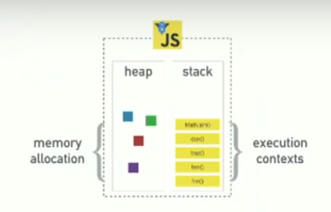
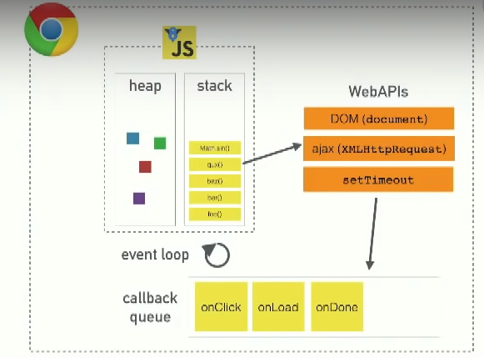
Event Loop
To understand event loop, we need to understand how does JavaScript work We have a JavaScript engine(Chrome’s V8) where JavaScript runs inside the browser A very simplified graphical representation is as follows
It does not contain DOM, setTimeOut, ajax calls, etc.
Other than JS runtime browser has something called web APIs message/event queue an event loop

Slide 4
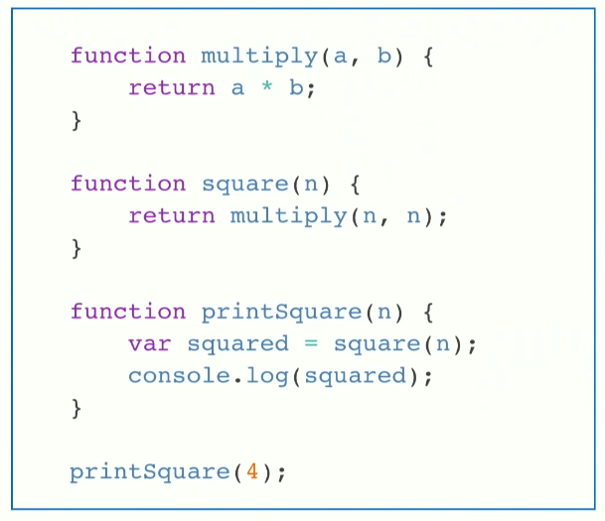
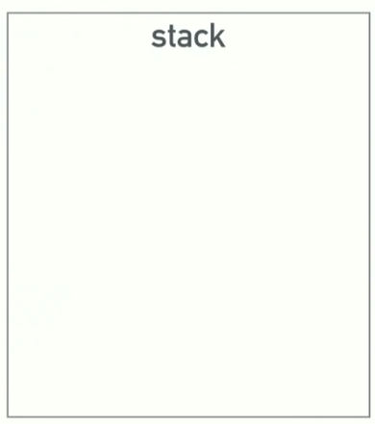




Event Loop- Call Stack
JavaScript is a single threaded language === one call stack === one thing at a time
Call stack is basically is a DS which records where in the program we are.
So if we call a function we push in something to the stack if we return from a function we pop out from the stack

Slide 5
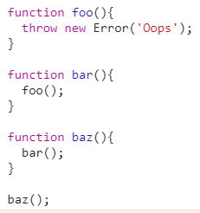


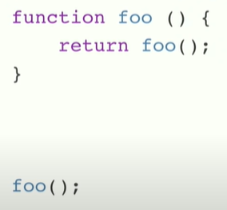
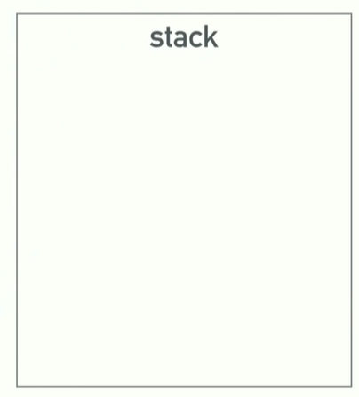

Event Loop- Call Stack
It will give the call stack as above
Blowing the stack

Slide 6
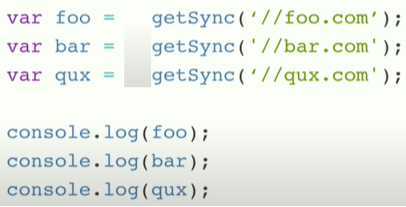
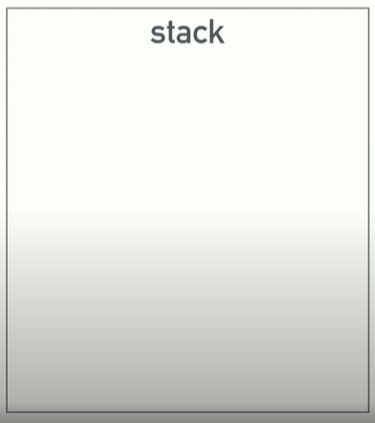






Event Loop- Blocking
What happens when thing are slow
Like a long loop, image processing, on the stack means blocking
The problem with such long blocking code is the browser gets nonresponsive until the execution completes.
The simplest and most primitive solution to this problem is asynchronous callbacks.

Slide 7
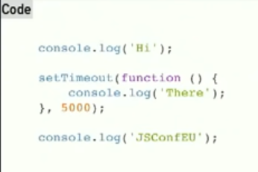
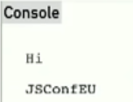

Event Loop- NonBlocking
Callbacks basically means we run some code and give it a callback and then run that later
Set timeout queues the console log for future so we move on to JSConfEU

Slide 8
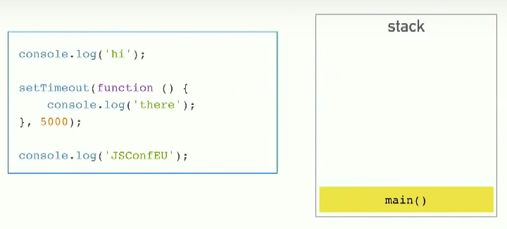





Event Loop- Async Callbacks & The Call Stack
How callback work in reference to the call stack
We know it don't execute immediately we cannot push console.log (‘there’) on the stack so somehow it just disappears from the stack
And then magically after five SEC console.log ‘there’ appears on the stack
How does that happen? Here comes in picture the event loop.

Slide 9
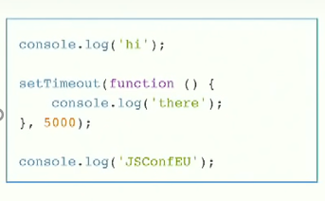
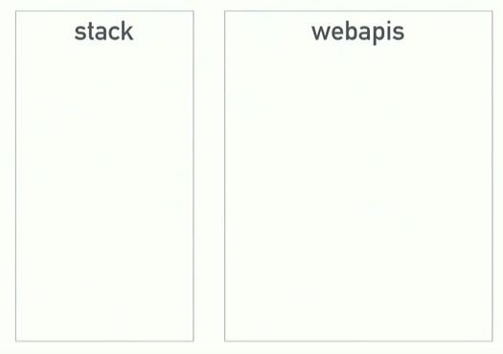










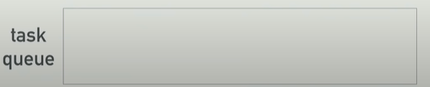

Concurrency & Event loop
It's a journey from synchronous to asynchronous or are you can say how we achieve multithreading in JS
So apart from JS runtime are browser has something called web API’s
setTimeout is an API provided by the browser, web API’s can’t modify your code directly, It cannot add things to stack, So once the timer completes it push the callback function to the event queue.

Slide 10
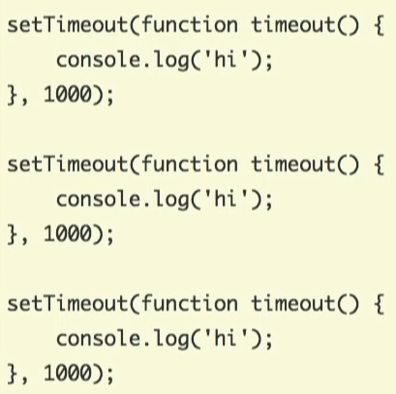
Concurrency & Event loop…
The event Loop’s job is to look at the stack and to the event queue and
If the stack is empty it takes the first thing on the queue and push it onto the stack
setTimeOut(fn,0): will defer the execution of the code till the stack is empty but web api/browser will immediately push the callback to the event/message queue.
It works similarly with XHR(ajax/fetch) calls.
setTimeOut indicates a minimum time—not a guaranteed time, just like setTimeout(fn ,0) doesn’t run the code immediately
So, now JS is a single threaded, asynchronous, non-blocking programming language.

Slide 11
ES6 Features
Let and const
Arrow function
export and import
Classes
Spread and Rest Operator
Destructuring
Reference and primitive type refresher
Refreshing arrays

Slide 12
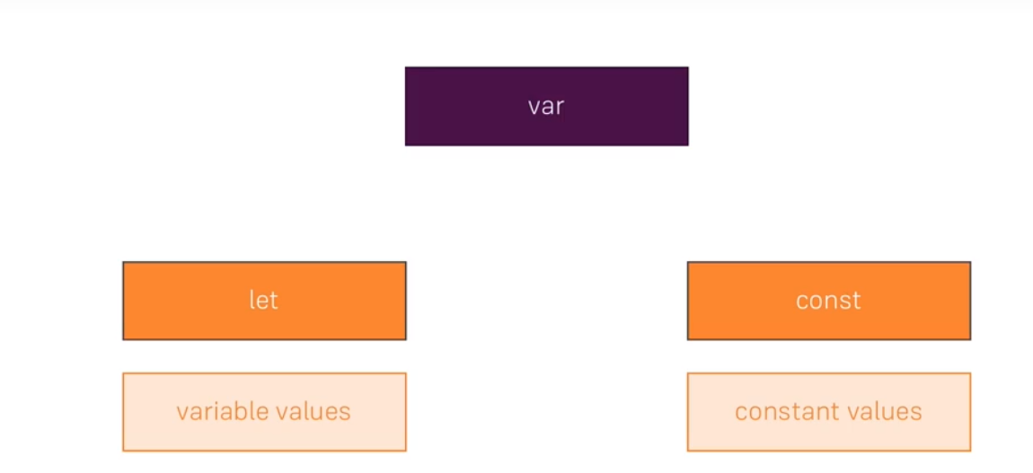


ES6 Features
Let and const
Function Scope
Block Scope
Block Scope

Slide 13
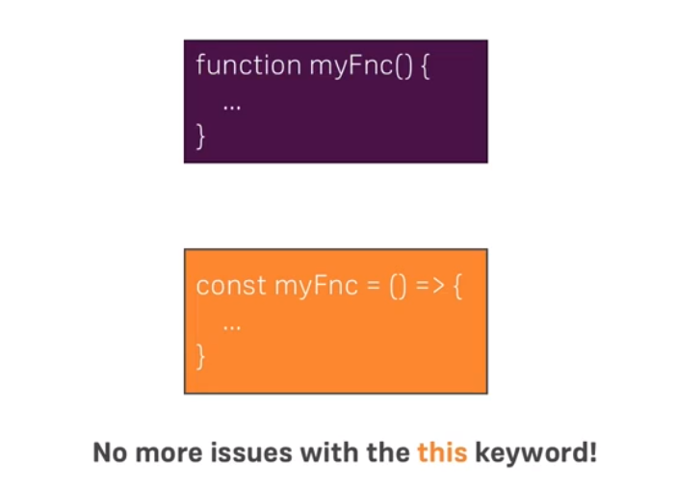




ES6 Features
Arrow Function
If only one argument - remove ()
If return only one line - remove {}

Slide 14
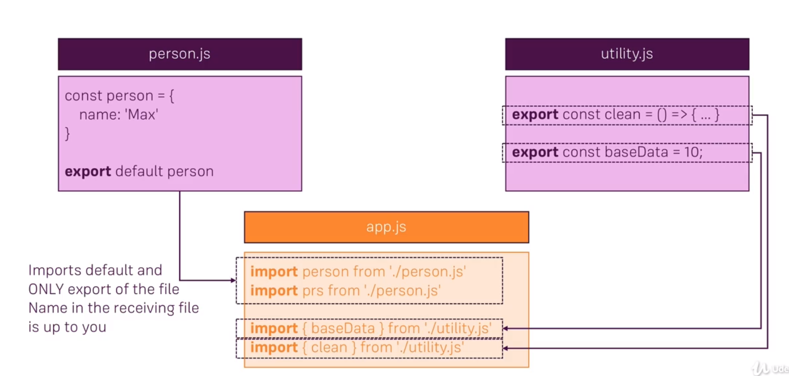
ES6 Features
Import and Export (Modules)

Slide 15
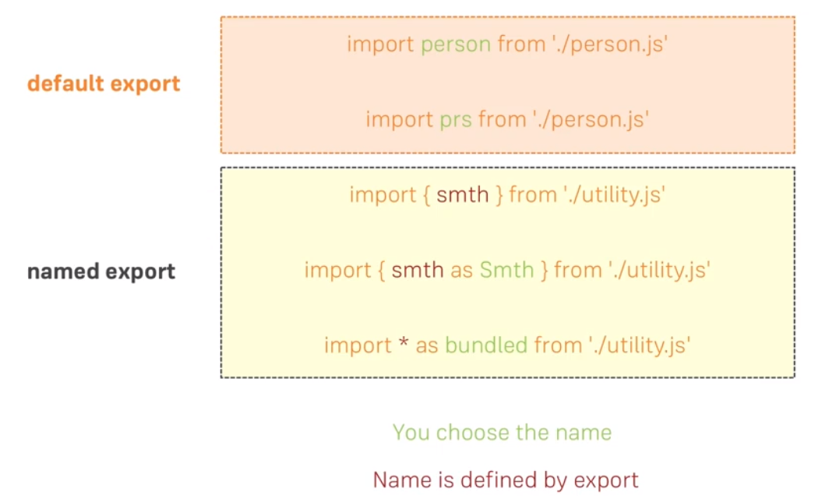
ES6 Features
Import and Export (Alternative Syntax)

Slide 16
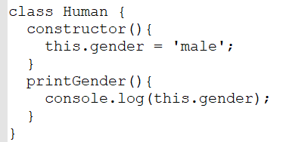
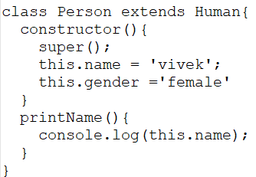
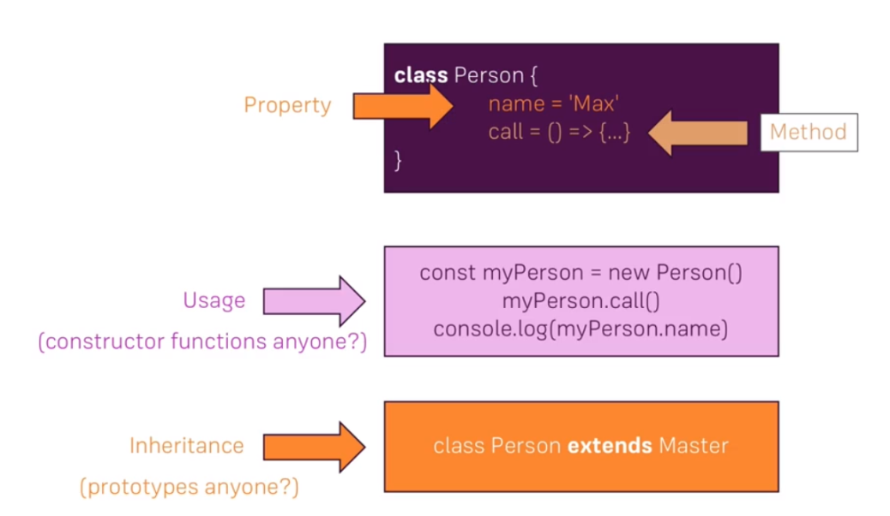

ES6 Features
Classes
blueprints for object
It has properties(variables) and method(functions)
instantiated by new keyword
more convenient way of creating constructor function
supports inheritance, (like in prototypes)

Slide 17
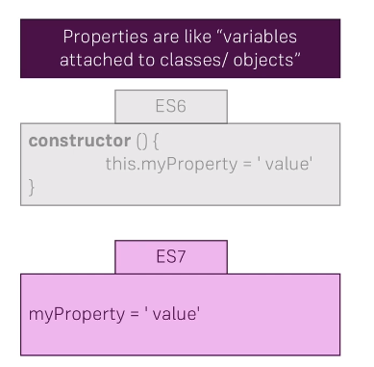

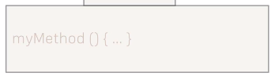

ES6 Features
Properties and Methods

Slide 18

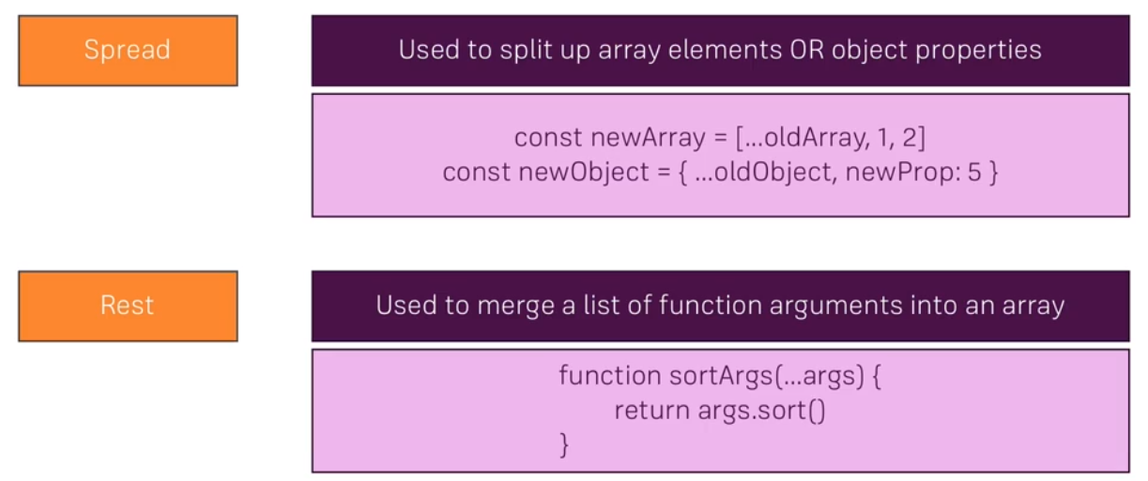
ES6 Features
Spread and Rest Operator

Slide 19


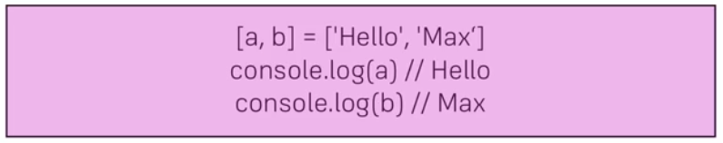

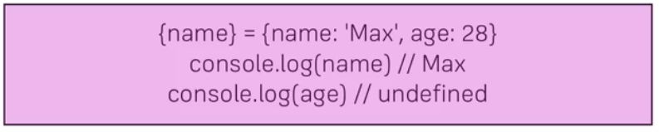
ES6 Features
Destructuring

Slide 20
ES6 Features
Refreshing Array Functions
Map :
The map() method creates a new array with the results of calling a function for every array element.
map() does not change the original array.
Filter:
method creates an array filled with all array elements that pass a test (provided by a function).
does not change the original array.
Reduce:
executes a reducer function for each value of an array.
returns a single value which is the function's accumulated result.
does not change the original array.
Find
Slice
Splice

Slide 21
ES6 Features
Primitive and Reference Type
Numbers, String Boolean are primitive type
Primitive Type: if you copy the variable it will create a real copy
Object and Arrays are reference types
If you are copying Object or Array you are copying the pointer and not the exact object or array

Slide 22
Thank You

