Slide 1
Introduction to DataBase
Google defines database as “a structured set of data held in a computer, especially one that is accessible in various ways.” At its most basic, a database is just a way of storing and organizing information. Ideally it is organized in such a way that it can be easily accessed, managed, and updated.

Slide 2
Database Management System (DBMS)
We often mistakenly say our database is Oracle, MySQL, SQL Server, MongoDB. But, they aren’t databases, they are database management systems (DBMS).
The DBMS is the software that would be installed on your personal computer or on a server, then you would use it to manage one or more database.
The database has your actual data and the rules about that data, while the DBMS is the program that surrounds and manages your actual data, and it enforces the rules you specified on your data. The rules for example could be the type of the data, like integer or string, or the relationship between them.

Slide 3
In practice it’s very common to have multiple databases. The database that deals with your order and customer information might be completely independent from you database that deals with human resource information. And in many organizations, you don’t just have multiple databases but multiple DBMS. Sometimes it’s because one DBMS is better at something than the other.
There are different DBMS, and they are categorized under:
Relational Database Management Systems.
Hierarchical Database Systems.
Network Database Systems.
Object-Oriented Database Systems.
NoSQL Database Systems.

Slide 4
We are going to focus on the relational database management systems (RDBMS). And here’s Why? …
They are the most common used one.
The principles we are going to discuss here are usable across all of them.
If you know you are going to jump into NoSQL databases, most of the introductions assumes you already understand relation database concepts and will use these concepts to explain what’s offered by NoSQL databases.
RDBMS are like Oracle, MySQL, SQL Server, SQLite, DB2, …etc.

Slide 5
Structured Query Language (SQL)
It’s the language that’s used to create, read, update or delete data (falls under the acronym CRUD), and also to define the databases themselves.
It’s not a programming language, it’s considered as a declarative query language. You just need to say what you want, and you let the DBMS handle how that’s actually done for you.
On the other hand, in the programming language, you would have to do write the steps to do this; maybe some loops, and checking to see if this is the required data or not.
We are going to cover SQL in later tutorials, the syntax is very easy to understand, but, most of DBMS have their own different implementation of the SQL language, although basic SQL knowledge works with all of them.

Slide 6
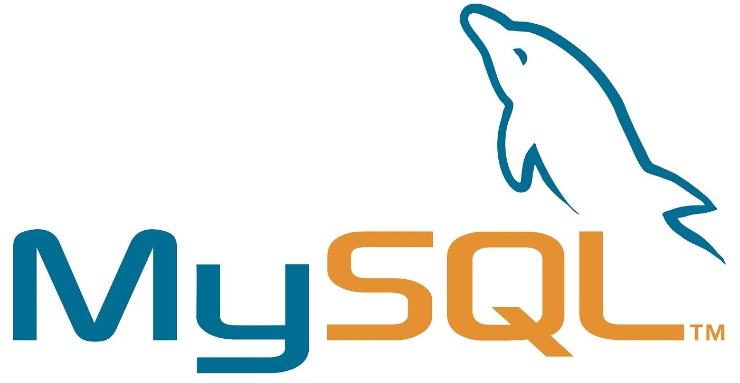
MySQL — The Relational Database
MySQL is a database system used on the web , The data in a MySQL database are stored in tables. A table is a collection of related data, and it consists of columns and rows.
MySQL is a database system that runs on a server
MySQL is ideal for both small and large applications
MySQL is very fast, reliable, and easy to use
MySQL uses standard SQL
MySQL compiles on a number of platforms
MySQL is free to download and use
MySQL is developed, distributed, and supported by Oracle Corporation

Slide 7
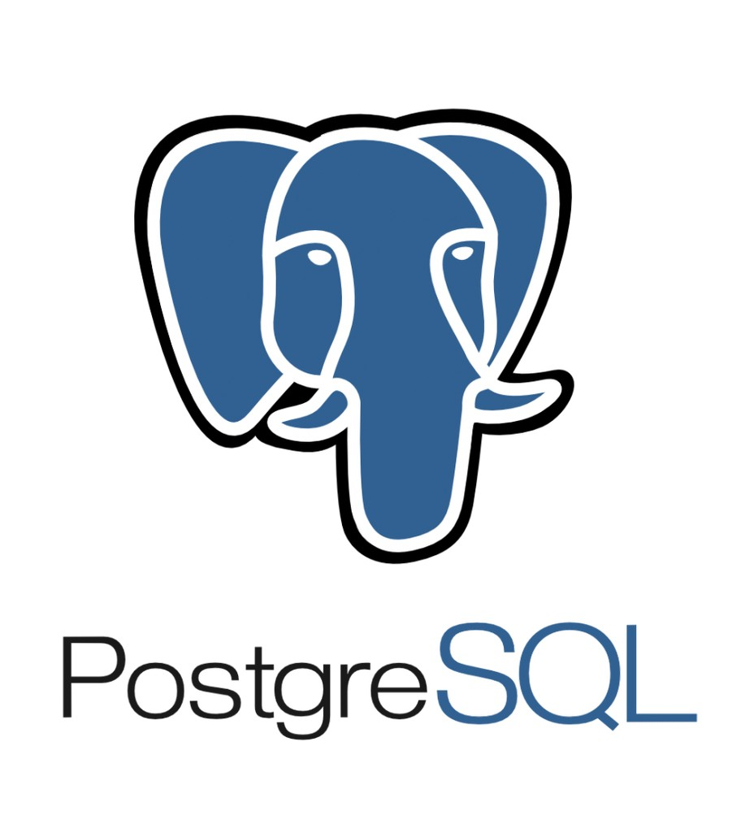
PostgreSQL
PostgreSQL is a powerful, open source object-relational database system that uses and extends the SQL language combined with many features that safely store and scale the most complicated data workloads.
PostgreSQL is highly extensible. For example, you can define your own data types, build out custom functions, even write code from different programming languages without recompiling your database.
It is a highly stable database management system.
PostgreSQL is used as the primary data store or data warehouse for many web, mobile, geospatial, and analytics applications

Slide 8
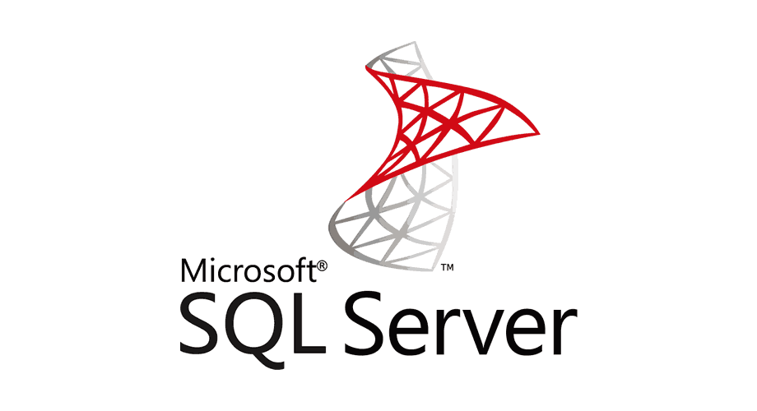
SQL Server
SQL Server is a RDMS developed by Microsoft. As a database server it is a software product with the primary function of storing and retrieving data as requested by other software applications.
Similar to other RDBMS software, SQL Server is built on top of SQL, a standard programming language for interacting with the relational databases.
SQL server is tied to Transact-SQL, or T-SQL, the Microsoft’s implementation of SQL that adds a set of proprietary programming constructs.
SQL Server is ensuring the security of your database.
SQL Server installation and configuration of Microsoft SQL Server are easier

Slide 9
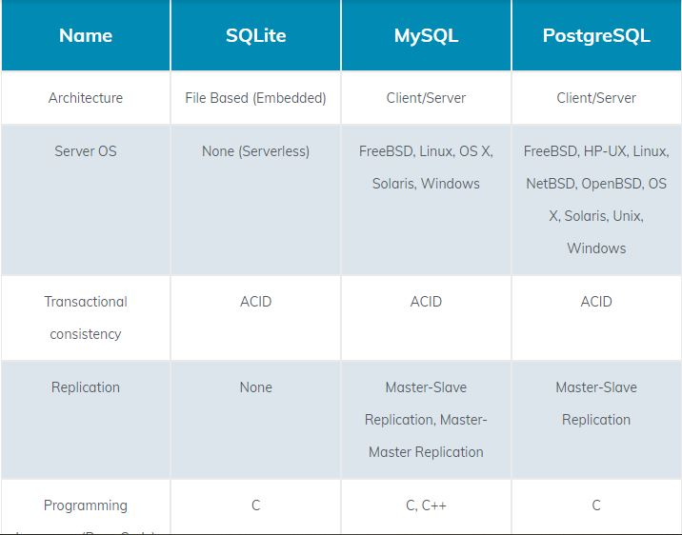
Difference Between the RDBMS

Slide 10
