Slide 1
Advanced Web Technology (CS163) Class
on
AJAX
Sonam Mittal
Department of Computer Science and Engineering
Chitkara University, Punjab

Slide 2
Client Server Model
It is a distributed application structure that partitions task or workload between the providers of a resource or service, called servers, and service requesters called clients.
In the client-server architecture, when the client computer sends a request for data to the server through the internet, the server accepts the requested process and deliver the data packets requested back to the client.
Clients do not share any of their resources.
Examples of Client-Server Model are Email, World Wide Web, etc.

Slide 3
Client server communication
Client: When we talk the word Client, it mean to talk of a person or an organization using a particular service. Similarly in the digital world a Client is a computer (Host) i.e. capable of receiving information or using a particular service from the service providers (Servers).
Servers: Similarly, when we talk the word Servers, It mean a person or medium that serves something. Similarly in this digital world a Server is a remote computer which provides information (data) or access to particular services.
So, its basically the Client requesting something and the Server serving it as long as its present in the database.

Slide 4
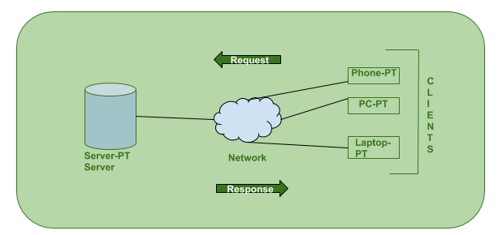
Client server communication

Slide 5
AJAX
AJAX = Asynchronous JavaScript And XML.
AJAX is not a programming language.
AJAX just uses a combination of:
A browser built-in XMLHttpRequest object (to request data from a web server)
JavaScript and HTML DOM (to display or use the data)
AJAX allows web pages to be updated asynchronously by exchanging data with a web server behind the scenes. This means that it is possible to update parts of a web page, without reloading the whole page.

Slide 6
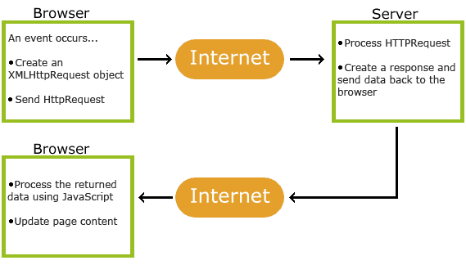
How AJAX Works

Slide 7
How AJAX Works
1. An event occurs in a web page (the page is loaded, a button is clicked).
2. An XMLHttpRequest object is created by JavaScript
3. The XMLHttpRequest object sends a request to a web server
4. The server processes the request
5. The server sends a response back to the web page
6. The response is read by JavaScript
7. Proper action (like page update) is performed by JavaScript

Slide 8
AJAX
AJAX cannot work independently. It is used in combination with other technologies to create interactive webpages.
JavaScript
Loosely typed scripting language.
JavaScript function is called when an event occurs in a page.
Glue for the whole AJAX operation.
DOM
API for accessing and manipulating structured documents.
Represents the structure of XML and HTML documents.
CSS
Allows for a clear separation of the presentation style from the content and may be changed programmatically by JavaScript.
XMLHttpRequest
JavaScript object that performs asynchronous interaction with the server.

Slide 9
HTTP
The Hypertext Transfer Protocol (HTTP) is an application-level protocol for distributed, collaborative, hypermedia information systems.
This is the foundation for data communication for the World Wide Web (i.e. internet) since 1990.
HTTP is a generic and stateless protocol which can be used for other purposes as well using extensions of its request methods, error codes and headers.

Slide 10
HTTP
Basically, HTTP is a TCP/IP based communication protocol, that is used to deliver data (HTML files, image files, query results, etc.) on the World Wide Web .
HTTP specification specifies how clients' request data will be constructed and sent to the server, and how the servers respond to these requests.

Slide 11
HTTP Features
HTTP is connectionless: The HTTP client, i.e., a browser initiates an HTTP request and after a request is made, the client waits for the response. The server processes the request and sends a response back after which client disconnect the connection. So client and server knows about each other during current request and response only.
HTTP is media independent: It means, any type of data can be sent by HTTP as long as both the client and the server know how to handle the data content. It is required for the client as well as the server to specify the content type using appropriate MIME-type( Multipurpose Internet Mail Extensions).

Slide 12
HTTP Features
HTTP is stateless: It is stateless protocol because each request is executed independently, without any knowledge of the requests that were executed before it, which means once the transaction ends the connection between the browser and the server is also lost.
Due to this nature of the protocol, neither the client nor the browser can retain information between different requests across the web pages.
What makes the protocol stateless is that in its original design, HTTP is a relatively simple file transfer protocol:
make a request for a file named by a URL,
get the file in response,
disconnect.
There was no relationship maintained between one connection and another, even from the same client. This simplifies the contract between client and server, and in many cases minimizes the amount of data that needs to be transferred.

Slide 13
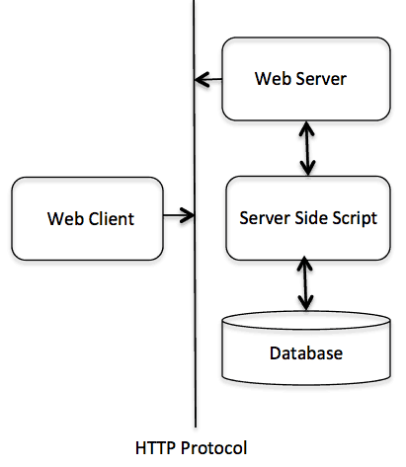
HTTP Architecture
This diagram shows a very basic architecture of a web application and depicts where HTTP protocol is a request/response protocol based on the client/server based architecture where web browsers, robots and search engines, etc. act like HTTP clients, and the Web server acts as a server.

Slide 14
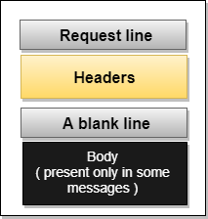
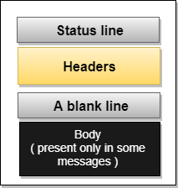
Request message Response Message

Slide 15

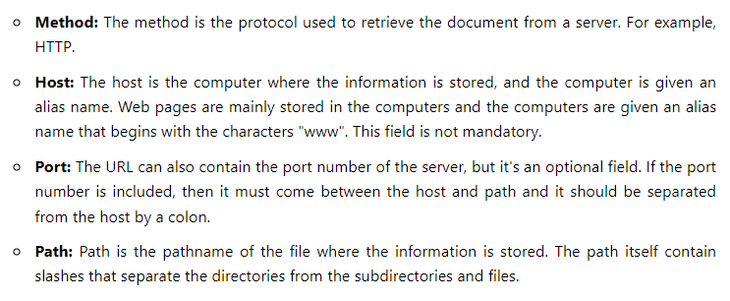
URL
The Uniform Resource Locator (URL) is a standard way of specifying any kind of information on the internet.

Slide 16
API
API stands for Application Programming Interface.
It is like a messenger that takes requests to a system and returns a response back via seamless connectivity.
APIs are used in many cases to get data for a web application or to connect to a remote server that has data like weather that keeps changing or to enable two applications to exchange data among each other.
API not only provide reusability of code but also uses the concept of abstraction (showing functionality by hiding complexity).

Slide 17
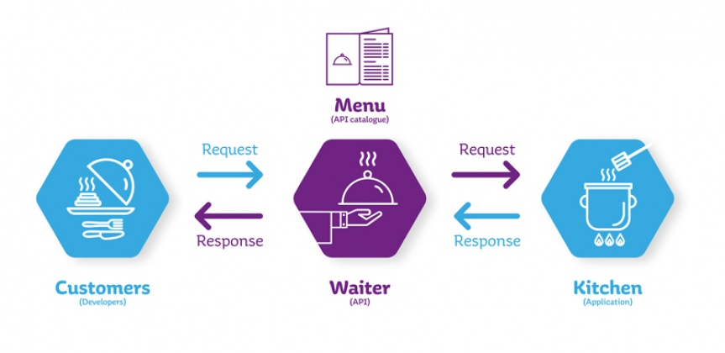
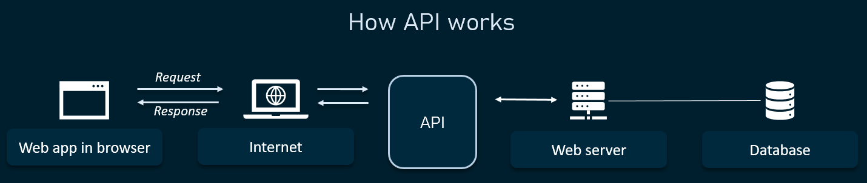
API

Slide 18
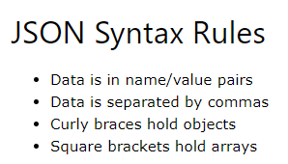
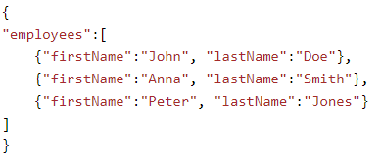
JSON
JSON stands for JavaScript Object Notation.
JSON is a lightweight data-interchange format used to send data between computers.
This example defines an employees object: an array of 3 employee records (objects):

Slide 19
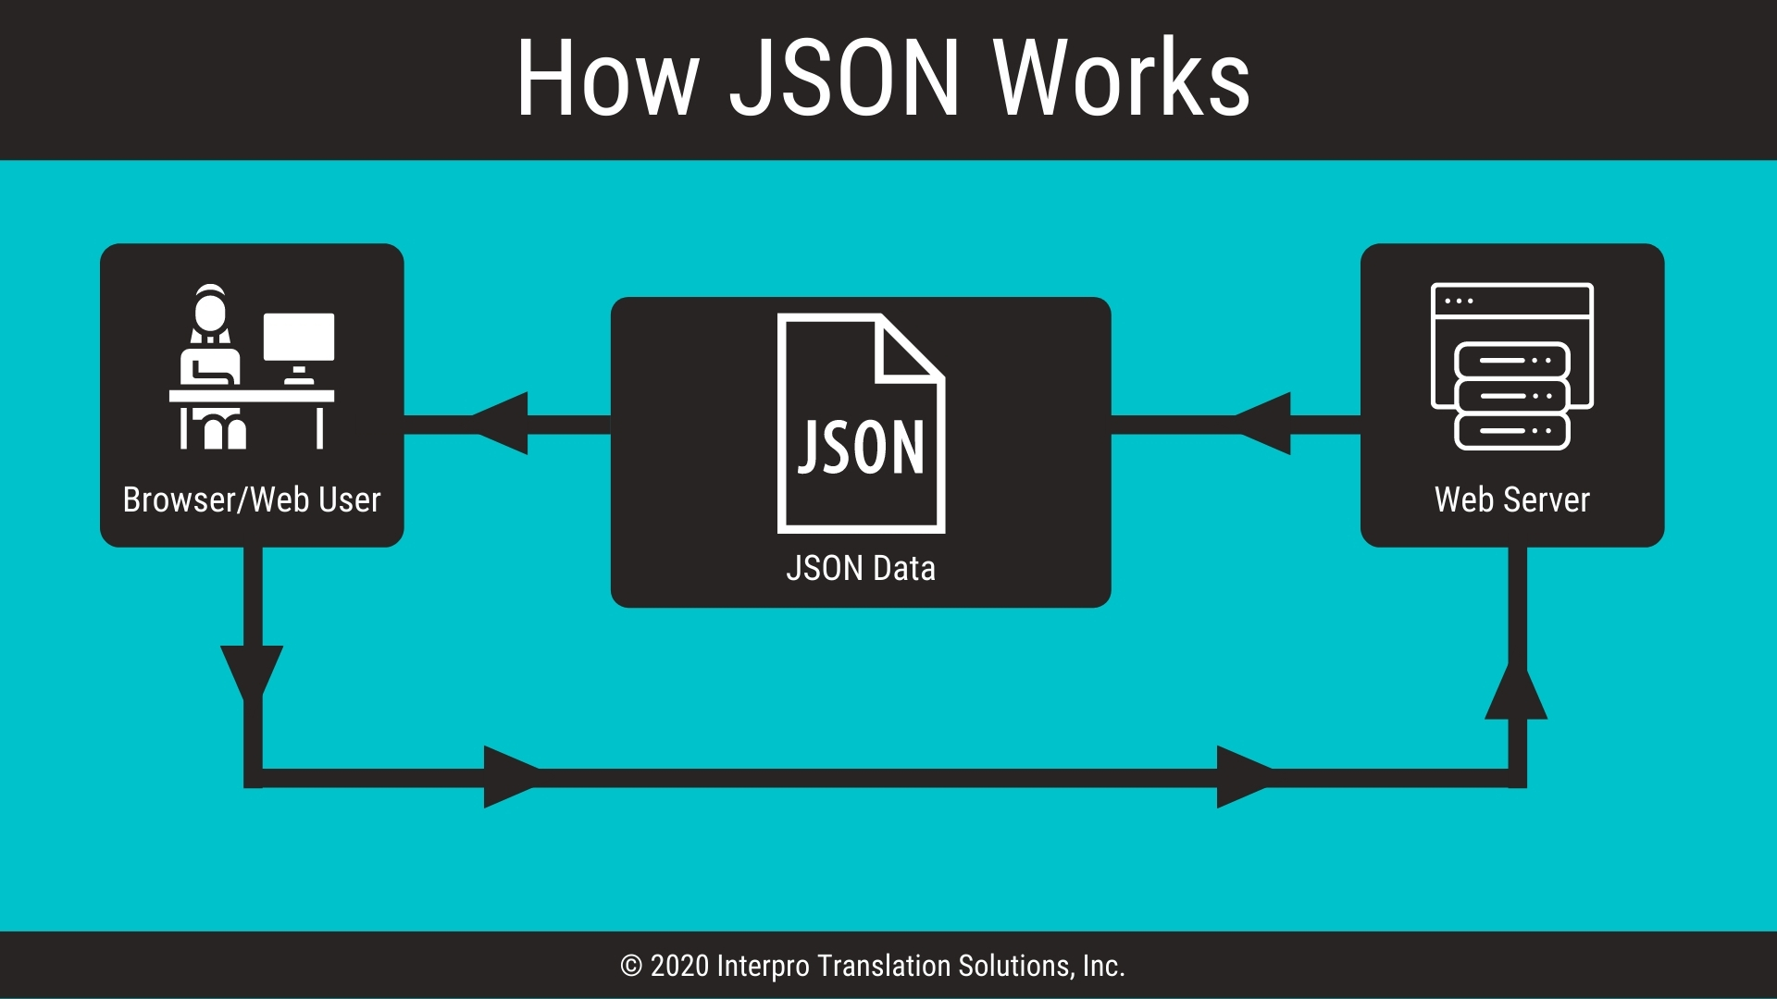
JSON

Slide 20
JSON Methods
JavaScript has a built in function for converting JSON strings into JavaScript objects:
JSON.parse()
JavaScript also has a built in function for converting an object into a JSON string:
JSON.stringify()
When storing data, the data has to be a certain format, and regardless of where you choose to store it, text is always one of the legal formats.
JSON makes it possible to store JavaScript objects as text.

Slide 21
Example (Parse)
<!DOCTYPE html> <html> <body> <h2>Create Object from JSON String</h2> <p id="demo"></p> <script> let text = '{"employees":[' + '{"firstName":"John","lastName":"Doe" },' + '{"firstName":"Anna","lastName":"Smith" },' + '{"firstName":"Peter","lastName":"Jones" }]}'; console.log(typeof(text)); const obj = JSON.parse(text); document.getElementById("demo").innerHTML = obj.employees[1].firstName + " " + obj.employees[1].lastName; console.log(typeof(obj)); </script> </body> </html>

Slide 22
Example (Parse)
<!DOCTYPE html> <html> <body> <h2>Parsing a JSON Array.</h2> <p>Data written as an JSON array will be parsed into a JavaScript array.</p> <p id="demo"></p> <script> const text = '[ "Ford", "BMW", "Audi", "Fiat" ]'; console.log(typeof(text)) const myArr = JSON.parse(text); console.log(typeof(myArr)) document.getElementById("demo").innerHTML = myArr[0]; </script> </body> </html>

Slide 23
Example (stringify)
<!DOCTYPE html> <html> <body> <h2>Create a JSON string from a JavaScript object.</h2> <p id="demo"></p> <script> const obj = {name: "John", age: 30, city: "New York"}; const myJSON = JSON.stringify(obj); console.log(typeof(obj)); document.getElementById("demo").innerHTML = myJSON; console.log(typeof(myJSON)); </script> </body> </html>

Slide 24
JSON string from a JavaScript array
<!DOCTYPE html> <html> <body> <h2>Create a JSON string from a JavaScript array.</h2> <p id="demo"></p> <script> const arr = ["John", "Peter", "Sally", "Jane"]; const myJSON = JSON.stringify(arr); document.getElementById("demo").innerHTML = myJSON; </script> </body> </html>

Slide 25
AJAX
AJAX is important, because you can:
Read data from a web server - after the page has loaded
Update a web page without reloading the page
Send data to a web server - in the background
The keystone of AJAX is the XMLHttpRequest object.
Create an XMLHttpRequest object
Define a callback function
Open the XMLHttpRequest object
Send a Request to a server

Slide 26
XMLHttpRequest Object
The XMLHttpRequest Object: All modern browsers support the XMLHttpRequest object.
It can be used to exchange data with a web server behind the scenes. This means that it is possible to update parts of a web page, without reloading the whole page.
Create an XMLHttpRequest Object: All modern browsers (Chrome, Firefox, IE, Edge, Safari, Opera) have a built-in XMLHttpRequest object.
Syntax : creating an XMLHttpRequest object:
variable = new XMLHttpRequest();
Define a Callback Function: A callback function is a function passed as a parameter to another function.
In this case, the callback function should contain the code to execute when the response is ready.
xhttp.onload = function() {
// What to do when the response is ready
}
Send a Request: To send a request to a server, you can use the open() and send() methods of the XMLHttpRequest object:
xhttp.open("GET", "ajax_info.txt");
xhttp.send();

Slide 27
AJAX - XMLHttpRequest
Ajax Method:-
xhttp.open("GET", "ajax_test.asp", true);
The file can be any kind of file, like .txt and .xml, or server scripting files like .asp and .php (which can perform actions on the server before sending the response back).
The url - A File On a Server:
The url parameter of the open() method, is an address to a file on a server:
Method | Description
open(method, url, async) | Specifies the type of request
method | the type of request: GET or POST
url | the server (file) location
async | true (asynchronous) or false (synchronous)
send() | Sends the request to the server (used for GET)
send(string) | Sends the request to the server (used for POST)
The url | A File On a Server

Slide 28
Contd…
Asynchronous - True or False?
Server requests should be sent asynchronously.
The async parameter of the open() method should be set to true:
xhttp.open("GET", "ajax_test.asp", true);
By sending asynchronously, the JavaScript does not have to wait for the server response, but can instead:
execute other scripts while waiting for server response
deal with the response after the response is ready
The default value for the async parameter is async = true.
You can safely remove the third parameter from your code.
Synchronous XMLHttpRequest (async = false) is not recommended because the JavaScript will stop executing until the server response is ready. If the server is busy or slow, the application will hang or stop.

Slide 29
AJAX Request get() and post() Methods
The jQuery get() and post() methods are used to request data from the server with an HTTP GET or POST request.
HTTP Request: GET vs. POST
Two commonly used methods for a request-response between a client and server are: GET and POST.
GET - Requests data from a specified resource
POST - Submits data to be processed to a specified resource
GET is basically used for just getting (retrieving) some data from the server. Note: The GET method may return cached data.
POST can also be used to get some data from the server. However, the POST method NEVER caches data, and is often used to send data along with the request.

Slide 30
GET or POST?
GET is simpler and faster than POST, and can be used in most cases.
However, always use POST requests when:
A cached file is not an option (update a file or database on the server).
Sending a large amount of data to the server (POST has no size limitations).
Sending user input (which can contain unknown characters).
POST is more robust and secure than GET.
GET is less secure compared to POST because data sent is part of the URL. So it's saved in browser history and server logs in plaintext. POST is a little safer than GET because the parameters are not stored in browser history or in web server logs.

Slide 31
GET Requests
In the mentioned example, you may get a cached result.
To avoid this, add a unique ID to the URL:
<!DOCTYPE html> <html> <body> <h2>The XMLHttpRequest Object</h2> <p id="demo">Let AJAX change this text.</p> <button type="button" onclick="loadDoc()">Change Content</button> <script> function loadDoc() { var xhttp = new XMLHttpRequest(); xhttp.open("GET", "hello.txt", false); xhttp.send(); document.getElementById("demo").innerHTML = xhttp.responseText; } </script> </body> </html>

Slide 32
POST Requests
To POST data like an HTML form, add an HTTP header with setRequestHeader(). Specify the data you want to send in the send() method.
<!DOCTYPE html> <html><body> <h2>The XMLHttpRequest Object</h2> <button type="button" onclick="loadDoc()">Request data</button> <p id="demo"></p> <script> function loadDoc() { const xhttp = new XMLHttpRequest(); xhttp.onload = function() { document.getElementById("demo").innerHTML = this.responseText; } xhttp.open("POST", “hello.txt"); xhttp.send(); } </script></body> </html>
<!DOCTYPE html><html><body> <h2>The XMLHttpRequest Object</h2> <button type="button" onclick="loadDoc()">Request data</button> <p id="demo"></p> <script> function loadDoc() { const xhttp = new XMLHttpRequest(); xhttp.onload = function() { document.getElementById("demo").innerHTML = this.responseText; } xhttp.open("POST", "demo_post2.asp"); xhttp.setRequestHeader("Content-type", "application/x-www-form-urlencoded"); xhttp.send("fname=Henry&lname=Ford"); } </script> </body> </html>

Slide 33
Synchronous Request
To execute a synchronous request, change the third parameter in the open() method to false:
xhttp.open("GET", "ajax_info.txt", false);
Sometimes async = false are used for quick testing. You will also find synchronous requests in older JavaScript code.
Since the code will wait for server completion, there is no need for an onreadystatechange function:
Synchronous XMLHttpRequest (async = false) is not recommended because the JavaScript will stop executing until the server response is ready. If the server is busy or slow, the application will hang or stop.
<!DOCTYPE html> <html> <body> <h2>The XMLHttpRequest Object</h2> <p id="demo">Let AJAX change this text.</p> <button type="button" onclick="loadDoc()">Change Content</button> <script> function loadDoc() { var xhttp = new XMLHttpRequest(); xhttp.open("GET", "ajax_info.txt", false); xhttp.send(); document.getElementById("demo").innerHTML = xhttp.responseText; } </script></body></html>

Slide 34
jQuery $.get() Method
The $.get() method requests data from the server with an HTTP GET request.
Syntax: $.get(URL,callback);
The required URL parameter specifies the URL you wish to request.
The optional callback parameter is the name of a function to be executed if the request succeeds.
The following example uses the $.get() method to retrieve data from a file on the server:
The first parameter of $.get() is the URL we wish to request ("demo_test.asp").
The second parameter is a callback function.
The first callback parameter holds the content of the page requested,
The second callback parameter holds the status of the request.
Example:
<!DOCTYPE html>
<html>
<head>
<script src="https://ajax.googleapis.com/ajax/libs/jquery/3.5.1/jquery.min.js"></script>
<script>
$(document).ready(function(){
$("button").click(function(){
$.get("demo_test.asp", function(data, status){
alert("Data: " + data + "\nStatus: " + status);
});
});
});
</script>
</head>
<body>
<button>Send an HTTP GET request to a page and get the result back</button>
</body>
</html>

Slide 35
jQuery $.post() Method
The $.post() method requests data from the server using an HTTP POST request.
Syntax: $.post(URL,data,callback);
The required URL parameter specifies the URL you wish to request. The optional data parameter specifies some data to send along with the request. The optional callback parameter is the name of a function to be executed if the request succeeds.
The following example uses the $.post() method to send some data along with the request:
The ASP script in "demo_test_post.asp" reads the parameters, processes them, and returns a result.
The first parameter of $.post() is the URL we wish to request ("demo_test_post.asp").
Then we pass in some data to send along with the request (name and city).
The third parameter is a callback function.
The first callback parameter holds the content of the page requested,
The second callback parameter holds the status of the request.
Tip: Here is how the ASP file looks like ("demo_test_post.asp"):
Example:
<!DOCTYPE html>
<html>
<head>
<script src="https://ajax.googleapis.com/ajax/libs/jquery/3.5.1/jquery.min.js"></script>
<script>
$(document).ready(function(){
$("button").click(function(){
$.post("demo_test_post.asp",
{
name: "Donald Duck",
city: "Duckburg"
},
function(data,status){
alert("Data: " + data + "\nStatus: " + status);
});
});
});
</script>
</head>
<body>
<button>Send an HTTP POST request to a page and get the result back</button>
</body>
</html>

Slide 36
POST Requests
To POST data like an HTML form, add an HTTP header with setRequestHeader(). Specify the data you want to send in the send() method.
<!DOCTYPE html> <html><head> <script src="https://ajax.googleapis.com/ajax/libs/jquery/3.6.0/jquery.min.js"></script> <script> $(document).ready(function(){ $("button").click(function(){ $.post("post1.php", { name: "Donald Duck", city: "Duckburg" }, function(data,status){ alert("Data: " + data + "\nStatus: " + status); }); }); }); </script> </head><body> <button>Send an HTTP POST request to a page and get the result back</button> </body> </html>
<?php $name = $_POST['name']; $city = $_POST['city']; echo "my name is $name i belong to $city"; ?>

Slide 37
AJAX error handling
Many pages send AJAX requests to a server. Because this relies on the cooperation of the server and the network between the client and the server, you can expect these AJAX errors:
Your JavaScript program receives an error response instead of data;
Your program has to wait too long for the response. You can't have the user wait indefinitely for some data to load.
Your program has to wait longer than expected for the response. You or your marketing department may decide to time out after 5 seconds, and that if responses take over 2 seconds to arrive you want to know about it.
This page shows how to implement AJAX error handling with JavaScript loggers that log to the server, so you find out about these issues.

Slide 38
jQuery ajaxError() Method Example
The ajaxError() method specifies a function to be run when an AJAX request fails.
<!DOCTYPE html>
<html>
<head>
<script src="https://ajax.googleapis.com/ajax/libs/jquery/3.5.1/jquery.min.js"></script>
<script>
$(document).ready(function(){
$(document).ajaxError(function(){
alert("An error occured!");
});
$("button").click(function(){
$("div").load("wrongfile.txt");
});
});
</script>
</head>
<body>
<div><h2>Let AJAX change this text</h2></div>
<button>Change Content</button>
</body>
</html>

Slide 39
Thank You

