Slide 1
Monte Carlo simulations
Addressing actual coverage of confidence interval methods for a Bernoulli population
Carlo Bianchi
Cosimo Matassini
Homework 1

Slide 2
Workflow
We simulated 9 different scenarios. Specifically we considered 3 different Bernoulli parameters for the population, then we obtained 3 samples of increasing sizes. We made 1000 Monte Carlo simulations for each scenario.
α = 0.05
[1] "Actual coverage con pi = 0.1 e n = 50 : 0.872"
[1] "Actual coverage con pi = 0.1 e n = 500 : 0.951"
[1] "Actual coverage con pi = 0.1 e n = 1000 : 0.96"
[1] "Actual coverage con pi = 0.5 e n = 50 : 0.917"
[1] "Actual coverage con pi = 0.5 e n = 500 : 0.945"
[1] "Actual coverage con pi = 0.5 e n = 1000 : 0.945"
[1] "Actual coverage con pi = 0.7 e n = 50 : 0.941"
[1] "Actual coverage con pi = 0.7 e n = 500 : 0.947"
[1] "Actual coverage con pi = 0.7 e n = 1000 : 0.956"

Slide 3
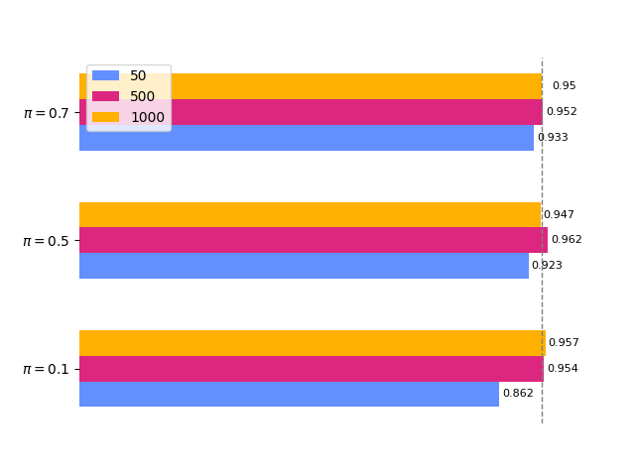
Results
As we can see, increasing the number of simulations
can help obtain a more accurate estimate of the true coverage.

Slide 4
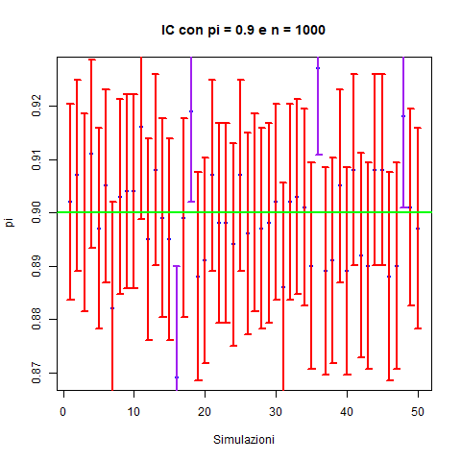
50 Monte Carlo simulations for CI
Actual coverage: 0.92 (46 CIs out of 50 contain the true pi value)
Theoric coverage: 0.95
We chose 50 iterations to show graphically what’s happening:
In this case we have an underestimation, which may be due to an insufficient number of Monte Carlo iterations.

Slide 5
References
Homework1_2.pdf
ChatGPT

