Slide 1
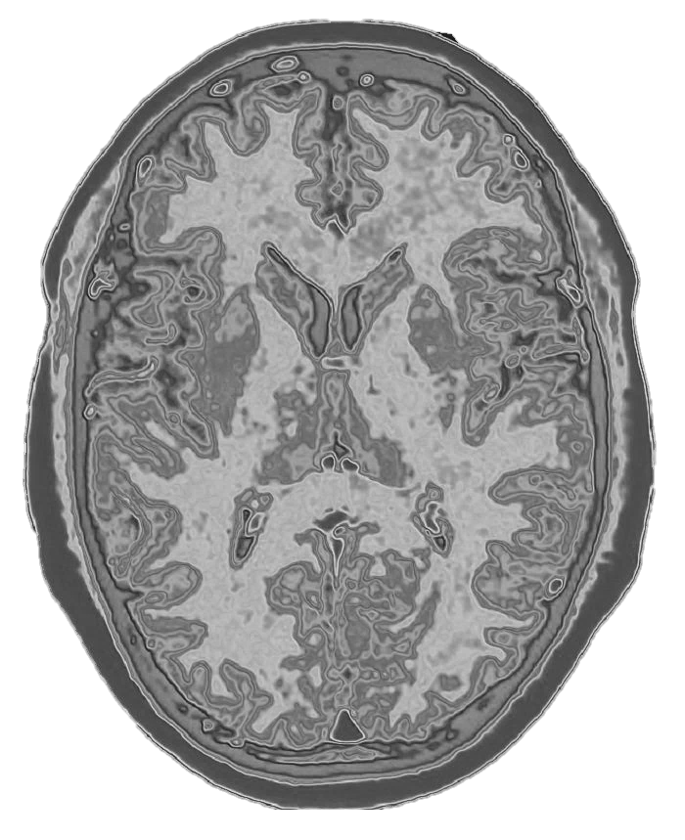
UNET
for Image Segmentation
An Introduction
Medical semantic image segmentation is a technique in medical imaging that uses artificial intelligence to precisely delineate different anatomical structures or pathological areas within an image. By assigning a label to each pixel, it helps doctors and researchers analyze medical scans more effectively, aiding in diagnosis, treatment planning, and research.

Slide 2
UNET
for Image Segmentation
An Introduction
Medical semantic image segmentation is a technique in medical imaging that uses artificial intelligence to precisely delineate different anatomical structures or pathological areas within an image. By assigning a label to each pixel, it helps doctors and researchers analyze medical scans more effectively, aiding in diagnosis, treatment planning, and research.
An Introduction
Deep learning models, particularly convolutional neural networks (CNNs) and transformer-based architectures, play a significant role in improving segmentation accuracy.

Slide 3
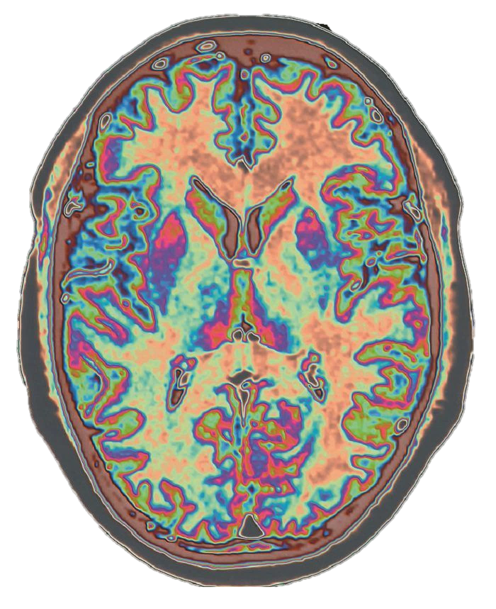
An Introduction
Medical semantic image segmentation is a technique in medical imaging that uses artificial intelligence to precisely delineate different anatomical structures or pathological areas within an image. By assigning a label to each pixel, it helps doctors and researchers analyze medical scans more effectively, aiding in diagnosis, treatment planning, and research.
An Introduction
Deep learning models, particularly convolutional neural networks (CNNs) and transformer-based architectures, play a significant role in improving segmentation accuracy.

Slide 4
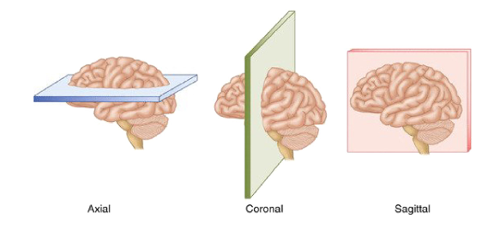
An introduction
Semantic image segmentation is a compound problem. To a local classification problem a spatial one is added. Every pixel of the input image has to be correctly classified.
There is a shortage in available training data.
It is difficult to biuld up model invariance to the most common modifications of medical images.
Medical images are 3D. They can be thought as stacks of slices of the organ along three different axes.

Slide 5
An introduction
Semantic image segmentation is a compound problem. To a local classification problem a spatial one is added. Every pixel of the input image has to be correctly classified.
There is a shortage in available training data.
It is difficult to biuld up model invariance to the most common modifications of medical images.
Medical images are 3D. They can be thought as stacks of slices of the organ along three different axes.

Slide 6
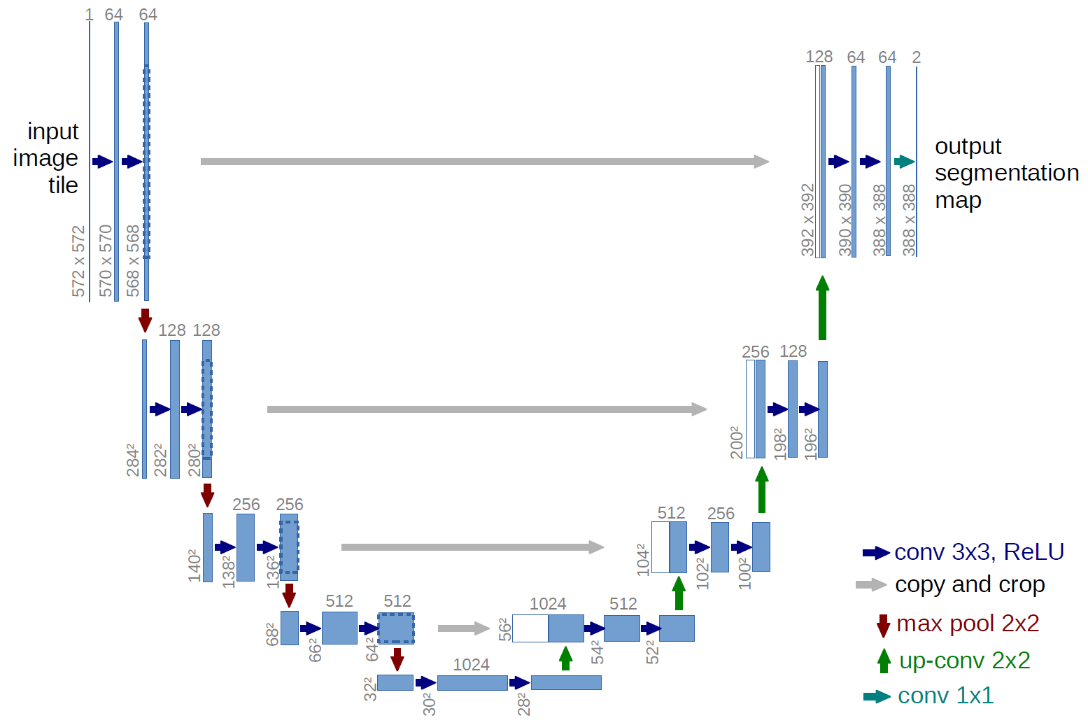
An Introduction
Deep learning models, particularly convolutional neural networks (CNNs) and transformer-based architectures, play a significant role in improving segmentation accuracy.
The Tool
U-Net is a deep learning architecture specifically designed for image segmentation, and it has had a significant impact on medical image analysis. It was introduced in 2015 by Olaf Ronneberger, Philipp Fischer, and Thomas Brox, primarily for biomedical image segmentation. Its key innovation is the combination of a contracting path (encoder) and an expansive path (decoder), allowing it to capture both low-level features and high-resolution spatial details. This makes it particularly effective for segmenting medical images where precision is crucial.
U-Nets are well-suited for medical semantic image segmentation because:
Preservation of Spatial Information: Unlike standard CNNs that lose spatial resolution due to pooling, U-Net uses skip connections to retain fine details, which is essential for tasks like tumor boundary detection
Data Efficiency: Medical imaging datasets are often limited. U-Net's architecture enables good performance even with relatively few training samples
Robustness to Image Variations: Given the complex nature of medical scans (MRI, CT, X-ray), U-Net can effectively handle different imaging modalities and structures.
High Accuracy in Segmenting Irregular Shapes: Medical abnormalities often have unpredictable shapes, and U-Net's design ensures precise segmentation even in such cases

Slide 7
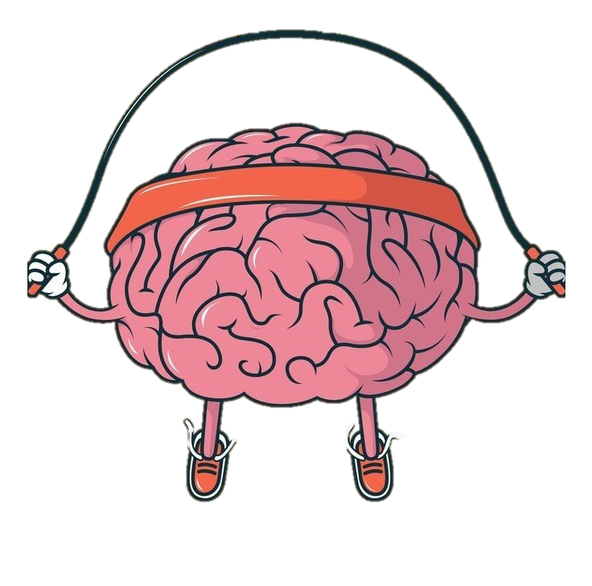
The Tool
U-Nets are well-suited for medical semantic image segmentation because:
Preservation of Spatial Information: Unlike standard CNNs that lose spatial resolution due to pooling, U-Net uses skip connections to retain fine details, which is essential for tasks like tumor boundary detection
Data Efficiency: Medical imaging datasets are often limited. U-Net's architecture enables good performance even with relatively few training samples
Robustness to Image Variations: Given the complex nature of medical scans (MRI, CT, X-ray), U-Net can effectively handle different imaging modalities and structures.
High Accuracy in Segmenting Irregular Shapes: Medical abnormalities often have unpredictable shapes, and U-Net's design ensures precise segmentation even in such cases
Training
Training a U-Net for medical image segmentation presents several challenges:
Data scarcity: Medical datasets are often limited due to privacy concerns and the cost of acquiring labeled images. Training a deep model with small datasets can lead to overfitting.
Class imbalance: In segmentation tasks, pathological regions (like tumors) are often much smaller than the surrounding healthy tissue. This imbalance can make the model biased toward background pixels.
High computational cost: U-Nets require significant computational power, especially for high-resolution medical images. Training them efficiently demands optimized hardware and techniques like mixed precision training.
Variability in medical images: Different imaging modalities (MRI, CT, X-ray) introduce variations in contrast, resolution, and noise levels, making it difficult to develop a universally robust model.
Annotation complexity: Manual segmentation by experts is time-consuming and sometimes subjective, leading to noisy labels that can affect model performance.

Slide 8
The Tool

Slide 9
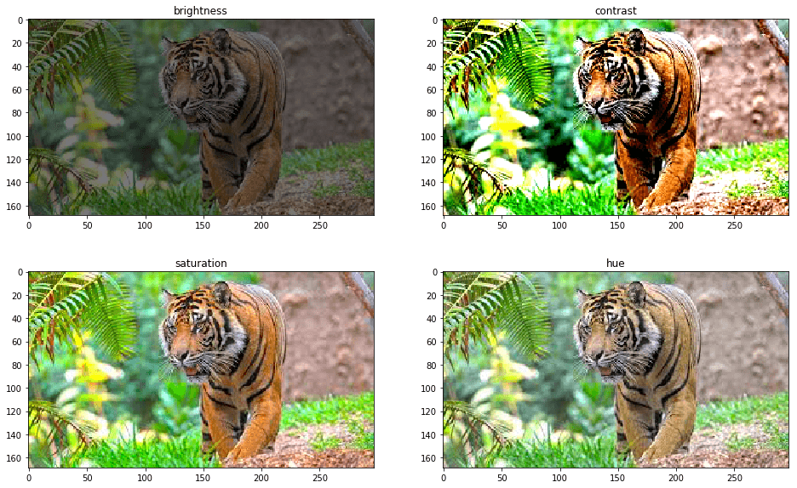
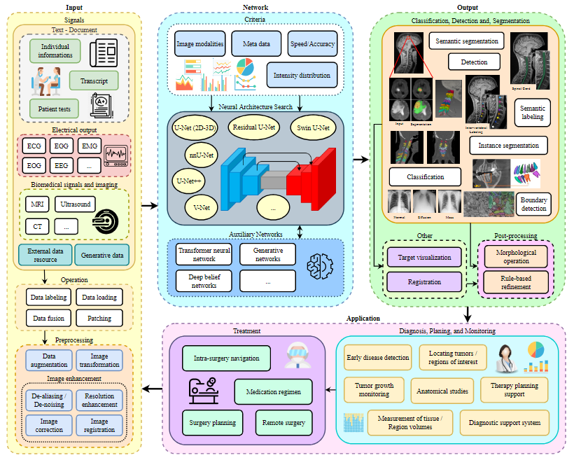
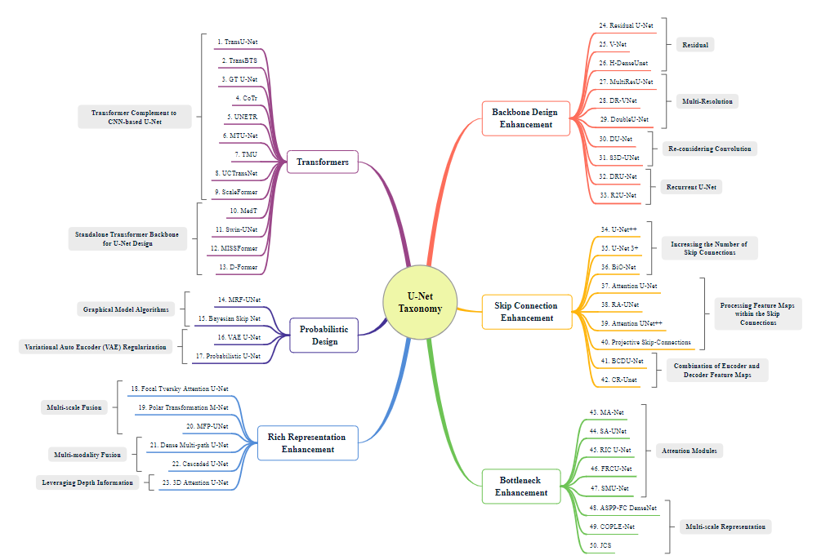

Slide 10
The encoder part takes the image to its latent space version. That is a space where a compressed version of the image is represented, indicating which data points are closest together. The decoder network takes the latent space representation of the image and takes it to its original form (in pixels).
Skip connections are a critical part of U-Net architecture. Semantic image segmentation is a compound problem, every pixel of the input image has to be labelled: to a local classification problem another spatial positional problem is added. Skip connections from an encoder layer to a same-depth decoder layer help to join deep level local information to spatial information. A main problem of deep CNN is this: the deeper the network, the more spatial information are lost.

Slide 11
For the researchers the core advantage causing U-Net popularity in the field is its symmetric nature, which enables broad modifications to its architecture. This can lead to increases in network performance for specific use cases.
Brain strokes are of two different kinds, with different treatments but same initial diagnosis, through MRI or CT. A stroke can be caused by: an oxygen deficiency to the brain (ischemic stroke) or because of a vein explosion which spreads blood in its neighborhood (hemorrhage stroke). The second one, even if it is more rare, is more lethal, being of greater interest for researchers (35-52% mortality rate).
During CoVID19 the shortage of competent health figures showed itself, underlining the improved necessity for this kind of models

Slide 12
Extensive data augmentation techniques are used in order to improve network invariance to shift, rotation and deformation. In fact these are the most common deformation seen in medical images.

Slide 14
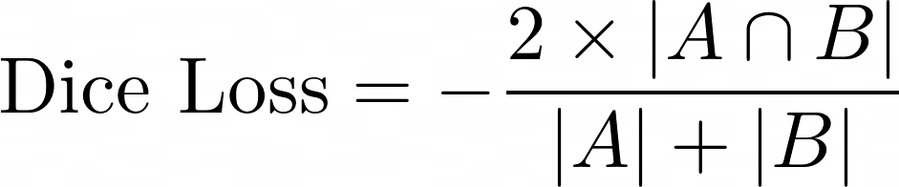
The Tool
U-Nets are well-suited for medical semantic image segmentation because:
Preservation of Spatial Information: Unlike standard CNNs that lose spatial resolution due to pooling, U-Net uses skip connections to retain fine details, which is essential for tasks like tumor boundary detection
Data Efficiency: Medical imaging datasets are often limited. U-Net's architecture enables good performance even with relatively few training samples
Robustness to Image Variations: Given the complex nature of medical scans (MRI, CT, X-ray), U-Net can effectively handle different imaging modalities and structures.
High Accuracy in Segmenting Irregular Shapes: Medical abnormalities often have unpredictable shapes, and U-Net's design ensures precise segmentation even in such cases
Training
Training a U-Net for medical image segmentation presents several challenges:
Data scarcity: Medical datasets are often limited due to privacy concerns and the cost of acquiring labeled images. Training a deep model with small datasets can lead to overfitting.
Class imbalance: In segmentation tasks, pathological regions (like tumors) are often much smaller than the surrounding healthy tissue. This imbalance can make the model biased toward background pixels.
High computational cost: U-Nets require significant computational power, especially for high-resolution medical images. Training them efficiently demands optimized hardware and techniques like mixed precision training.
Variability in medical images: Different imaging modalities (MRI, CT, X-ray) introduce variations in contrast, resolution, and noise levels, making it difficult to develop a universally robust model.
Annotation complexity: Manual segmentation by experts is time-consuming and sometimes subjective, leading to noisy labels that can affect model performance.
I built U-net neural network using the keras high and low-level API.
I used the high level functional API for building the network. It has an encoder with 5 layers and a decoder with the same number of layers. It has about 31 million parameters to train.
The low level API has been used for creating task-specific cost functions and metrics. For training purposes, I used the Dice coefficient.

Slide 15
Training
I built U-net neural network using the keras high and low-level API.
I used the high level functional API for building the network. It has an encoder with 5 layers and a decoder with the same number of layers. It has about 31 million parameters to train.
The low level API has been used for creating task-specific cost functions and metrics. For training purposes, I used the Dice coefficient.

Slide 16
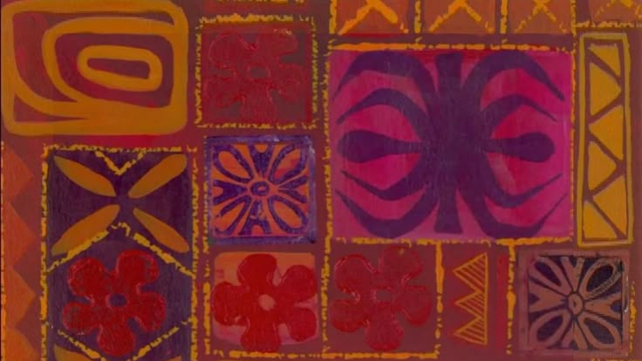
52 Hours
Later…

Slide 17
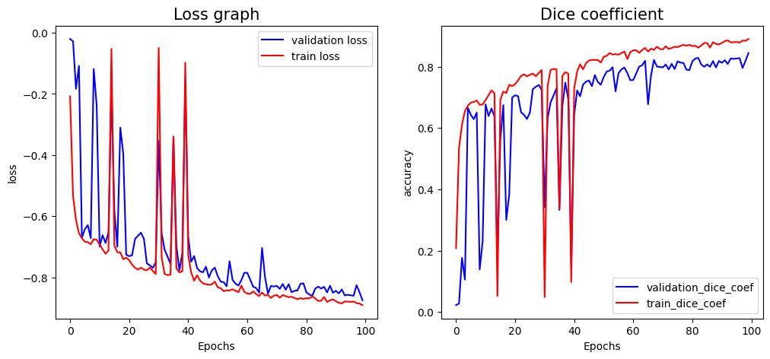
Result
Grafici della dice lossi di validazione e training
Test Loss: -0.834266
Test Loss: -0.834266
Test Dice Coefficient: 0.69

Slide 18
Result
Test Loss (complete): -0.834266
Test Dice Coefficient (complete): 0.69
Test Loss (partial): -0.78678
Test Dice Coefficient (partial): 0.64

Slide 19
Author: Bianchi Carlo Geron: Hands on Machine Learning Li et al. (2021): Deep Learning for Hemorrhagic Lesion Detection and Segmentation on Brain CT Images Azed et al. (2022): Medical Image Segmentation Review: The Success of U-Net Ronneberger et al. (2015): U-Net: Convolutional Networks for Biomedical Image Segmentation Walsh er al. (2022): Using U-Net network for efficient brain tumor segmentation in MRI images

