Slide 1
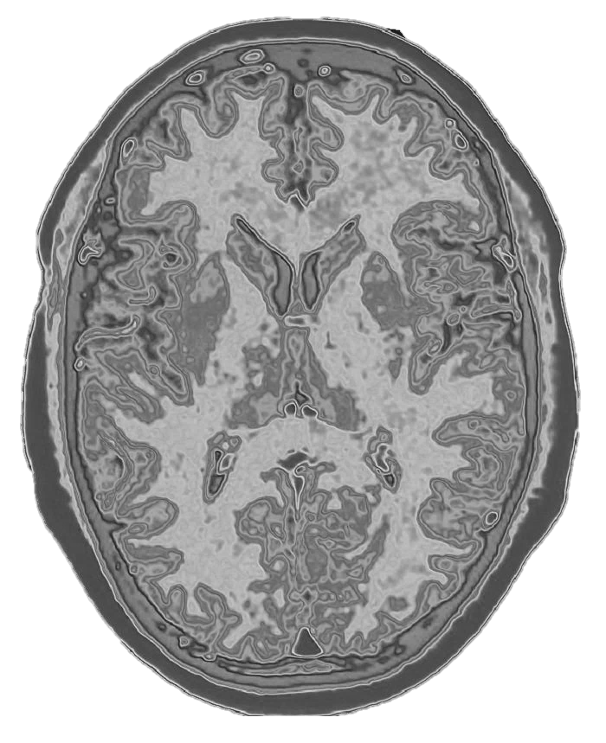
UNET
for Image Segmentation
An Introduction
Medical semantic image segmentation is a technique in medical imaging that uses artificial intelligence to precisely delineate different anatomical structures or pathological areas within an image. By assigning a label to each pixel, it helps doctors and researchers analyze medical scans more effectively, aiding in diagnosis, treatment planning, and research.

Slide 2
UNET
for Image Segmentation
An Introduction
Medical semantic image segmentation is a technique in medical imaging that uses artificial intelligence to precisely delineate different anatomical structures or pathological areas within an image. By assigning a label to each pixel, it helps doctors and researchers analyze medical scans more effectively, aiding in diagnosis, treatment planning, and research.
An Introduction
Deep learning models, particularly convolutional neural networks (CNNs) and transformer-based architectures, play a significant role in improving segmentation accuracy.

Slide 3
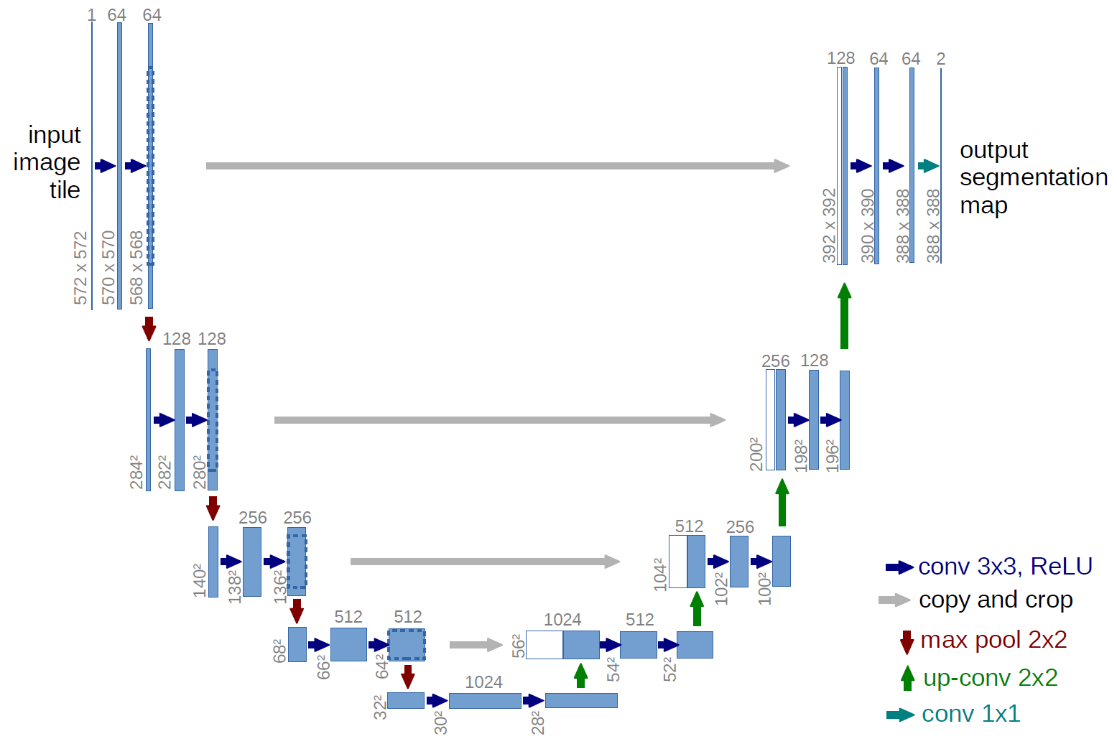
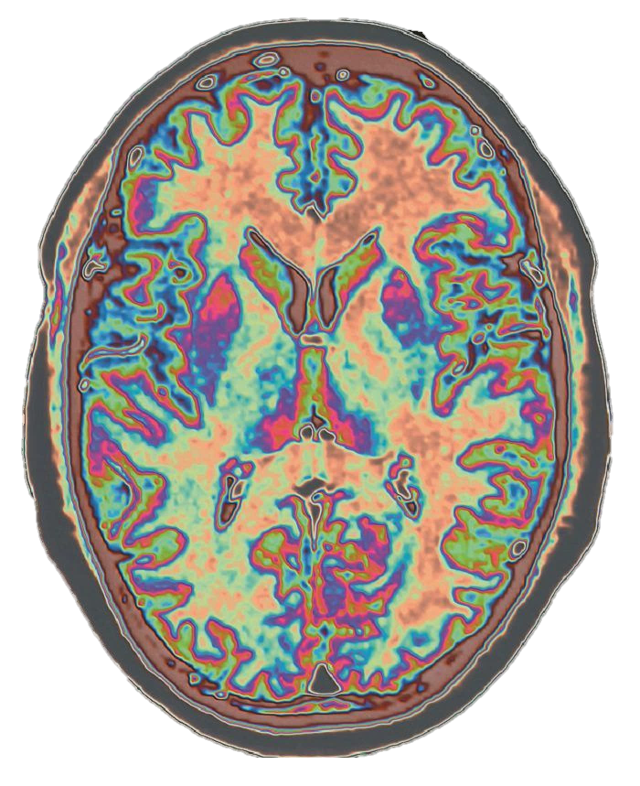
An Introduction
Medical semantic image segmentation is a technique in medical imaging that uses artificial intelligence to precisely delineate different anatomical structures or pathological areas within an image. By assigning a label to each pixel, it helps doctors and researchers analyze medical scans more effectively, aiding in diagnosis, treatment planning, and research.
An Introduction
Deep learning models, particularly convolutional neural networks (CNNs) and transformer-based architectures, play a significant role in improving segmentation accuracy.
The Tool
U-Net is a deep learning architecture specifically designed for image segmentation, and it has had a significant impact on medical image analysis. It was introduced in 2015 by Olaf Ronneberger, Philipp Fischer, and Thomas Brox, primarily for biomedical image segmentation. Its key innovation is the combination of a contracting path (encoder) and an expansive path (decoder), allowing it to capture both low-level features and high-resolution spatial details. This makes it particularly effective for segmenting medical images where precision is crucial.

Slide 4
An Introduction
Deep learning models, particularly convolutional neural networks (CNNs) and transformer-based architectures, play a significant role in improving segmentation accuracy.
The Tool
U-Net is a deep learning architecture specifically designed for image segmentation, and it has had a significant impact on medical image analysis. It was introduced in 2015 by Olaf Ronneberger, Philipp Fischer, and Thomas Brox, primarily for biomedical image segmentation. Its key innovation is the combination of a contracting path (encoder) and an expansive path (decoder), allowing it to capture both low-level features and high-resolution spatial details. This makes it particularly effective for segmenting medical images where precision is crucial.
U-Nets are well-suited for medical semantic image segmentation because:
Preservation of Spatial Information: Unlike standard CNNs that lose spatial resolution due to pooling, U-Net uses skip connections to retain fine details, which is essential for tasks like tumor boundary detection
Data Efficiency: Medical imaging datasets are often limited. U-Net's architecture enables good performance even with relatively few training samples
Robustness to Image Variations: Given the complex nature of medical scans (MRI, CT, X-ray), U-Net can effectively handle different imaging modalities and structures.
High Accuracy in Segmenting Irregular Shapes: Medical abnormalities often have unpredictable shapes, and U-Net's design ensures precise segmentation even in such cases

Slide 5
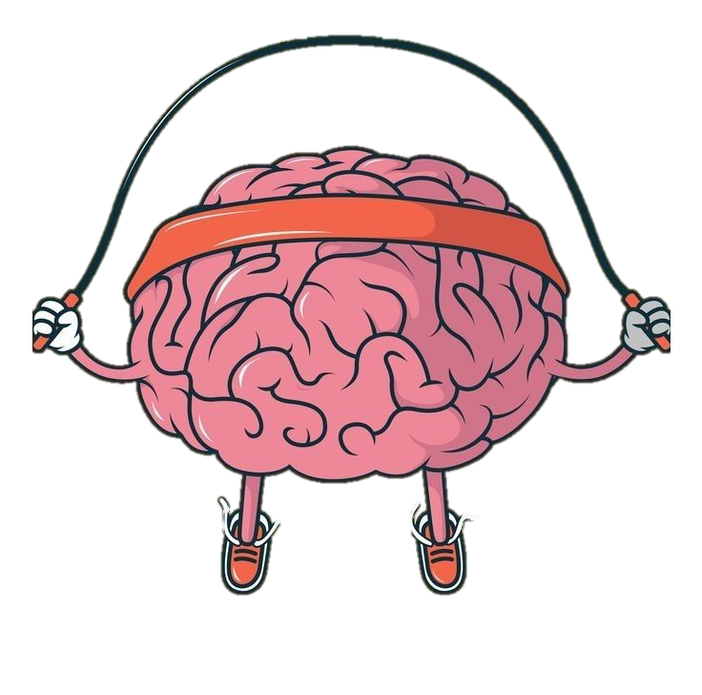
The Tool
U-Nets are well-suited for medical semantic image segmentation because:
Preservation of Spatial Information: Unlike standard CNNs that lose spatial resolution due to pooling, U-Net uses skip connections to retain fine details, which is essential for tasks like tumor boundary detection
Data Efficiency: Medical imaging datasets are often limited. U-Net's architecture enables good performance even with relatively few training samples
Robustness to Image Variations: Given the complex nature of medical scans (MRI, CT, X-ray), U-Net can effectively handle different imaging modalities and structures.
High Accuracy in Segmenting Irregular Shapes: Medical abnormalities often have unpredictable shapes, and U-Net's design ensures precise segmentation even in such cases
Training
Training a U-Net for medical image segmentation presents several challenges:
Data scarcity: Medical datasets are often limited due to privacy concerns and the cost of acquiring labeled images. Training a deep model with small datasets can lead to overfitting.
Class imbalance: In segmentation tasks, pathological regions (like tumors) are often much smaller than the surrounding healthy tissue. This imbalance can make the model biased toward background pixels.
High computational cost: U-Nets require significant computational power, especially for high-resolution medical images. Training them efficiently demands optimized hardware and techniques like mixed precision training.
Variability in medical images: Different imaging modalities (MRI, CT, X-ray) introduce variations in contrast, resolution, and noise levels, making it difficult to develop a universally robust model.
Annotation complexity: Manual segmentation by experts is time-consuming and sometimes subjective, leading to noisy labels that can affect model performance.

Slide 6
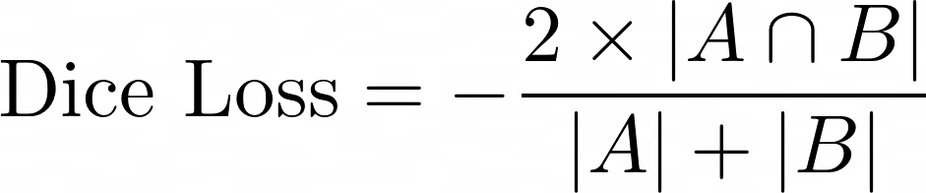
The Tool
U-Nets are well-suited for medical semantic image segmentation because:
Preservation of Spatial Information: Unlike standard CNNs that lose spatial resolution due to pooling, U-Net uses skip connections to retain fine details, which is essential for tasks like tumor boundary detection
Data Efficiency: Medical imaging datasets are often limited. U-Net's architecture enables good performance even with relatively few training samples
Robustness to Image Variations: Given the complex nature of medical scans (MRI, CT, X-ray), U-Net can effectively handle different imaging modalities and structures.
High Accuracy in Segmenting Irregular Shapes: Medical abnormalities often have unpredictable shapes, and U-Net's design ensures precise segmentation even in such cases
Training
Training a U-Net for medical image segmentation presents several challenges:
Data scarcity: Medical datasets are often limited due to privacy concerns and the cost of acquiring labeled images. Training a deep model with small datasets can lead to overfitting.
Class imbalance: In segmentation tasks, pathological regions (like tumors) are often much smaller than the surrounding healthy tissue. This imbalance can make the model biased toward background pixels.
High computational cost: U-Nets require significant computational power, especially for high-resolution medical images. Training them efficiently demands optimized hardware and techniques like mixed precision training.
Variability in medical images: Different imaging modalities (MRI, CT, X-ray) introduce variations in contrast, resolution, and noise levels, making it difficult to develop a universally robust model.
Annotation complexity: Manual segmentation by experts is time-consuming and sometimes subjective, leading to noisy labels that can affect model performance.
I built U-net neural network using the keras high and low-level API.
I used the high level functional API for building the network. It has an encoder with 5 layers and a decoder with the same number of layers. It has about 31 million parameters to train.
The low level API has been used for creating task-specific cost functions and metrics. For training purposes, I used the Dice coefficient.

Slide 7
Training
I built U-net neural network using the keras high and low-level API.
I used the high level functional API for building the network. It has an encoder with 5 layers and a decoder with the same number of layers. It has about 31 million parameters to train.
The low level API has been used for creating task-specific cost functions and metrics. For training purposes, I used the Dice coefficient.

Slide 8
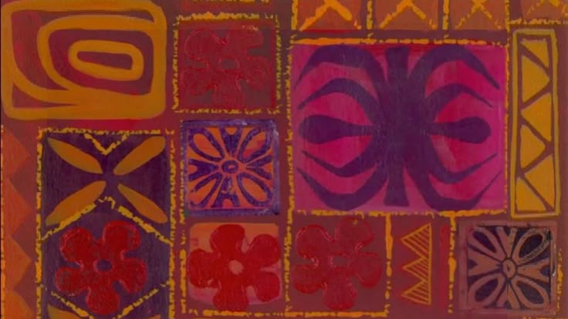
52 Hours
Later…

Slide 9
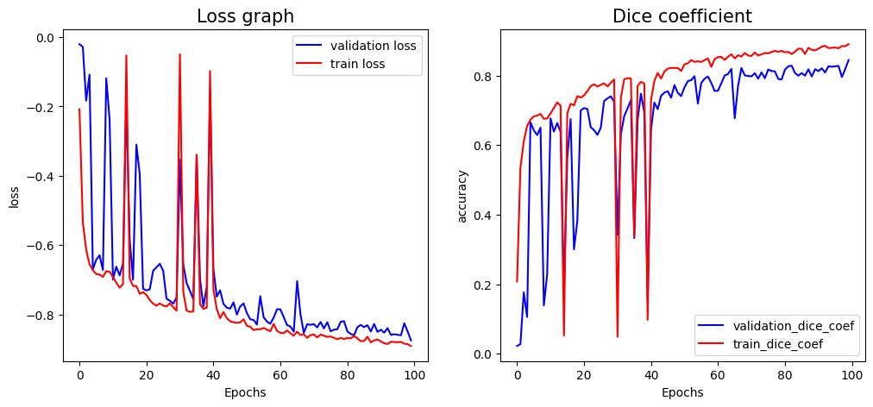
Result
Grafici della dice lossi di validazione e training
Test Loss: -0.834266
Test Loss: -0.834266
Test Dice Coefficient: 0.69

Slide 10
Result
Test Loss (Complete net): -0.834266
Test Dice Coefficient: 0.69
Test Loss (Partial net): -0.546790
Test Dice Coefficient (0.44)

