Slide 1
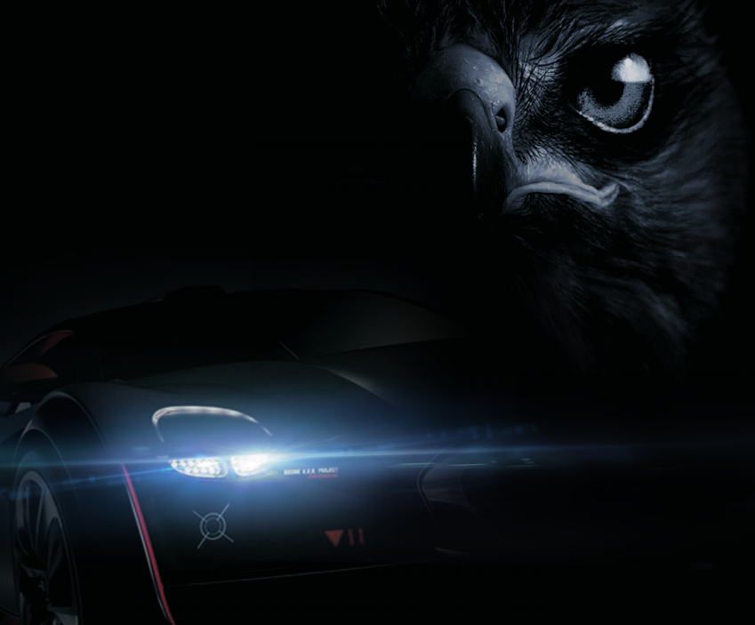
EXPERTBEAM

Slide 2
EXPERTBEAM
belongs to KEWANGDIANZI Ltd., which is one of the leading manufacturers and suppliers of automobile and motor LED lights and accessories. We have been providing our customers with top-quality LED lights since 2013.
We will always provide you the best products and service. Your encouragement will help us moving forward. We sincerely hope that we’ll have more chances to serve you.
We are devoted to make your life more pleasant and wonderful.

Slide 3
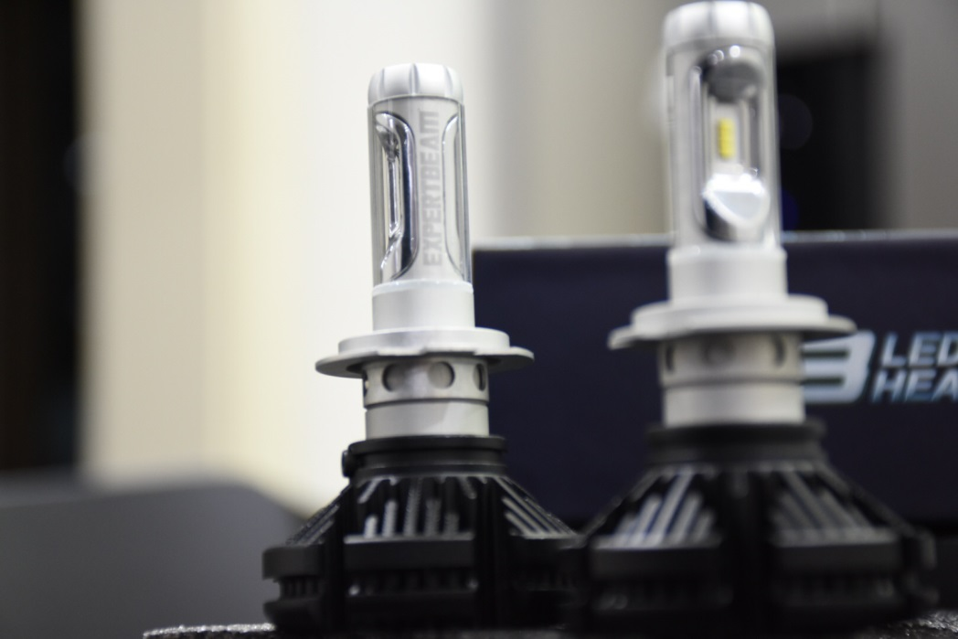
200% brighter than Halogen headlight with Philips ZES LED chips, excellent beam intensity without black spot.
Cool White 6500K, high luminous efficacy, flux Up to 8000LM per pair. Fully co-work with reflector, 360 degree beam increases 30% effective range than other LED light bulb. Superior optic control on road for optimal beam pattern to see the road condition clearly
0.1S quick start, allow a great distance for you to see and be seen in all weather conditions. Whole aluminum housing ensure your LED Headlight bulbs Over 50,000 hrs of brilliant continuous light.

Slide 4
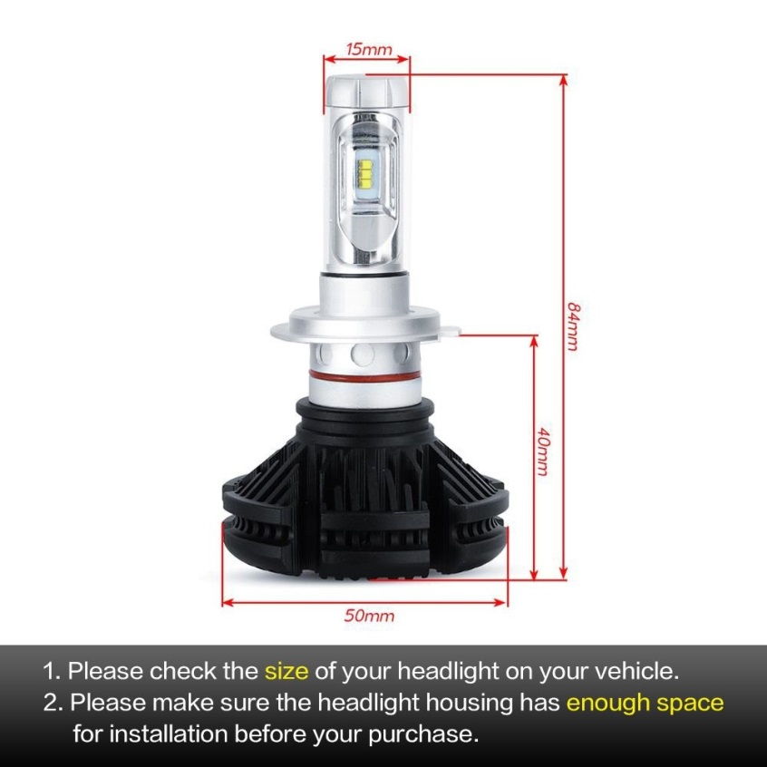
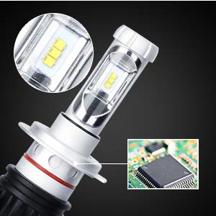
HIGH POWER:
Philips ZES LED chips. High luminous efficacy, with output 4000lm per light for safety driving at night, 6500K xenon white color, 200% brighter than the halogen lamp and HID lamp
LONGER LIFE:
Last more than 50,000 Hours. Works underwater! Rainproof driver and housing works even in extreme situations.

Slide 5
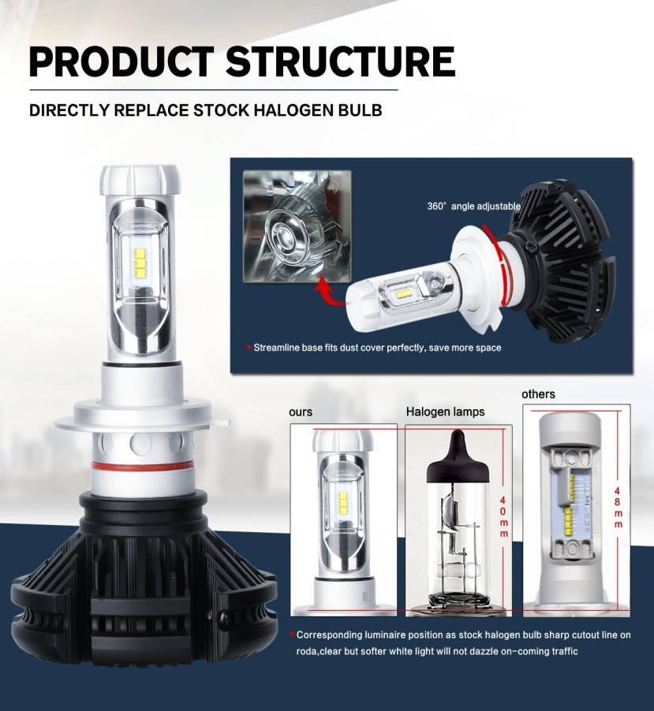
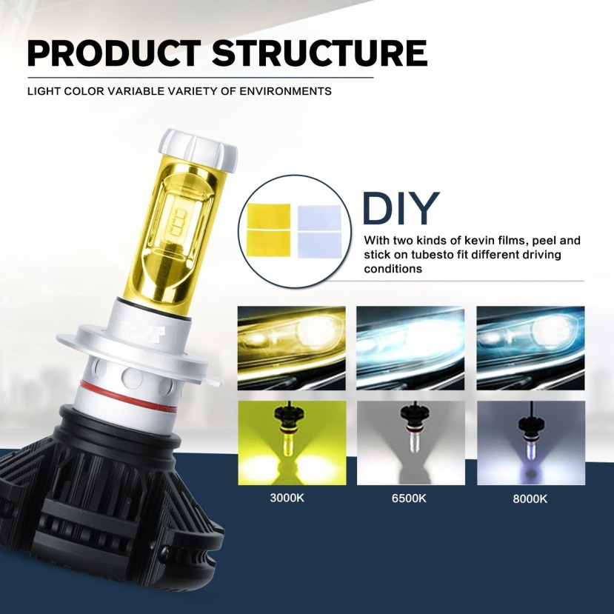
EASY INSTALLATION :
1:1 halogen’s design ,no more modification on headlight housing or cover. Perfect choice if you want to upgrade your headlights to LED type.

Slide 6
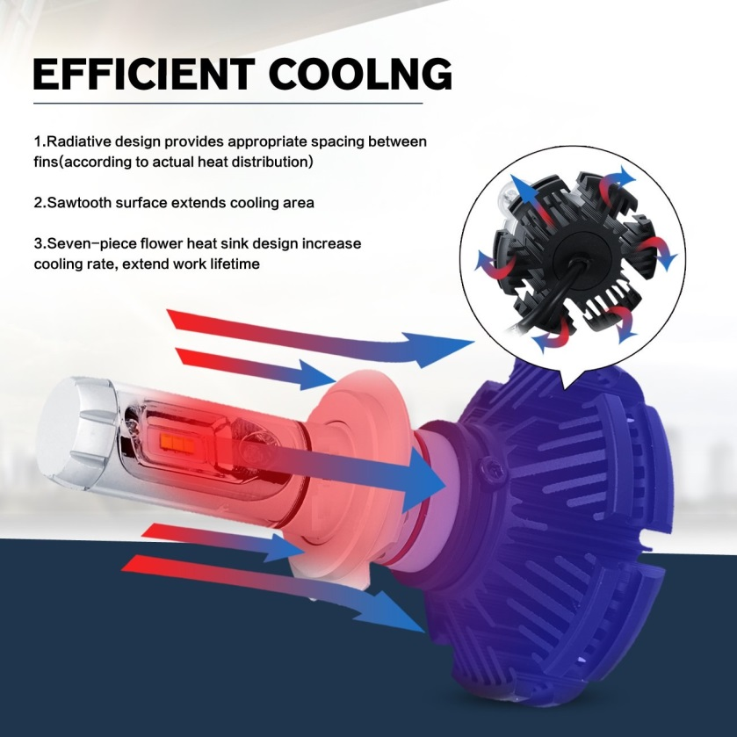
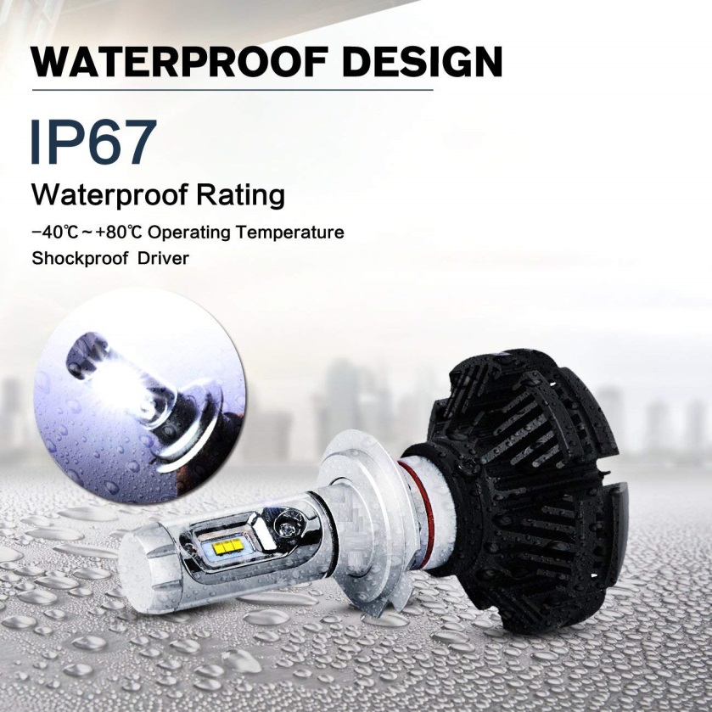
Excellent Cooling System:
Superior heat conduction system and advanced grooved heat sink fins keep the light bulb in appropriate working temperature.
Constant current instant start up,no circuit interference and electromagnetic radiation.
IP67 water and dust seal makes headlight bulb working under extreme environment,
Operating Temperature: -40-80 degree Celsius.
Operating Voltage: DC 9-32V(fit 12V/24V vehicle).

