Slide 1

MuseESB初探
Joseph Cui
2013-01-27

Slide 2
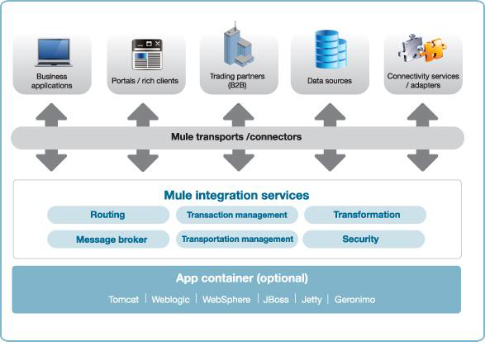
MuseESB in Enterprise

Slide 3
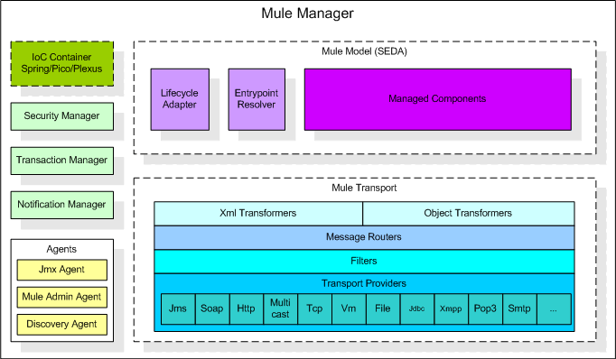
MuleESB Architecture

Slide 4
Patterns
Enterprise Integration Patterns (EIP)
Message Exchange Patterns

Slide 5
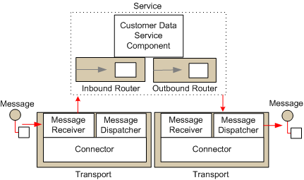

Slide 6
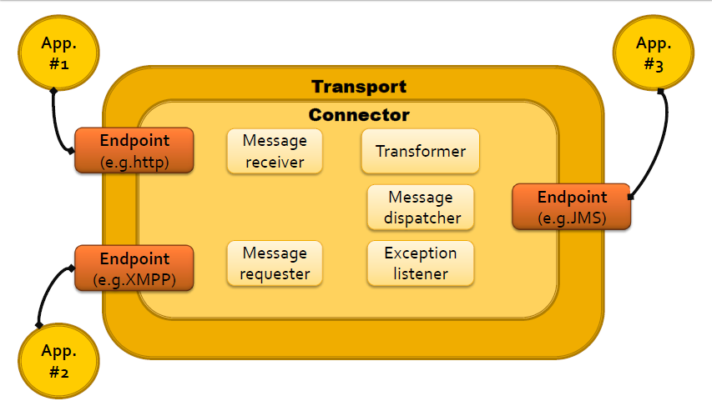
MuseESB Transport

Slide 7
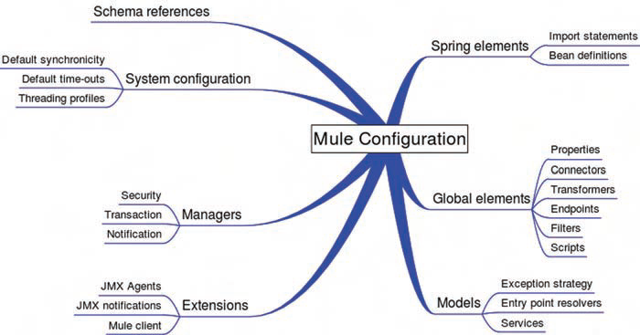

Slide 8
Core Concepts
Service Components
Endpoints
Connectors
Routers
Transformers

Slide 9
Service Components
Universal Message Object (deprecated)
Business Logic (for Integration)
POJOs (No MuleESB dependency)
<service name="GreeterService">
<inbound>
<inbound-endpoint address=“..
<vm:inbound-endpoint path=“…
</inbound>
<component class= "org.mule.samples...
<outbound>
<filtering-router>
<vm:outbound-endpoint
</filtering-router>
</outbound>
</service>

Slide 10
Endpoints
Message Endpoint pattern
<inbound-endpoint address="stdio://in"
transformer-refs="StringToNameString"/>
<outbound-endpoint address="smtp://ross@muleumo.org"/>
<jms:inbound-endpoint queue="my.queue"/>
<stdio:outbound-endpoint system="OUT"/>

Slide 11
Connectors
aka. provider or a transport
Endpoints that use this protocol will automatically be linked to the correct connector.
<stdio:connector name="SystemStreamConnector"
promptMessage="Please enter something:”
messageDelayTime="1000"/>

Slide 12
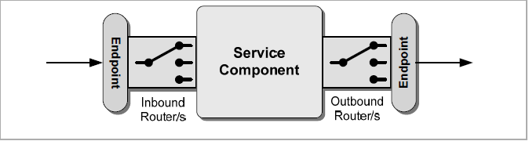
Routers
Message Router pattern
Inbound/Outbound Endpoints/Router Collection

Slide 13
Transformers
Message Translator pattern
Type transformation
<custom-transformer name="StringToNameString"
class="org.mule.samples.hello.StringToNameString"/>
<byte-array-to-object-transformer
name="ByteArrayToObject" ignoreBadInput="true"/>

Slide 14
Mule Transports
service descriptor file in META-INF
The Console Transport: stdio
The VM Transport: vm (Intra JVM)
The File Transport: file
The Http, FTP, SMTP Transport: http, ftp, smtp
The JMS Transport: jms
The JDBC Transport: jdbc
Notes:
Mule in-built transports with connectors and endpoints

Slide 15
Mule2 Demo
MuleClient
tcp to call Mule across JVM

Slide 16
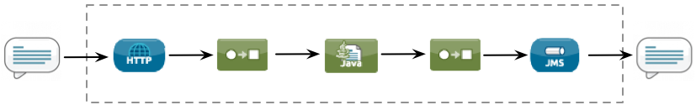
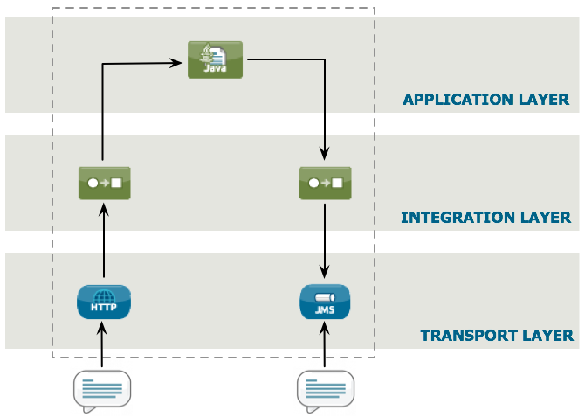
Mule3.x
Flow

Slide 17
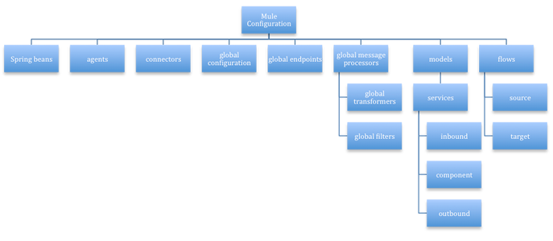
Mule3.x

Slide 18
Mule3 Demo

