Slide 1
SLF4J project
Ceki Gülcü
ceki@qos.ch

Slide 2
Jakarta Commons Logging (JCL)
  Same problem domain
  Well-established library
So why do we re-invent the wheel?
  Because details of implementation matter.
Notes:
Small variations in requirements can lead to wide differences in implementations and details of implementation matter. For a logging framework where reliability is paramount, a simpler implementation is preferable to more complex variant even if the latter offers other advantages.

Slide 3
SLF4J
SLF4J: Simple Logging Façade for Java
Problem definition:
  Abstract logging frameworks
Automatically/dynamically select underlying logging framework (in JCL)
Manually/statically select underlying logging framework (in SLF4J)

Slide 4
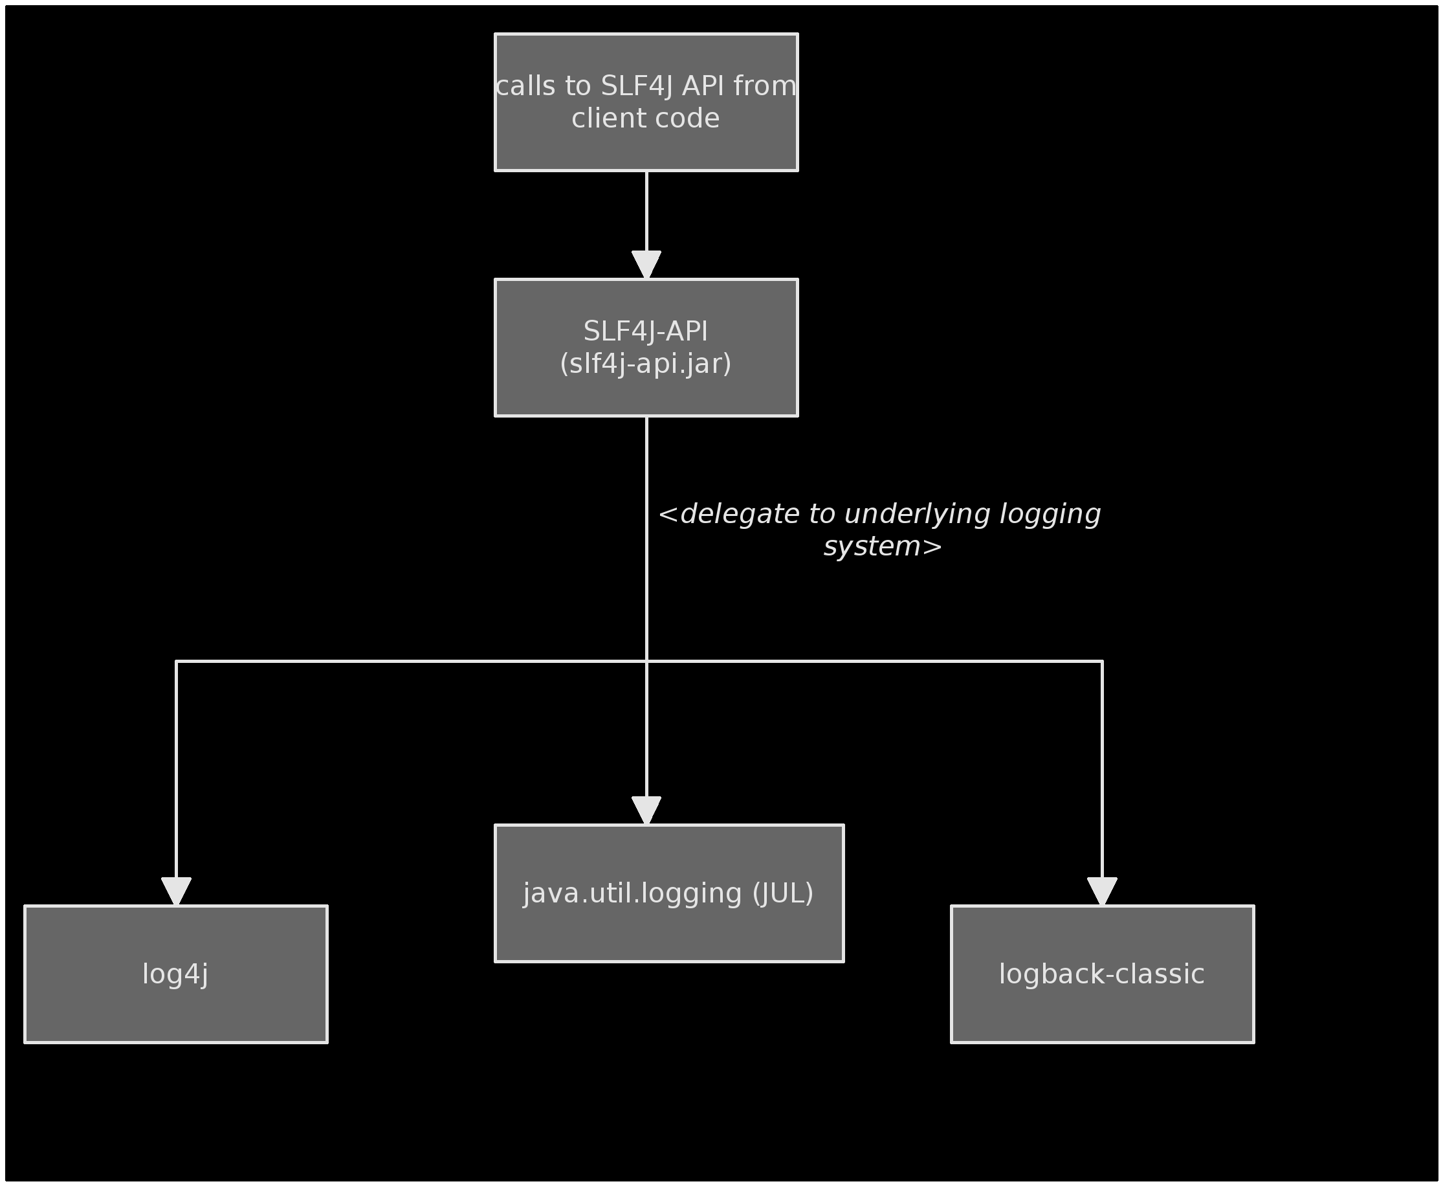
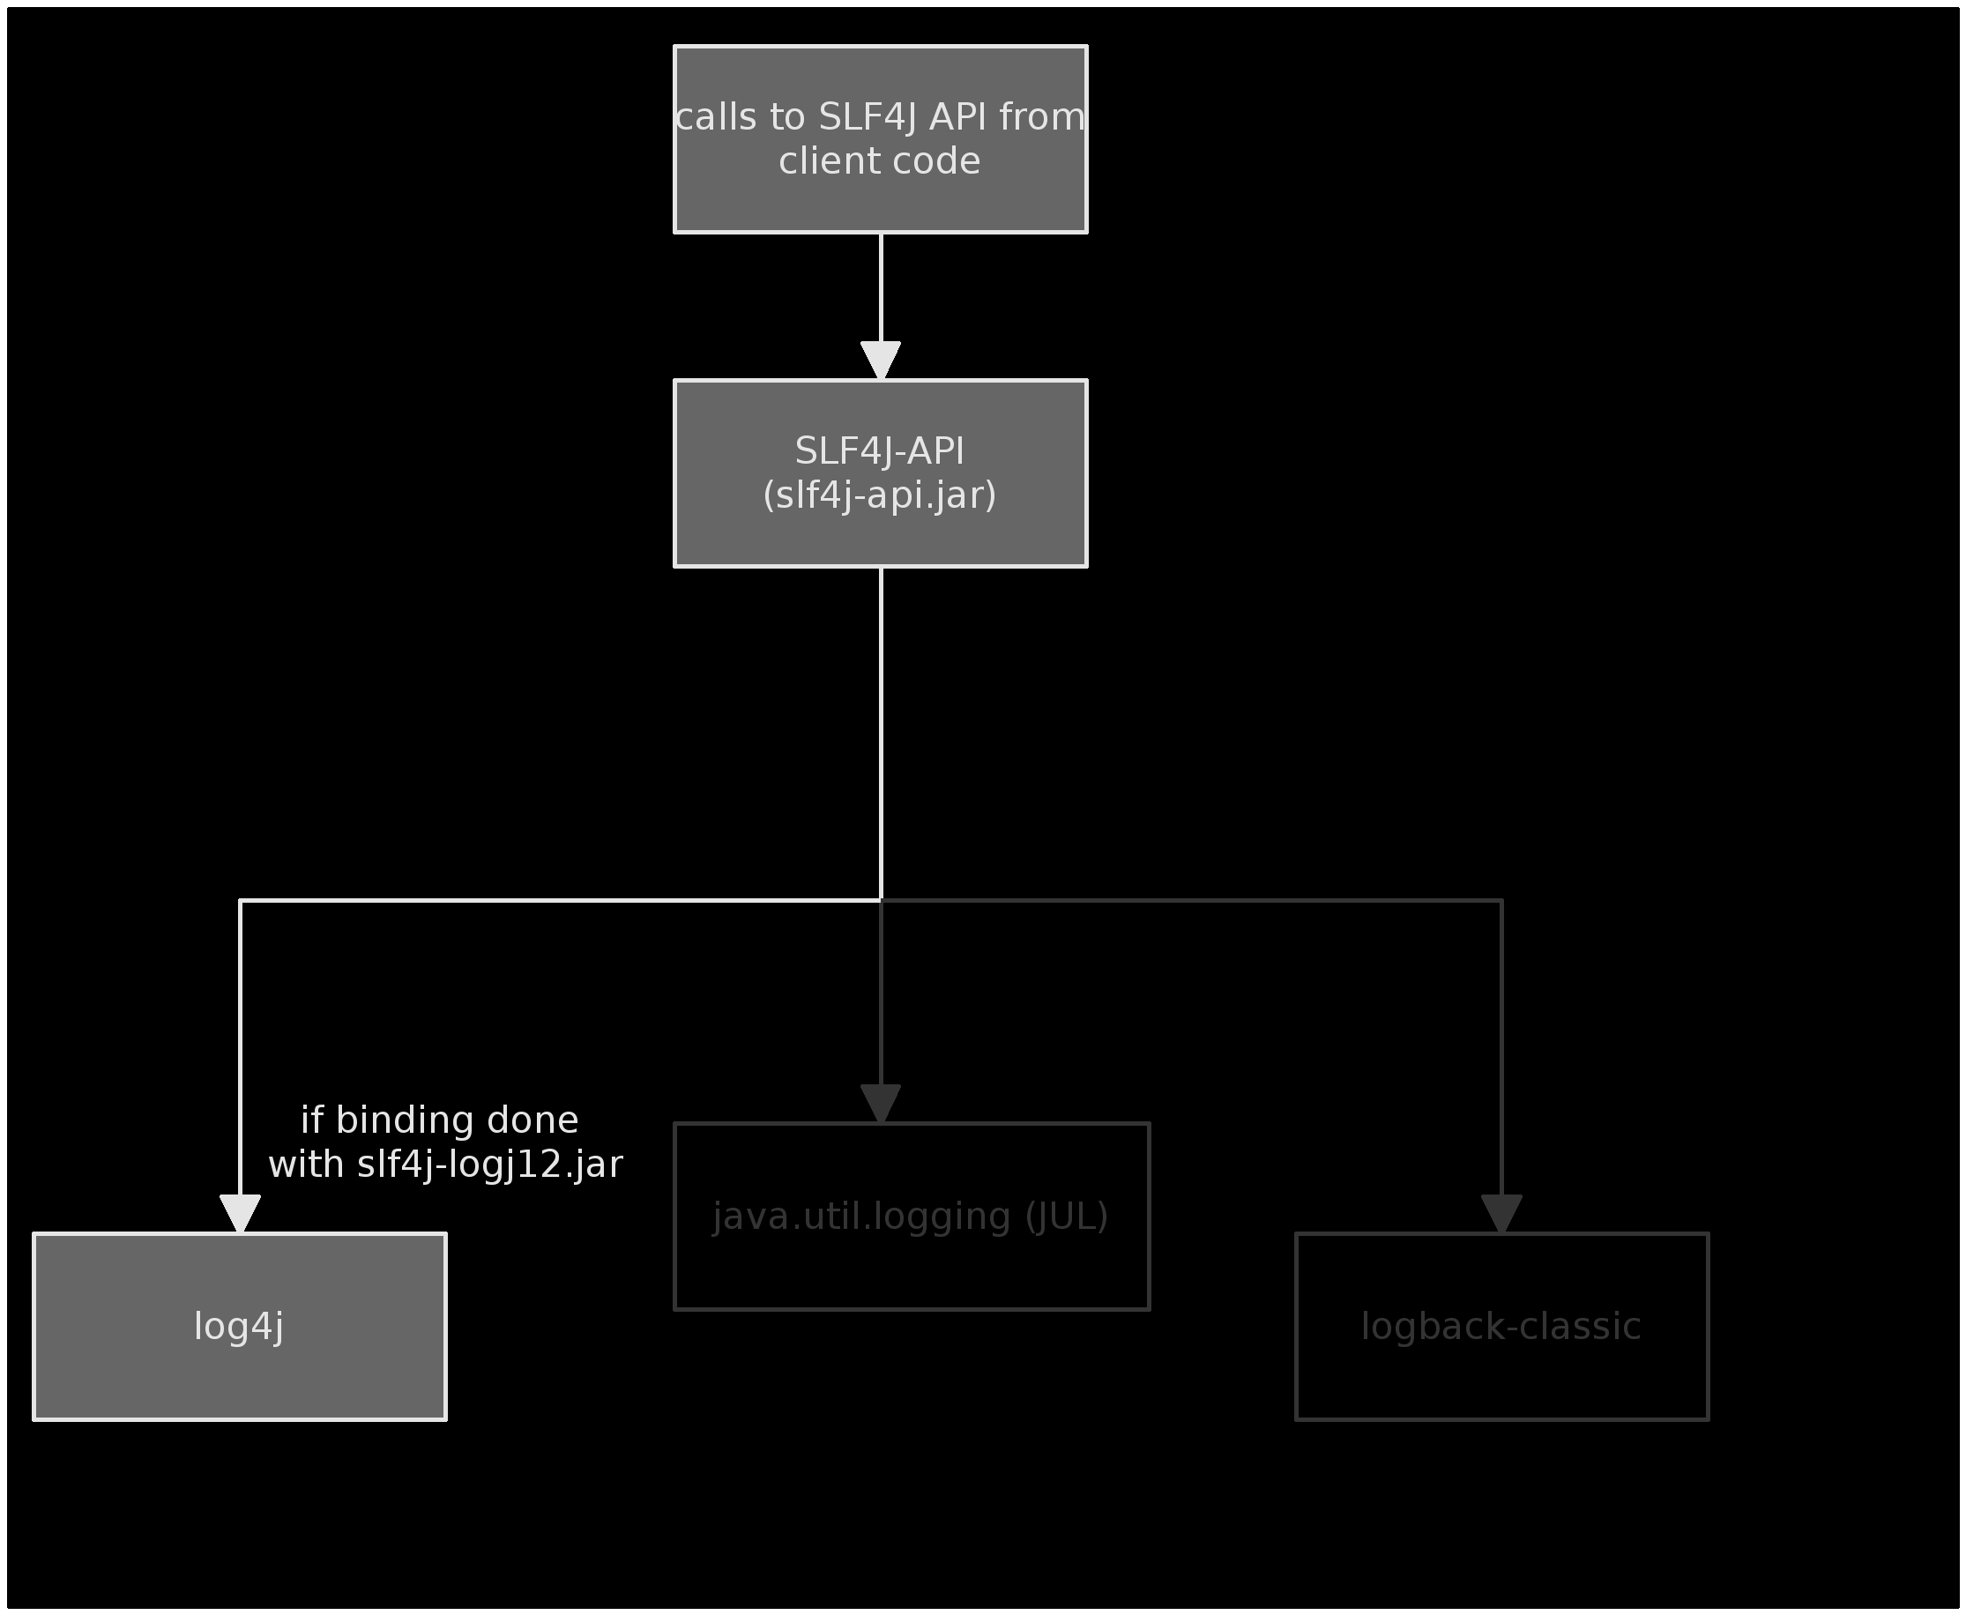
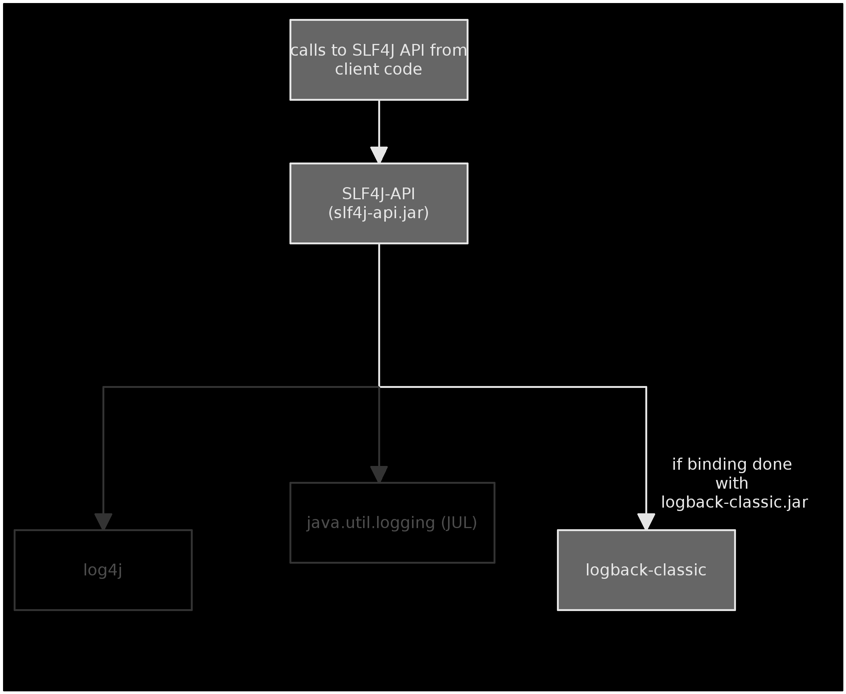
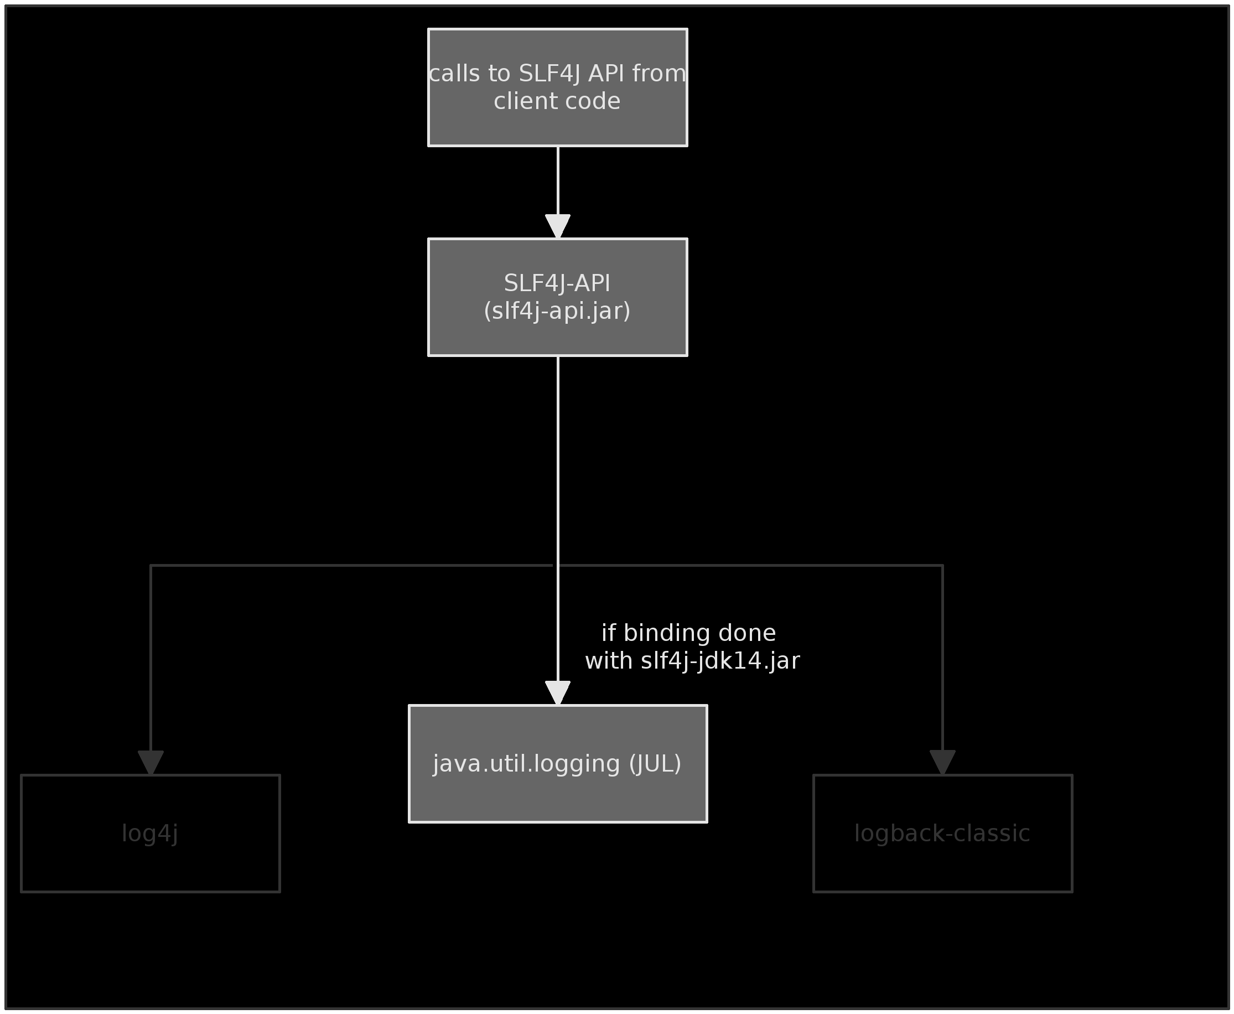

Slide 5
The API
1: import org.slf4j.Logger;
2: import org.slf4j.LoggerFactory;
3:
4: public class Wombat {
5:
6: final Logger logger = LoggerFactory.getLogger(Wombat.class);
7: Integer t;
8: Integer oldT;
9:
10: public void setTemperature(Integer temperature) {
11:
12: oldT = t;
13: t = temperature;
14:
15: logger.debug("Temperature set to {}. Old temperature was {}.", t, oldT);
16:
17: if(temperature.intValue() > 50) {
18: logger.info("Temperature has risen above 50 degrees.");
19: }
20: }
21: }

Slide 6
Parameterized logging
inefficient syle:
logger.debug("Hello "+name);
old style (efficient):
if(logger.isDebugEnabled()) {
logger.debug("Hello "+name);
}
new style (efficient):
logger.debug("Hello {}", name);

Slide 7
Parameterized logging
inefficient syle
logger.debug("Hello "+name);
old style:
if(logger.isDebugEnabled()) {
logger.debug("Hello "+name);
}
new style:
logger.debug("Hello {}", name);
Notes:
In Java, any string parameter passed to a method is constructed before the method is called. While it make take 2 nanoseconds to evaluate that a logger is disabled for the DEBUG level when logger.debug() is invoked, it may take on “average” over 100 nanosecond to build the string “Hello”+ name. Thus, if you are concerned about performance, you might want to use conditional logging, or the much more convenient new style called parameterized logging introduced in SLF4J.

Slide 8
Marker API
Marker hibMarker =
MarkerFactory.getMarker(“hibernate”);
Marker sqlMarker = MarkerFactory.getMarker(“sql”);
// organize markers in a graph
sqlMarker.add(hibMarker);
logger.info(sqlMarker, “select from...”);

Slide 9
Other supported features
MDC (for log4j, logback and j.u.l)
Markers

Slide 10
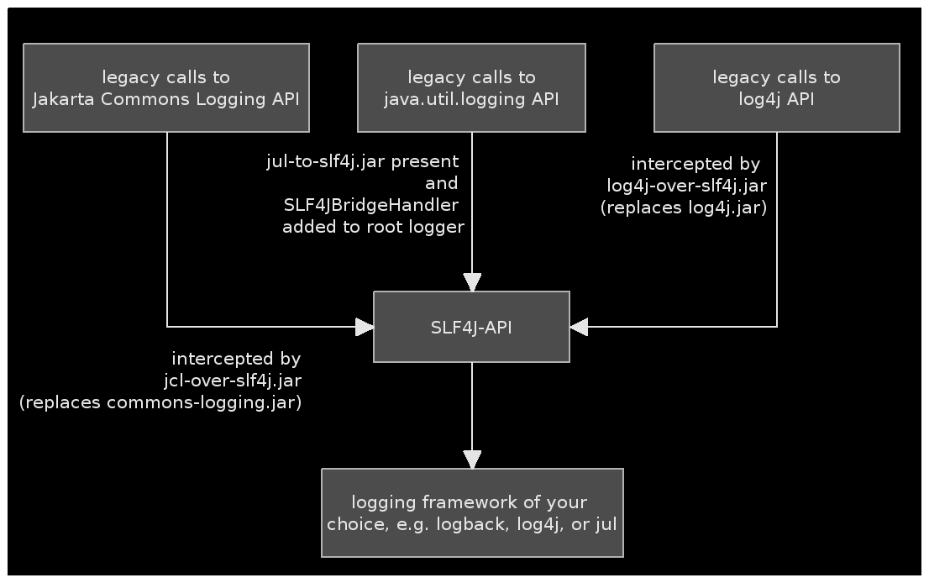
Bridging legacy systems

Slide 11
Using SLF4J:
Apache Archiva Apache Directory Apache FTPServer Apache Geronimo Apache Graffito Apache Jetspeed Apache Jackrabbit Apache Mina Apache Qpid Apache Sling Apache Tapestry Apache Wicket Aperture Apogee | Artifactory Bitronix DbUnit Display tag GMaven Gradle GreenMail GumTree H2 Database HA-JDBC Hibernate Igenko Jabsorb | Jetty v6 jLynx JMesa JODConverter JTrac JWebUnit 2.x LIFERAY log4jdbc Magnolia MRCP4J Mindquarry Mugshot Mule | Novocode NetCDF OpenRDF Penrose Proximity PZFileReader QuickFIX/J SMSJ Spring-OSGi StreamBase TimeFinder WTFIGO YASL Xooctory

Slide 12
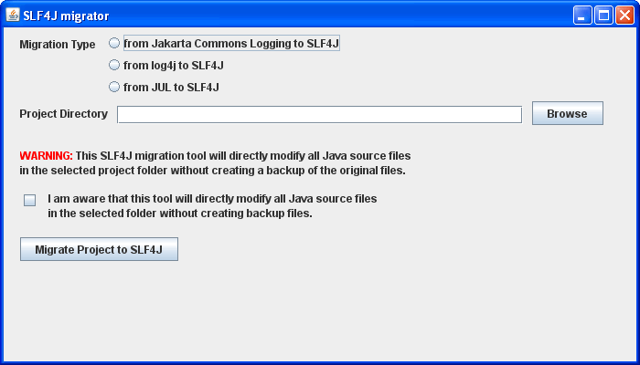
Migrator

Slide 13
Conclusion
Simplicity is powerful.
-- Evan Williams
Robustness, particularly in the context of logging, is a killer feature and simplicity implies robustness.
Notes:
There are lessons to be learned from the SLF4J experience. How could a new competitor gain mindshare in a market with dominant players and very strong network effects?
Robustness, particularly in the context of logging, is a killer feature. Simplicity implies robustness…

