Slide 1
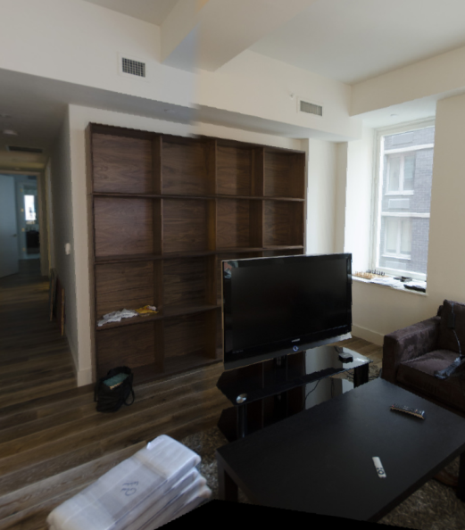
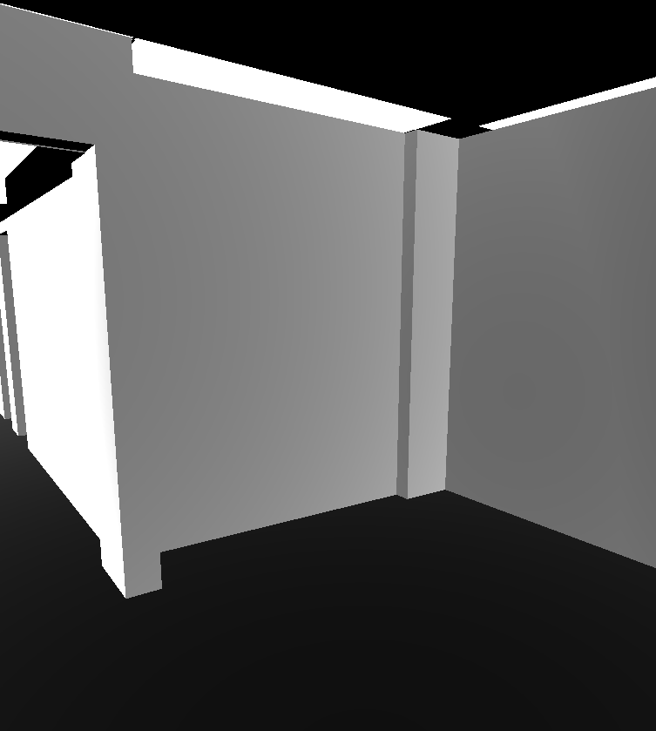
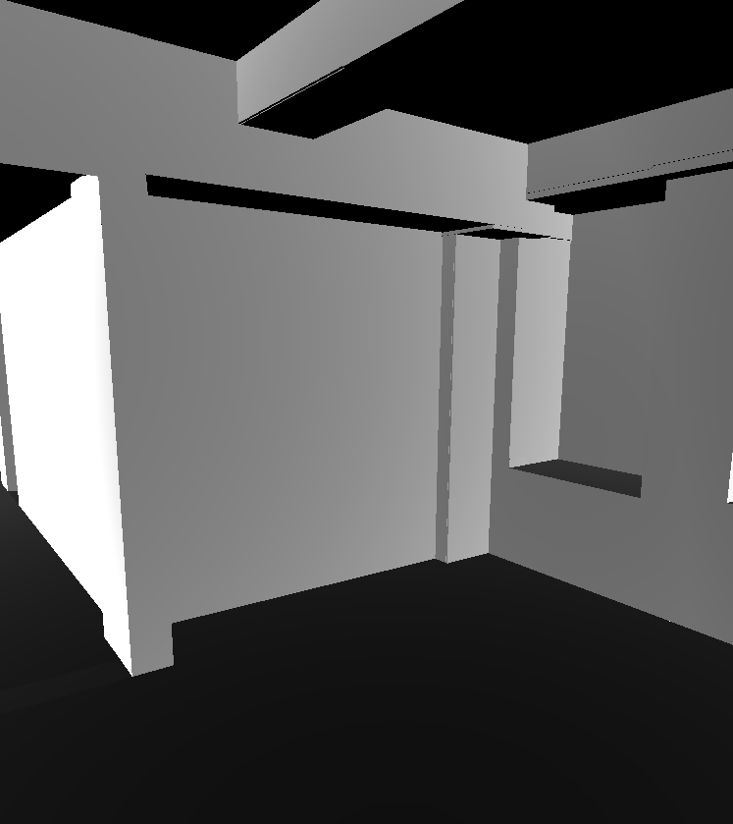
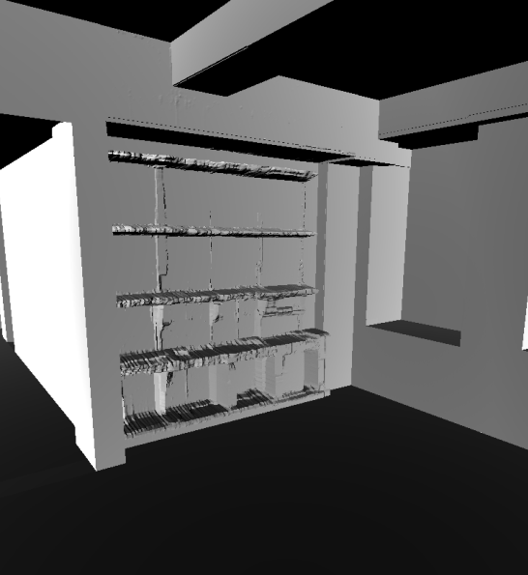
Wall
Object
Wall
Object
Wall
Object
Wall
Detail
Wall
Detail
Wall
Detail
Target
(a) Meshes 1
(b) Meshes 2
(c) Meshes 3
Notes:
<number>

