Slide 1

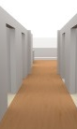
Wall-2
Wall-1

