Slide 1
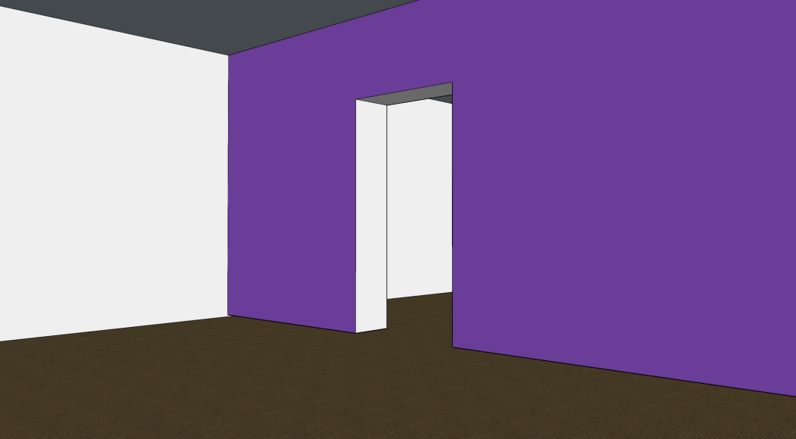
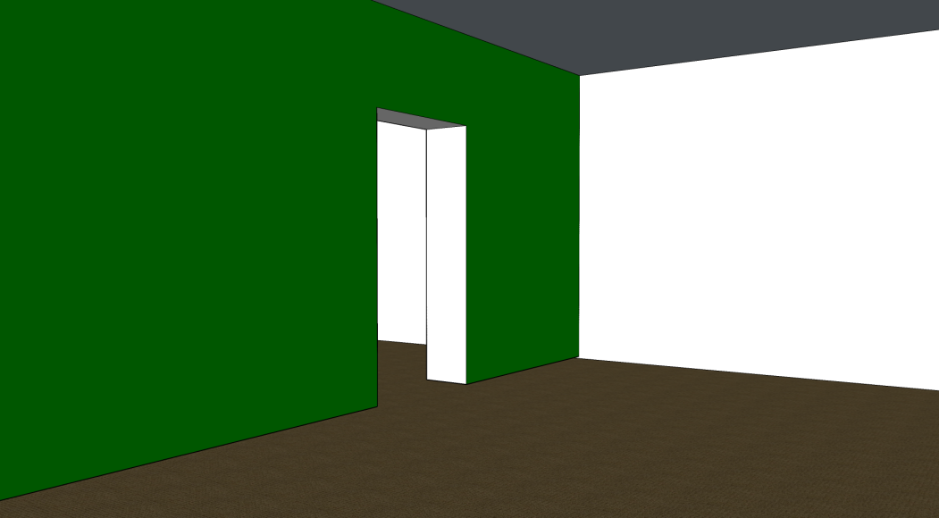








Wall-1
Wall-2
$$T_{W_{1}}$$
$$T_{W_{2}}$$
$$L_{W_{1}}$$
$$R_{W_{1}}$$
$$L_{W_{2}}$$
$$R_{W_{2}}$$
$$Ω$$
$$Ω$$
Cost map (wall-1)
Cost map (wall-2)

