Slide 1

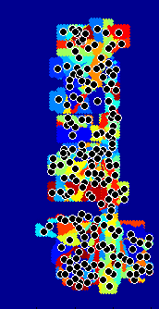



0
1
evidence
(input)
(b) evidence
(cleaned)
(c) clustering
(initial)
(d) clustering
(final)
(e) propagated

