Slide 1
DESIGNER DAY · SUBMISSION
Tersolisib / STX-478
Oncology · Small Molecule · Designer Day DD#1
20-Feb-2026 · SMDD Digital Chemistry · Eli Lilly and Company
Company Confidential ©2026 Eli Lilly and Company

Slide 2
ASSET INFORMATION · Slide 2
COMPOUND / ASSET NAME
LSN / LY NUMBER
DESIGNER DAY DATE
Tersolisib / STX-478
LY4064809
20-Feb-2026
THERAPEUTIC AREA
MODALITY
CURRENT PHASE
DESIGNER DAY #
Oncology
Small Molecule
Pre-RSM
DD#1
SUMMARY
Tersolisib (STX-478 / LY4064809) — PI3Kα-selective inhibitor. Current route: 9-step LLS via Fries rearrangement acylation + ring closing (AcOH/DMF, 120°C, 60%). GLP-tox in progress; GMP1 Oct 2026. Peak demand: 10 MT/year.
Company Confidential ©2026 Eli Lilly and Company 2

Slide 3
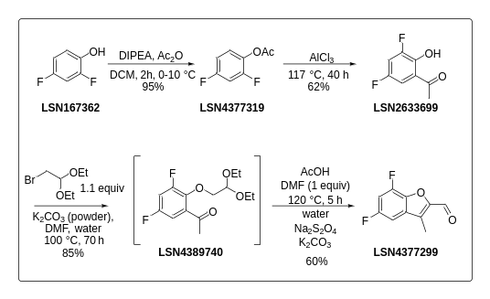
CURRENT ROUTE · Slide 3
CURRENT ROUTE SCHEME
Company Confidential ©2026 Eli Lilly and Company 3

Slide 4
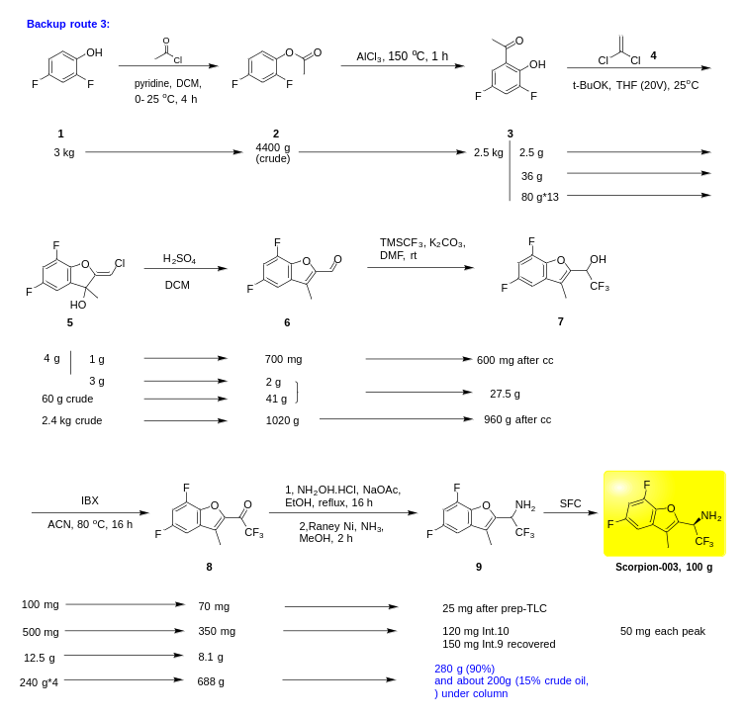
DEVELOPMENT HISTORY · Slide 4
APPROACH 1 (Slide 4)
DEVELOPMENT HISTORY · Slide 4 · Source: Slides 4 & 5
Acylation — Dev History (Slide 4)
Ring Closing — Dev History (Slide 5)
TfOH, MsOH, Zn and Ti salts, BBr3, FeCl3, TFA. Friedel-Crafts works but no advantage (two-step yield > one-step; Cl analog still forms). ~88% conversion with neat TfOH not reproducible.
DMF required for solubility (~4 wt% in AcOH) but decomposes at high temp. Residual alkyl bromide promotes side reactions. TFA or AcOH in EtOAc/toluene → poor conversion.
Old Wuxi Routes (Slide 11)
SCHEME
Company Confidential ©2026 Eli Lilly and Company 4

Slide 5
CURRENT CHALLENGES · Slide 5
OPERATIONAL / PROCESS CHALLENGES
High temperatures
Low yields for 2 steps
Slow reactions
Undesirable solvents / reagents — DMF at high temperature with acid/base
Fries rearrangement gives Cl substitution impurity — cannot be purged in any step
DEVELOPMENT PRIORITIES
Solvents/reagents with better safety profile
Improved cycle time
Avoid Cl substitution impurity
Company Confidential ©2026 Eli Lilly and Company 5

Slide 6
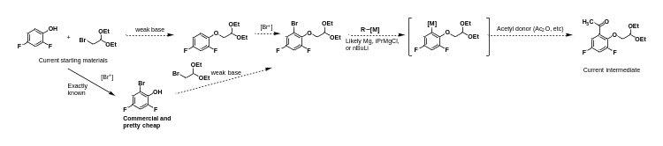
PROPOSED ROUTE · Slide 6 · Source: Slide 6
PROPOSED ROUTE NAME / TITLE
Project team route idea: Aromatic bromination (DIY or buy it) then Metal/X exchange + acetylation
SCHEME (Source: Slide 6)
Pros:
Cons:
Uses current SMs or commercial derivative. Probably can avoid true cryogenic conditions via Grignard (i-PrMgCl). High likelihood of technical success.
Retains SN2 step with toxic electrophile and electron-deficient phenol — anticipate slow. Generates halogenated organic waste. Retains final step of current sequence.
"Killer"/Key Experiments:
Proposed By: Alex Harmata
Finding appropriate conditions to maximize yield of acetylation step. Reaction of Grignard with Ac2O at −10°C is a starting point.
Date: 03-Feb-2026
Company Confidential ©2026 Eli Lilly and Company 6

Slide 7
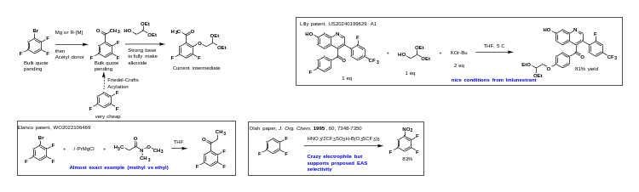
PROPOSED ROUTE · Slide 7 · Source: Slide 7
PROPOSED ROUTE NAME / TITLE
Project team route idea: SNAr onto trifluorinated acetophenone
SCHEME (Source: Slide 7)
Pros:
Cons:
Avoids toxic alkyl bromide and DMF. 3 steps from cheap materials to aldehyde. Good precedent for both steps. Milder temp conditions. UPDATE: preliminary experimental support.
Fluoride generated in step 2. Retains final step of current sequence. Friedel-Crafts challenging on electron-poor arene. Acetophenone expensive; isomer concerns.
"Killer"/Key Experiments:
Proposed By: Alex Harmata
SNAr step — appropriate choice of base/conditions to avoid side reactivity from acetophenone enolate.
Date: preliminary experimental support.
Company Confidential ©2026 Eli Lilly and Company 7

Slide 8
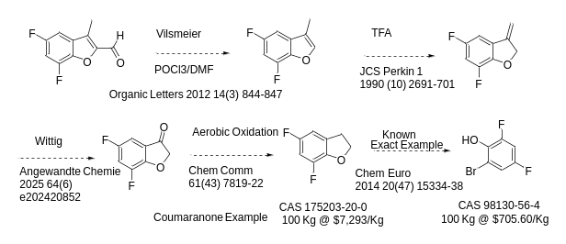
PROPOSED ROUTE · Slide 8 · Source: Slide 8
PROPOSED ROUTE NAME / TITLE
Priority — eliminates the Fries rearrangement (STX-478 SM)
SCHEME (Source: Slide 8)
Pros:
Cons:
Eliminates the Fries rearrangement. Solid Literature.
—
"Killer"/Key Experiments:
Proposed By: JRR (John Rizzo)
NA
Date: 02/03/26
Company Confidential ©2026 Eli Lilly and Company 8

Slide 9
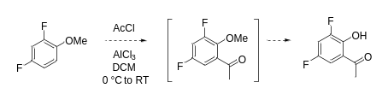
PROPOSED ROUTE · Slide 9 · Source: Slide 9
PROPOSED ROUTE NAME / TITLE
One pot difluoro-anisole Friedel-Crafts followed by demethylation
SCHEME (Source: Slide 9)
Pros:
Cons:
Mild conditions; run in solvent. Generally clean and high-yielding. Starting anisole sold by multiple vendors; not expensive. Simple process with firsthand experience.
Chlorinated solvent required.
"Killer"/Key Experiments:
Proposed By: Nick Magnus
— (see following slides for example of this reaction)
Date: 03-Feb-2026
Company Confidential ©2026 Eli Lilly and Company 9

Slide 10
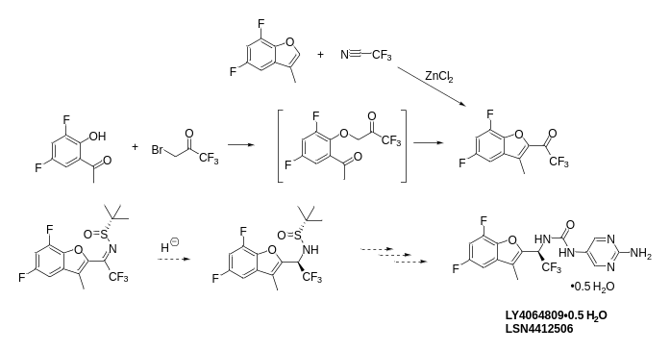
PROPOSED ROUTE · Slide 10 · Source: Slide 10
PROPOSED ROUTE NAME / TITLE
Ellman Sulfoximine Reduction Approach
SCHEME (Source: Slide 10)
Pros:
Cons:
Trifluoromethylketone synthesis is well precedented. Hydridic reduction of the Ellman sulfoximine would arrive at a common intermediate in the current route.
—
"Killer"/Key Experiments:
Proposed By: Nick Magnus
Formation of the Ellman sulfoximine and diastereoselective reduction.
Date: 03-Feb-2026
Company Confidential ©2026 Eli Lilly and Company 10

Slide 11
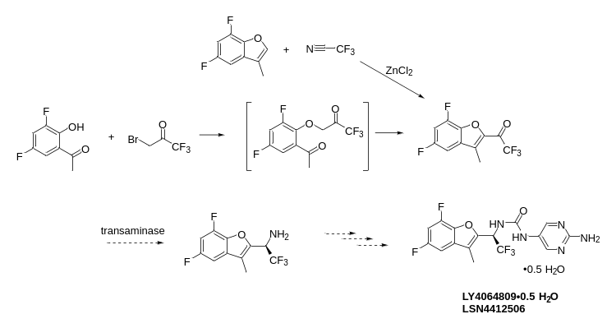
PROPOSED ROUTE · Slide 11 · Source: Slide 11
PROPOSED ROUTE NAME / TITLE
Trifluoromethylketone Transamination Approach
SCHEME (Source: Slide 11)
Pros:
Cons:
Trifluoromethylketone synthesis is well precedented. Enantioselective transamination gives direct access to the chiral amine.
—
"Killer"/Key Experiments:
Proposed By: Nick Magnus
Transamination.
Date: 03-Feb-2026
Company Confidential ©2026 Eli Lilly and Company 11

Slide 12
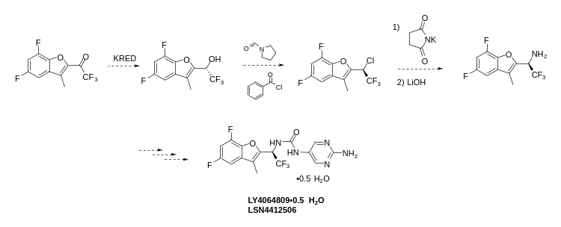
PROPOSED ROUTE · Slide 12 · Source: Slide 12
PROPOSED ROUTE NAME / TITLE
Trifluoromethylketone KRED Vilsmeier-Gabriel Approach
SCHEME (Source: Slide 12)
Pros:
Cons:
Trifluoromethylketone synthesis is well precedented. KRED, Vilsmeier to chiral chloride — precedented and scalable.
More steps.
"Killer"/Key Experiments:
Proposed By: Nick Magnus
KRED reduction, chloride formation, and Gabriel reaction.
Date: 03-Feb-2026
Company Confidential ©2026 Eli Lilly and Company 12

Slide 13
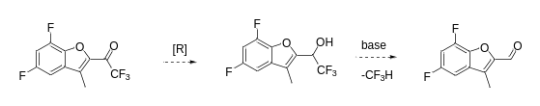
PROPOSED ROUTE · Slide 13 · Source: Slide 13
PROPOSED ROUTE NAME / TITLE
Aldehyde via a haloform type elimination
SCHEME (Source: Slide 13)
Pros:
Cons:
Trifluoromethylketone synthesis is well precedented. Aldehyde generated 'on demand' in situ with a base treatment.
—
"Killer"/Key Experiments:
Proposed By: Nick Magnus
Haloform reaction. Based on unpublished work by Nick Magnus: DABCO and heat gave elimination of fluoroform.
Date: 20-Feb-2026
Company Confidential ©2026 Eli Lilly and Company 13

Slide 14
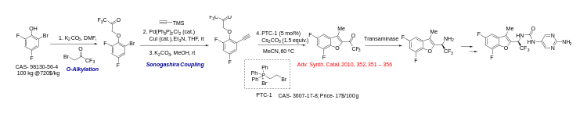
PROPOSED ROUTE · Slide 14 · Source: Slide 14
PROPOSED ROUTE NAME / TITLE
Phase-Transfer-Catalyzed Intramolecular Cyclization of ortho-Alkynyl Phenyl Ether
SCHEME (Source: Slide 14)
Pros:
Cons:
1. 4-step direct access to CF3 ketone variant.
2. Omitting the Fries rearrangement & acid-cat cyclization.
3. PTC-1 readily available or can be made in-house.
—
"Killer"/Key Experiments:
Proposed By: Samrat Sahu
Whether the cyclization will be favored under EWG present in the ring.
Date: 02/04/26
Company Confidential ©2026 Eli Lilly and Company 14

Slide 15
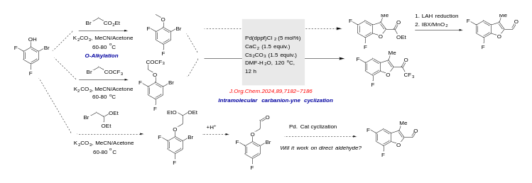
PROPOSED ROUTE · Slide 15 · Source: Slide 15
PROPOSED ROUTE NAME / TITLE
Accessing Benzofurans via Pd cat. Intramolecular Cyclization
SCHEME (Source: Slide 15)
Pros:
Cons:
1. No Fries / acid-cat cyclization.
2. 2-step access to −CF3 derivative directly.
3. Both SMs inexpensive & available in bulk.
1. Pd impurity purging required at last step.
2. Safety profile of CaC2 at high temperature.
"Killer"/Key Experiments:
Proposed By: Samrat Sahu
1. Will the cyclization work for direct aldehyde?
2. Scalability of the cyclization step.
Date: 02/05/26
Company Confidential ©2026 Eli Lilly and Company 15

Slide 16
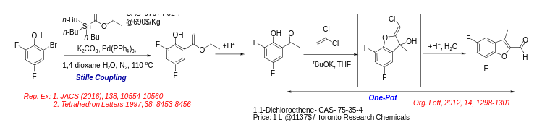
PROPOSED ROUTE · Slide 16 · Source: Slide 16
PROPOSED ROUTE NAME / TITLE
Synthesis of Benzofurans via Base mediated cyclization using Dichloroethylene
SCHEME (Source: Slide 16)
Pros:
Cons:
1. Replacing Fries with Stille Coupling.
2. 3-step LLS.
3. Already tested the last step with WuXi.
1. Scalability of Stille coupling.
"Killer"/Key Experiments:
Proposed By: Samrat Sahu
Stille coupling of electron-deficient ring system might be challenging. Use –I instead of –Br for facile oxidative addition.
Date: 02/04/26
Company Confidential ©2026 Eli Lilly and Company 16

Slide 17
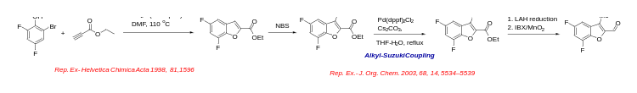
PROPOSED ROUTE · Slide 17 · Source: Slide 17
PROPOSED ROUTE NAME / TITLE
Accessing Benzofurans via Cu cat. Alkynylation & Alkyl-Suzuki
SCHEME (Source: Slide 17)
Pros:
Cons:
1. Cu cat alkynylation/Pd cat cyclization to access benzofuran — removes Fries / acid-cat cyclization.
1. Alkyl Suzuki-Coupling to install −Me group.
2. 5-step LLS.
3. Mostly linear sequence.
"Killer"/Key Experiments:
Proposed By: Samrat Sahu
1. Feasibility of the Alkyl Suzuki.
Date: 02/05/26
Company Confidential ©2026 Eli Lilly and Company 17

Slide 18
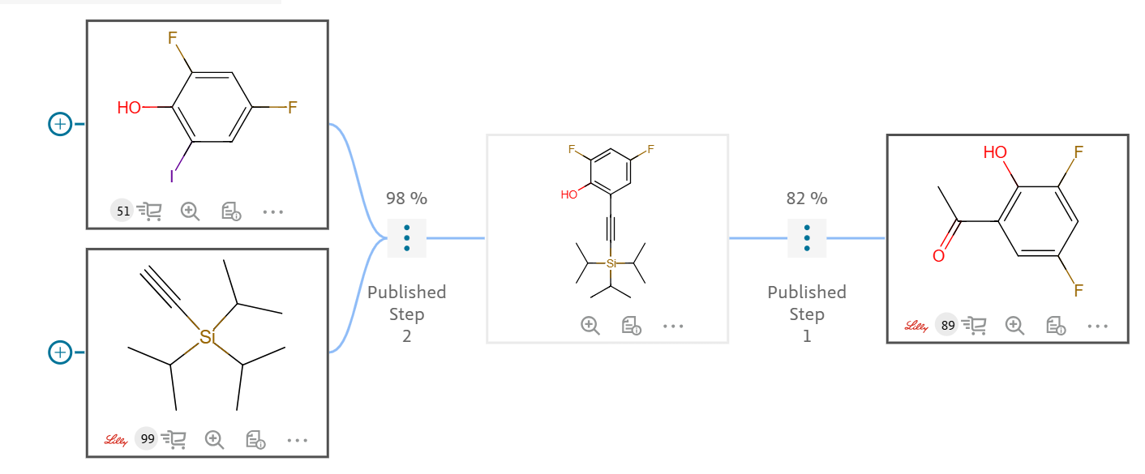
PROPOSED ROUTE · Slide 18 · Source: Slide 18
PROPOSED ROUTE NAME / TITLE
Alternate Approach to Fries Rearrangement — Sonagashira
SCHEME (Source: Slide 18)
Pros:
Cons:
Known/executed chemistry.
Discovery scale. Long reaction times. Harsh conditions.
"Killer"/Key Experiments:
Proposed By: Stan Kolis / Reaxys
Get bromo arene to work. Can reaction times be reduced?
Date: 06-Feb-2026
Company Confidential ©2026 Eli Lilly and Company 18

Slide 19
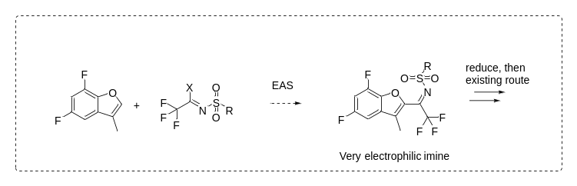
PROPOSED ROUTE · Slide 19 · Source: Slide 19
PROPOSED ROUTE NAME / TITLE
Vilsmaxxing
SCHEME (Source: Slide 19)
Pros:
Cons:
Don't have to worry about CF3 anion or fluoroform; cheap. Almost the same intermediate so downstream steps similar.
Highly reactive intermediate; may use PFAs. May form trifluoroacetonitrile as a side product.
"Killer"/Key Experiments:
Proposed By: Jon Day
Not sure if a sulfinate will be electron-poor enough to give selectivity for the amide carbonyl Vilsmeier formation.
Date: 18-Feb-2026
Company Confidential ©2026 Eli Lilly and Company 19

Slide 20

PROPOSED ROUTE · Slide 20 · Source: Slide 20
PROPOSED ROUTE NAME / TITLE
Two-step telescoped cyclization (NaOEt/EtOH, in-situ HCl quench)
SCHEME (Source: Slide 20)
Pros:
Cons:
Better control of each transformation to reach high conversion and easier workup/isolation.
Not sure about the reactivity of cyclization or how long the reaction will take.
"Killer"/Key Experiments:
Proposed By: Zhengao Feng
Cyclization at reflux to see reaction kinetics. NaOEt/EtOH to avoid DMF. Quench in-situ with HCl to deprotect aldehyde.
Date: 19-Feb-2026
Company Confidential ©2026 Eli Lilly and Company 20

Slide 21
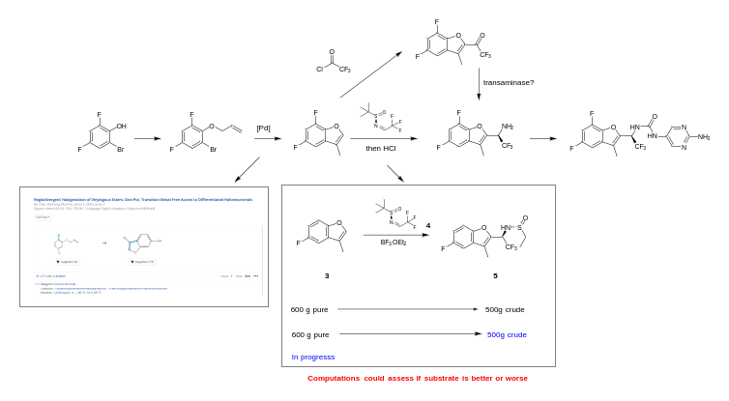
PROPOSED ROUTE · Slide 21 · Source: Slide 21
PROPOSED ROUTE NAME / TITLE
Intramolecular Heck
SCHEME (Source: Slide 21)
Pros:
Cons:
Fast to test. The key asymmetric addition is proven on similar substrate. No Fries or Cl-impurity. SM is $720/kg.
Adds a Pd step. Could be more expensive than current route. Asymmetric addition can have reactivity/selectivity issues.
"Killer"/Key Experiments:
Proposed By: Alonso Arguelles
The asymmetric addition would be less reactive — but this could help selectivity. Computationally assessable.
Date: 19-Feb-2026
Company Confidential ©2026 Eli Lilly and Company 21

Slide 22
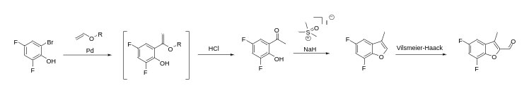
PROPOSED ROUTE · Slide 22 · Source: Slide 22
PROPOSED ROUTE NAME / TITLE
Benzofuran from hydroxy-acetophenone ring closure around carbenoid equivalent
SCHEME (Source: Slide 22)
Pros:
Cons:
Two steps to benzofuran from commercial material.
Adds Pd step. Vinyl ether Heck with ortho-bromophenols is not well established.
"Killer"/Key Experiments:
Proposed By: Tom Pickel
— (Ref: Chem. Eur. J. 2015, 21, 4, 1482–1487)
Date: 20-Feb-2026
Company Confidential ©2026 Eli Lilly and Company 22

Slide 23
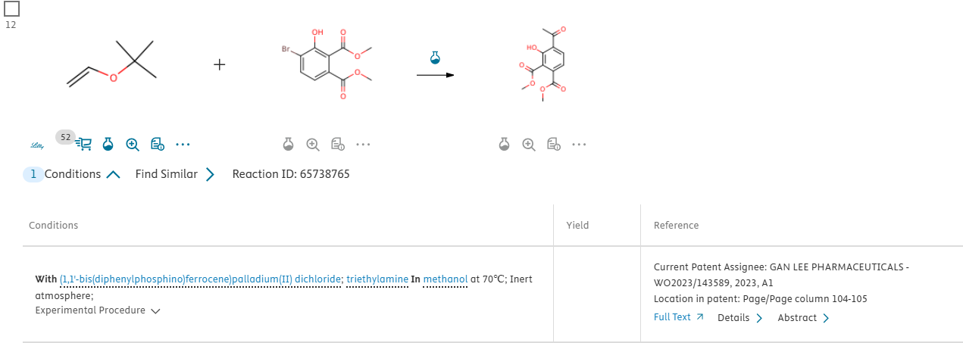
PROPOSED ROUTE · Slide 23 · Source: Slide 23
PROPOSED ROUTE NAME / TITLE
Pyruvate-derived Ullman cyclization/SNAR
SCHEME (Source: Slide 23)
Pros:
Cons:
Precedented cyclization; concise.
Palladium/Cu use. Should be RSM — correct?
"Killer"/Key Experiments:
Proposed By: Joey Tuccinardi
Heck reaction may be difficult, but very similar examples exist.
Date: 20-Feb-2026
Company Confidential ©2026 Eli Lilly and Company 23

Slide 24
SUPPORTING SLIDES · Preserved from source PPT
Background material from the original submission (Tersolisib_DD1_v4.pptx) is preserved in the source PPT but not parsed by the portal. Open the source file to view DFT analyses, literature references, and supporting experimental data.
Company Confidential ©2026 Eli Lilly and Company 24

