Slide 1

HACKATHON DEMO · AGENTIC CROSS-BORDER OPERATIONS
The Gate
Never let an LLM decide what is legal.
A deterministic compliance engine: OPA and Rego rule tables turn the facts an AI agent extracts into verdicts a regulator can be argued with - recorded, replayable and tamper-evident.
Pillar 1 · Deterministic + LLM hybrid guardrails
Pillar 2 · Sovereign cross-region ingestion Pillar 3 · Autonomous pricing agents

Slide 2
What breaks at scale
Every agent in this ecosystem will eventually be told no by a regulator.
WHAT THE AGENTS ARE FOR
WHAT THE AUDITOR ASKS
Read contracts, invoices and spec sheets
Join customer data across regions for analytics
Browse competitor pages and reprice locally
Speed is the entire pitch.
Why did a controlled item ship to that destination?
Why did patient data land in another jurisdiction?
Who decided, on what rule, with what evidence?
The answer cannot be the model's confidence.
An agent that can be prompted can be wrong at scale. So it never gets to stamp the paperwork.

Slide 3

The division of labour
Agents produce facts.
Deterministic rules produce verdicts.
The LLM is the intern who reads the paperwork and highlights the numbers. OPA is the customs officer who stamps it.
Nothing in the Python boundary computes a legal outcome. Nothing in the Rego packs reads a document. Each side can only do its own job.
So a change in compliance posture is a policy bundle build - not a service deploy, not a retraining run, not a prompt edit.
If a rule change ever needs a Python change, the design is broken.

Slide 4
Request path
A thin boundary in front of a policy engine that holds all of the legal logic.
Agent
parses documents, proposes facts with provenance
FastAPI
validate shape · normalise units · stamp clock
OPA sidecar
Rego packs + 6 deterministic rule tables decide
Ledger
hash-chained, append-only, inside the request path
Review queue
derived from the ledger, closed by a named human
compiled policy bundle, hot-reloaded
Policy ships independently of service
Rebuild the bundle and the running sidecar picks it up on its poll interval - no restart, no engine deploy. Disk mode reloads per request while rules are being authored.
A missing verdict is a fault
Sidecar unreachable returns 503, a policy error 502, and a rule that produced no value 500. Silence is never read as permission.
One HTTP call per decision. Zero LLM calls on the decision path.

Slide 5
Guardrail 1 · Evidence asymmetry
Every fact carries a source, and the source decides how much weight that fact may carry.
AUTHORITATIVE · CAN CLEAR A CONTROL
MACHINE-EXTRACTED · CAN ONLY RAISE RISK
CERTIFICATE SIGNED_SPEC_SHEET
DECLARATION REGULATOR_RULING
ERP_MASTER_DATA · MANUAL_VERIFICATION
Signed, filed or verified by a person who owns the statement - and each one carries an evidence ref that a reviewer can go and look at.
GEMINI_EXTRACTION LLM_EXTRACTION
MODEL_EXTRACTED RULE_BASED_PARSER
Extraction is welcome - it is how a 40-page spec sheet gets read.
It may add risk without limit and retire none of it.
The same encryption product, the same numbers, two provenances
MANUAL_VERIFICATION → ALLOW
GEMINI_EXTRACTION → HUMAN_REVIEW
Proven in CI: test_extraction_can_never_retire_a_control

Slide 6
Guardrail 2 · The authority ceiling
ILLUSTRATIVE_*
is a value inside the rule table itself - not a comment, not a flag in code.
THE RULE
An unverified table may escalate a job. It can never grant a terminal ALLOW.
The cap is applied after the rules run, so a permissive answer from a placeholder table is tightened rather than trusted.
THE SIGNAL
authority_ceiling_applied: true
is returned on the verdict, and GET /v1/policies/version lists every unverified table - five of six today - with its effective date and review cadence.
This is the honest answer to "is this real law?" No - and the engine will not let anyone use it as if it were.

Slide 7
Guardrail 3 · Replayable verdicts
The same input must give the same answer in October as it gave in March.
1
2
3
4
Clock from the request
CI lint blocks the build
Revision travels with it
Auditor re-posts it
Rules read as_of from the input, never wall time, so a verdict is not a function of when the server woke up.
Rego that reaches for time.now_ns, http.send, print or env. fails policy_test.sh before merge.
Each ledger record stores the exact request plus the policy artifact revision that answered it - not "the current rules".
Replay the stored input against that bundle and diff the answers. Any drift is a build problem, not an opinion.
WHY IT MATTERS
Determinism is what lets an automated verdict stand in front of a regulator. An engine that cannot reproduce its own answer for the same facts turns every decision into an argument - and every audit into a rewrite of history.

Slide 8
Guardrail 4 · Fail closed, fail visibly
cleared to proceed
escalated, blocked, or stopped
Verdicts are ordered, so the loudest signal always wins.
0
ALLOW
TERMINAL · pipeline proceeds
1
HUMAN_REVIEW
BLOCKING · a named person decides
2
REQUIRE_LICENCE
REQUIRE_MECHANISM
BLOCKING · stop and fetch the authorisation
3
DENY
TERMINAL · hard stop
4
PROHIBITED
TERMINAL · never, in any jurisdiction
FAIL-CLOSED BY DEFAULT
Anything the engine cannot work with does not become ALLOW. An unmapped destination, a category the dataset never declared, a quantity whose unit will not parse, a screening step that did not run, a null payload - each one resolves to HUMAN_REVIEW carrying a reason code that names exactly what is missing.

Slide 9
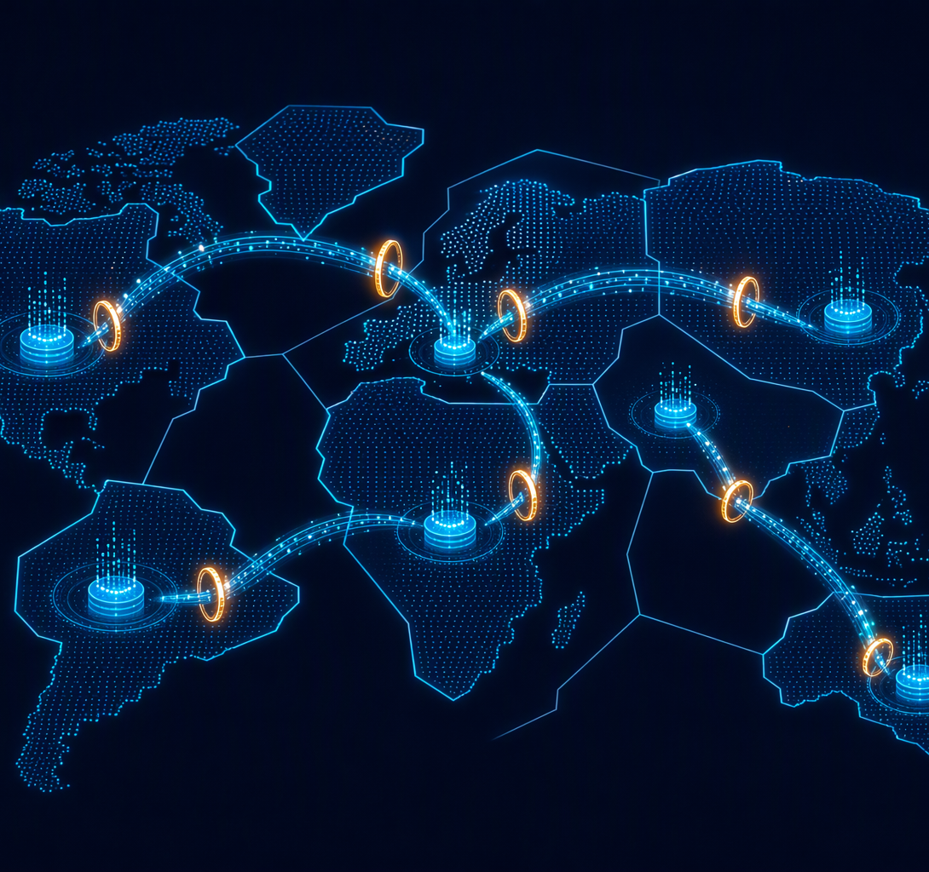
Pillar 2 · The gate before the write
Residency is resolved before a cross-border read is allowed to happen - three live verdicts.
DE-origin PII into EU analytics
SCC_MODULE_2_C2P · evidence on file · a contract route needs a named human
HUMAN_REVIEW
JP-origin telemetry into EU
EU_ADEQUACY · the only rung that auto-clears · no evidence gate
ALLOW
Hard-localised payments data
no mechanism offered · residency here is absolute
DENY
Sovereign pipeline: data lands in-region, only aggregated results may leave.

Slide 10
Pillar 3 · Bounding the pricing agent
Autonomous capture, human-owned consequences - the same gate, pointed at a browser-equipped agent.
01
Registered, not prompted
02
Gate before the browser
03
Facts out, verdicts in
agent_id: agt-pricing-scout-mea
tool_class: browser_capture
operating_regions: ["ae-1"]
allowed_purposes:
competitive_pricing_intelligence
autonomy_level: RECOMMEND_ONLY
may_write_pii: false
The scout calls the gate with its own agent id and purpose. If the purpose is not on the allow-list, the capture never starts.
What it collected still clears residency, the k-anonymity floor, and the transfer ladder.
RECOMMEND_ONLY means a price change is a proposal with a human owner, never a write.
Parsed parameters come back with "authoritative": false - and no verdict field at all.
A model-read spec sheet can raise a classification toward review. It can never pull one into ALLOW.
These bounds live in the tenant record the policy reads. Re-wording the agent's prompt cannot widen them - an off-list purpose or an unlisted region stops the job at the gate.
AUTHORITATIVE SOURCES ONLY
MANUAL_VERIFICATION · CERTIFICATE
DECLARATION · SIGNED_SPEC_SHEET
REGULATOR_RULING · ERP_MASTER_DATA
The pricing engine is the part of the ecosystem most likely to act on its own - so it is the part the gate is tightened around hardest. Speed is allowed; self-authorization is not.

Slide 11
What is actually running
Not a mock-up - every number below came off a test run on this repo.
0
69
35
LLM calls on the decision path
the model never returns the verdict
Rego policy tests
opa test - 69 of 69, plus the lint
End-to-end API tests
each one a real decision
6
3
9
Deterministic rule tables
staged as data.json, read by Rego
Reference tenants
each with its own residency flags
Transfer mechanisms
only adequacy auto-clears
FOUR COMMANDS TO REPRODUCE IT
scripts/policy_test.sh · scripts/policy_build.sh · scripts/opa_serve.sh --bundle · python -m pytest
The build stamps a revision into the bundle and reads it back; the sidecar pulls the artifact over HTTP and hot-reloads it with no restart.

Slide 12

Fast and wrong is a liability.
Every verdict is written to an append-only, hash-chained ledger. Change one byte and the chain says so.
TAMPER TEST, RUN TODAY
Rewrite the decision on one recorded line, then ask the ledger to verify itself:
{ "ok": false, "broken_at_seq": 0,
"reason": "payload edited" }
WHAT COMES NEXT
1 Tables sourced and signed off by a compliance owner. Today they carry an ILLUSTRATIVE_* legal basis, which is exactly why the ceiling exists.
2 Sanctions / denied-party and customs packs on the same spine - new Rego and new tables, no new engine.
3 Shared append-only storage so several replicas chain into one ledger instead of one file per node.
C:\Users\Lalit\Documents\Qoder\2026-10-10\d20d45e6

