Slide 1
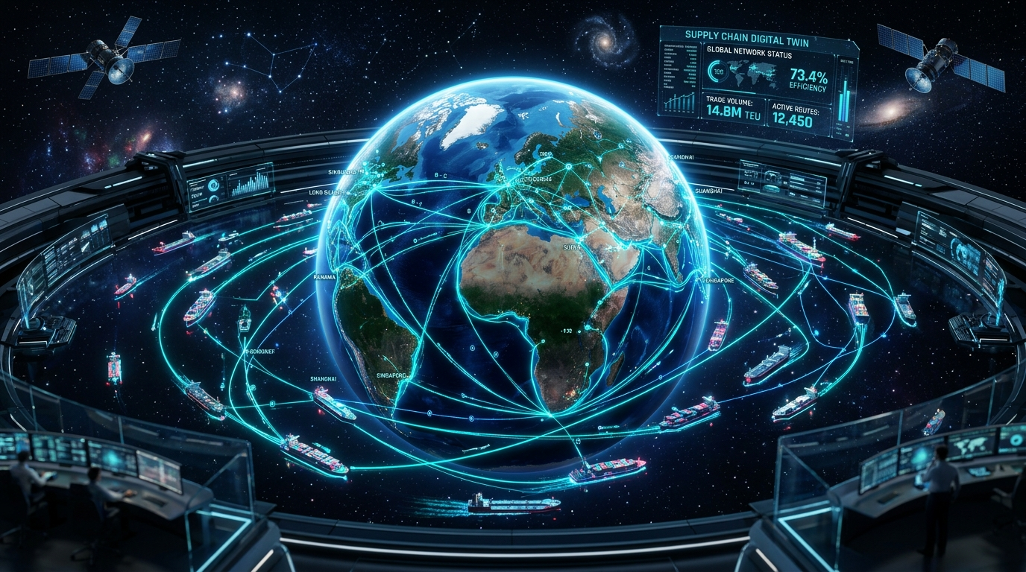
⚡ HACKATHON ENTERPRISE SHOWCASE
Self-Evolving AI
Supply Chain Network
Autonomous Global Logistics Orchestration, Real-Time Market Shift Forecasting & Human-in-the-Loop Governance
ARCHITECTURE STACK:
• LangGraph Durable Workflows • ClickHouse Time-Series OLAP
• Neo4j Tier-N Knowledge Graph • Apache Kafka / Redpanda
• NeMo Guardrails Policy Bounds • Arize Phoenix Tracing

Slide 2
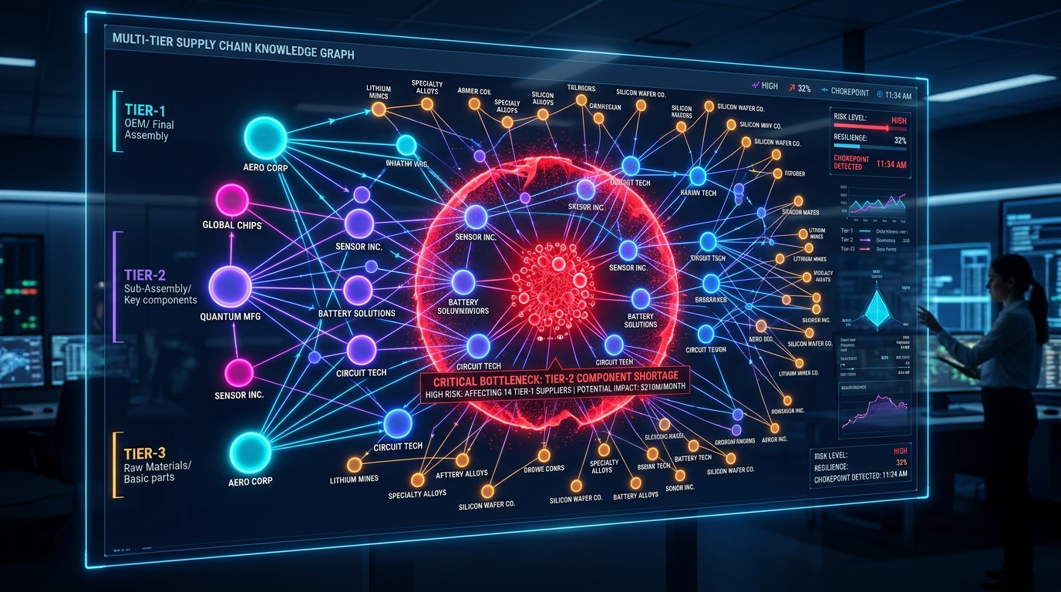
THE PROBLEM: The $50B Fragility Crisis in Global Supply Chains
1. The 'Tier-N' Visibility Blindspot
• OEMs only know their Tier-1 direct integrators.
• Zero visibility into Tier-2 sub-assemblies or Tier-3 raw chemical foundries.
• A silent disruption at Tier 3 halts OEM assembly lines weeks later, costing over $8,500/day per delayed container.
2. Unbounded LLM Financial Risk
• Raw LLMs hallucinate and cannot be given root access to enterprise capital.
• Unconstrained agents risk accepting 200% price premiums or contracting sanctioned suppliers.
• Enterprisewide adoption demands deterministic guardrails with Human-in-the-Loop fallbacks.

Slide 3
THE SOLUTION: 5-Pillar Enterprise Autonomous Architecture
01
Kafka / Redpanda
Live Event Streaming
• Sub-second pub/sub
• IoT GPS container pings
• Baltic spot rate surges
• Geopolitical alerts
02
Dual OLAP & Graph
Storage Engine
• ClickHouse: Time-series
z-score anomaly detection
• Neo4j: Multi-tier graph
SPOF blast radius model
03
LangGraph Durable
Multi-Agent Network
• StateGraph orchestration
• Market Intelligence Agent
• Graph Traversal Agent
• Contract Negotiator Agent
04
NeMo Guardrails &
HITL Checkpoint
• $50k spend limit ceiling
• 15% rate markup ceiling
• Sanctions embargo filter
• MemorySaver interruption
05
Meta-Learning
Self-Evolution Loop
• Objective reward function
• Heuristics self-tuning
• Episodic memory log
• Generation advancement
🚀 Enterprise Differentiator: Hybrid Deterministic & LLM Architecture — The AI reasons and plans, but deterministic mathematical policy bounds enforce safety.

Slide 4
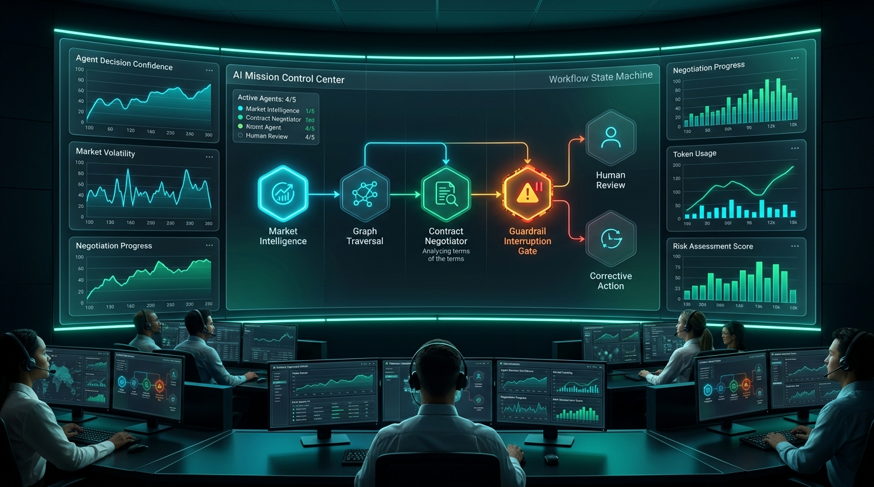
LIVE SCENARIO: Red Sea Chokepoint to Autonomous Resolution in 2.8s
• 1. Stream Anomaly Trigger
Kafka ingests maritime threat alert + ClickHouse flags +75% Suez spot rate surge.
• 2. Blast Radius Calculated
Neo4j traverses Tier-1 Shenzhen Mechatronics & Tier-2 Penang; flags $14.7M in OEM line risk.
• 3. Proposal Synthesized
Contract Negotiator synthesizes alternative bypass via Saigon Advanced Assembly, saving 12 days.
• 4. NeMo Guardrail Interruption
Contract exceeds $50k limit; LangGraph halts state at Human-in-the-Loop breakpoint.
• 5. Executive Sign-Off & Evolution
Supervisor approves; execution committed; Self-Evolution advances Gen 1 -> Gen 2 with +68.8 reward.

Slide 5
BUSINESS IMPACT: Quantifiable ROI & Enterprise Competitive Moat
SAVINGS MITIGATED
$142,500+
Per disruption event by avoiding dock detention
CYCLE TIME REDUCTION
12 Days Saved
Multimodal rerouting vs waiting at chokepoint
GOVERNANCE & SAFETY
100% Policy Bound
Zero unapproved contracts over $50k spend
Competitive Moat vs Existing Solutions
• Traditional ERP (SAP/Oracle): Batch processed, static schedules, reactive phone calls.
• Generic LLM Agents: Hallucinate supplier terms, unbounded financial liability, zero persistence.
• Our Autonomous Network: Real-time Kafka streaming, ClickHouse OLAP z-scores, Neo4j multi-tier blast radius, NeMo Guardrails, and true self-evolving memory.
Production Scaling Roadmap
• 1. Air Freight & Intermodal Rail Spot Dispatch
• 2. Sovereign Cross-Border Pipelines (ITAR/GDPR)
• 3. Live SAP S/4HANA & Oracle ERP Webhook Sync
• 4. Federated Multi-Enterprise Agent Negotiation

