Slide 1
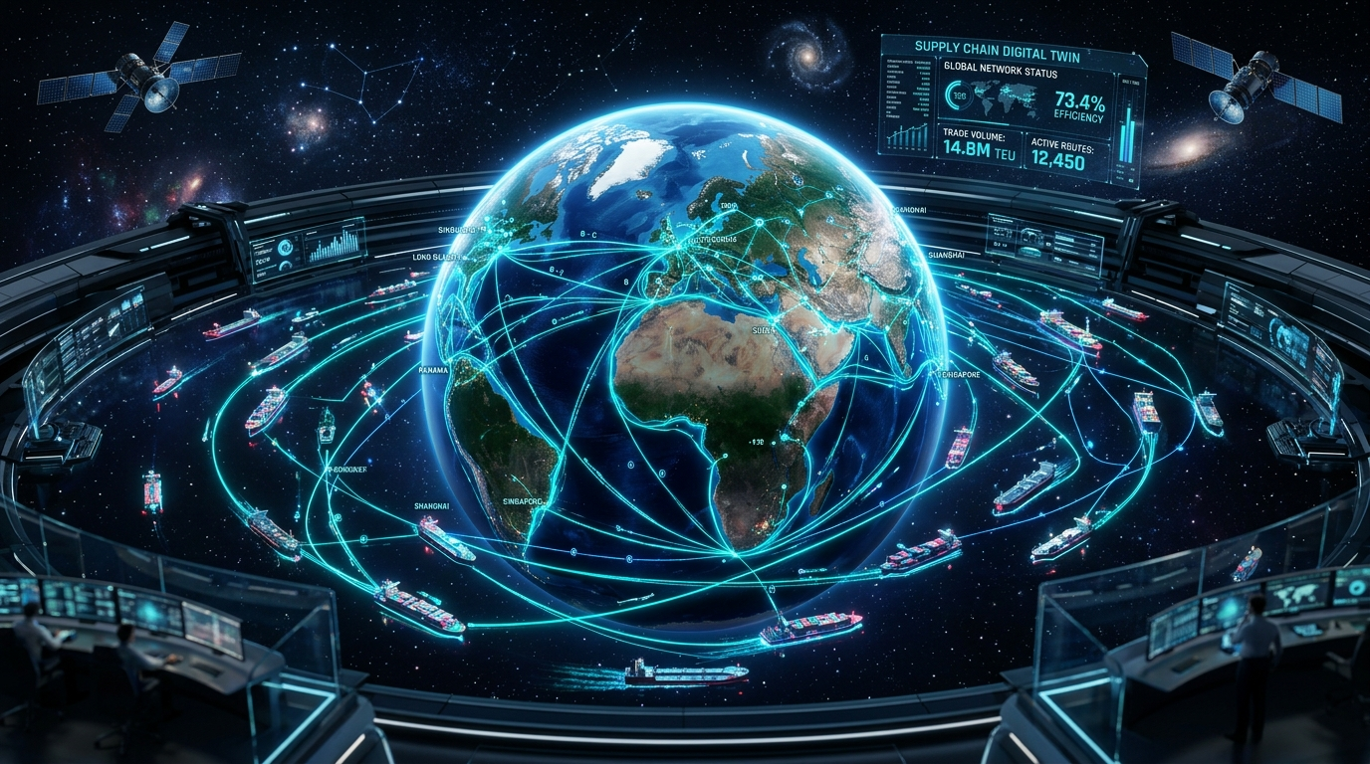
⚡ ENTERPRISE AI SHOWCASE
Self-Evolving AI
Supply Chain Network
Smart Real-Time Logistics Tracking, Early Disruption Alerts & Safe Human Control
CORE PRODUCTION STACK:
• LangGraph Multi-Agent Team • ClickHouse Fast Anomaly Detection
• Neo4j Deep Supplier Graph • Apache Kafka Live Streaming
• NeMo Safety & Spend Rules • Arize Phoenix Tracing

Slide 2
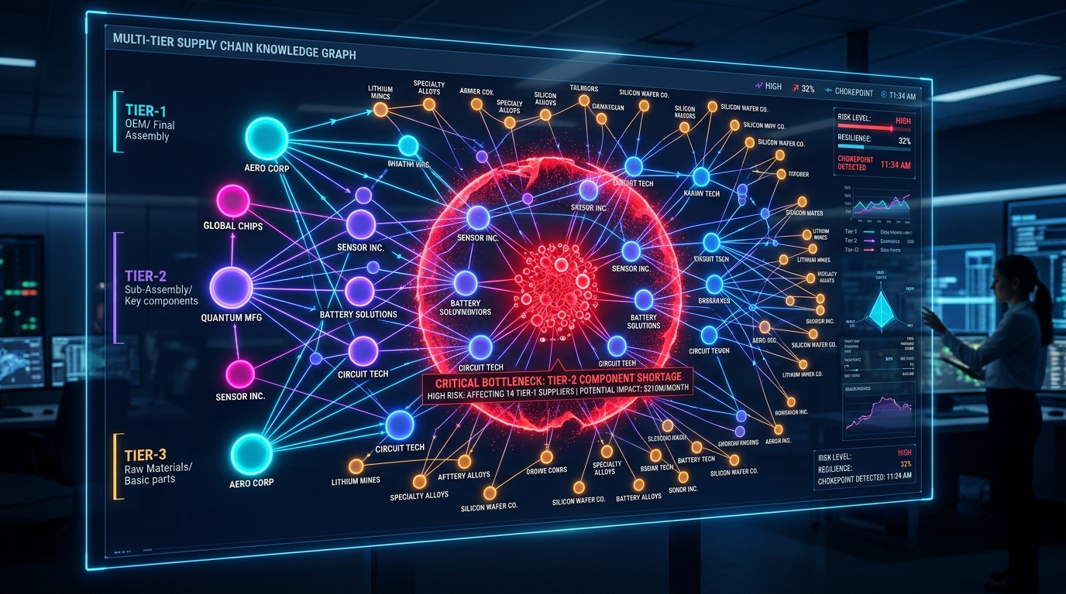
THE PROBLEM: The Hidden Supplier Blindspot & Cost Spikes
1. The Hidden Supplier Blindspot
• Most companies only know their direct suppliers (Tier-1).
• They have zero visibility into deeper suppliers (Tier-2 parts & Tier-3 raw materials).
• When a deep raw-material supplier shuts down, companies find out weeks too late—only after factory assembly lines freeze.
2. Sudden Delays & Runaway Costs
• Chokepoints (like Suez or Panama Canal) cause sudden +300% shipping delays.
• Spot freight rates jump +75% within 48 hours during geopolitical disruptions.
• Late port fees cost companies over $8,500 per day for each delayed shipment.

Slide 3
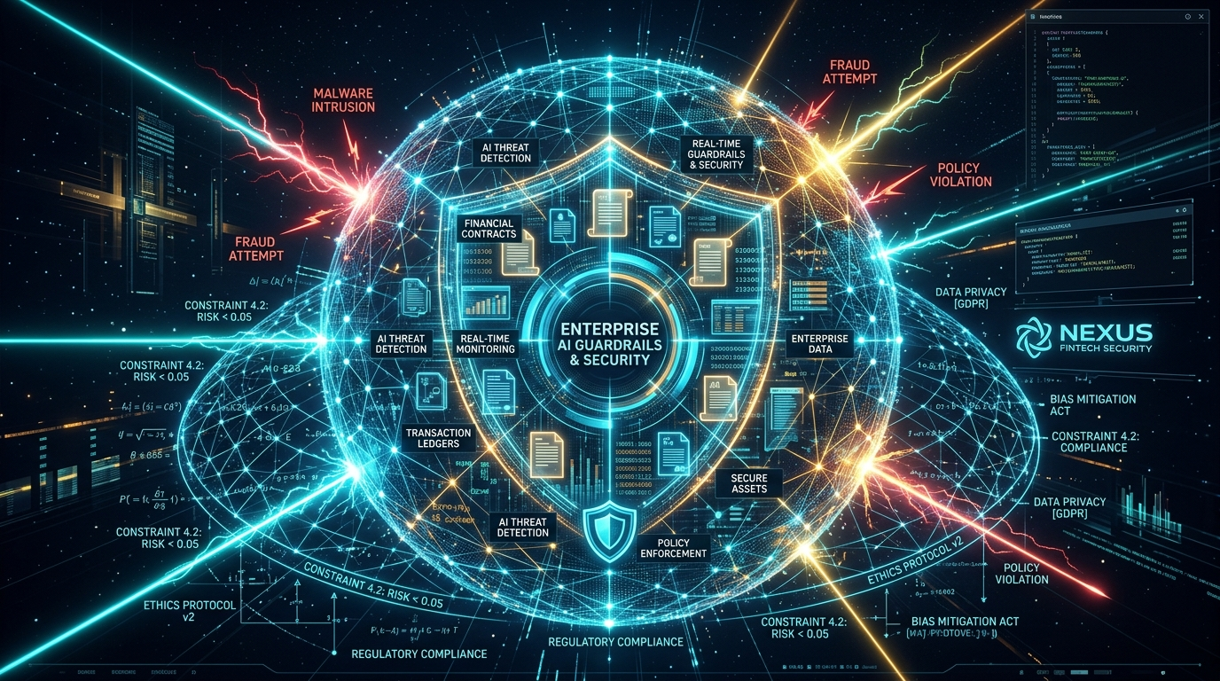
THE SAFETY CHALLENGE: Why Raw AI Cannot Run Supply Chains Alone
1. The AI Mistake & Risk Trap
• Standard AI models make guesses and can hallucinate false information.
• Giving AI direct purchasing power could result in approving 200% price markups or booking unverified vendors.
• International trade rules and embargoes require strict, guaranteed checks—not probabilistic guesses.
2. Guaranteed Safety with NeMo Guardrails
• Hard Spending Limit: Maximum $50,000 without human approval.
• Price Spike Protection: Rejects markups higher than 15%.
• Sanctions Filter: Instantly freezes orders from restricted regions.
• High-Risk Control: Mandates executive sign-off on critical contracts.

Slide 4
HOW IT WORKS: 5-Pillar Enterprise Autonomous Engine
01
Kafka / Redpanda
Live Event Stream
• Sub-second data updates
• GPS container pings
• Live shipping rate alerts
• Geopolitical news feed
02
ClickHouse & Neo4j
Fast & Graph Memory
• ClickHouse: Catches sudden
price and delay surges
• Neo4j: Maps entire deep
supplier network links
03
LangGraph Network
Smart AI Team
• Market Watch Agent
• Supply Chain Graph Agent
• Deal & Contract Agent
• Dependable multi-step runs
04
NeMo Guardrails
Safety & Human Sign-Off
• $50,000 spend ceiling
• 15% rate markup limit
• Blocked region filter
• Pauses for manager review
05
Meta-Learning
Self-Evolution Loop
• Scores every decision
• Self-tunes strategy rules
• Stores lessons learned
• Gets smarter each cycle
🚀 Smart AI + Strict Safety Guardrails: Agents solve complex logistics while strict mathematical rules prevent mistakes.

Slide 5
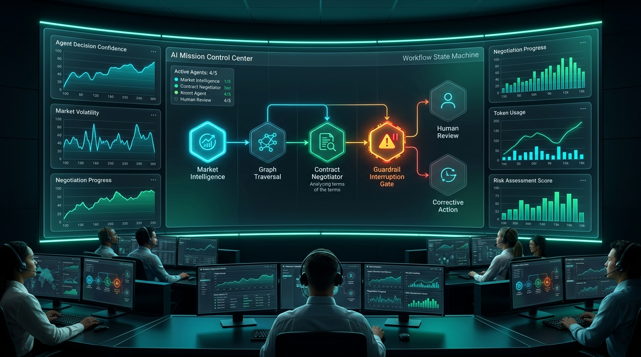
WORKFLOW IN ACTION: From Disruption to Human Approval
• 1. Live Threat Detected
Kafka receives delay ping; ClickHouse catches a +75% shipping rate surge.
• 2. Impact Mapped Instantly
Neo4j traces deep supplier connections; flags $14.7M in factory risk.
• 3. Smart Rerouting Created
Contract Agent designs an alternate route via Saigon (saving 12 days).
• 4. Safety Gate Triggered
Order exceeds the $50k spend limit; LangGraph safely pauses for approval.
• 5. Manager Approves & Executes
Supervisor clicks 'Authorize'; system immediately places the order.

Slide 6

CONTINUOUS LEARNING: How the AI Network Improves Over Time
1. Clear Performance Score (Reward Function)
Score = (0.6 × Risk Reduced) + (3.5 × Days Saved) - Cost Penalty
Evaluates every resolved incident against real delivery results.
2. Adaptive Strategy Memory (evolution_memory.json)
• Supplier Trust Weight: Automatically increases for reliable suppliers.
• Shipping Speed Weight: Gives higher priority to speed during port blockades.
• Risk Threshold: Adjusts sensitivity based on supervisor decisions.
3. Lessons Learned (Episodic Memory)
Stores key insights (e.g. 'Always maintain backup suppliers for microcontrollers') and feeds them into future AI planning cycles.

Slide 7
BUSINESS VALUE: Proven ROI, Key Advantages & Future Roadmap
MONEY SAVED
$142,500+
Saved per disruption by avoiding late port fees
TIME SAVED
12 Days Faster
Smart rerouting around congested bottleneck ports
SAFETY & CONTROL
100% Compliant
Zero unapproved orders above the $50k spend limit
Why Our System Wins vs Existing Tools
• Traditional ERP (SAP/Oracle): Slow batch schedules, static data, and reactive phone calls.
• Generic AI Chatbots: Make guesses, risk huge financial mistakes, and have no long-term memory.
• Our Self-Evolving Network: Live data streaming, deep supplier relationship mapping, strict safety rules, and continuous learning.
Enterprise Production Roadmap
• 1. Air Freight & Multi-Modal Rail Dispatch
• 2. Global Compliance & Cross-Border Privacy
• 3. Live SAP & Oracle ERP System Sync
• 4. Multi-Company AI Negotiation Network

