Slide 1

SMART NATIONAL HISTORIC SITE 4.0
TEAM JOMPALANG | FIBO KMUTT
Art & Cultural Conservation & Tourism Information System

Slide 2

Ref : https://www.thaisabuy.com/travel/travel-buriram/
Notes:
ปราสาทหินพนมรุ้งแลนด์มาร์คของจังหวัดบุรีรัม

Slide 3
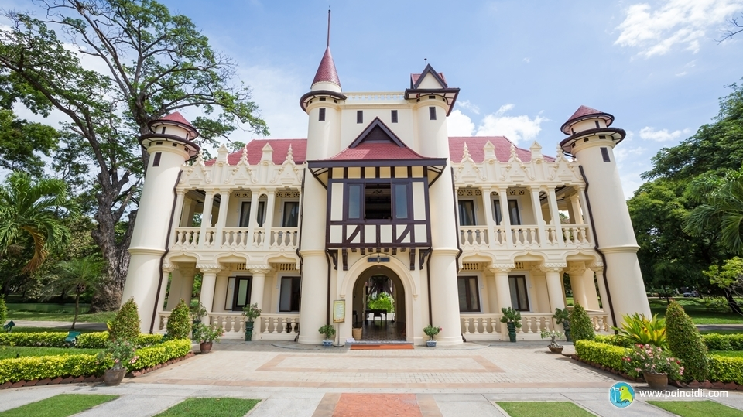
Ref : http://www.painaidii.com/review/9293/sanam-chandra-palace-73000/lang/th/

Slide 4
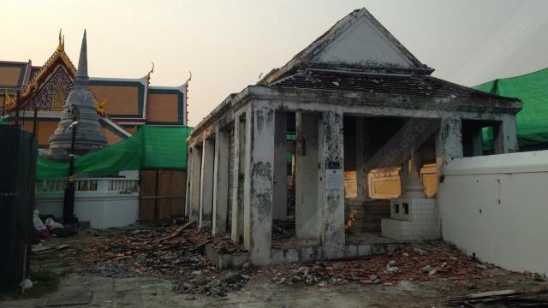
Ref : https://mgronline.com/travel/detail/9510000026336

Slide 5
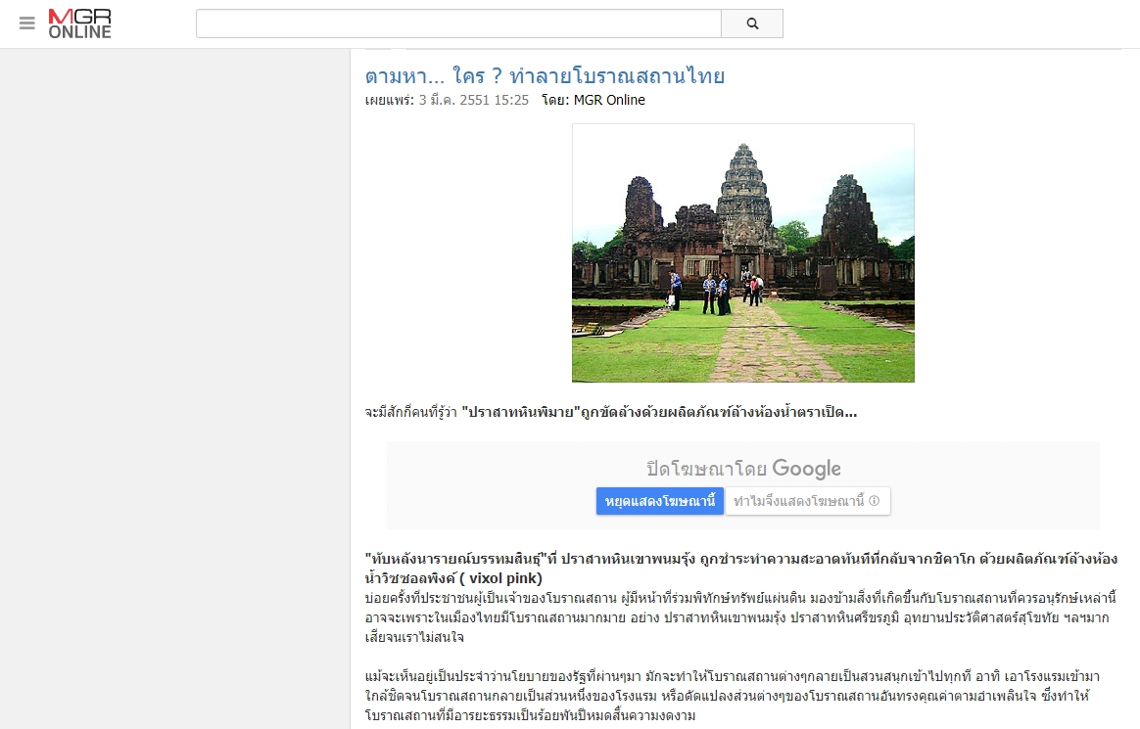
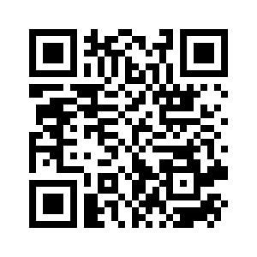
Ref : https://mgronline.com/travel/detail/9510000026336

Slide 6
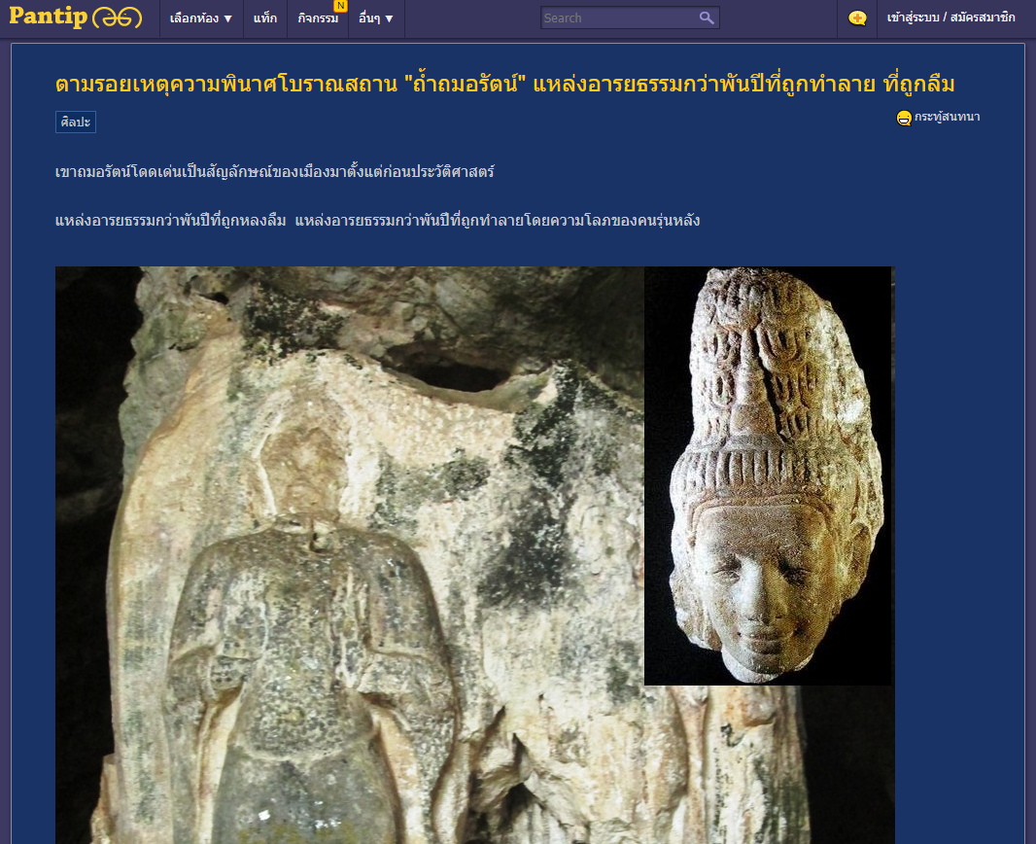
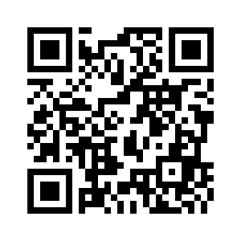
Ref : https://pantip.com/topic/30547172

Slide 7

Pain point
ตามเวลา
ละเลย
นักท่องเที่ยว
CARELESS
Pain Point

Slide 8
Pain point
ตามเวลา
ละเลย
นักท่องเที่ยว
DETERIORATION
Pain Point

Slide 9
Pain point
ตามเวลา
ละเลย
นักท่องเที่ยว
HUMAN & ANIMAL
Pain Point

Slide 10
SMART NATIONAL HISTORIC SITE 4.0
TEAM JOMPALANG | FIBO KMUTT
Art & Cultural Conservation & Tourism Information System

Slide 11
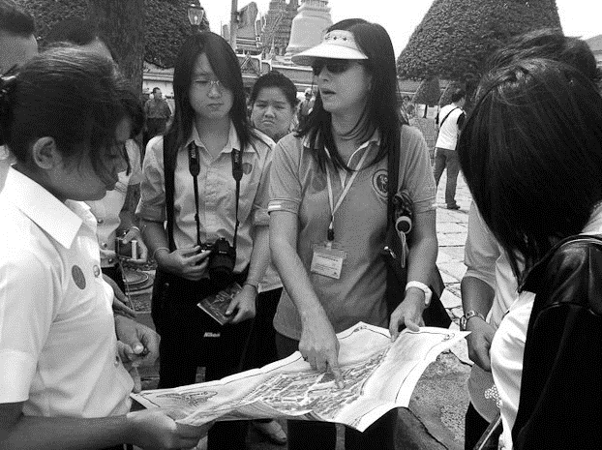

USER
Staff
Tourism

Slide 12
USER
Line Chat Bot
Information Service
Advertisement and News
User Feedback
Information and Contact
Map (inside and around the place)
Historical
Travel
Tourism
Line Beacon
Greeting
Caution
Introduce the name of each zone

Slide 13
USER
Line Chat Bot
Display data from sensor and Line beacon
Display User Feedback
Alert for crowded area
Alert for Unusual situation
Predict the future data
Staff

Slide 14
OPERATION PLAN
1
Find Problems
2
Brain Strom
3
Select Features
4
Implement
5
Test

Slide 15
OPERATION PLAN
1
Find Problems
2
Brain Strom
3
Select Features
4
Implement
5
Test

Slide 16
OPERATION PLAN
1
Find Problems
2
Brain Strom
3
Select Features
4
Implement
5
Test

Slide 17
OPERATION PLAN
1
Find Problems
2
Brain Strom
3
Select Features
4
Implement
5
Test

Slide 18
OPERATION PLAN
1
Find Problems
2
Brain Strom
3
Select Features
4
Implement
5
Test

Slide 19
OPERATION PLAN
1
Find Problems
2
Brain Strom
3
Select Features
4
Implement
5
Test

Slide 20




TEAM MANAGEMENT
HARDWARE
SERVER
AI
LINE
Ha
Team
Aob
PIMPIM
Toiy

Slide 21
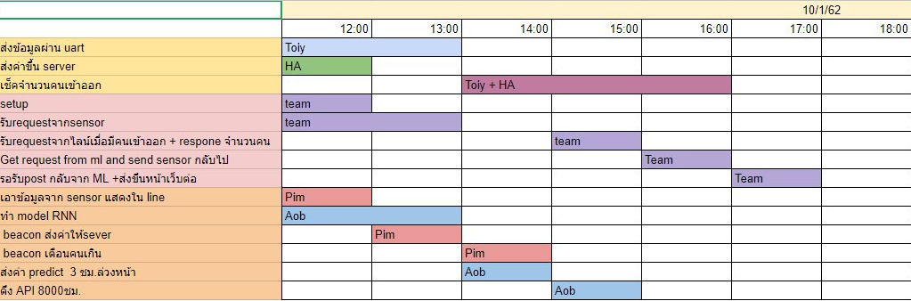
TEAM MANAGEMENT

Slide 22
FEATURES
Tourism
Staff
Line Chat Bot
Line Chat Bot
Display data from sensor and Line beacon
Display User Feedback
Alert for crowded area
Alert for Unusual situation
Predict the future data
Information Service
Advertisement and News
User Feedback
Information and Contact
Map (inside and around the place)
Historical
Travel
Line Beacon
Greeting
Caution
Introduce the name of each zone

Slide 23

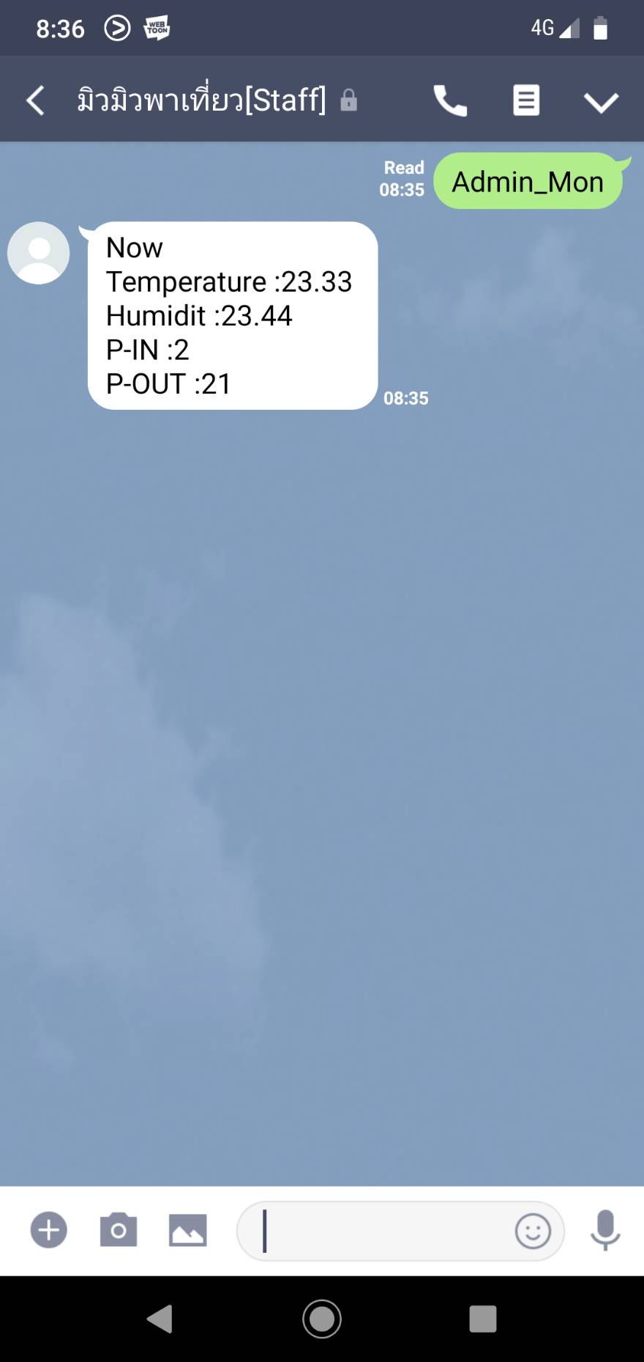
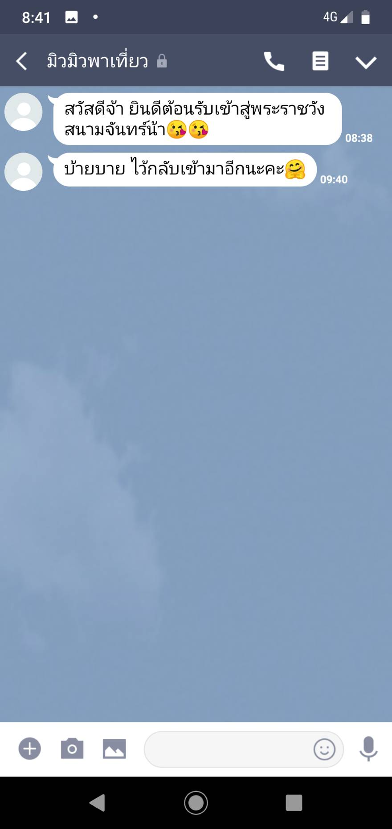
Display Data(Staff)

Slide 24
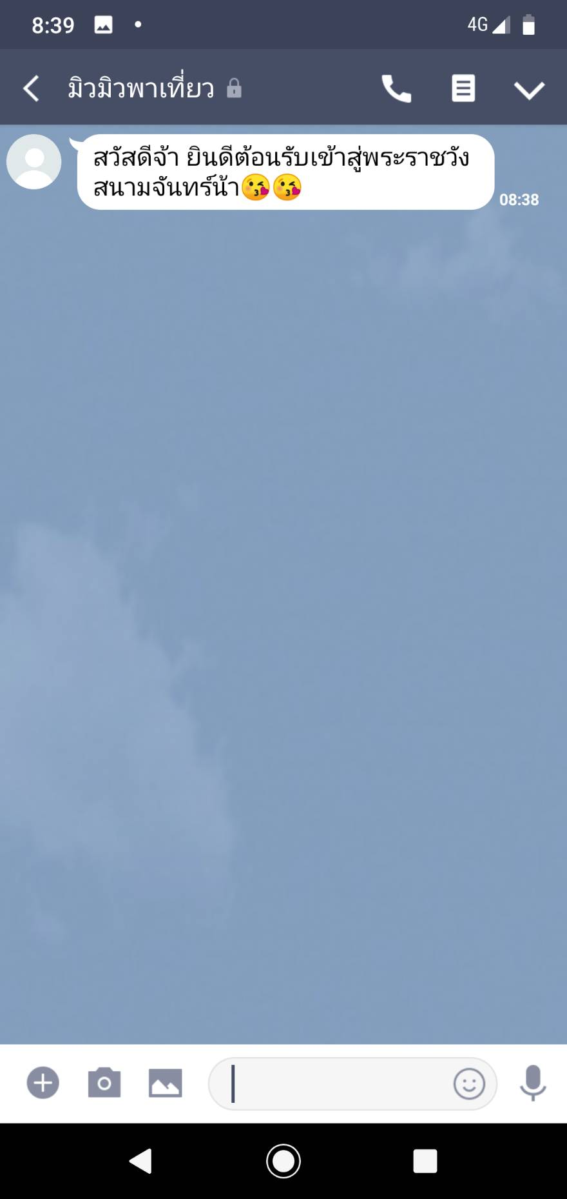
Line Beacon(Tourism)

Slide 25
Line Beacon(Tourism)

Slide 26

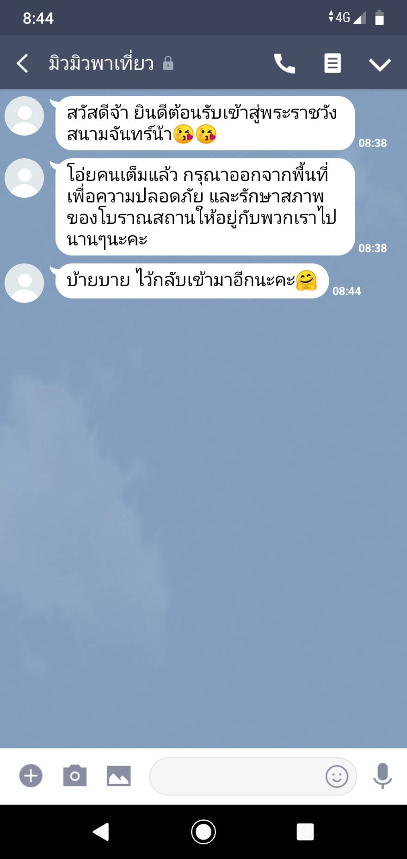
Caution
Line Beacon(Tourism)

Slide 27
-NLP for chatbot -Increase prediction model accuracy with Big data -Historic site network
Build on Ideas

Slide 28
THANK YOU
TEAM JOMPALANG | FIBO KMUTT

