Slide 1
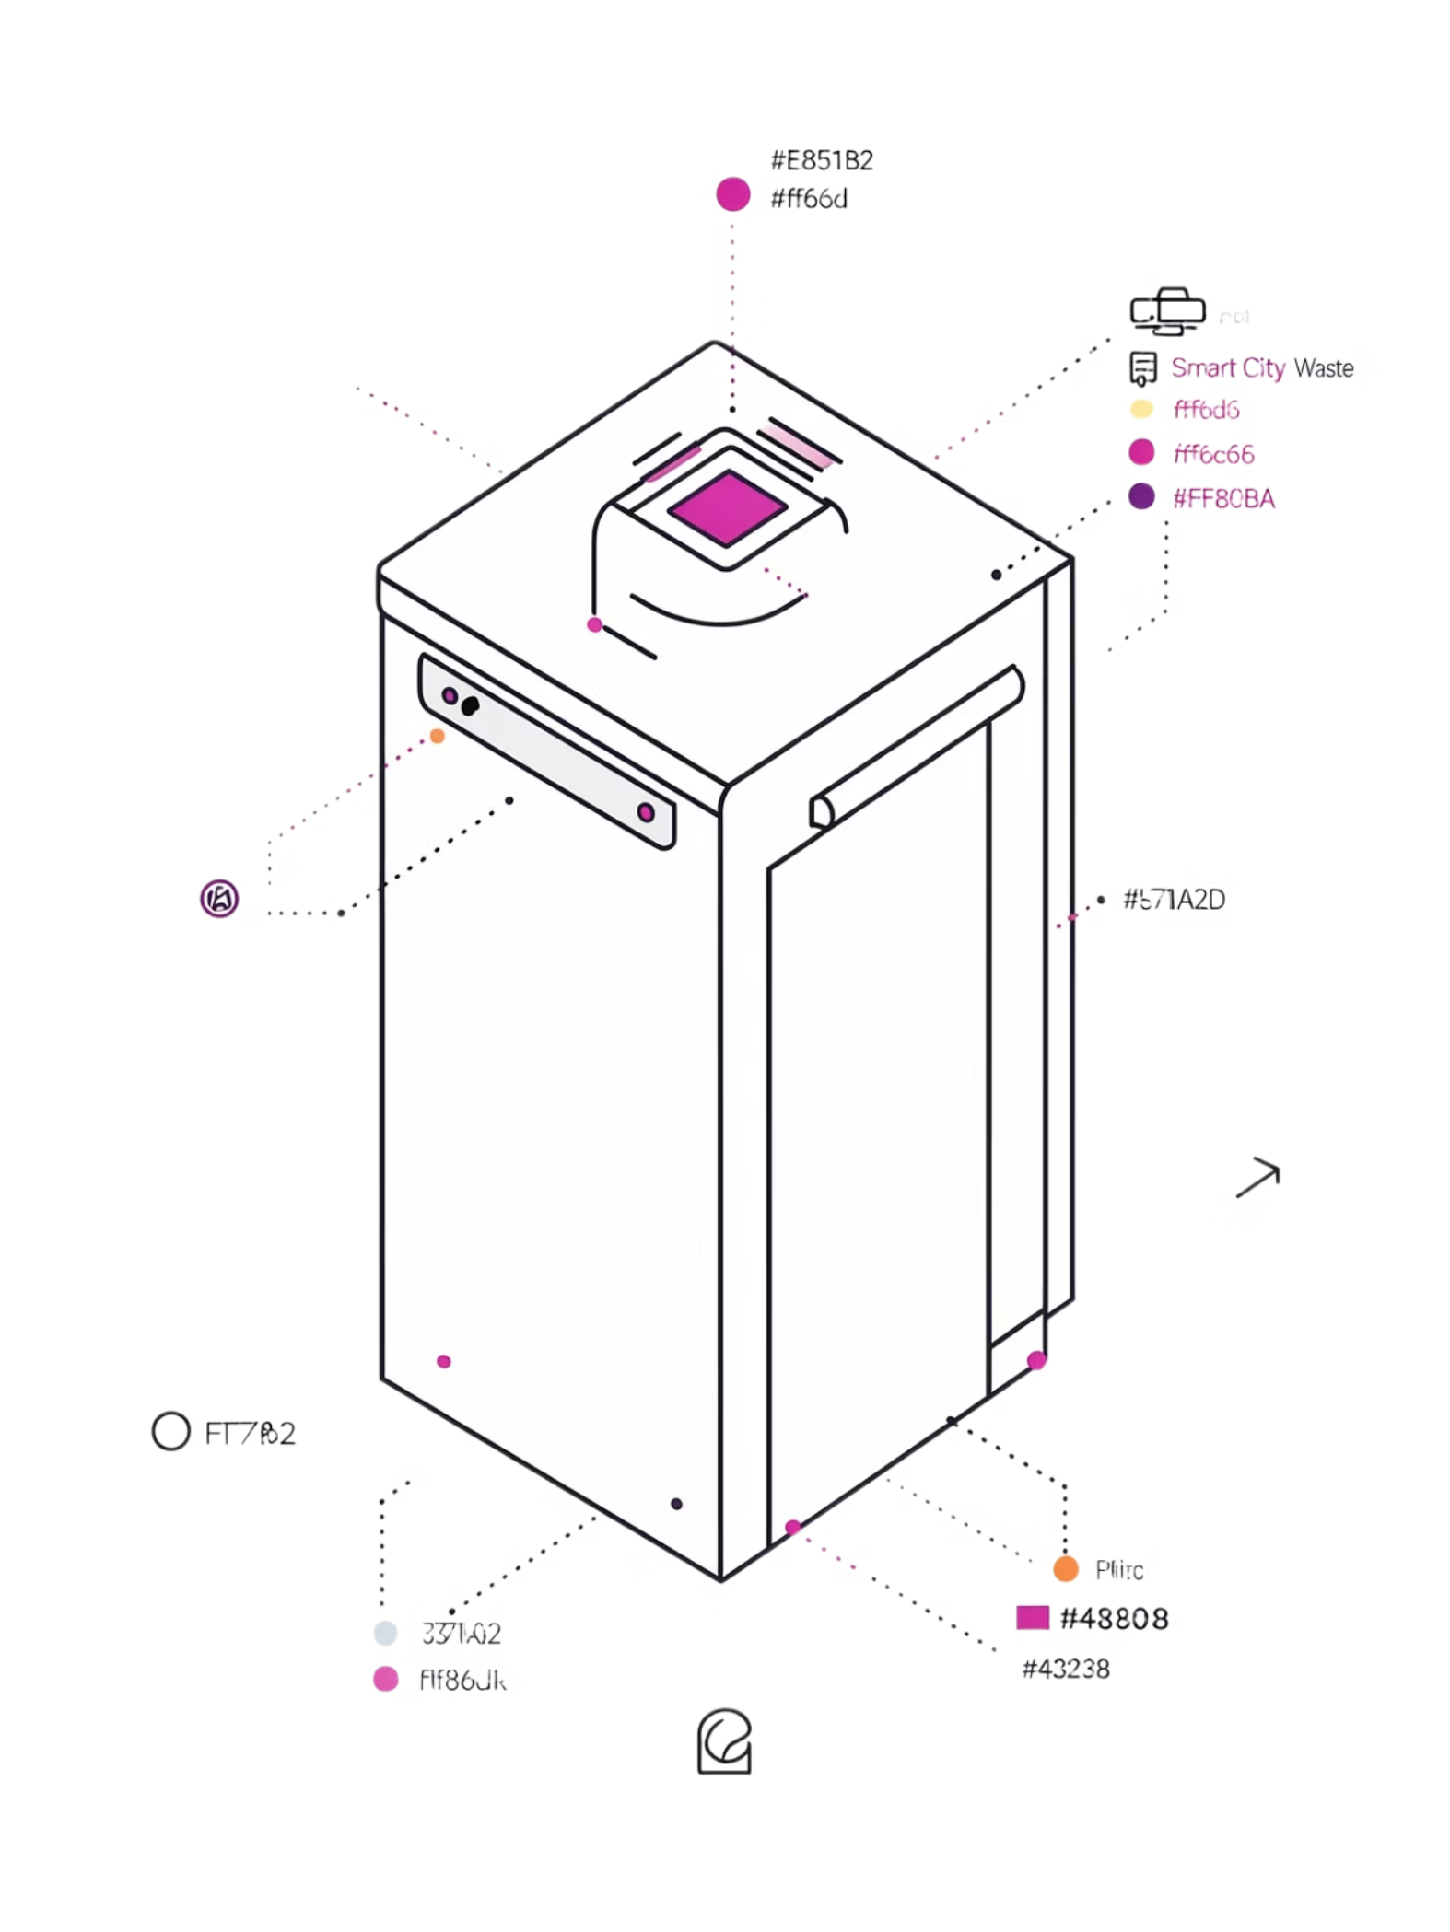
Intelligent Waste Management System
Using IoT Sensors for Bin Fill Level Monitoring and Automated Collection Alerts
An IoT-based solution for intelligent, efficient, and sustainable waste collection — continuously monitoring bin fill levels and automatically generating collection alerts to support cleaner urban environments.
ABHAY KUMAR TAPPITA
323129520020

Slide 2
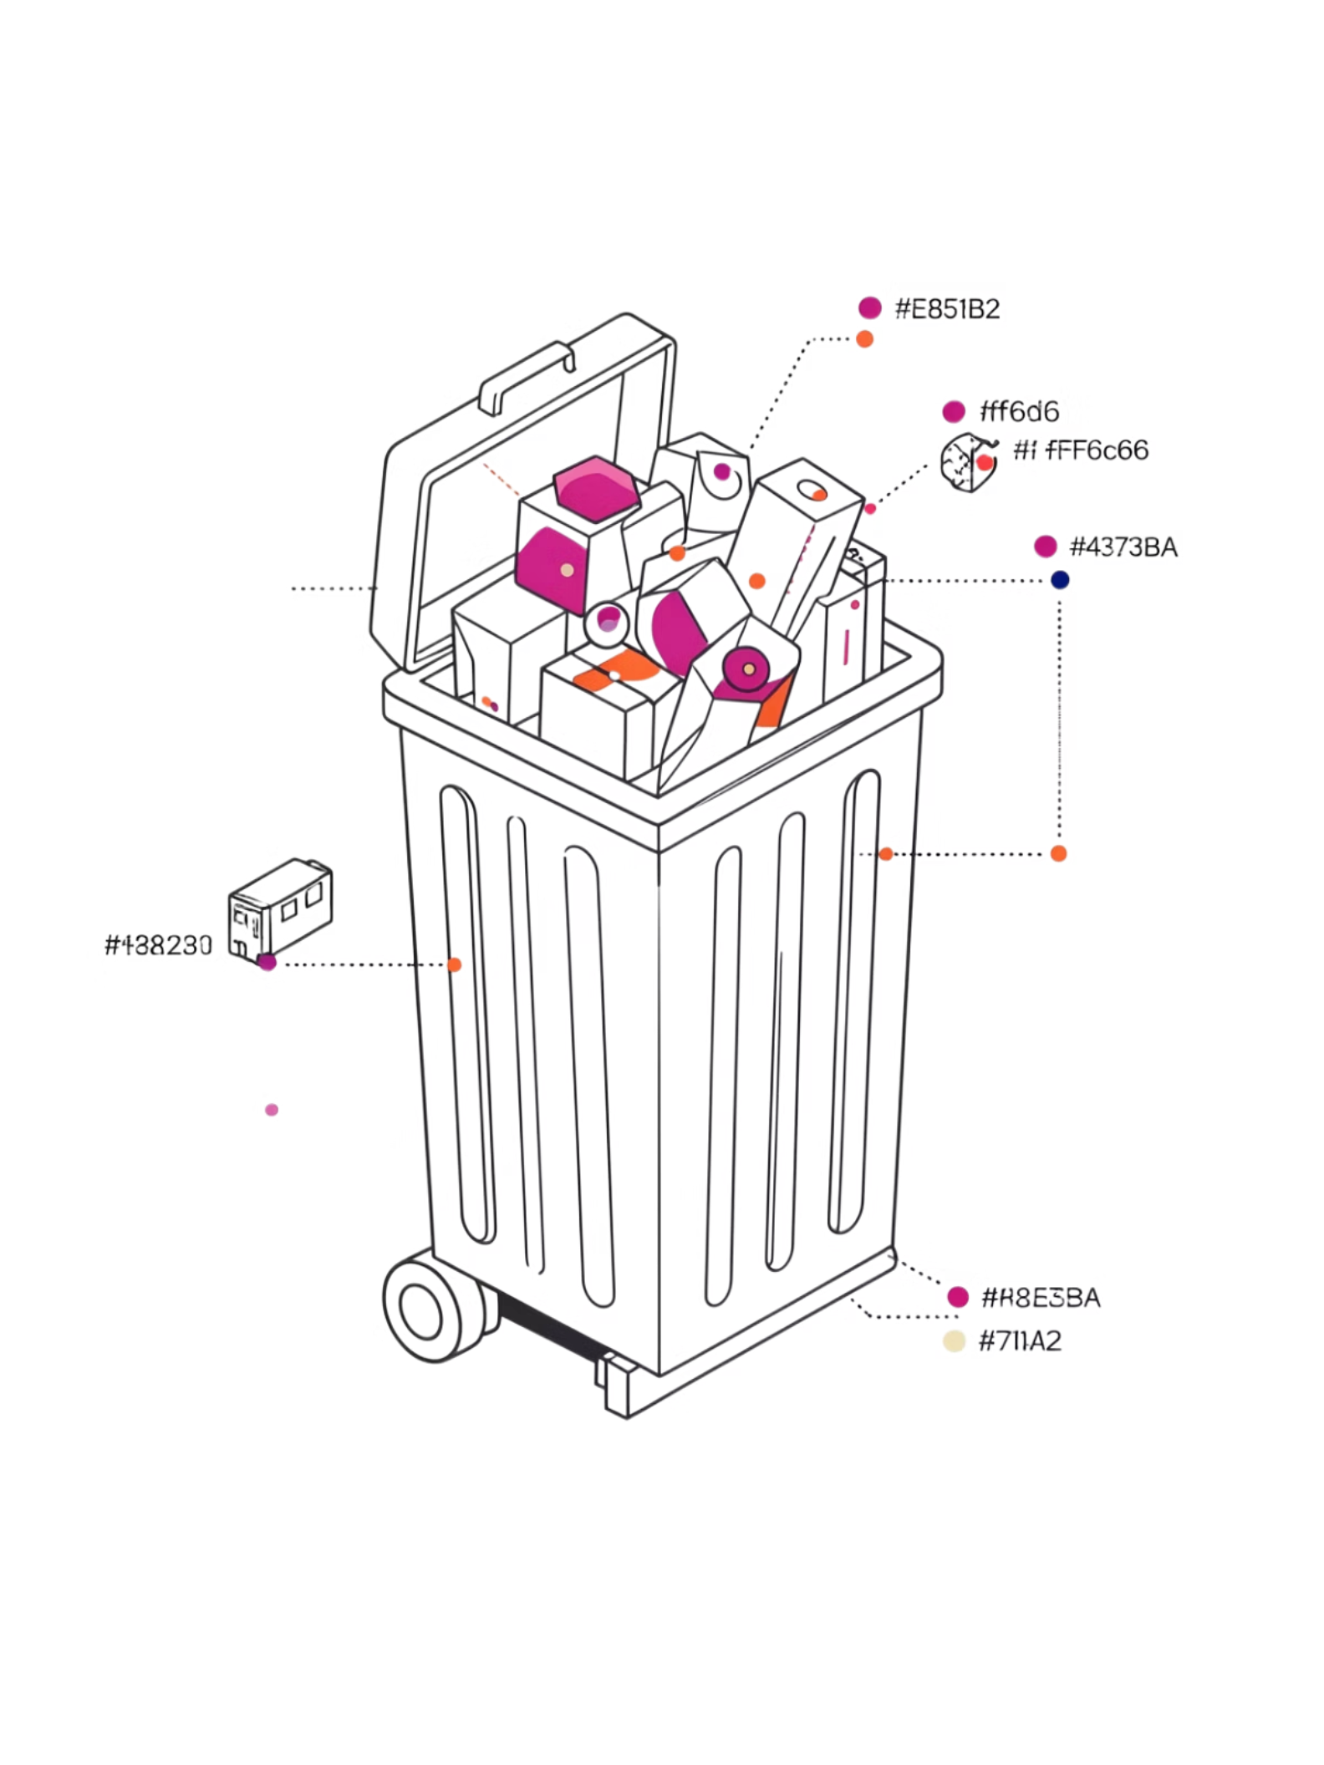

Problem Statement
The Core Challenge
Why Traditional Systems Fall Short
Efficient waste collection is essential for maintaining clean urban environments and improving public health. Yet most cities still rely on outdated, fixed-schedule collection systems.
Overflow Risk
Bins fill up before the scheduled collection, causing spillage and hygiene issues.
Fixed schedules cause bins to overflow before the next collection — or waste trips on partially filled bins.
Wasted Resources
Collection vehicles are dispatched to partially filled bins, wasting fuel and labor.
No Real-Time Visibility
Municipal authorities lack live data to make informed, dynamic collection decisions.

Slide 3
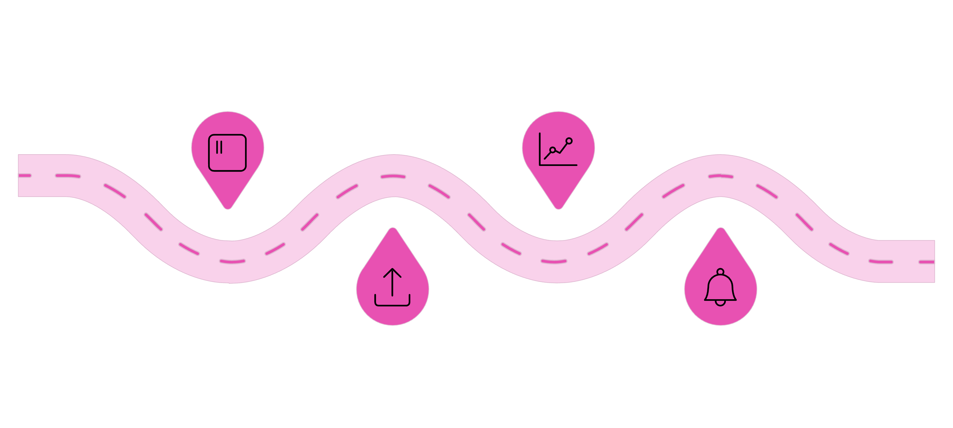
Proposed Solution
The Intelligent Waste Management System uses IoT sensors to continuously monitor waste bins, transmit fill-level data to a central server, and automatically trigger collection alerts when thresholds are exceeded.
IoT Sensors
Analysis
Monitor bin fill levels continuously
Evaluate fill levels and trends
Data Transfer
Collection Alert
Send readings to central server
Generate automated pickup notifications
This centralized, secure, and user-friendly platform gives authorities real-time information to make smarter, faster collection decisions — replacing guesswork with data-driven action.

Slide 4
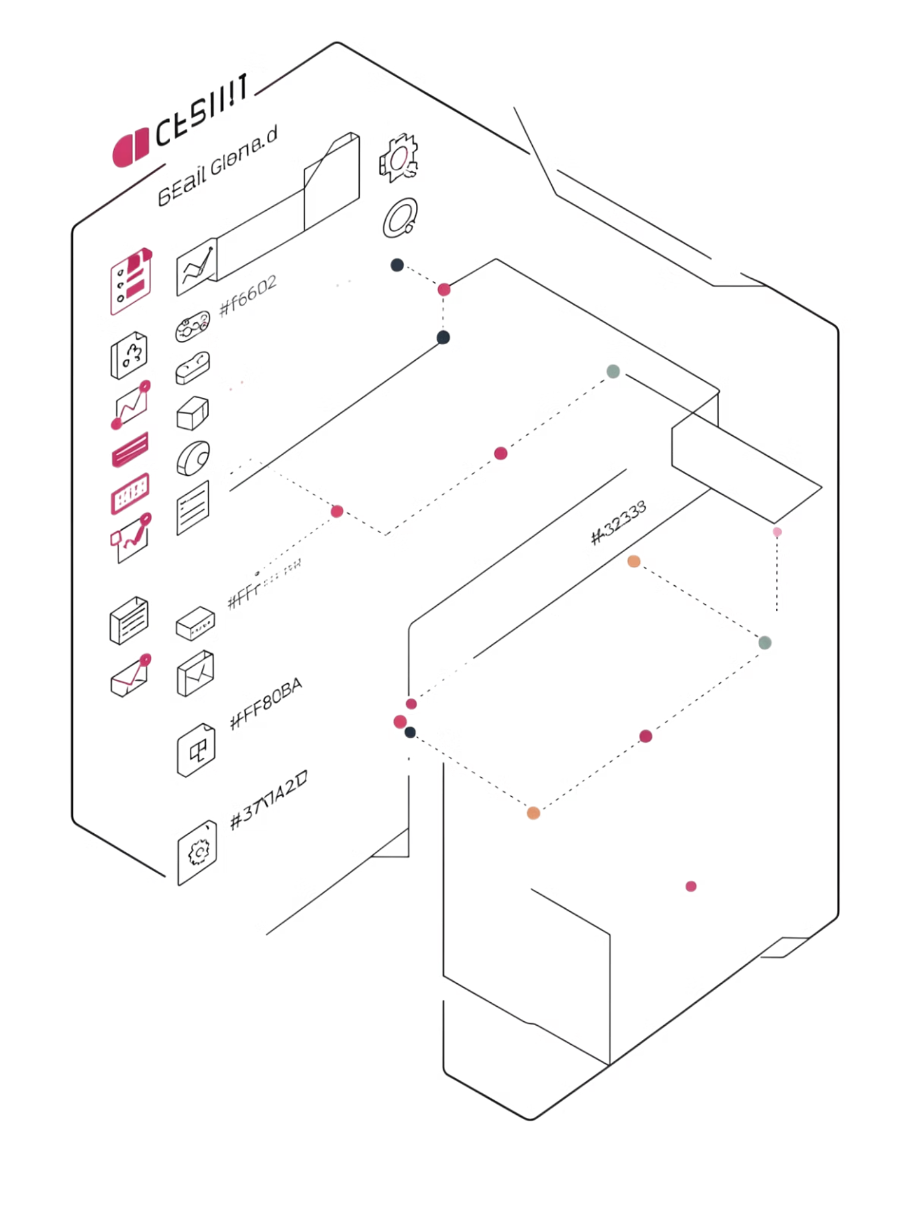
Project Objectives
Continuous Monitoring
Monitor waste-bin fill levels in real time and detect when bins reach predefined thresholds.
Automated Alerts
Automatically generate collection alerts when fill levels exceed set thresholds.
Optimized Schedules
Reduce overflowing bins and avoid unnecessary collection of partially filled bins.
Sustainable Cities
Improve efficiency, reduce operational costs, and support cleaner urban environments.

Slide 5
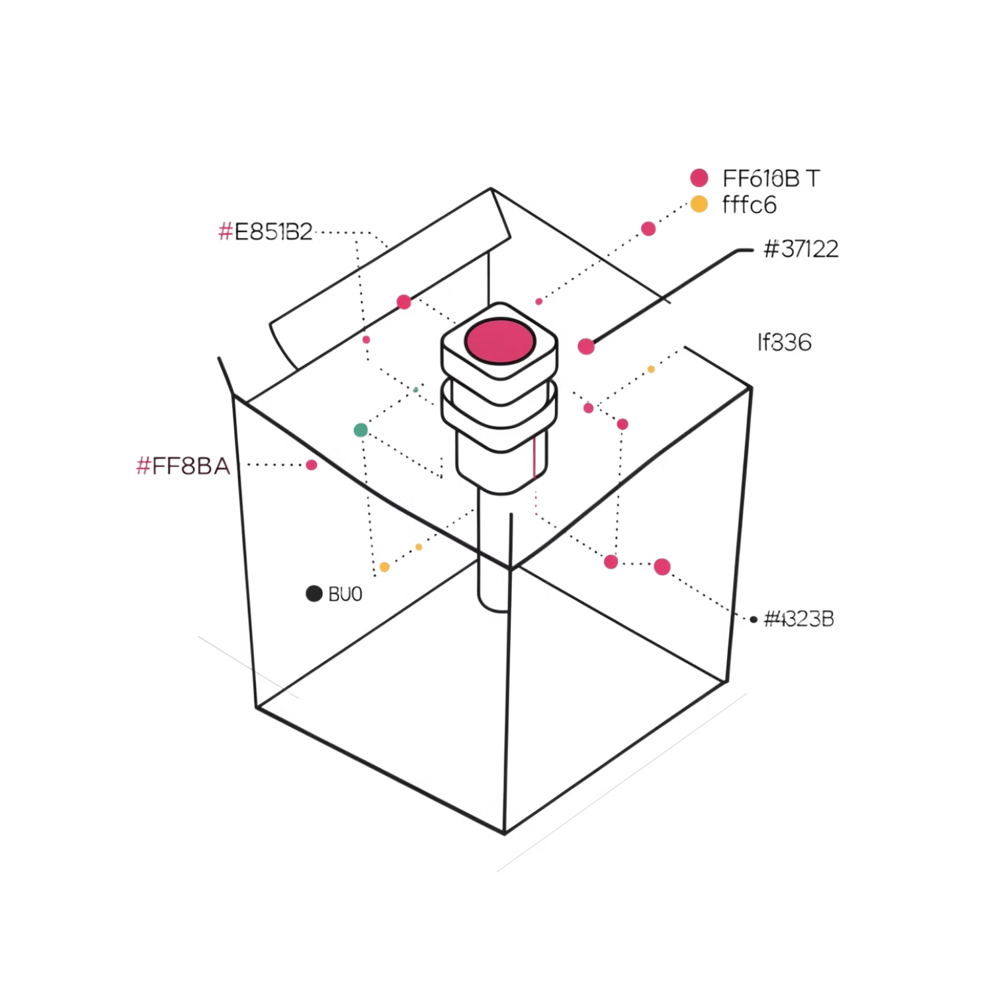
IoT-Based Waste-Level Monitoring
How the Sensors Work
Ultrasonic sensors are installed inside waste bins to continuously measure the available space and fill level. IoT communication modules then transmit this data to the central monitoring system in real time.
Ultrasonic Sensing
IoT Transmission
Cloud Analytics
Measures waste level inside each bin with precision.
Communication modules relay sensor data to the cloud instantly.
Real-time analytics processes data, replacing fixed collection schedules entirely.

Slide 6
System Working Process
A complete, step-by-step workflow — from sensor installation to alert delivery and data recording.
01
02
Sensor Installation
Level Measurement
Ultrasonic sensors are installed inside waste bins.
Sensors measure the waste level inside each bin continuously.
03
04
Data Transmission
Fill Analysis
Sensor data is transmitted via IoT communication modules to the central server.
The system analyzes the current fill percentage and compares it with the predefined threshold.
05
06
Alert Generation
Data Recording
If the threshold is exceeded, an automated collection notification is generated and sent to personnel.
Collection information is recorded for future monitoring and analysis.

Slide 7
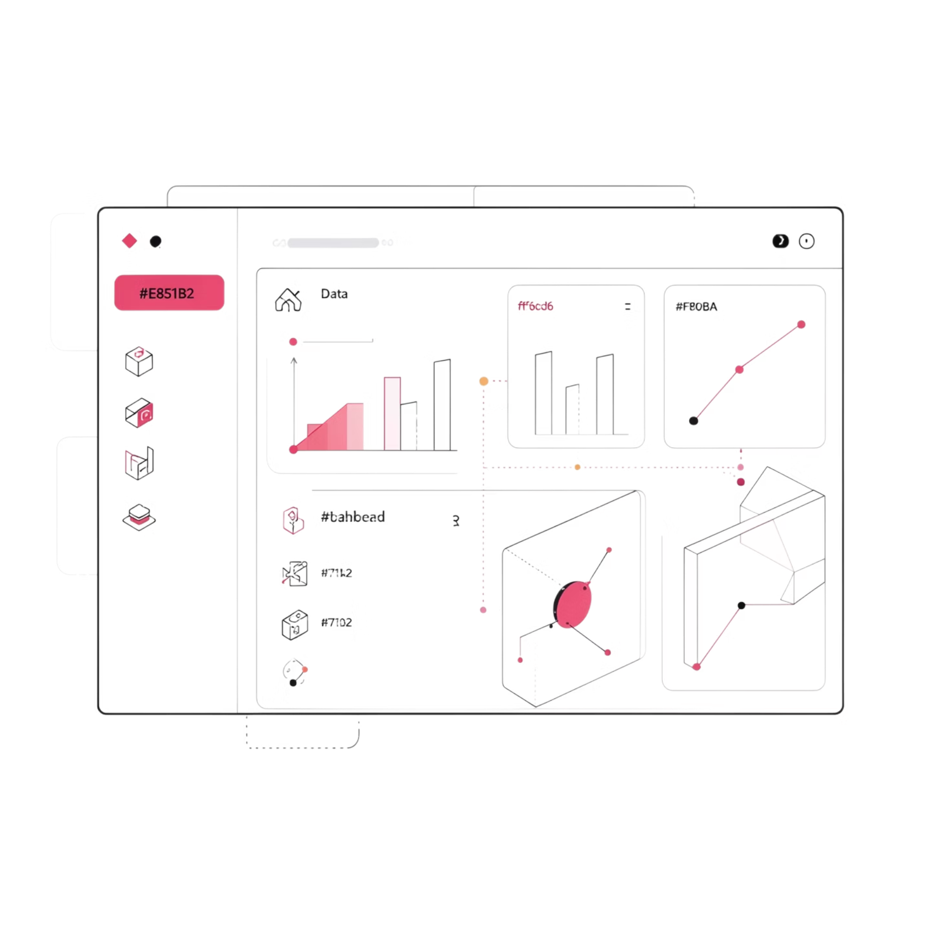
Monitoring Dashboard and Analytics
What the Dashboard Provides
Current bin status and waste-bin fill percentage
Real-time fill-level information across all monitored bins
Collection alerts triggered by threshold breaches
Collection history and waste collection records
Route optimization reports for efficient dispatch
Real-time analytics for data-driven decision making
The dashboard enables municipal authorities and waste management personnel to identify bins requiring collection and improve collection planning at a glance.

Slide 8
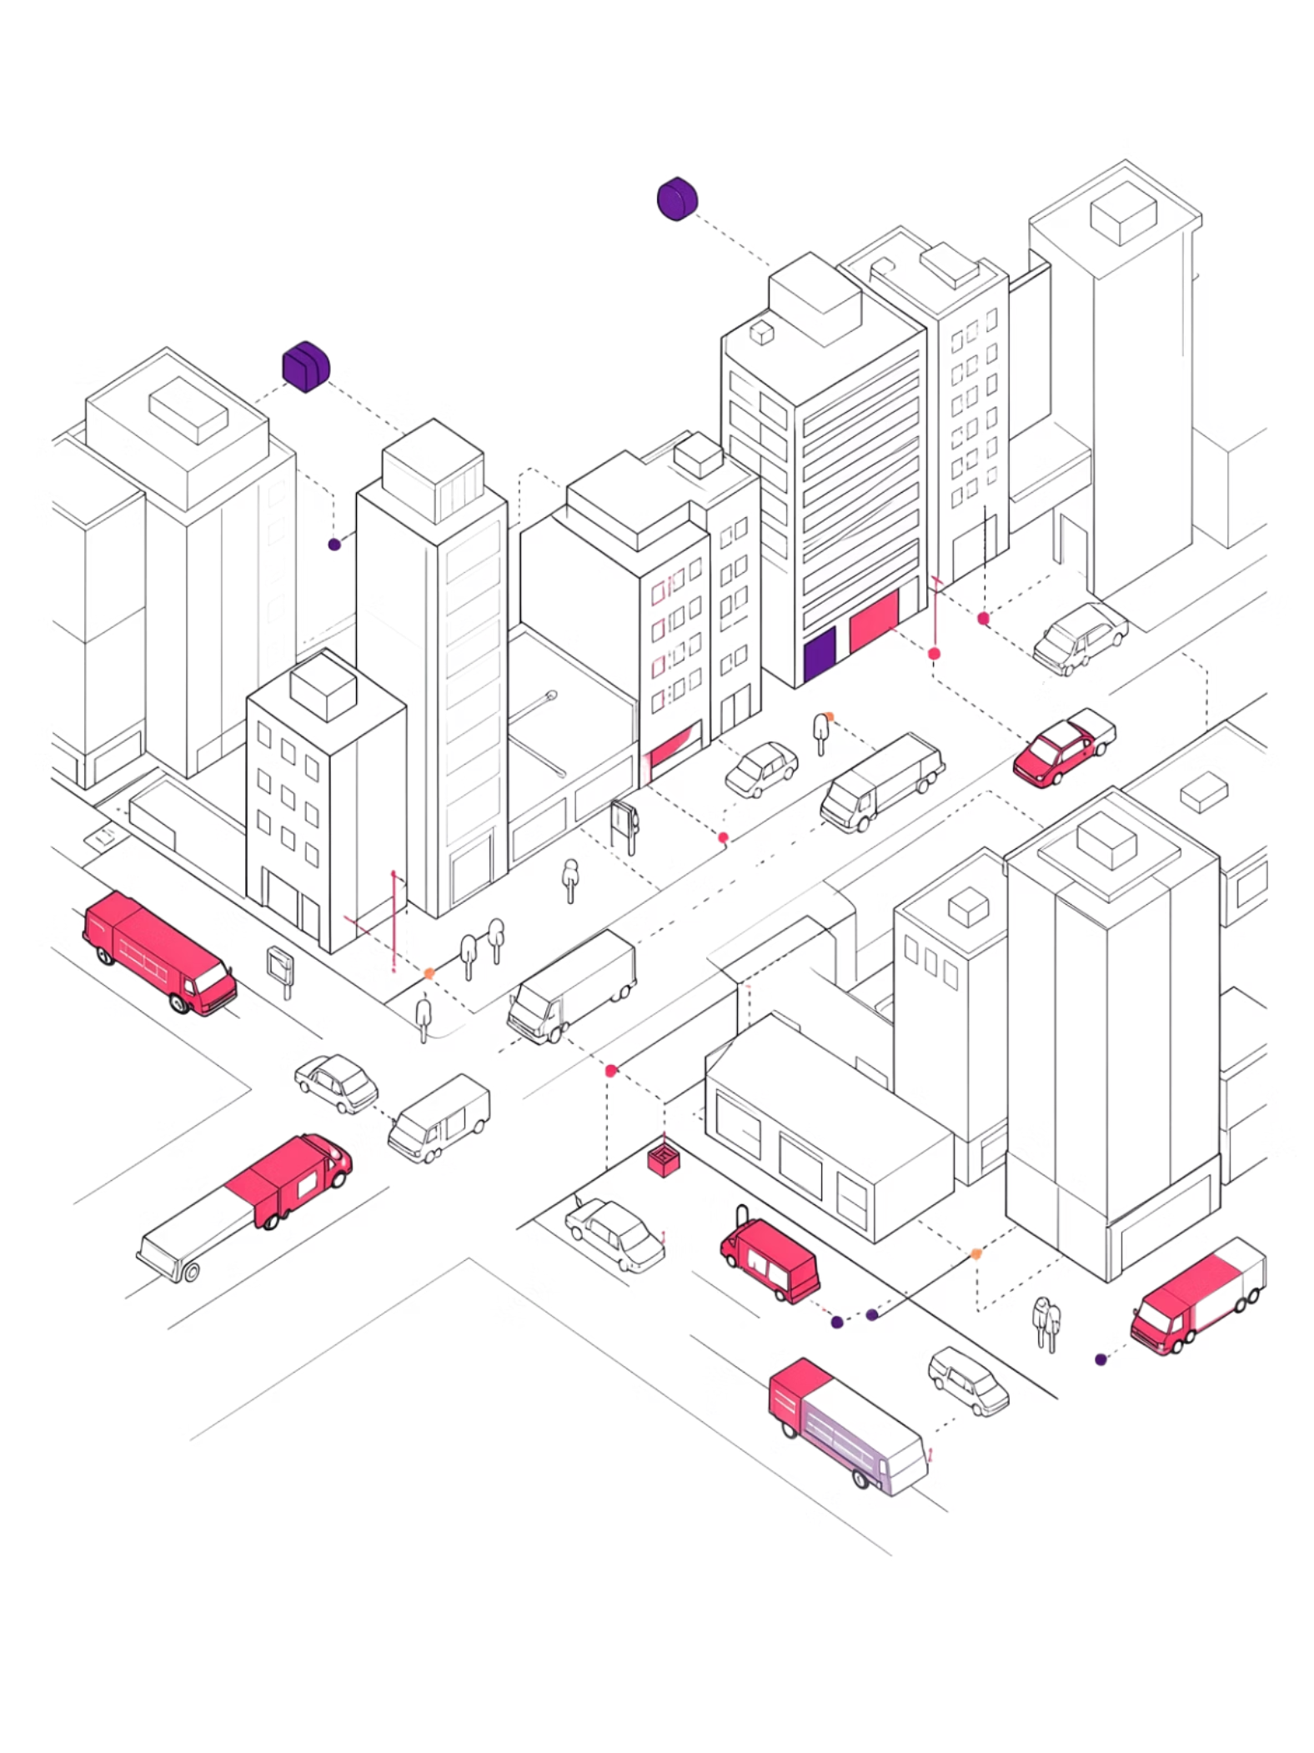
Benefits and Advantages
Operational Efficiency
Cost Savings
Reduces overflowing waste bins
Enables timely waste collection
Optimizes collection schedules
Improves overall operational efficiency
Prevents unnecessary trips to partially filled bins
Reduces waste collection costs
Helps personnel respond to alerts efficiently
Sustainability
Provides real-time visibility of bin conditions
Supports cleaner urban environments
Contributes to sustainable waste management

Slide 9

Applications and Scope
Where the System Can Be Deployed
System Scope
The system supports centralized monitoring of multiple waste bins, helping authorities manage collection operations more efficiently through:
Municipalities
Real-time data from distributed IoT sensors
Automated alerts when thresholds are exceeded
Collection analytics for continuous improvement
City-wide waste monitoring and optimized public collection routes.
The system is designed to be secure and scalable — suitable for small campuses and large smart city deployments alike.
Educational Institutions
Campus-wide bin monitoring for schools, colleges, and universities.
Hospitals & Communities
Hygienic waste management for healthcare facilities and residential areas.

Slide 10
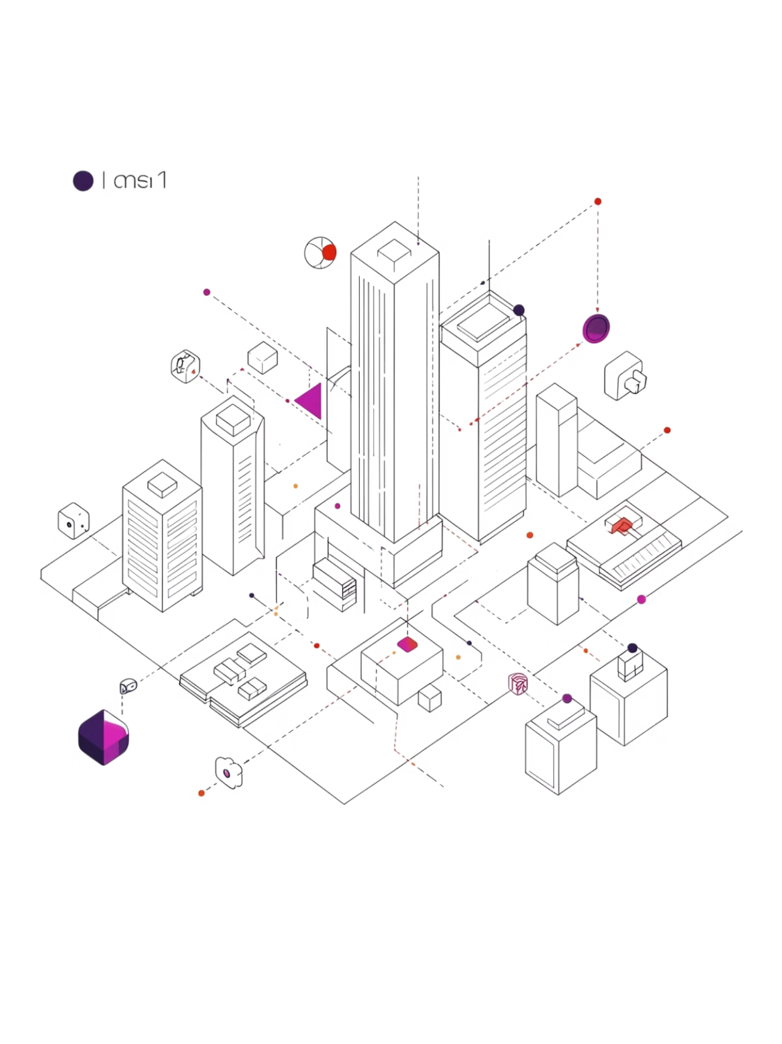
Conclusion
The Intelligent Waste Management System delivers a modern, data-driven approach to waste collection — combining IoT sensors, cloud-based monitoring, real-time analytics, and automated alerts into one unified platform.
Continuous Monitoring
IoT sensors track bin fill levels around the clock, providing always-current data.
Automated Alerts
Collection personnel are notified the moment bins exceed predefined thresholds.
Smarter Operations
Dashboards, history, and route optimization reduce overflow and unnecessary trips.
Sustainable Impact
Cleaner, more efficient, and more intelligent urban environments for everyone.
"Smart waste monitoring and automated collection alerts enable efficient, cost-effective, and sustainable waste management."

