Slide 1
MIMIC Database Exploratory Data Analysis Graphs and General Instructions

Slide 2
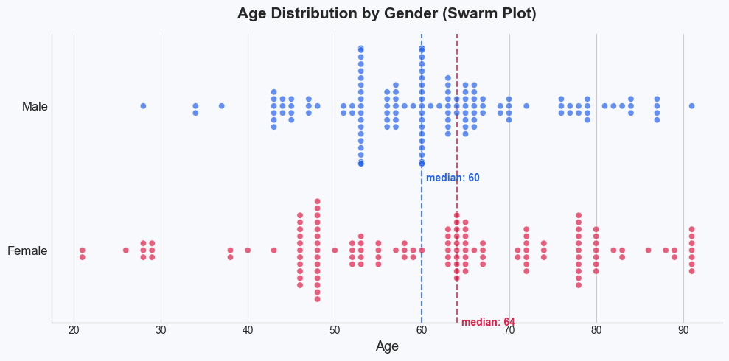
Instructions
Group patient and admissions
Made using seaborn an matplotlib.
Create figure and axis using clear background.
Use sns swarmplot to build the graph
5. Calculate the age median for gender
6. Draw a vertical dashed line at the median
7. Add a title.

Slide 3
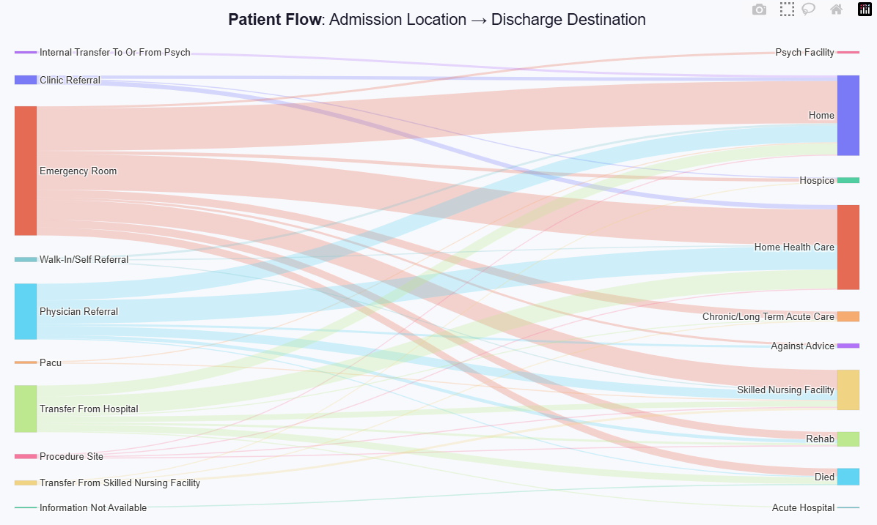
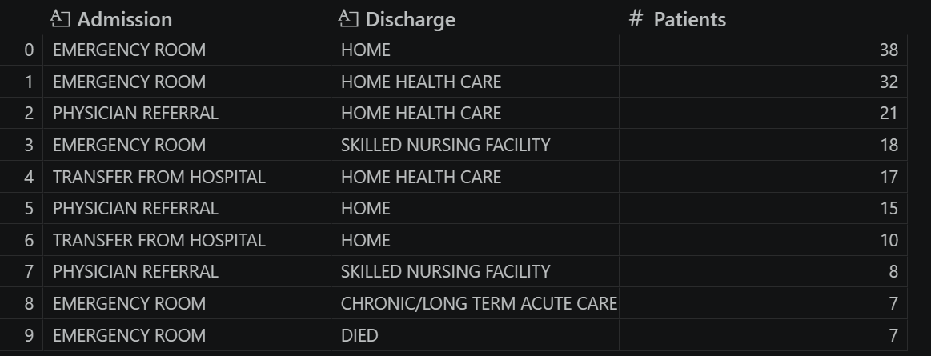
Instructions
Group admissions and discharge location
Make a unique label list and map each source- target.
Build the Sankey figure using graph objects on plotly. With source and target.
Add a title Admission Location -> Dischage Destination.

Slide 4
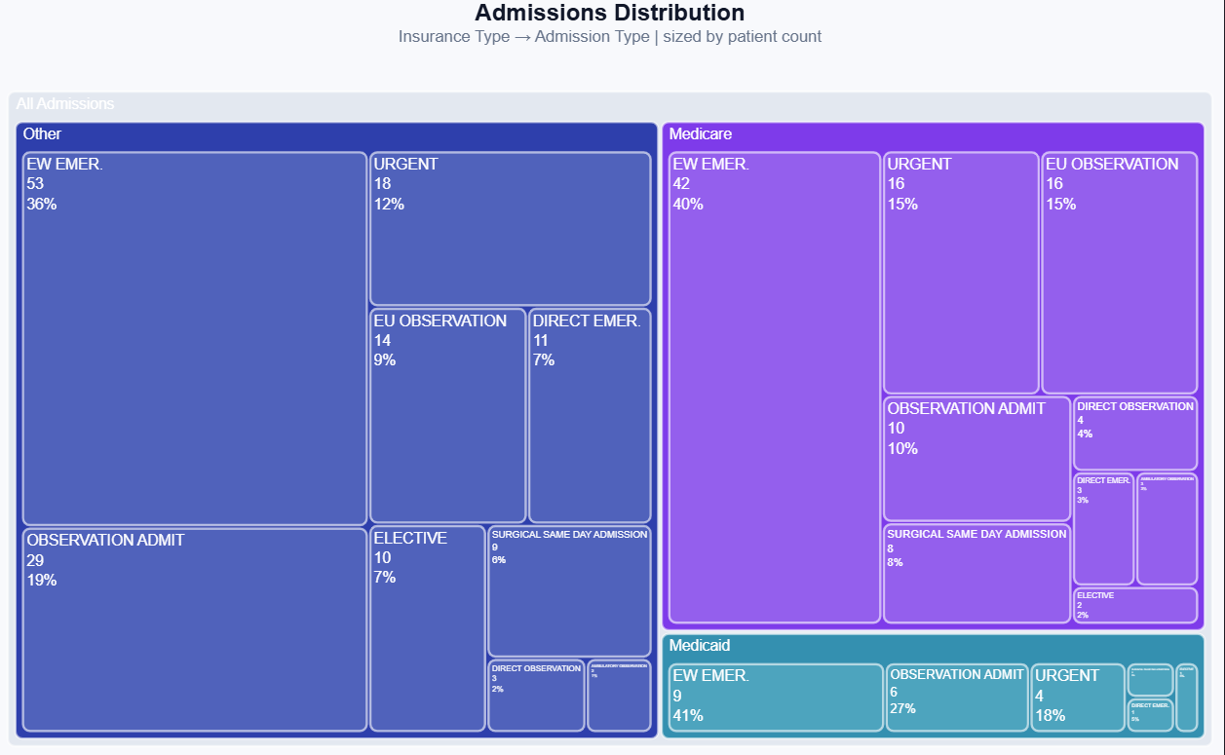
Instructions
Group insurance and admission type
Add a root level “All admissions”
Using plotly.express build the treemap
Root->insurance->admission
Add a title Admission Distribution

Slide 5
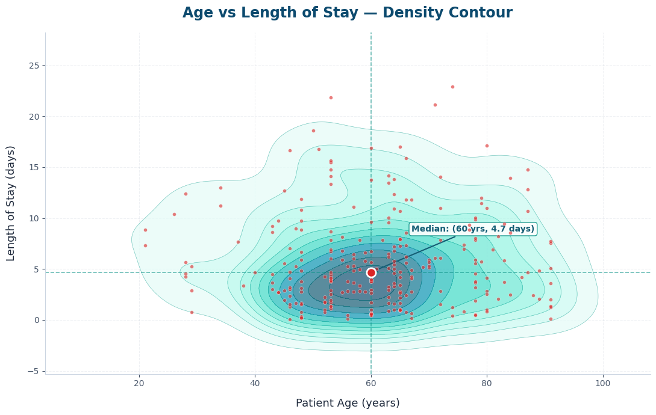
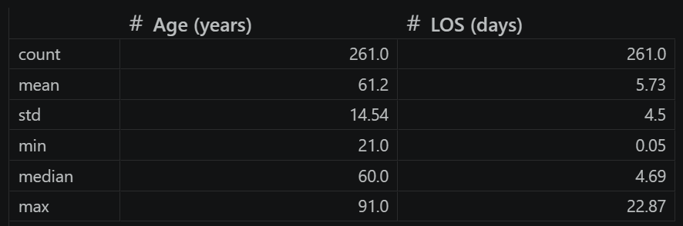
Instructions
Using length of stay drop 5% outliers
Create a sns density contour plot (kdeplot in sns)
Scatter points on pyplot axis (age vs length of stay)
Calculate median and plot it
Add title Age vs Length of Stay

Slide 6
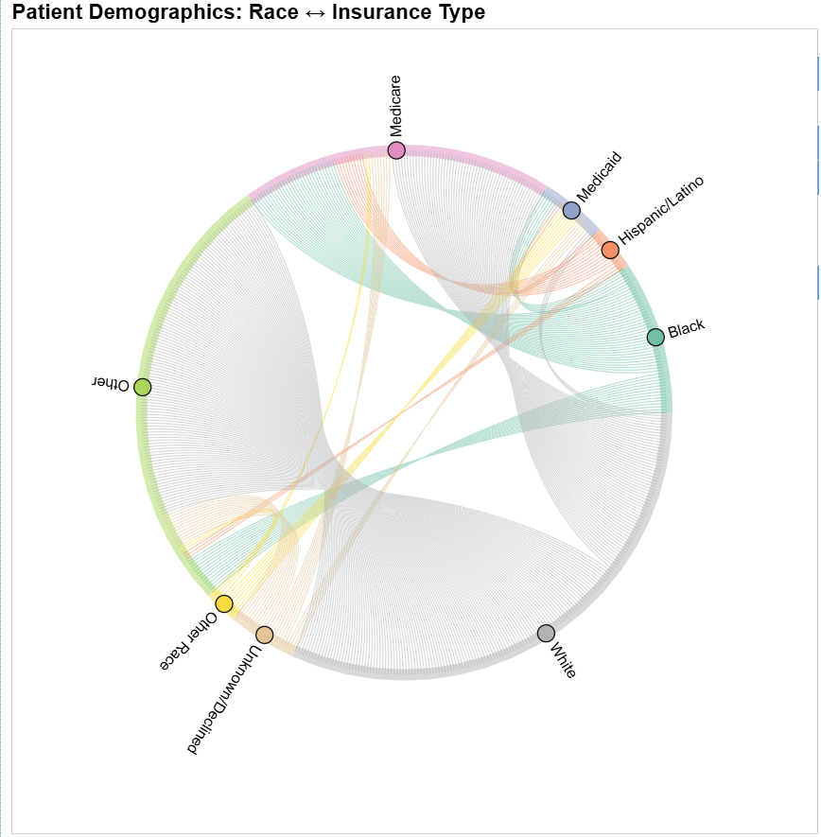
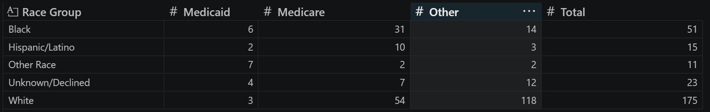
Instructions
Group race cathegories into broader group to make the graph cleaner
This graph uses the holoview library.
Map race group to insurance feature and count them.
Build the braph using holoview.
Add a title.

